Slide 1
Music Reactive RGB LED Strip

Slide 2
Music Reactive RGB LED Strip
In this project we are going to make a music reactive RGB LED strip which will change the color and number of LEDs glowing according to the sound meter.

Slide 3
Music Reactive RGB LED Strip
We are going to use Dabble Sensor module to access the sound sensor of the mobile.
For this project you will need: evive, RGB LED strip and a Bluetooth Module.
If you want to make a light box, then you can make a small cardboard box with translucent sheet on one face.

Slide 4
What is RGB LED Strip?

Slide 5
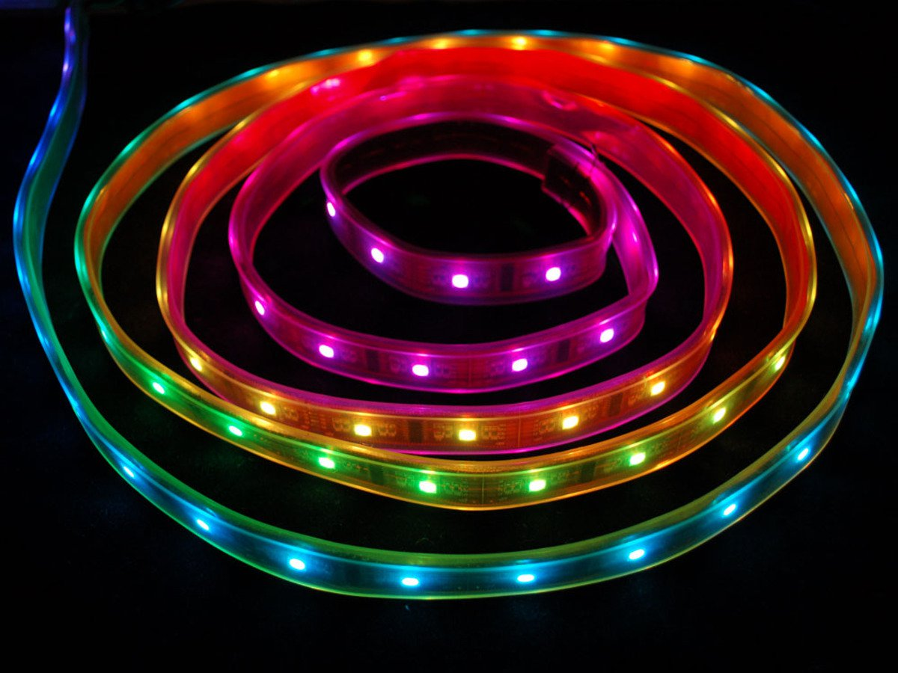
Digital RGB LED Strip
The Digital-type strips have a chip for each LED, to use the strip you have to send digitally coded data to the chips. However, this means you can control each LED individually!
We are using digital type strip in this project.

Slide 6
Connecting RGB LED to evive

Slide 7
Circuit Diagram
Connect GND of LED strip to GND of evive.
Connect 5V of LED strip to 5V of evive.
Connect Din pin of the LED strip to digital pin 2 of evive.

Slide 8
Phone Sensor Dabble Module

Slide 9
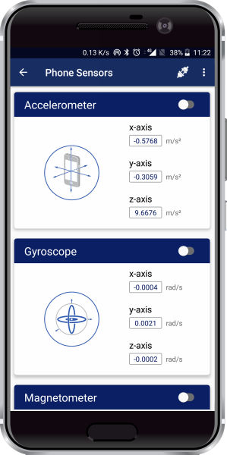
Phone Sensor
This phone sensor module allows you to access the following inbuilt sensors of your smartphone:
Accelerometer
Gyroscope
Proximity sensor
Magnetometer
Light meter
Sound meter
GPS
Temperature sensor
Barometer.

Slide 10
Phone Sensor
The sound meter senses the intensity of nearby sound in dB.
The range varies from 0 to 120 dB.
We will get the sound sensor measurement and according to the reading, manipulate the LEDs.

Slide 11
Blocks to Control RGB LED Strip

Slide 12
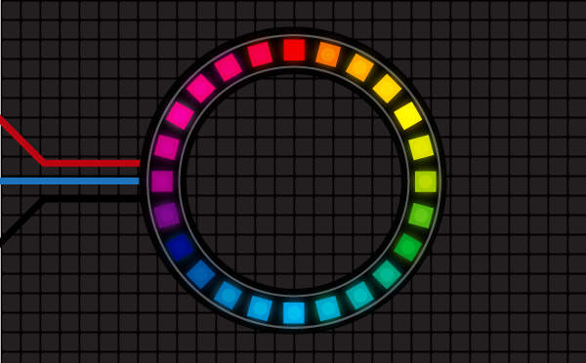
Lighting Extension
Lighting Extension enables you to manipulate colors of an RGB LED strip.
You can add the extension from the extension library.

Slide 13
Lighting Extension
Initialise RGB strip () with () LED pixels on pin () block initializes the RGB LED strip to the selected digital pin.
The user also has to specify the number of LED pixels in the RGB LED.
The user can initialize up to 5 LED strips at a time.

Slide 14
Lighting Extension
Set RGB strip () LED pixel () color () block sets the selected RGB LED strip's pixel (specified in the block) to a color selected from the color picker.
Show RGB strip () block refreshes the LED state once all the pixel's color has been specified. The color of the strip will not change until you execute this block.

Slide 15
Lighting Extension
() RGB strip () with color () & delay () seconds block executes two patterns on the selected RGB Strip: Color Wipe and Theater Chase, of the specified color (from the color picker) and delay.

Slide 16
Blocks to Get Sound Sensor Reading

Slide 17
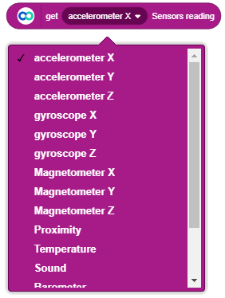
Dabble Extension
Get () sensors reading block is a reporter block available in Dabble extension.
This block reports the current value of the selected sensor.

Slide 18
PictoBlox Program

Slide 19
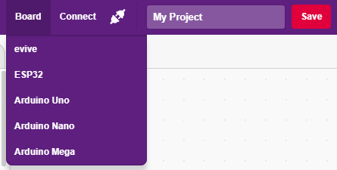
Interfacing evive with PictoBlox
Connect evive to your laptop/PC and open PictoBlox.
In PictoBlox, go to the menu and click on the Boards Select the evive.

Slide 20
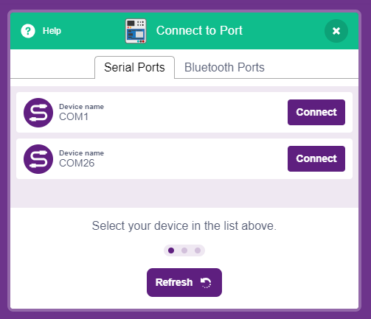
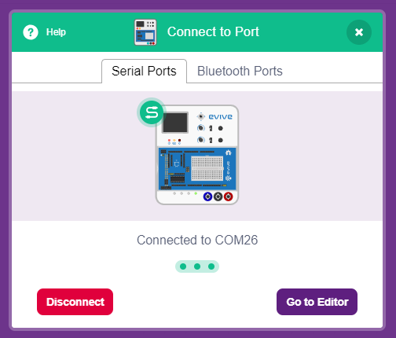
Interfacing evive with PictoBlox
Once you’ve selected the board, click on the Connect tab and connect the board.

Slide 21
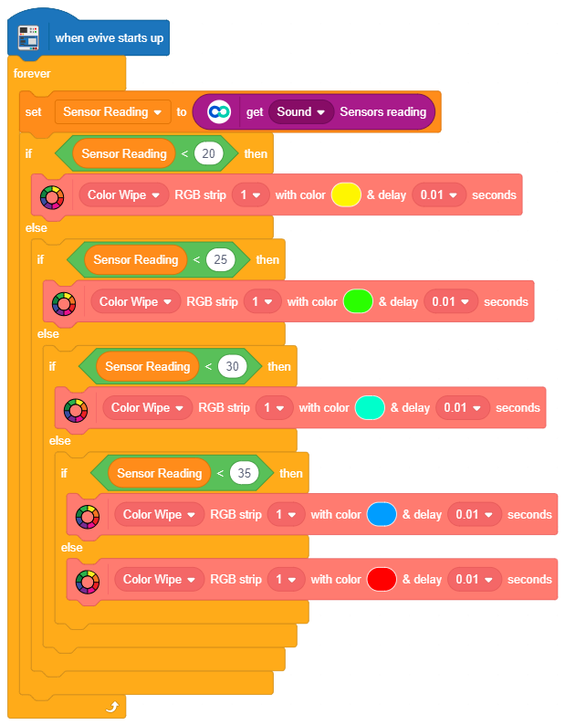
Program
We will glow the LED with different colors in different values of the sound sensor reading.
Make the program shown.
You can change the colors and the range to fine tune the project.

Slide 22
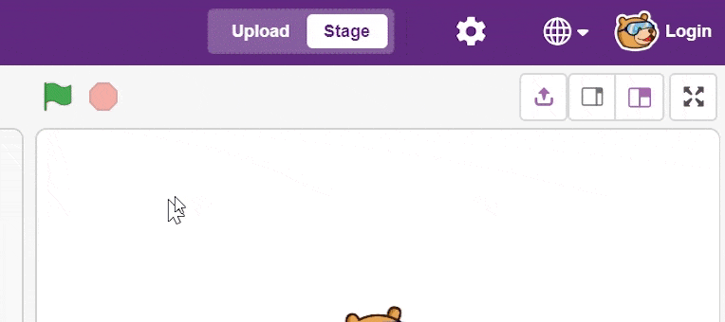
Uploading the Code
Select the Upload Mode.

Slide 23
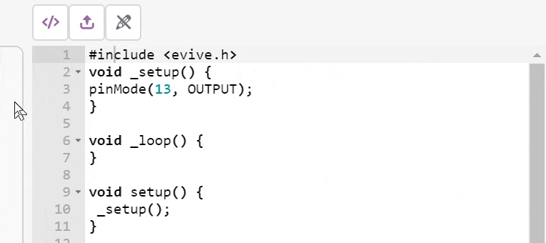
Uploading the Code
Upload the code to evive.

Slide 24
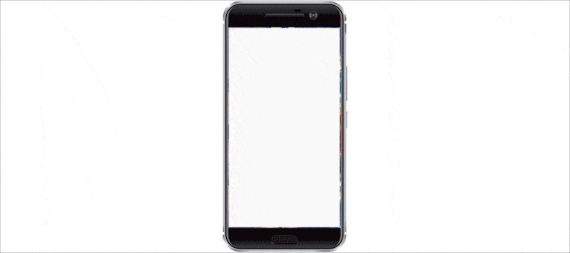
Connecting Bluetooth to Dabble
Turn ON evive and connect the Bluetooth to Dabble App.
Go to phone sensors and enable the sound sensor to send the sensor data to evive.

