Slide 1
Space Battle Game

Slide 2
Game Play
The aim of the game is to control the rocket using Smartphone and shoot the enemy coming.

Slide 3
Setting Up the Stage

Slide 4
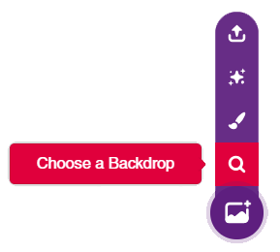
Setting up the Stage
Click on the purple colored icon which says Choose a Backdrop.
Select the Stars backdrop from the library.

Slide 5
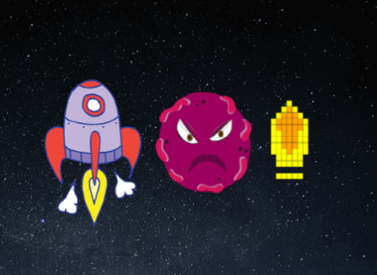
Bringing in the Sprites
For this game, we need three sprites: our rocketship, our enemy – the space monsters, and something to destroy them with – special monster-killing bullets.
Click on the Choose a Sprite button and add the three sprites one by one from the library.

Slide 6
Readying the Rocketship

Slide 7
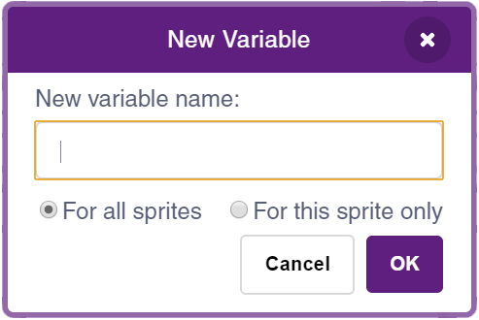
Create Variables
We will track the Health and Score in the game.
Create two variables named Health and Score.

Slide 8
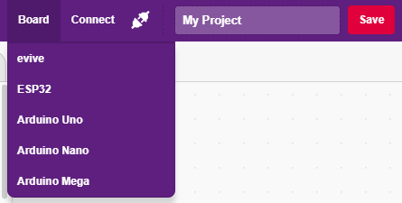
Interfacing evive with PictoBlox
Connect evive to your laptop/PC and open PictoBlox.
In PictoBlox, go to the menu and click on the Boards Select the evive.

Slide 9
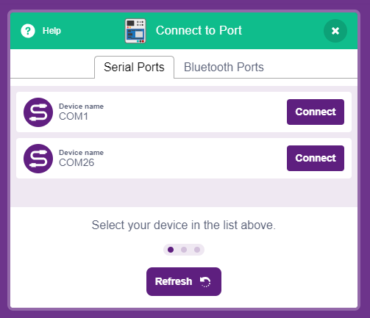
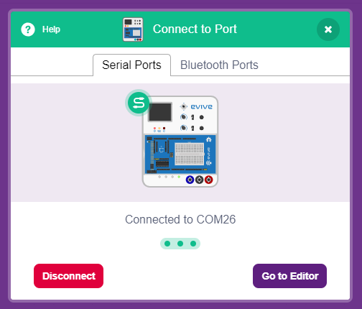
Interfacing evive with PictoBlox
Once you’ve selected the board, click on the Connect tab and connect the board.

Slide 10
Upload Firmware
You have to upload the firmware into the device before interacting with it.
Click on Upload Firmware button.
Once you successfully uploaded the firmware you will see evive logo on evive display.

Slide 11
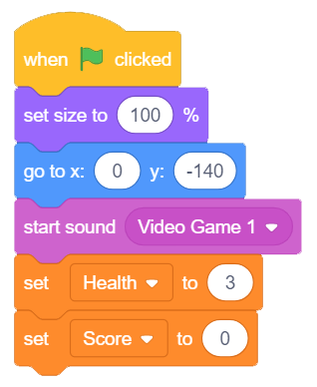
Game Initialisation
This time, let’s add some music at the beginning of the game. Add the start sound () block from the Sound palette.
Now, click on the Sound tab. In the bottom-left corner, you will find the Choose a Sound button. Select Video Game 1 from the library.

Slide 12
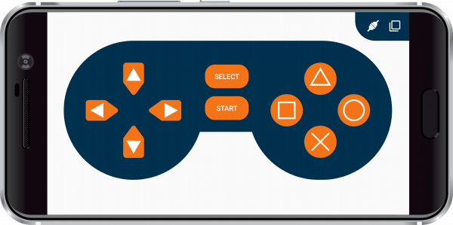
Gamepad Module
We are going to use a Smartphone to control the actions of our rocketship. For that, we are going to use Dabble
We will use Dabble’s Gamepad module.

Slide 13
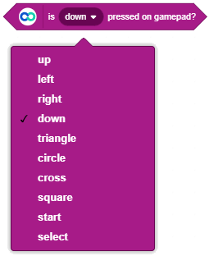
is () pressed on gamepad?
is () pressed on gamepad? block reports whether the button is currently pressed on the gamepad or not. If the chosen button is pressed, then it returns true, else it returns false.

Slide 14
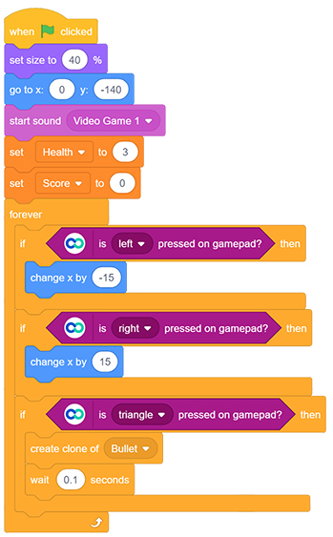
Rocket Script
On pressing Left, the value of x coordinate will change by -15 i.e your rocketship will move 15 steps in the left
Similarly, on pressing Right on the gamepad, the value of x coordinate will change by 15 and the rocket will go right.
We will fire the bullets using the Triangle button on the gamepad.

Slide 15
Scripts for the Monsters

Slide 16
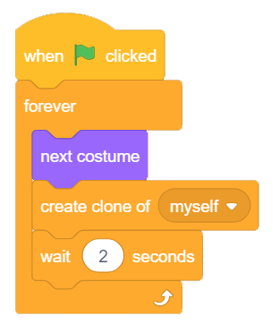
Scripts for the Monsters
We will write two scripts: first for creating multiple monsters and second for assigning actions to them.
We will create monster every 2 seconds and change their costume also.

Slide 17
Assigning Actions to the Monsters
The monsters should randomly appear from the top of the stage and gradually move downward until either they reach the bottom of the stage or you shoot them down.
If they hit by the bullet, they should disappear and the score should increase by 1;
however, if anyone of them touches our rocketship, they will harm us! Hence, the value of the Health variable should decrease by one.
If it reaches 0, the game should end.

Slide 18
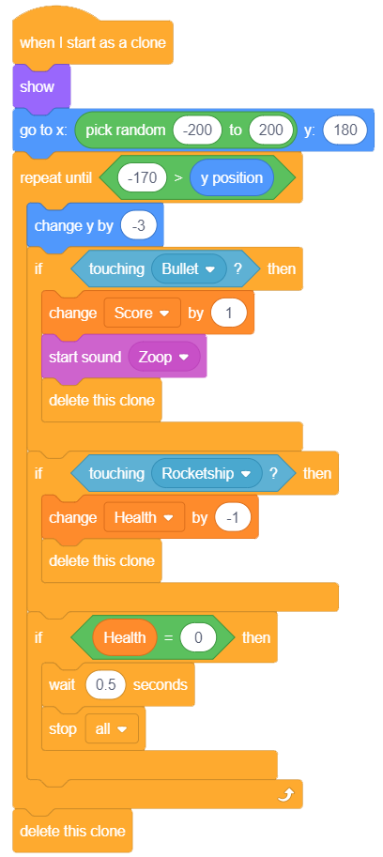
Assigning Actions
Given is the script based on this logic:

Slide 19
Shooting the Bullets

Slide 20
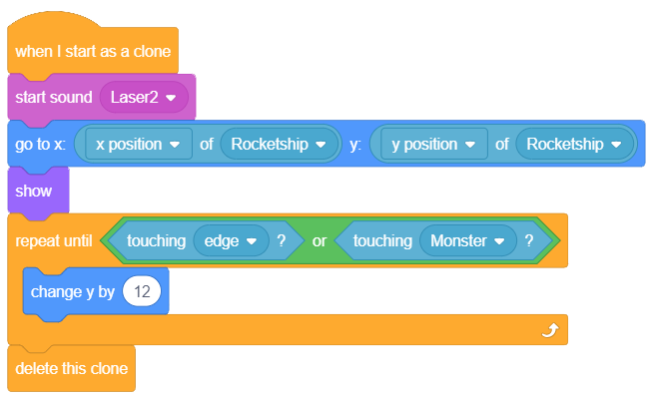
Shooting the Bullets
Make sure that the bullet sprite is selected.
The bullet will start near the rocket and then move upwards until it touches edge or the monster.

Slide 21
Connection with Smartphone

Slide 22
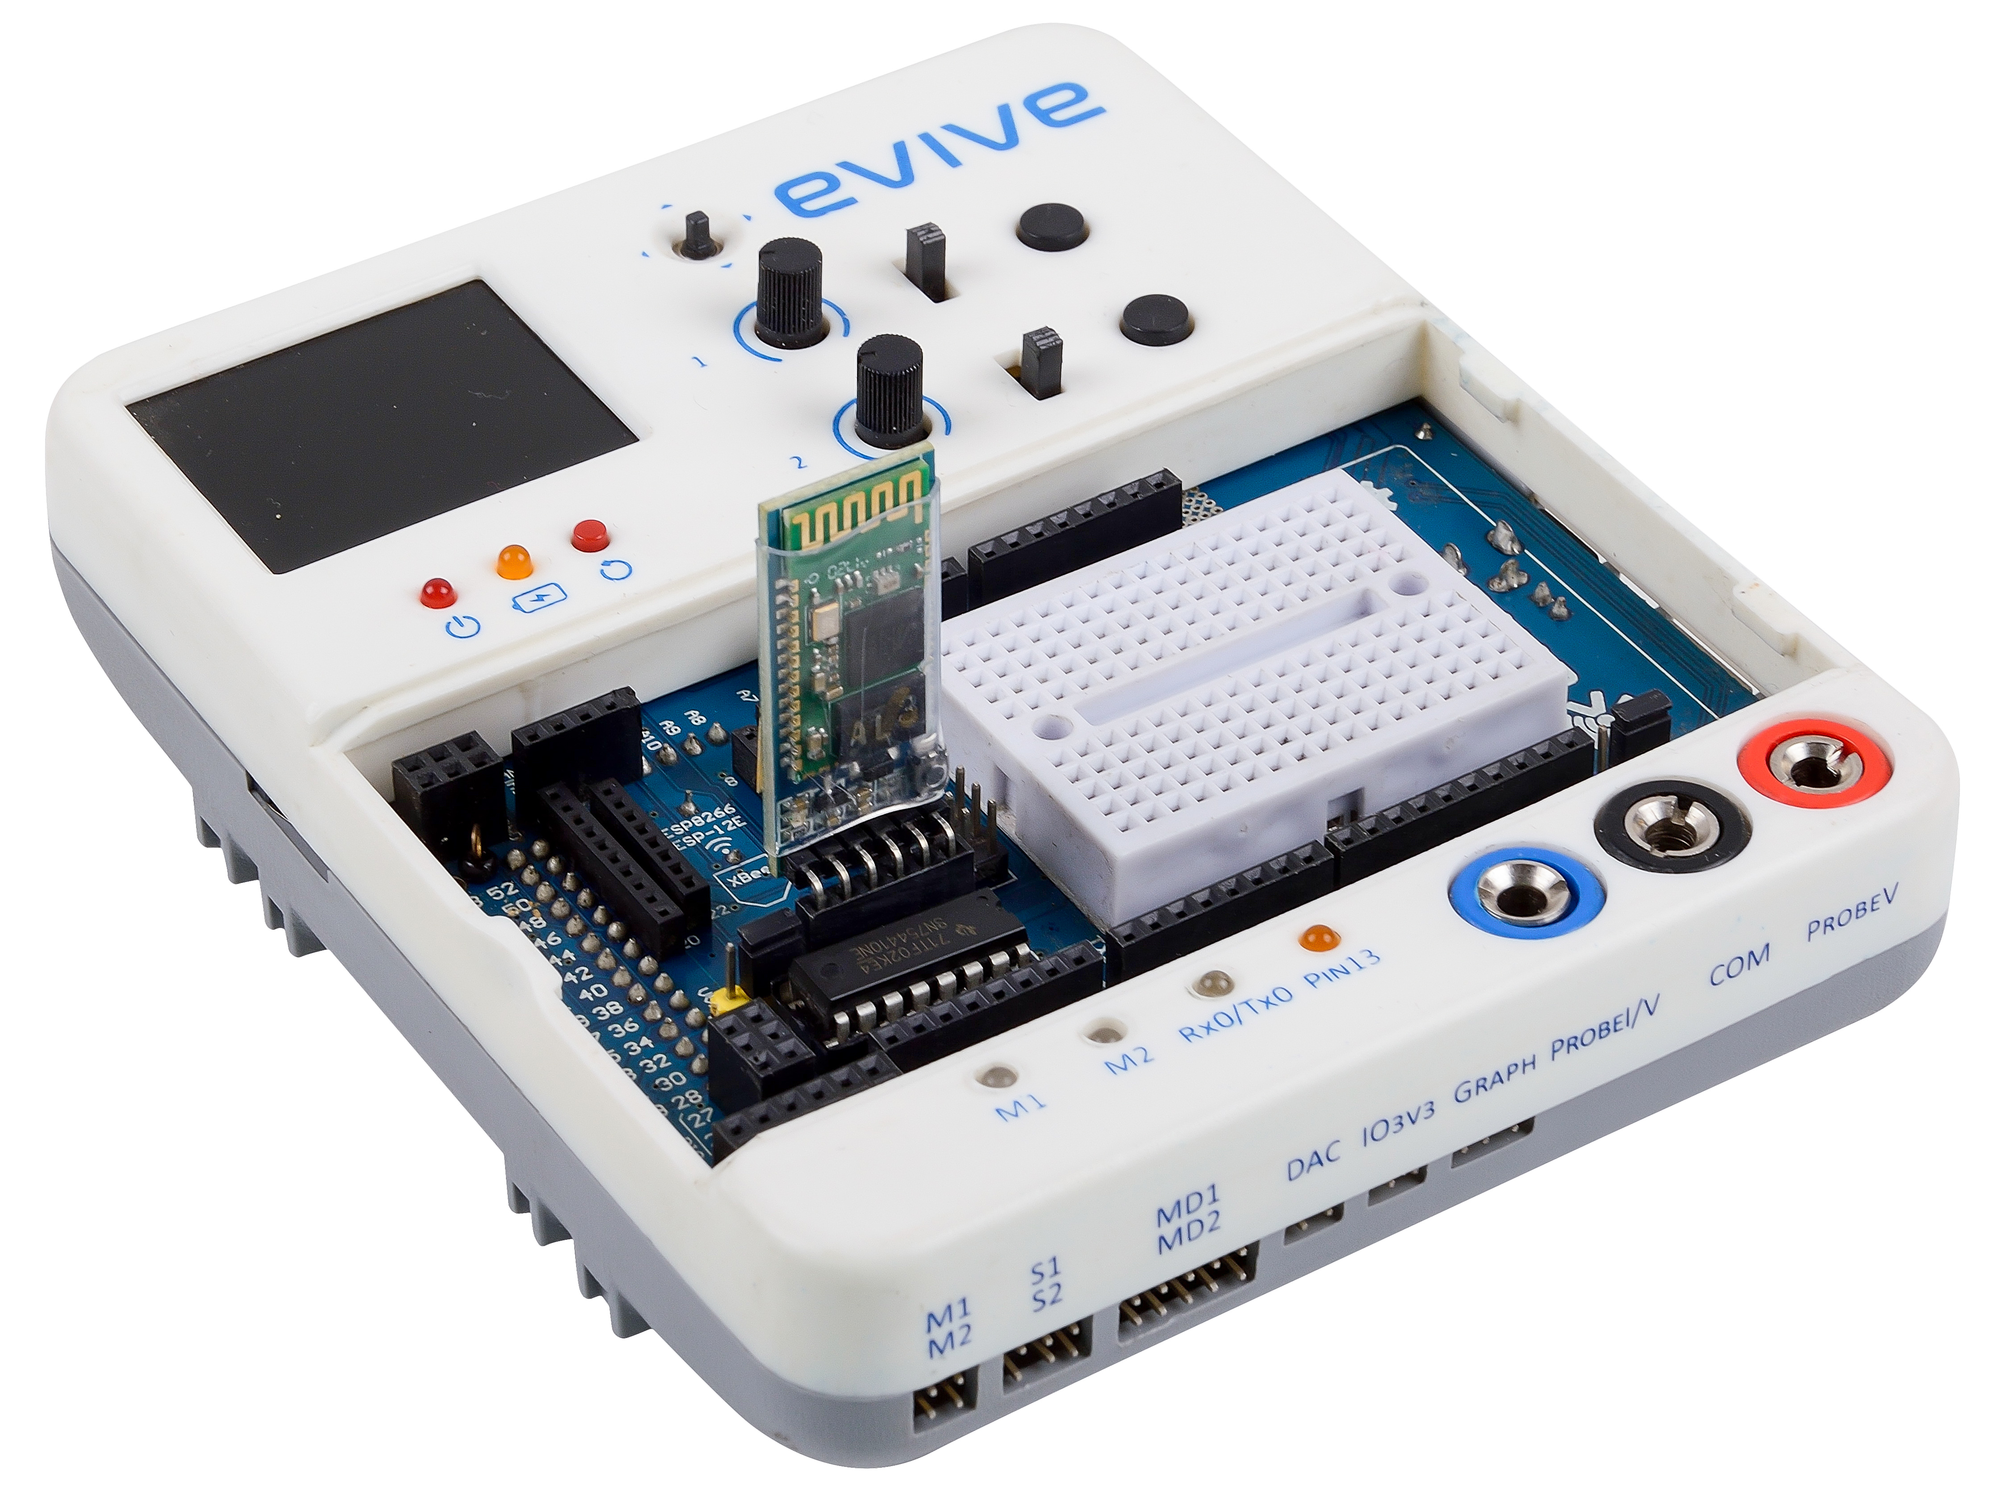
Connection with Smartphone
Connect the HC-05 Bluetooth module

Slide 23
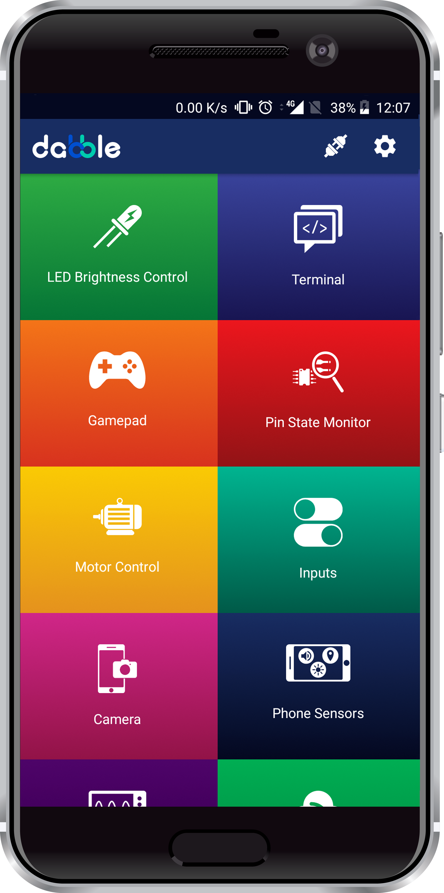
Connecting to smartphone
Turn on evive.
Click on connect icon on top right corner of dabble.

Slide 24
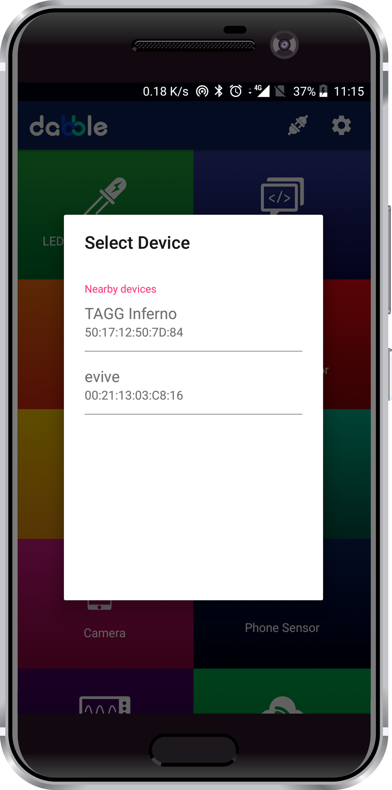
Connecting to smartphone
List of available devices will come.
Select the appropriate Bluetooth module from the list.

Slide 25
Gamepad Module
Open the Gamepad module in Dabble and select Digital mode.
Enjoy the game.

