Slide 1
Dodge Game

Slide 2
Gameplay

Slide 3
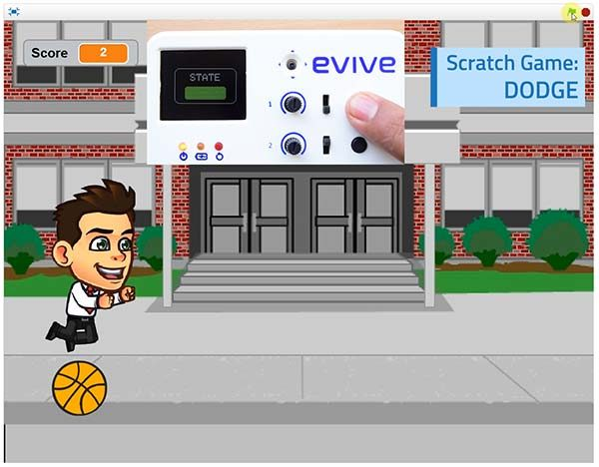
Game Play
The aim of the game is to control the kid and dodge the objects coming his way for as long as possible.

Slide 4
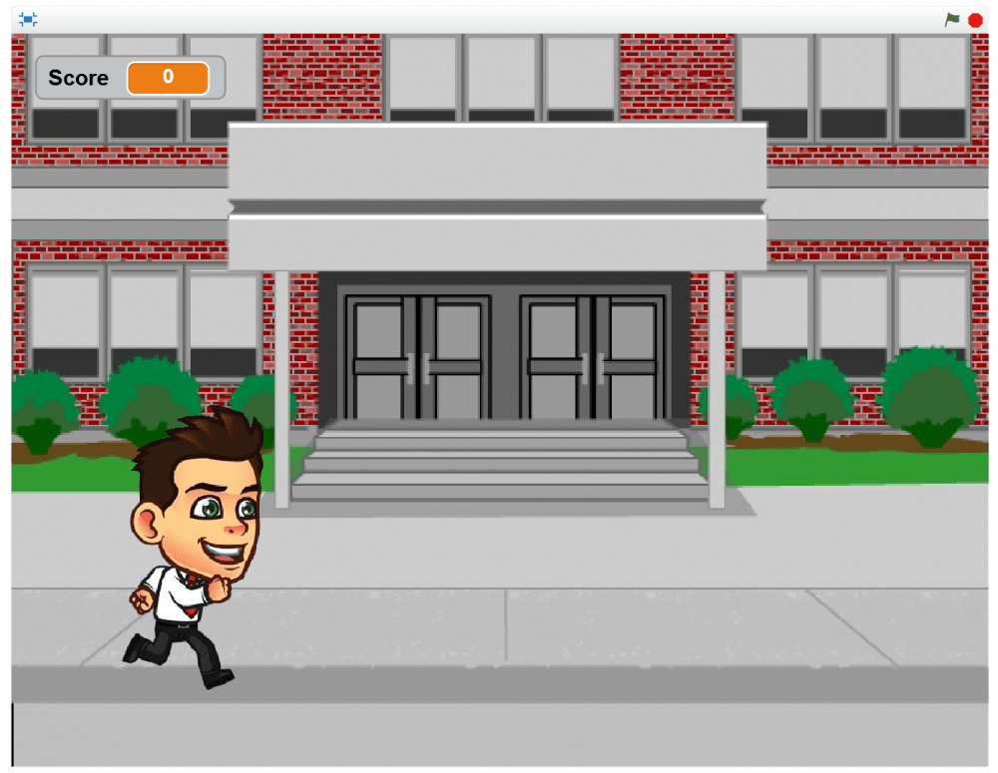
Game Play
Boy is running all time. This is the screenshot when there are no obstacles.

Slide 5
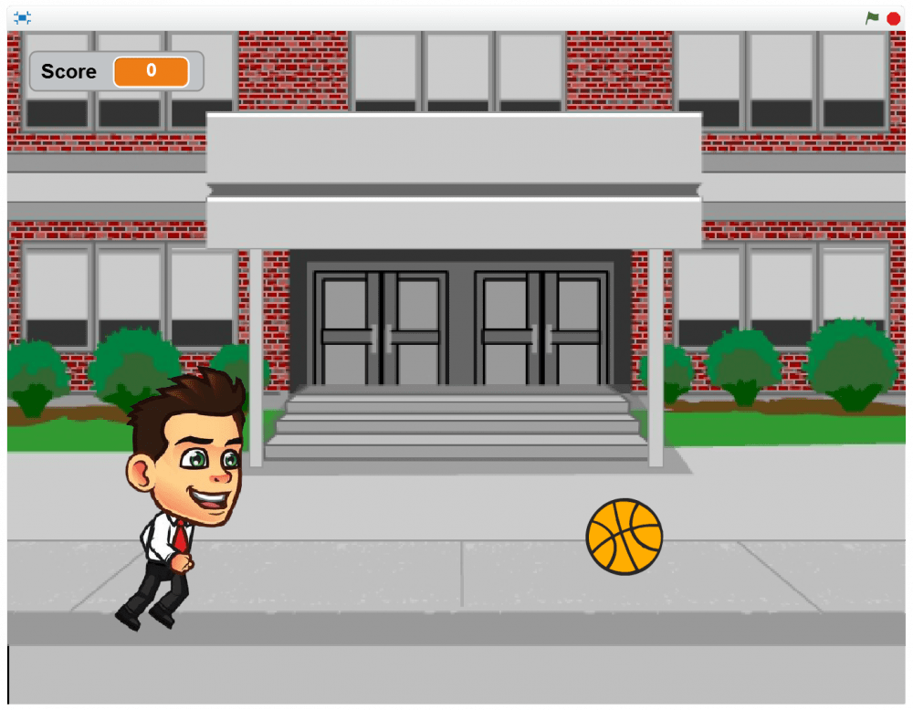
Game Play
There are two obstacles in the game. First a bouncing ball will come towards the boy.

Slide 6
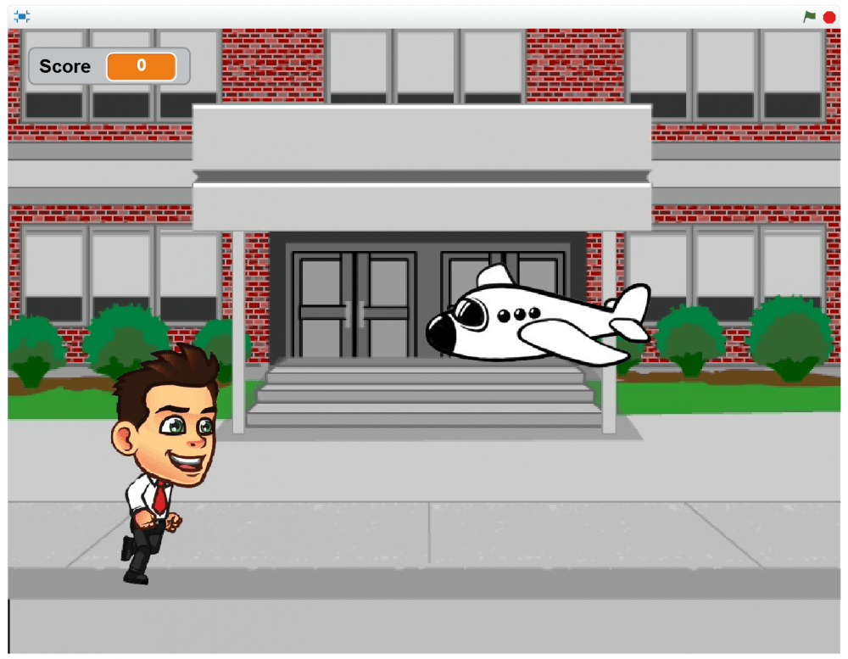
Game Play
Then a plane flying at such low altitudes.

Slide 7
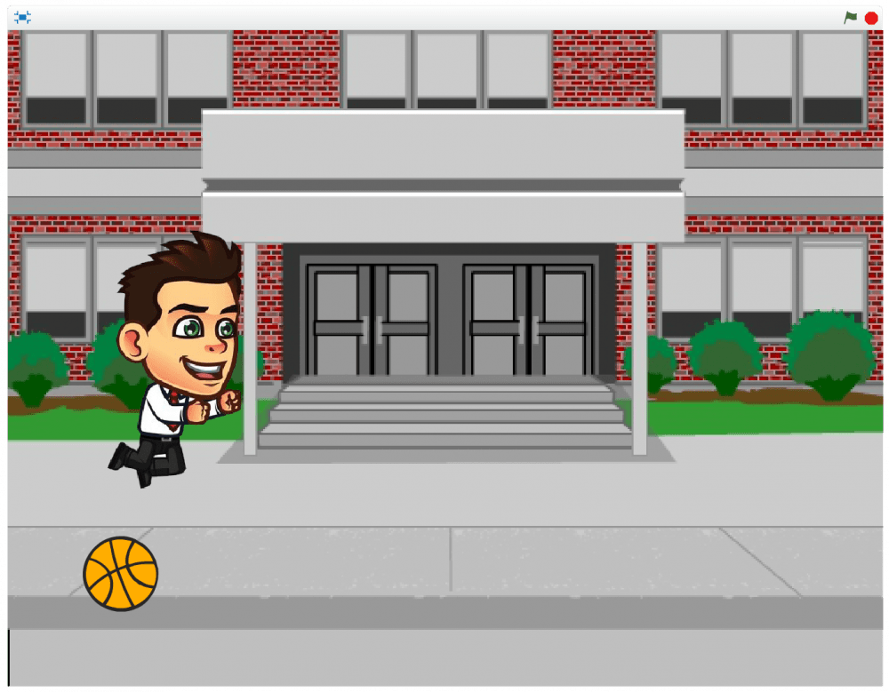
Game Play
The ball will bounce and come to you but it’ll be grounded in your vicinity to give you a fair chance at dodging it. Dodge the ball by jumping.

Slide 8
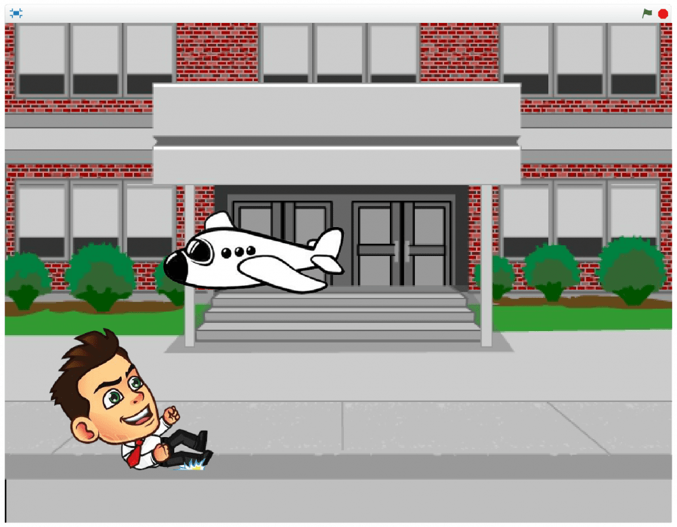
Game Play
The plane will fly straight at you. Dodge it by sliding under it.

Slide 9
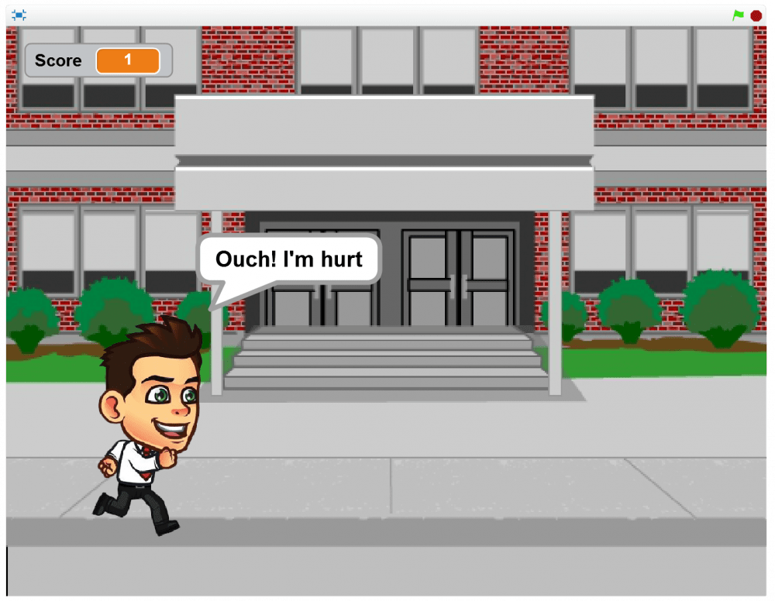
Game Play
If you fail to dodge an obstacle, our sprite returns a message confirming the same.

Slide 10
Game Play
It’s GAME OVER once an object hits you.

Slide 11
Running Boy Animation

Slide 12
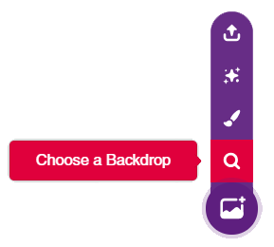
Setting up the Stage
Click on the purple colored icon which says Choose a Backdrop.
Select the School backdrop from the library.
Also add the Boy Sprite.

Slide 13
Running Boy Animation
There are four running costumes for the boy.
We know that all we have to do is to just switch between costumes as fast as possible.
The various costumes for running are shown in sequence:

Slide 14
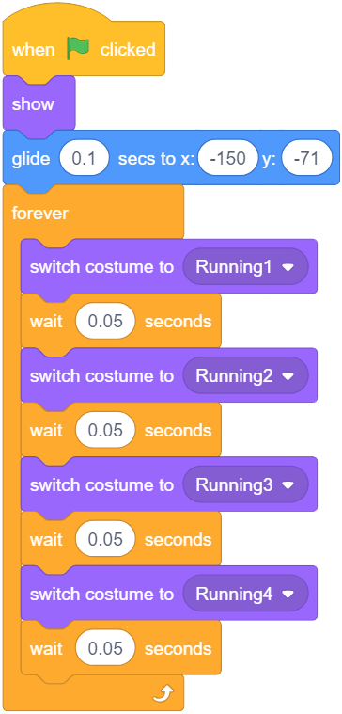
Running Boy Animation
The X and Y coordinates can be determined by dragging the sprite and dropping it where you require it to be.
Make the script.

Slide 15
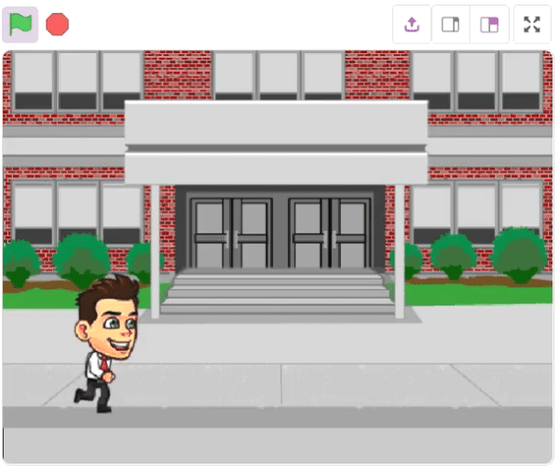
Running Boy Animation
This should be the result when you run the script.

Slide 16
Jumping Animation

Slide 17
Jumping Animation
The costumes for jumping are given below.
The 3 costumes in the middle represent time when the boy is in the air while the first and last represent the start and the end of the jump respectively.

Slide 18
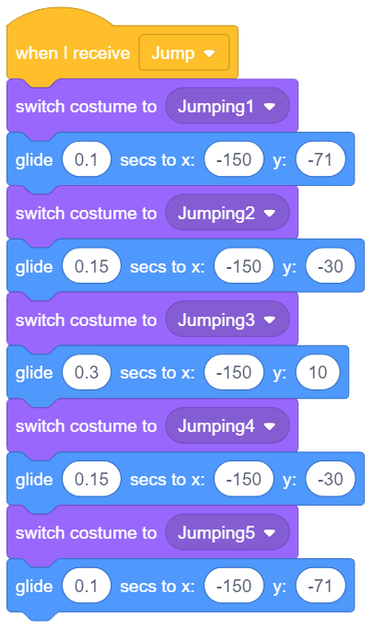
Jumping Animation
Observe that, and this is important, the sprite should remain in air for more time than on ground because we are jumping.

Slide 19
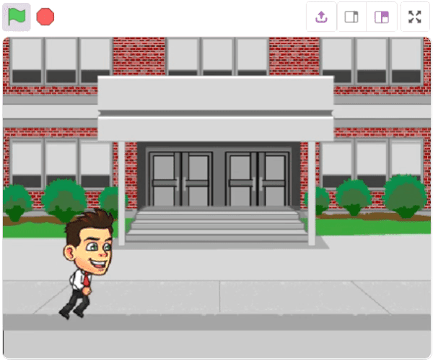
Jumping Animation
This should be the result when you run the script.

Slide 20
Sliding Animation

Slide 21
Sliding Animation
The subsequent images show the stages of sliding.
Again, one has to carefully manipulate the time and height on each costume so it may be possible to slide under the plane.

Slide 22
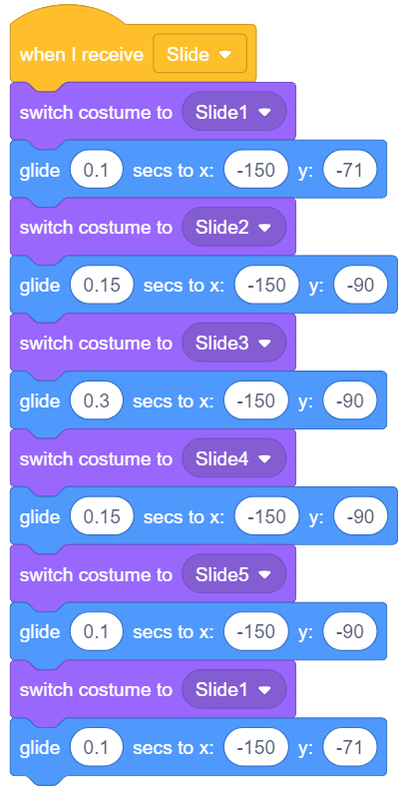
Sliding Animation
Notice the increased time (in seconds) the sprite spends in costumes 3, 4 and 5, where the boy looks as if he is sliding.

Slide 23
Running, Jumping and Sliding simultaneously

Slide 24
Running, Jumping and Sliding
We will jump and slide to avoid obstacles and run at all other times.
The Jumping and Sliding scripts start off with the “When I receive” block.
We will check if the tactile switch 1 or the tactile switch 2 of evive is pressed and then jump or slide accordingly.

Slide 25
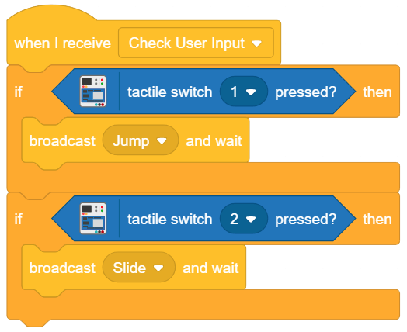
Running, Jumping and Sliding
To check which switch is pressed we will use tactile switch pressed ()? block and activate the Jump and Slide script.
Note that the script is again triggered when Check User Input message is received.

Slide 26
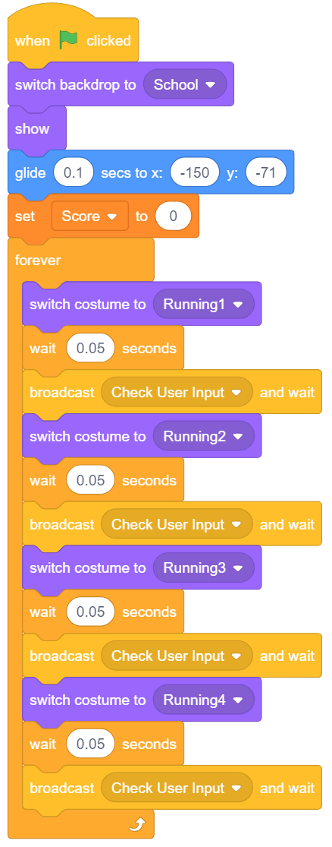
Running, Jumping and Sliding
Check User Input message will triggered in the running script. So modify the script as shown.

Slide 27
Spawning the ball and the plane randomly

Slide 28
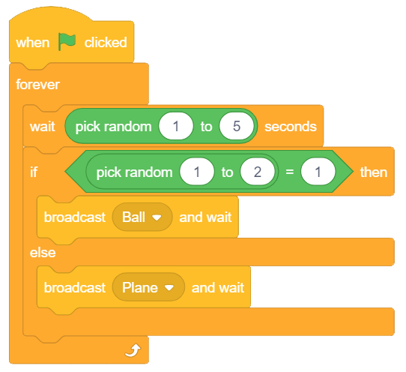
Spawning the ball and the plane
It’s time for the obstacles now.
We are not yet programming our plane and ball. Instead, we are just deciding at what times they will appear on stage.
We first wait for a random time period from 1 to 5 seconds. Then, we want any of the ball or the plane to appear so we choose randomly between the two.

Slide 29
Plane Script

Slide 30
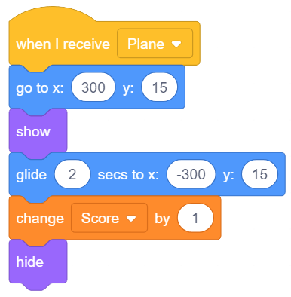
Plane Script
Starting from the right edge, keep the Y-coordinate constant and glide the plane to the same position at the other end.
Hide it at the end of the script.
Every time the plane successfully passes the boy, Score should increase by 1.

Slide 31
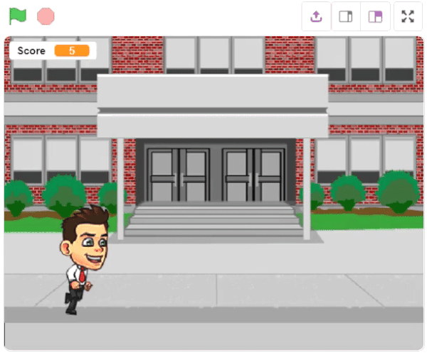
Plane Script
This is how the plane will fly:

Slide 32
Ball Script

Slide 33
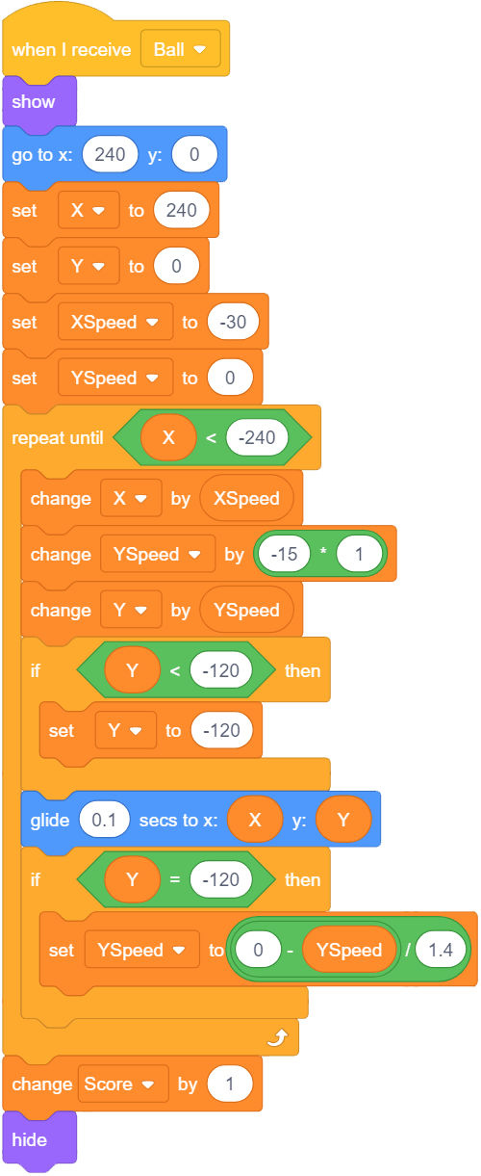
Ball Script
Because the ball has to bounce on its’ way before settling down, the code is a bit complicated. We create variables X, Y and XSpeed, YSpeed to keep track of position and speeds (in horizontal and vertical directions) respectively.

Slide 34
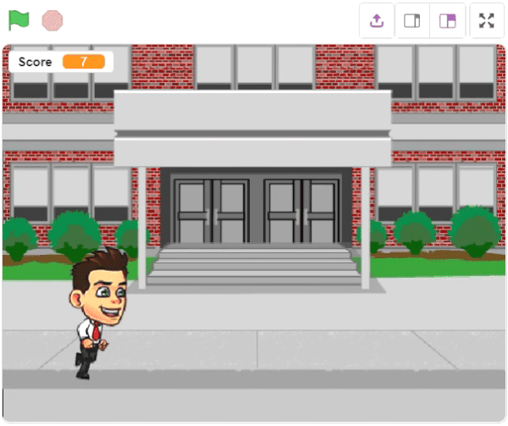
Ball Script
This is how the Ball bounces:

Slide 35
Game Over

Slide 36
Game Over
In this section, we will control what happens when the game is over, i.e. either the plane or the ball has struck the boy. When the game ends, we want these things to happen:
The boy displays a message saying he is hurt
All motion on the school backdrop stops.
The backdrop switches to GAME OVER

Slide 37
Boy Script
We will check if the boy touches the plane or the ball. After that, we will broadcast GAME OVER throughout the scripts.
This will notify the other sprites in the game to execute their respective “GAME OVER” scripts.
We will also make the kid say – “Ouch! I’m hurt”, hide the sprite and switch backdrops.

Slide 38
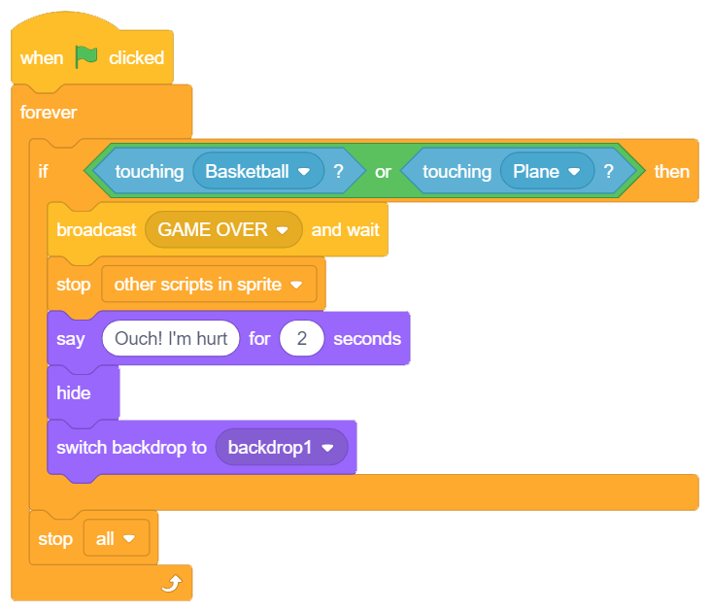
Boy Script

Slide 39
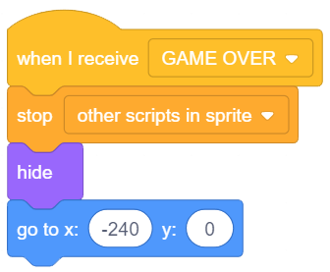
Ball Script
As soon as the ball receives GAME OVER, it stops other scripts, hides the ball and sends it to its’ starting point: (240, 0).

Slide 40
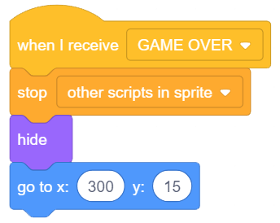
Plane Script
As soon as the plane receives GAME OVER, it stops other scripts, hides the plane and sends it to its’ starting point: (300, 15).

Slide 41
Initial Position

Slide 42
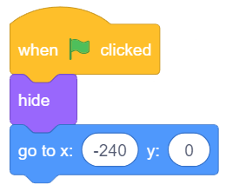
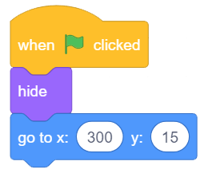
Initial Position
Also, when you start the game, the sprites, the ball and the plane, should go to their initial position and should be invisible. Given below is the script for the same.
Make sure you choose the right sprite while writing the script.
Play

