Slide 1
Shoot the Bat Game

Slide 2
Key elements of a game
ANIMATION: A game doesn’t exist if there isn’t any animation!
RANDOMNESS: Randomness is when Jake from Subway Surfers is running away from the heavy than usual policeman and his dog when he suddenly sees a magnet in front of him out of nowhere. In general, randomness is when different objects, either powerups or obstacles, appear in the game without any pattern.
SCORE: The score is to keep a record of how you perform in the game.
TIME CONSTRAINT: Without time constraint, a game doesn’t have the element of competition, the element of excitement, the element to perform better within the same time frame, and the element to push the boundaries.

Slide 3
Introduction to the Game

Slide 4
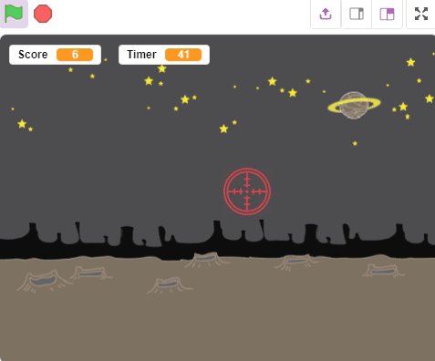
Shoot the Bat

Slide 5
Game
We call this game Shoot the Bat, in which you must aim at the bat, appearing randomly anywhere on the screen, using a Joystick.
The moment you aim at a bat, it will disappear.
More the number of bats you aim at within the given time limit more will be your score.

Slide 6
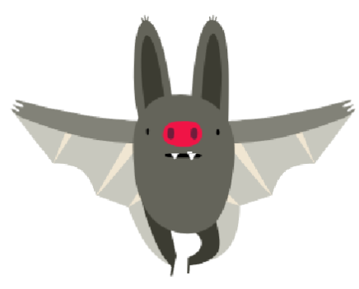
Elements of the Game
The bat sprite is one of the many sprites in sprite library.
This sprite has two costumes, which allow the bat to ‘fly’.
How? We’ll see that in a moment.

Slide 7
Elements of the Game
Using the Joystick you will move the aim sprite in the screen with the objective to aim at as many bats as you can.
The score will be the number of bats you successfully aim at. Your score will be stored in a variable and it will be displayed on the corner of screen.
The timer, as you know, will display how much time will be left till the game ends. It will also be displayed on the screen.

Slide 8
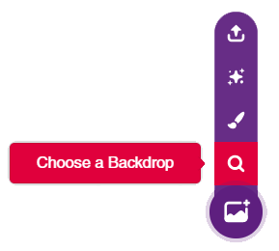
Setting up the Scene
Go to sprite library by clicking on choose backdrop from library in the Stage
From the library, select the backdrop named space.

Slide 9
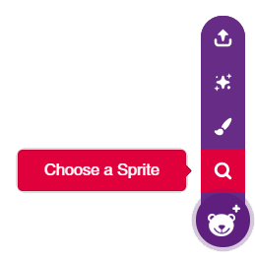
Setting up the Scene
Time to choose the sprite. right below the stage, you will see another purple button. Take the cursor over it and select Choose a Sprite; then select the Bat sprite.
Now there are two sprites: the bat and Tobi, Right click on the icon for Tobi (below the stage) and click on delete option.

Slide 10
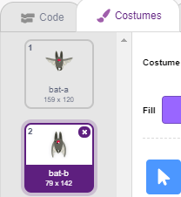
Bat Animation
The bat we created right now has stationary wings. Surely, an animal that flies must know how to flap its wings.
Let us then create an animation so that the bat flaps its’ wings while flying. Switch to the Costumes tab. Observe that, there are four costumes; we will use the first two.

Slide 11
Bat Animation
Try to quickly switch between the two costumes by clicking the first costume and then the second one in succession. You will get a glimpse of how the bat should look while flying.

Slide 12
Bat Animation
To make the bat look like it’s flying, we need to switch between costumes quickly.
PictoBlox has a block called switch costume to which can be used for switching costumes.
The bat switches between its costume every 0.2 seconds which gives us an impression that it is flapping its wings.

Slide 13
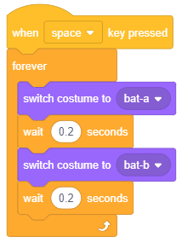
Bat Animation

Slide 14
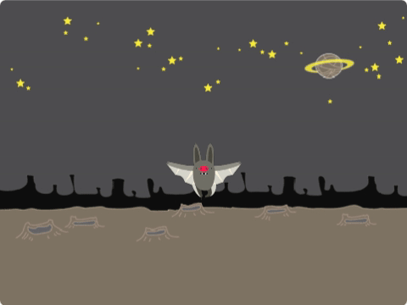
Bat Animation

Slide 15
Bat Birth, Movement, and Death Script
According to our game’s logic, once we touch the bat with the aim sprite it will disappear and a new bat will spawn; we will have to then aim at that bat and so on.
The new bat should spawn at a random point on the Stage.
The bat should steadily increase in size while emerging.
The bat should fly around randomly and we will have to aim at it by adjusting the position of the aim sprite (using a Joystick).
Once we have given the player enough time to aim, the bat should start to disappear (provided the player still isn’t able to aim) gradually i.e. decrease in size and eventually disappear.

Slide 16
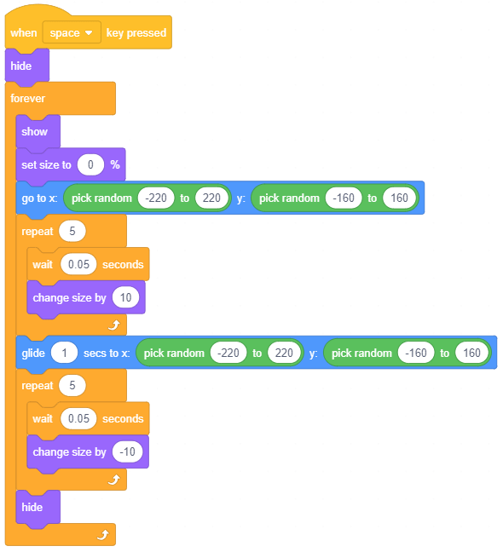
Bat Birth, Movement, and Death Script

Slide 17
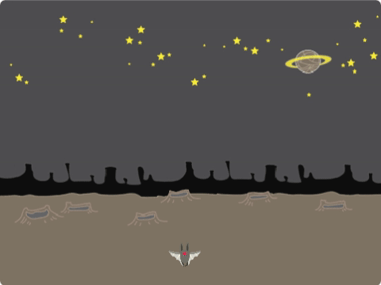
Bat Birth, Movement, and Death Script

Slide 18
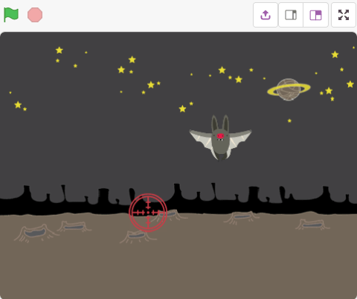
Creating the Aim Sprite & Variables
Select Aim sprite from the sprite library.
You can adjust the size of the sprite (using blocks in the Looks palette) if it seems too big or too small to you.

Slide 19
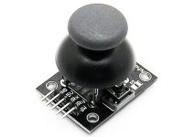
Interfacing the Joystick with evive
A Joystick has two potentiometers which allow the user to move it along the X and Y axes.
It also has a switch which gets active when user center press on the joystick.

Slide 20
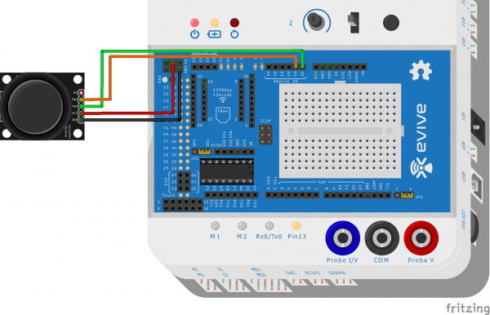
Interfacing the Joystick with evive

Slide 21
Script for aim control
We will be writing code for the aim sprite. Please make sure that it is selected.
Select the board as evive from the Menu bar if you haven’t selected it yet.
Connect your evive and upload the firmware onto evive.

Slide 22
Script for aim control
The pins that we’re using to read the value of the movement in the X-axis and Y-axis are analog pins; and for each analog input, you already know that the number of possible unique values that evive can work with are 1024 (0-1023).
Therefore, the mean, or the central, or the neutral position of the Joystick would correspond to the middle value of the range, i.e. 512 (≈ 1023/2).

Slide 23
Script for aim control
However, because nothing is ever 100% accurate, some fluctuations and inaccuracies may creep in; for that we’re going to ignore values between 400 and 600 and accept values only above 600 and below 400.
The difference between the values and 512 will give the position of the Aim sprite.
To slow down its motion and keep it within the boundaries of the stage, we’ll divide the result by 20.

Slide 24
Script for aim control
To control the movement of the aim sprite we will create two variables which keep track of its’ X-coordinate and Y-coordinate. Let’s call these variables XPosition and YPosition.
To create them, go to the Variables palette and select Make a Variable.
Write the name and click OK.
Make 2 more variables, Xvalue and Yvalue to store the readings from the joystick.

Slide 25
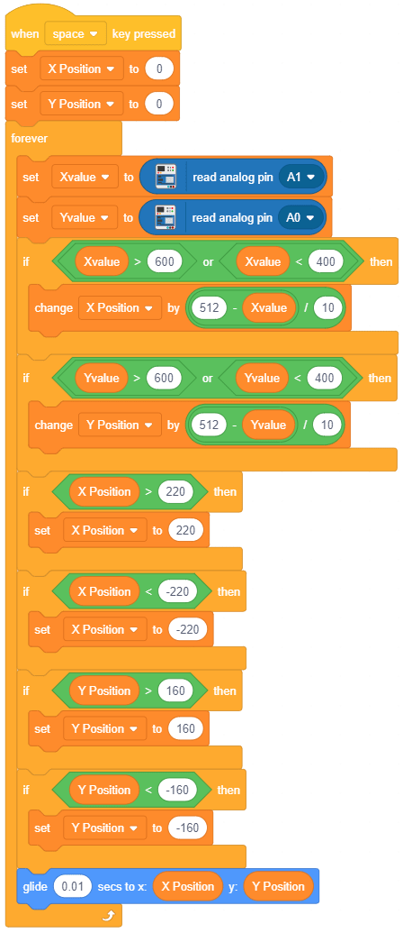
Script for aim control

Slide 26
Scoring Script
The logic is simple: As soon as the aim sprite touches the bat, the score will increase by one.
There is a touching block available in the Sensing palette in PictoBlox that checks if the sprite you are writing the script for touches a particular element of the Stage.
Select aim from the drop-down list of the touching block. Now this block will check whether the bat touches the aim sprite or not.
Next, create a variable Score to store the score.

Slide 27
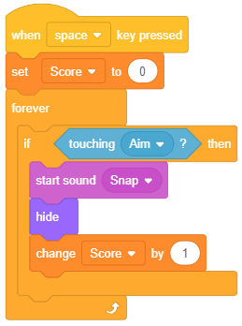
Scoring Script

Slide 28
Scoring Script
The code above will serve two purposes:
Keep track of Score
Recall the script for the bat we wrote. That script assumed throughout that the player wouldn’t hit the bat so it had no clause pertaining to that. That small yet instrumental detail is taken care of in here. Not only will we increase the score but we will also “hide” the bat sprite when it touches aim.

Slide 29
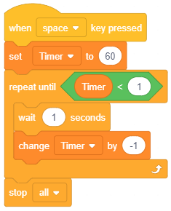
Timer Script
We will give the player a limited amount of time to score as high as possible. The timer will count how many seconds are remaining on the game. Create a variable Timer and check the box in front of it (to display time remaining to the user). Every second the time remaining should decrease by 1.

Slide 30
Timer Script
Initially, the Timer will be set to 60, i.e. we are giving the player 60 seconds. We will now decrement the time remaining by 1 every second. Therefore, we will wait for one second before decreasing it by 1. Also, we want all activity to stop once the Timer reaches zero. Hence, we will repeat this loop until the Timer reaches zero (use the repeat until block). Once that loop exits we will stop all activity using the stop block.

Slide 31
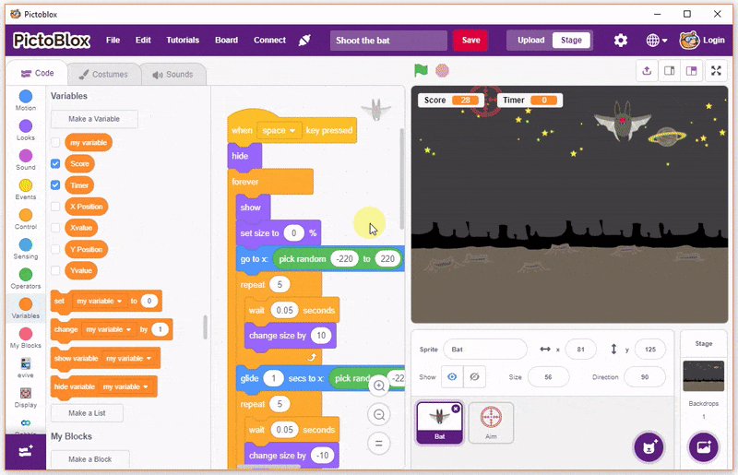
Lets Play

