Slide 1
Physical Computing evive Display – Animating Shapes

Slide 2
evive Display Extension

Slide 3
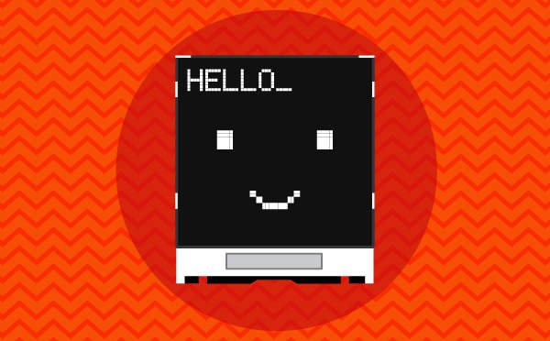
evive Display Extension
evive Display Extension allows you to control the display on evive screen (change colour, font size, and font colour), draw shapes, write text, and display values on the screen.

Slide 4
evive Display Extension: Shape Block

Slide 5
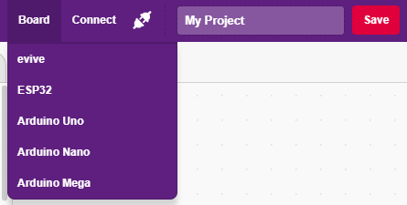
Interfacing evive with PictoBlox
Connect evive to your laptop/PC and open PictoBlox.
In PictoBlox, go to the menu and click on the Boards Select the evive.

Slide 6
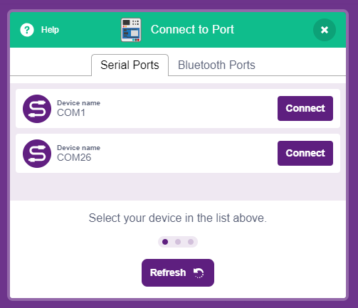
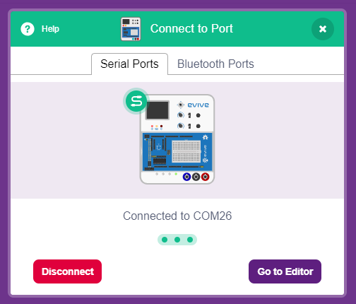
Interfacing evive with PictoBlox
Once you’ve selected the board, click on the Connect tab and connect the board.

Slide 7
Upload Firmware
You have to upload the firmware into the device before interacting with it.
Click on Upload Firmware button.
Once you successfully uploaded the firmware you will see evive logo on evive display.

Slide 8
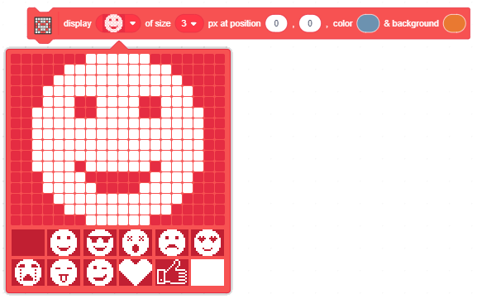
Shape Block
Display () of size () px at position (), (), color () & background () block is used to draw characters and symbols on evive TFT Display.
The matrix size for the block is 20 horizontally and 16 vertically.

Slide 9
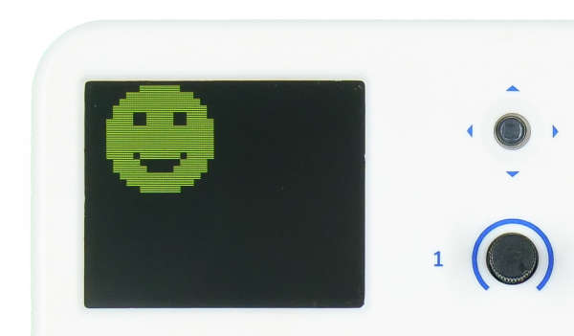
Shape Block - Parameters
The matrix having 20 x 16 boxes. You can either enable or disable a particular box by clicking on the box. If the box is enabled, its color is white, else the color is dark red. You can draw any shape using this.

Slide 10
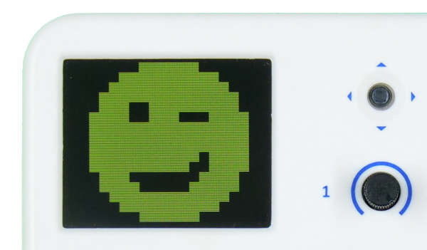
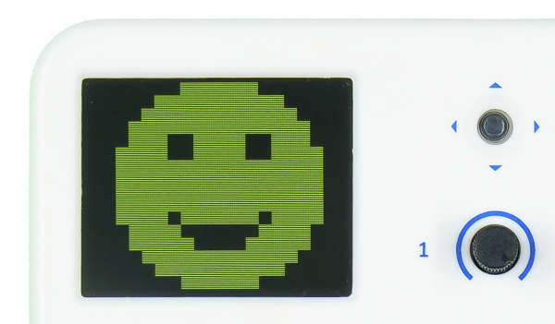
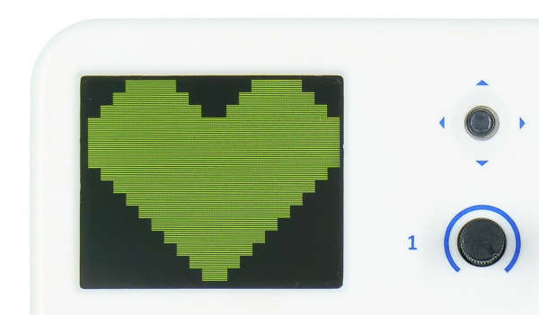
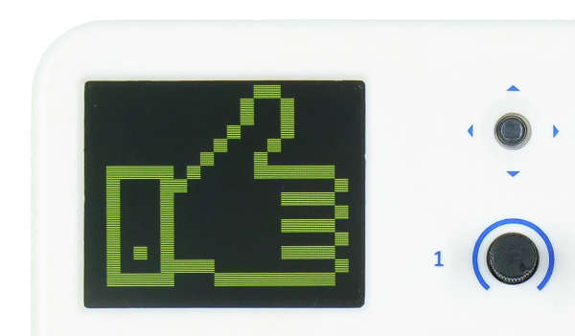
Predefined Shapes

Slide 11
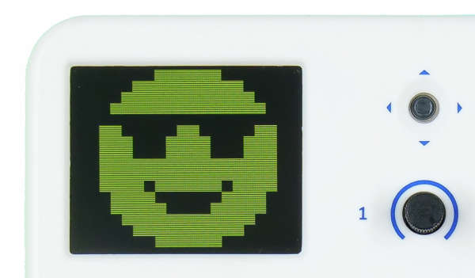
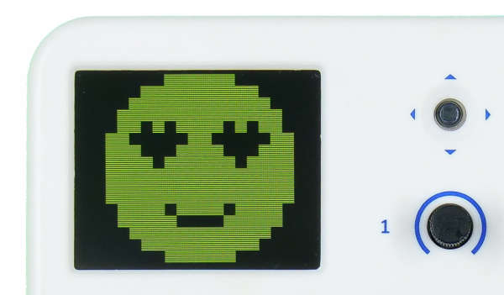
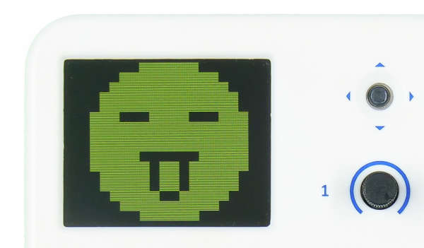
Predefined Shapes

Slide 12
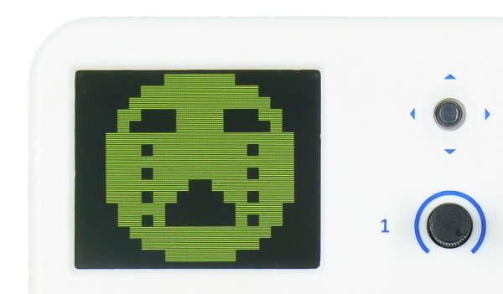
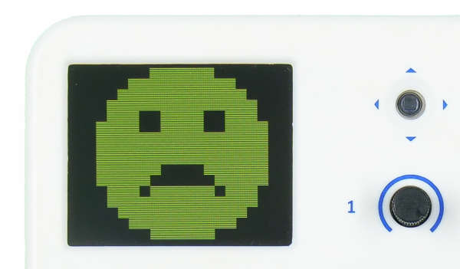
Predefined Shapes

Slide 13
Shape Block - Parameters
Size of the matrix on the TFT display. We are making a matrix of 20 x 16. Using this option, we can set how big the matrix will display on the screen.
If we set 1 px, then each box will have the width and the height of 1px.
If we set 8 px, then each box will have the width and the height of 8px.

Slide 14
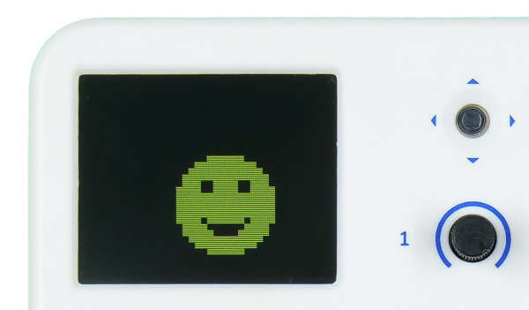
Shape Block - Parameters
X position of the top left corner pixel of the matrix from where the matrix will be displayed.
Y position of the top left corner pixel of the matrix from where the matrix will be displayed.

Slide 15
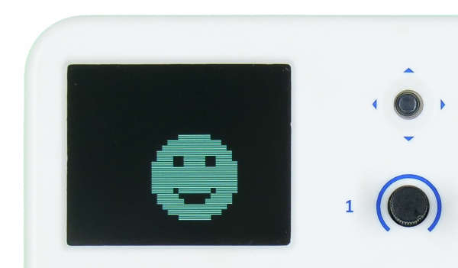
Shape Block - Parameters
The primary color of the shape. All boxes colored white in the matrix will be displayed with this color.

Slide 16
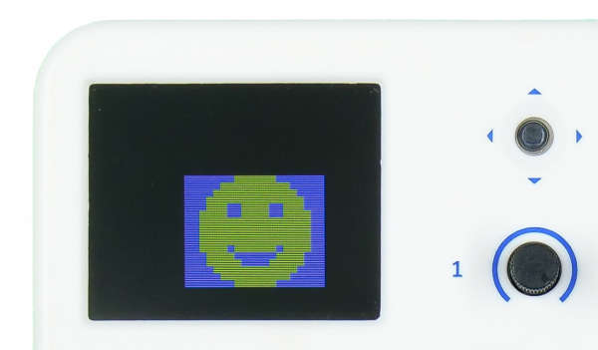
Shape Block - Parameters
The background color of the shape. All boxes colored dark red in the matrix will be displayed with this color.

Slide 17
Activity: Character Animation on Display

Slide 18
Character Animation on Display
In this activity you will make a smiled face go up, down, left and right using keyboard keys.
Make 2 variables to track X and Y coordinates of the character.

Slide 19
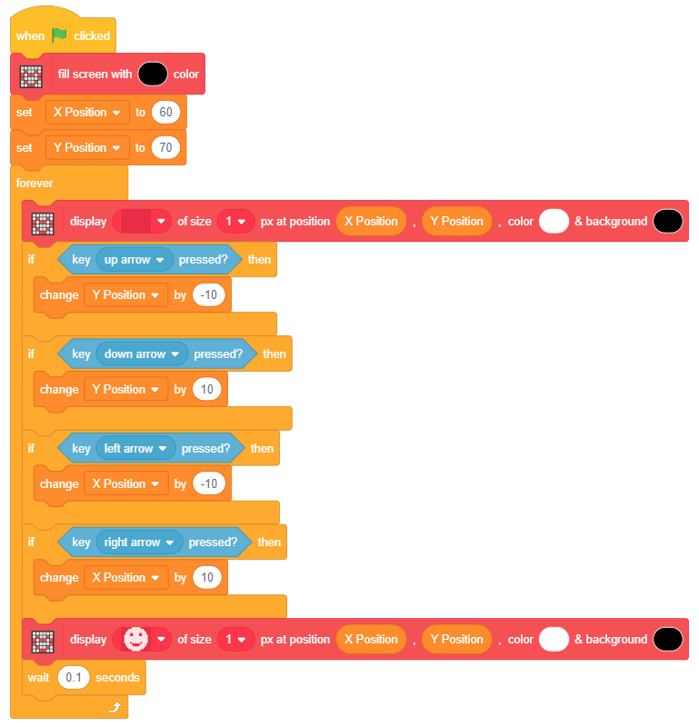
Smile Animation on Display

