Slide 1
Visualizing RC Circuits

Slide 2
What is a Capacitor?
<number>

Slide 3
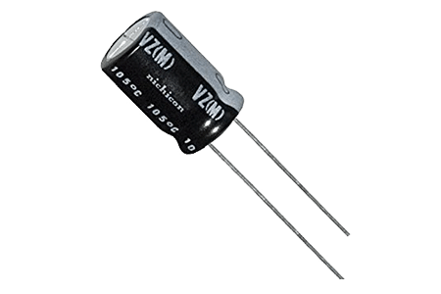
What is a Capacitor?
A capacitor is an electronic device that stores electric energy.
It is similar to a battery, but is smaller, lightweight and charges up much quicker.
Capacitors guard the circuit against current spikes, so they are used to maintain stable voltage in a circuit.
<number>

Slide 4
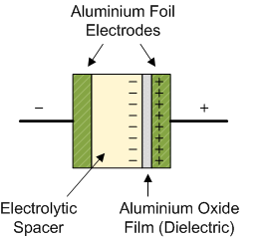
What is a capacitor made up of?
A capacitor consists of at least one pair of electrical conductors often in the form of metallic plates or surfaces separated by an insulator (non-conductive material).
<number>

Slide 5
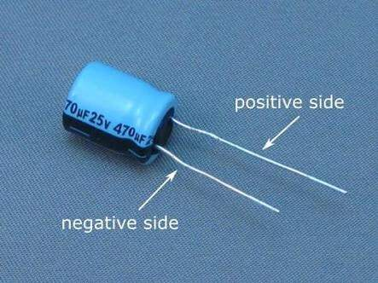
Anode and Cathode
Anode – Positive Side
Cathode – Negative Side
<number>

Slide 6
How does a capacitor work?
<number>

Slide 7
How does a capacitor work?
A battery uses chemicals to store electrical energy and release it very slowly through a circuit; sometimes it can take several years.
A capacitor charges up in few seconds and usually expends its energy much more quickly — often in seconds.
<number>

Slide 8
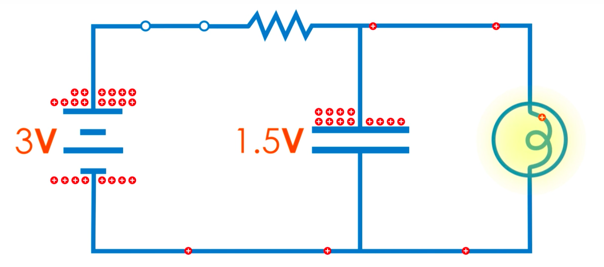
How is a capacitor charged?
You can charge a capacitor simply by wiring it up into an electric circuit.
When you turn on the power, an electric charge gradually builds up on the plates.
One plate gains a positive charge and the other plate gains an equal and opposite (negative) charge.
<number>

Slide 9
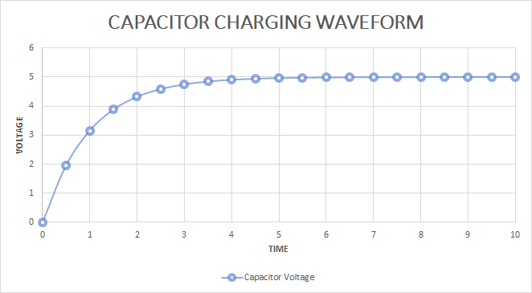
Capacitor Charging
During the charging of capacitor, the voltage across the capacitor increases and them stabilises as shown in the graph below.
<number>

Slide 10
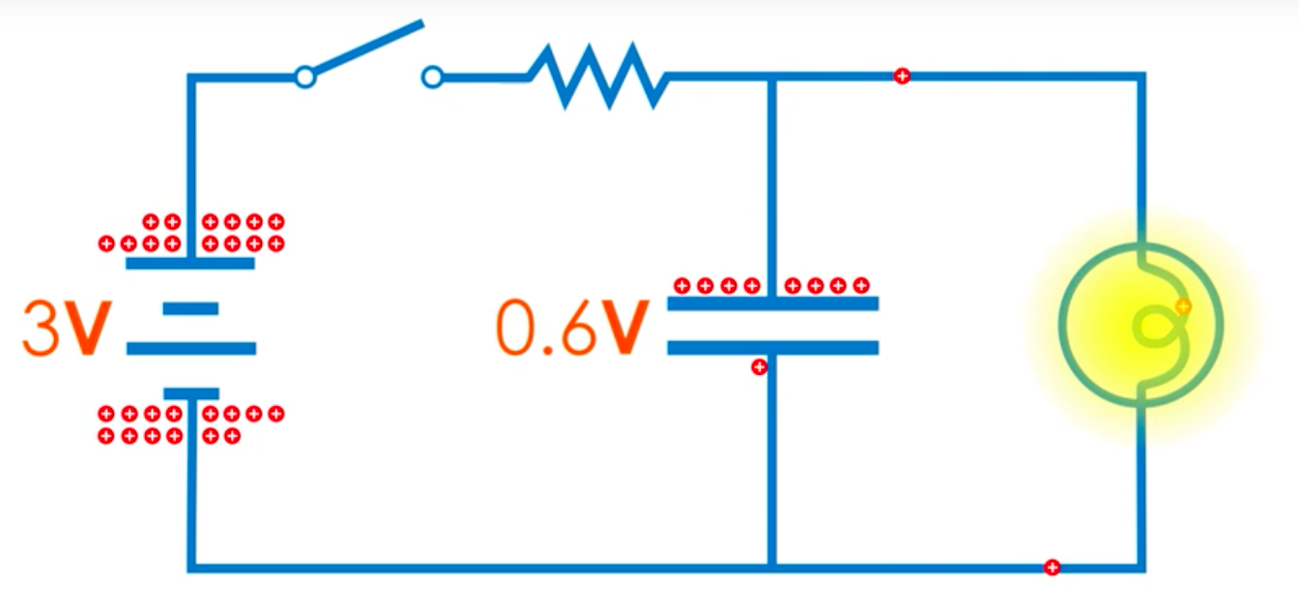
How is a capacitor discharge?
Now when you disconnect the power, the capacitor continues to hold its charge.
So here given that the capacitor is still connected to a circuit containing a bulb, charge will flow from the capacitor through the bulb until there’s none left on the plates. In other words, the capacitor will discharge quickly and turn on the light bulb.
<number>

Slide 11
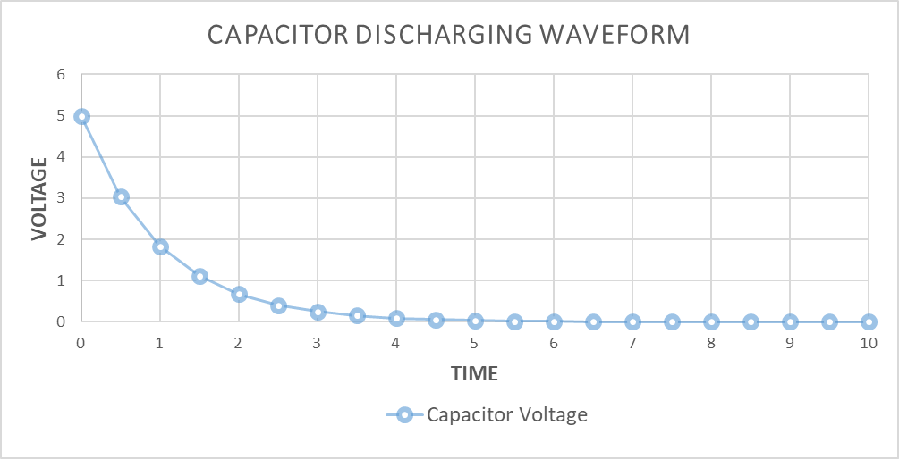
Capacitor Discharging
During the discharging of capacitor, the voltage across the capacitor decreases until its 0 as shown in the graph below.
<number>

Slide 12
Visualizing RC (Resistor Capacitor) Circuits
<number>

Slide 13
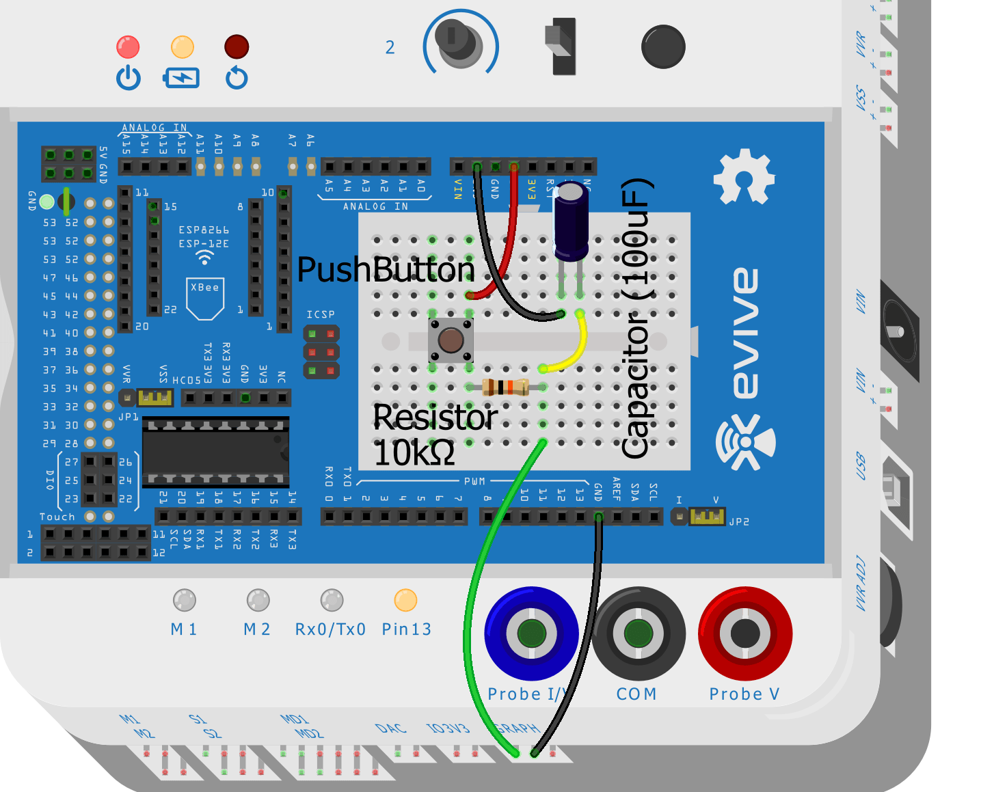
RC Circuit
Make the following circuit. Make sure you connect cathode of the capacitor to ground of the evive.
<number>

Slide 14
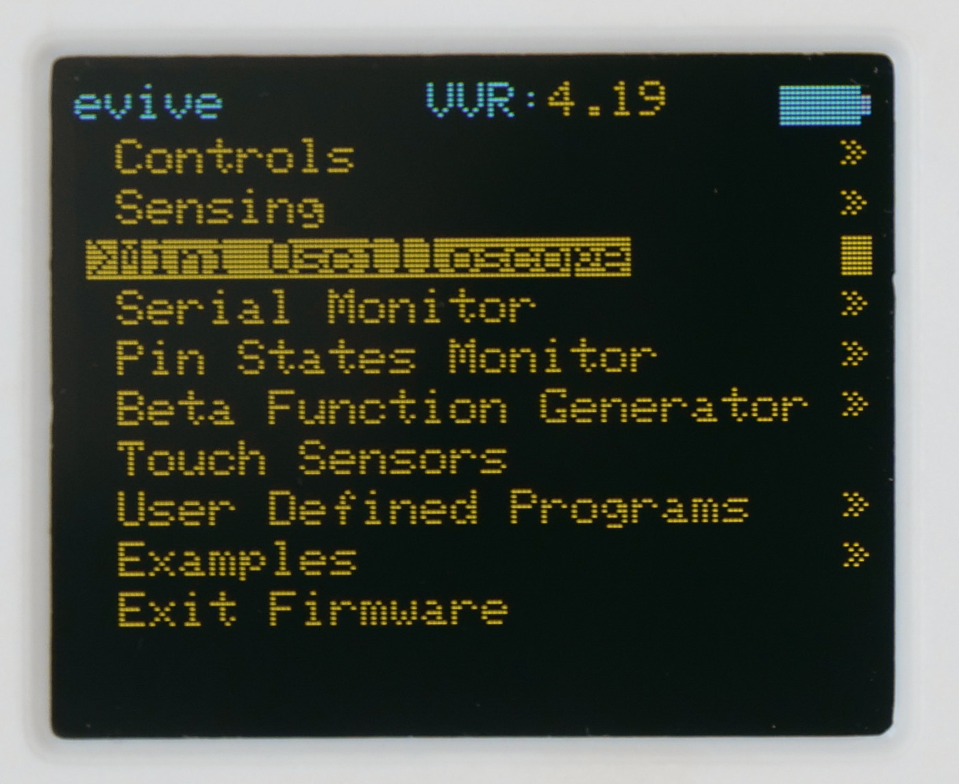
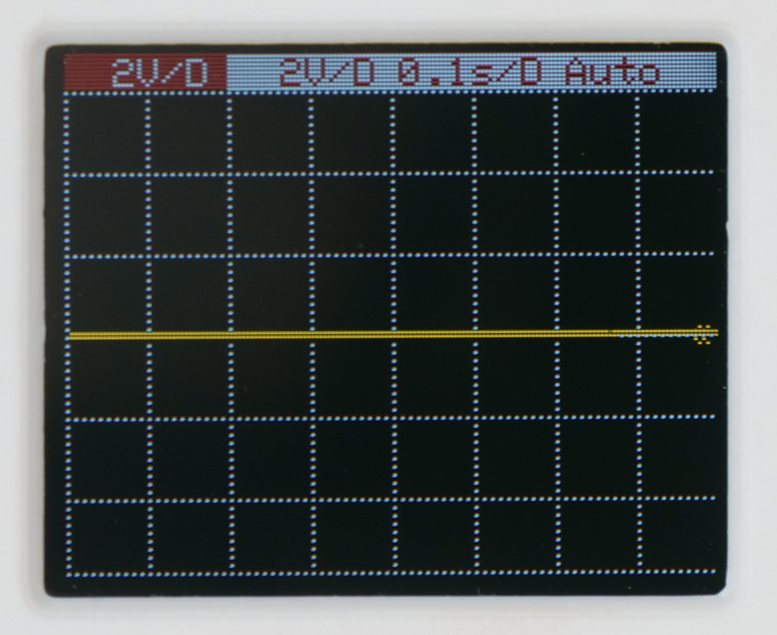
Visualising in Mini Oscilloscope
Start evive and navigate to Mini Oscilloscope.
<number>

Slide 15
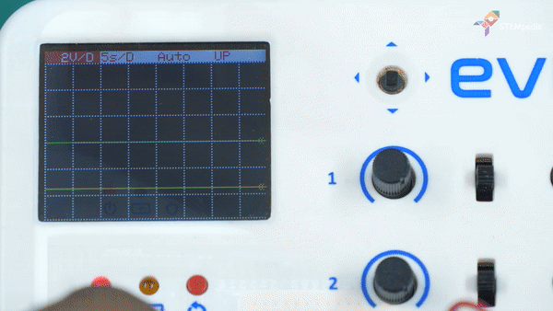
RC Charging
Press the switch, to close the circuit and charge the Capacitor.
<number>

Slide 16
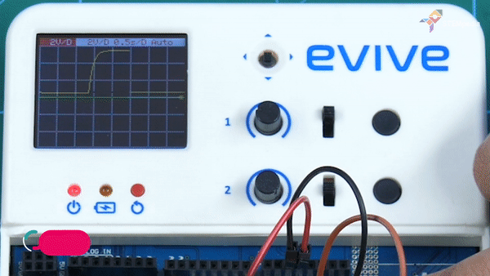
RC Discharging
Release the switch, to open circuit and discharge the Capacitor.
<number>

Slide 17
<number>

