Slide 1
Circuit with Switch and Potentiometer

Slide 2
Activity 1: Controlling the brightness of a LED
2

Slide 3
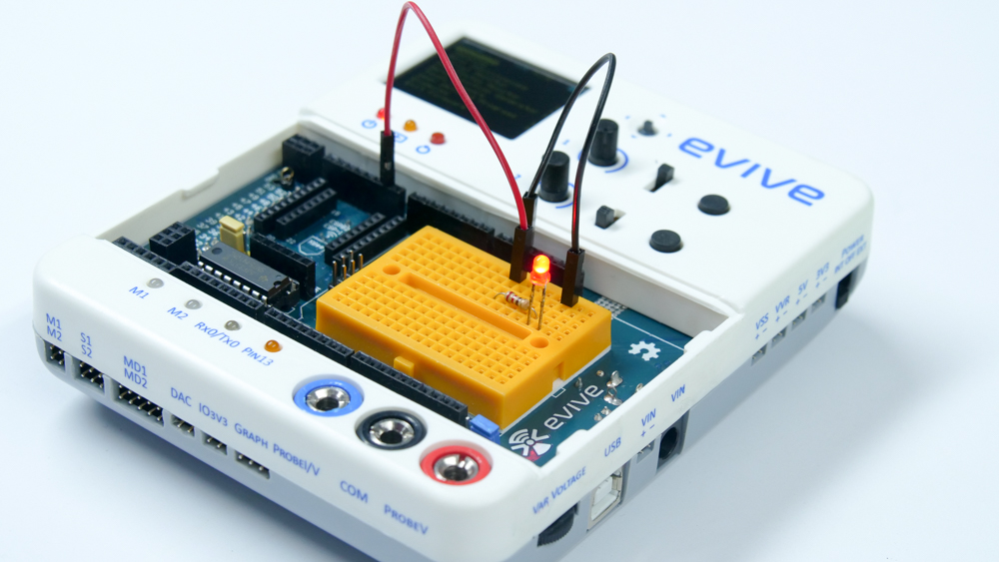
Controlling the brightness of a LED
In this activity, we're going to vary the brightness of an LED using evive’s potentiometer 1.
3

Slide 4
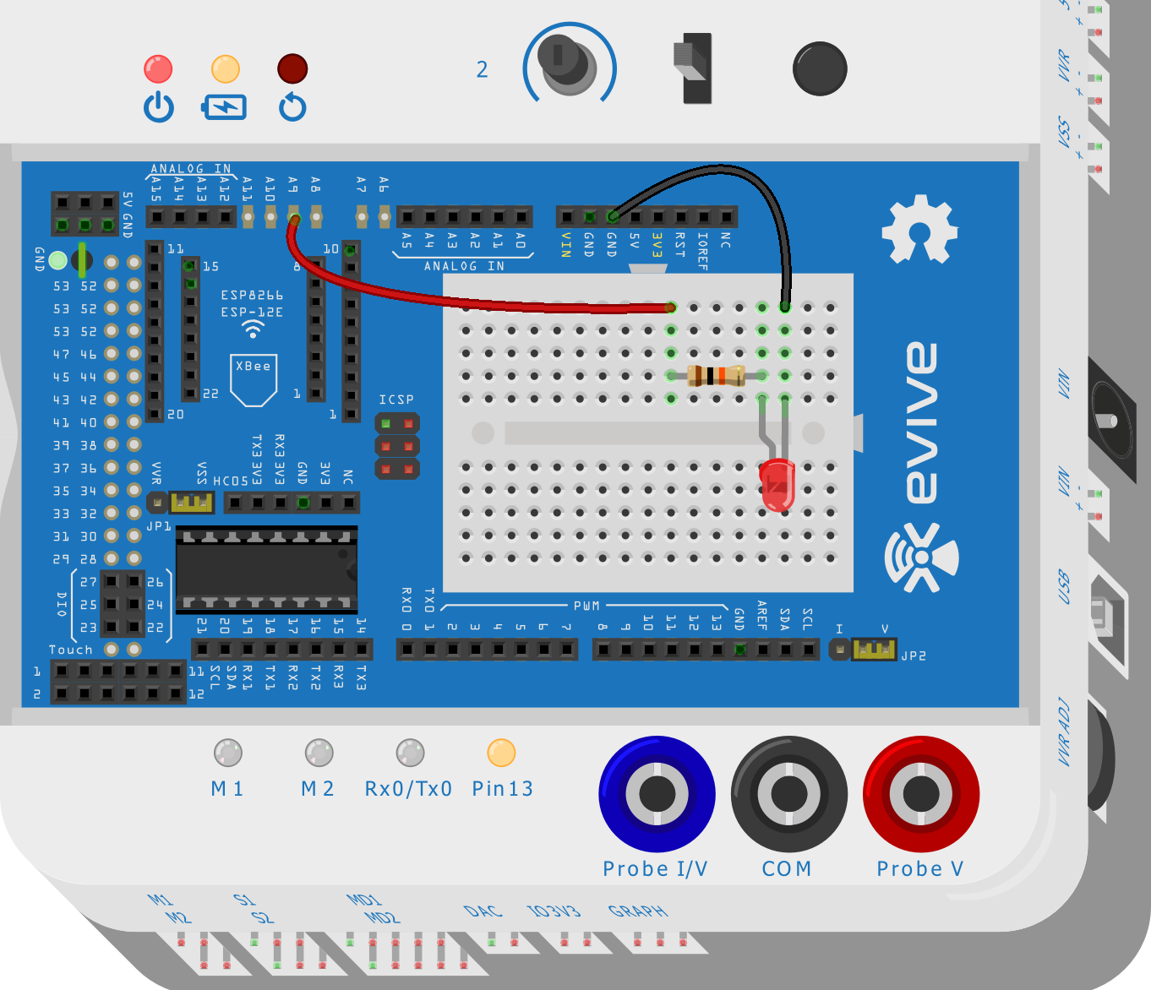
Circuit
Make the circuit as shown below:
4

Slide 5
Controlling the brightness of a LED
Power the evive. You can change the potentiometer angle to change the input voltage to the LED and thus its brightness.
5

Slide 6
Activity 2: Controlling LED state using Switch
6

Slide 7
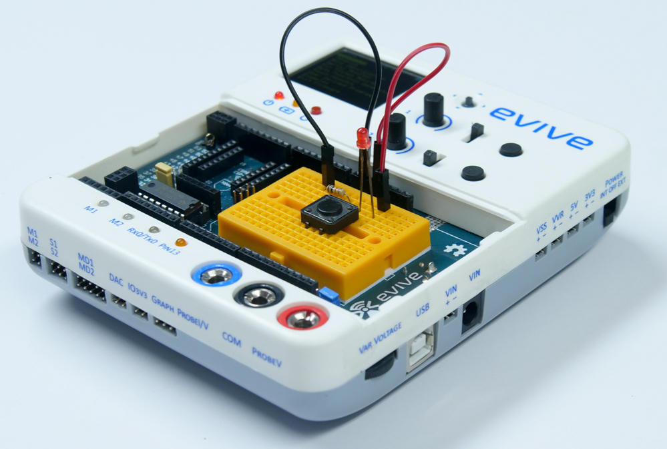
Controlling LED state using Switch
In this activity, we’re going to switch an LED on and off using a tactile switch.
7

Slide 8
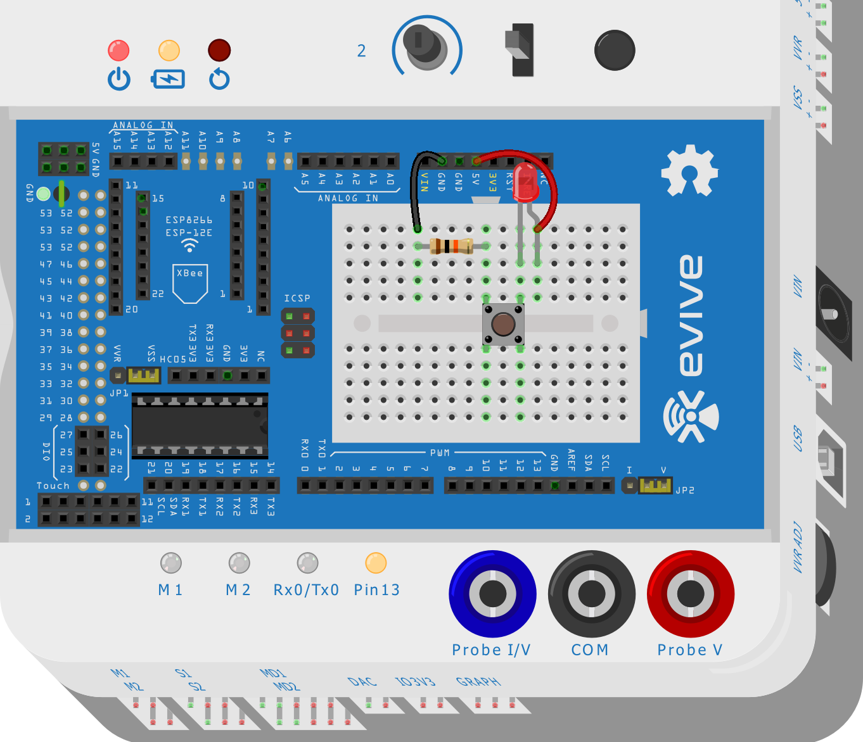
Circuit
Make the circuit as shown below:
8

Slide 9
Controlling LED state using Switch
Power the evive. Now press the switch to turn it ON.
9

Slide 10
Assignment
10

Slide 11
Assignment
Make a circuit using switch and potentiometer, in which the brightness of the LED is controlled using the potentiometer and the state of the LED is controlled using the switch.
11

Slide 12
12

