Slide 1
ABC of Digital Signal

Slide 2
Revision
Signal is anything that carries some sort of information.
Signal to a machine is generally in terms of voltage that varies with time.
Analog signal is a signal that represents all the possible values in a given range as it varies with respect to time.
It is easier to visualize an analog signal on a graph.
A potentiometer is a variable resistor.
Since the movement of the slider or the knob is smooth and continuous, the change in the value of the resistance is smooth. As the resistance changes, the voltage drop also changes.

Slide 3
Digital Signal

Slide 4
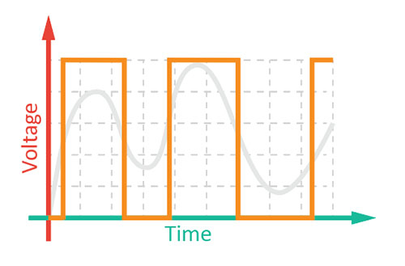
Digital Signal
A digital signal is a signal that represents a quantity as a series of discontinuous values.

Slide 5
Digital Signal
The simplest digital signal can represent only 2 values: ‘zero’ and ‘one’, or ‘true’ and ‘false’, or ‘HIGH’ and ‘LOW’ and it is known as a binary signal.
If we were to represent a binary signal using a voltage vs. time graph, it would look a square wave.

Slide 6
What is a Switch?

Slide 7
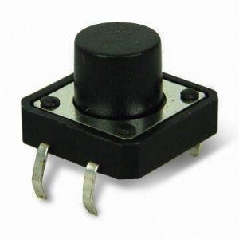
Switch
A switch is one of the most basic, but VERY important components in a circuit.
When the switch is open, the circuit is broken, and no current will flow through it. When the switch is closed, the circuit is closed or made, and therefore, current will flow through it.

Slide 8
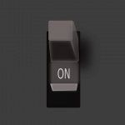
Types of Switches
Mechanical switches: Mechanical switches work only when someone or some external force actives them either by moving, touching, pressing, or releasing its contacts.

Slide 9
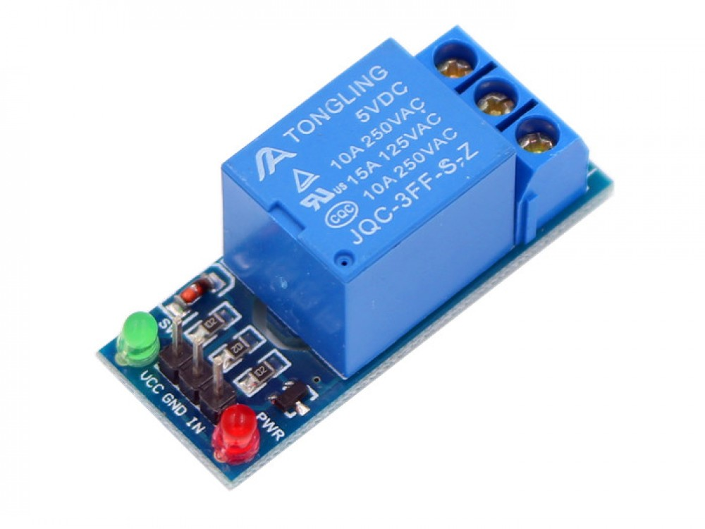
Types of Switches
Electrical switches: Electrical switches do not require anybody from the outside to activate them. They are electrical components that generally turn ON or OFF depending on the current flowing through them.

Slide 10
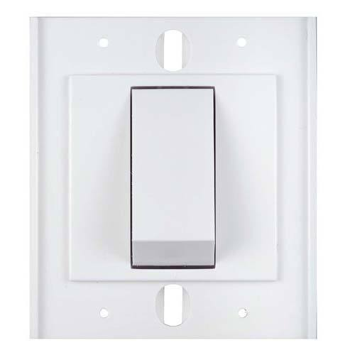
Types of Switches
Maintained Switches: These switches stay in one state i.e. either ON or OFF, unless the state is changed by someone.

Slide 11
Types of Switches
Momentary switches: These switches stay in a state i.e. either ON or OFF, if they are activated. They come back to their original state once they are released.
A tactile switch is a simple momentary switch which is ON only when the button the pressed. As soon as the button is released, the switch returns to its original state, i.e. the OFF state.

Slide 12
Visualizing Digital Signal

Slide 13
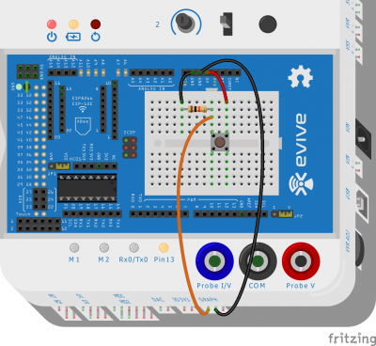
Activity: Visualising digital signal
We will visualize the voltage output of a switch.

Slide 14
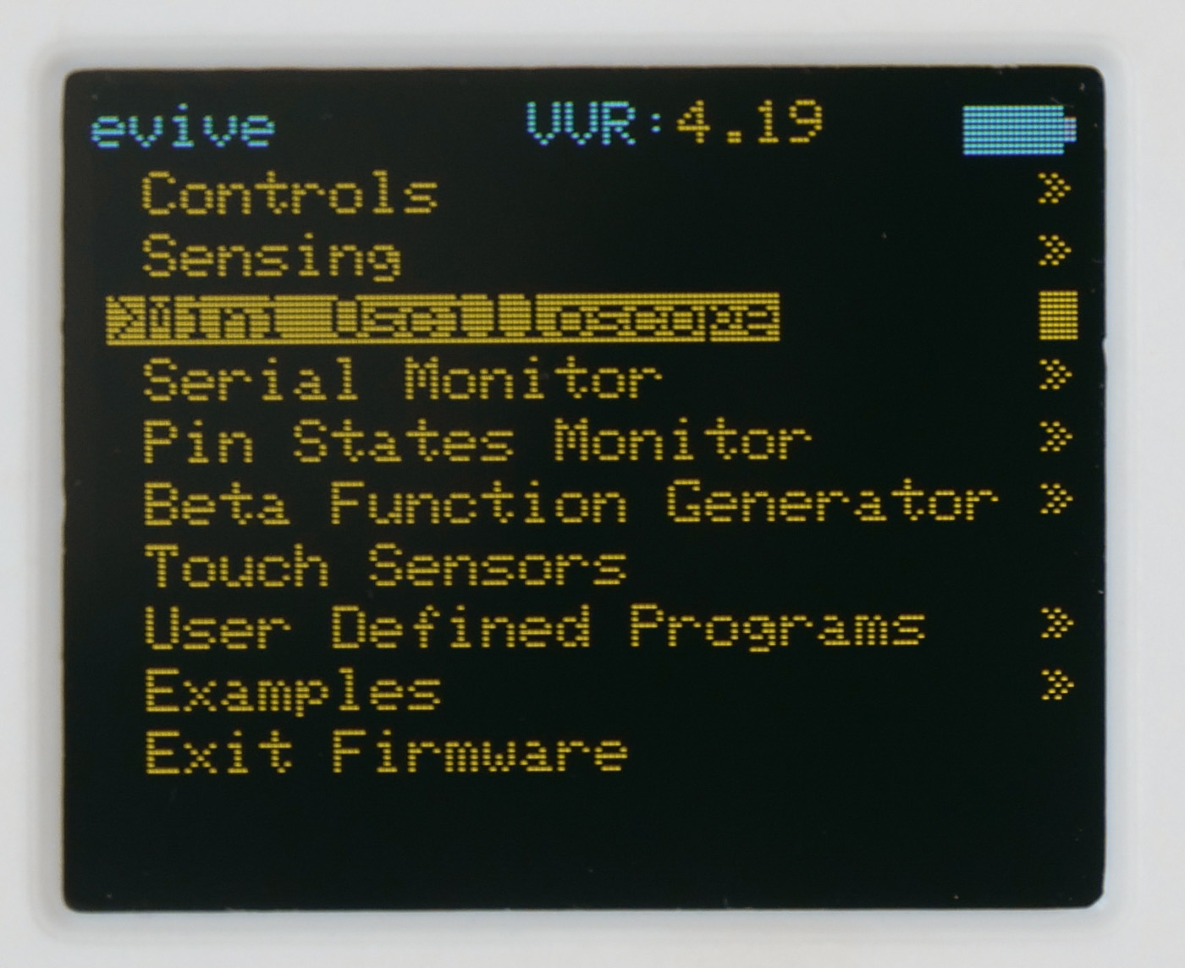
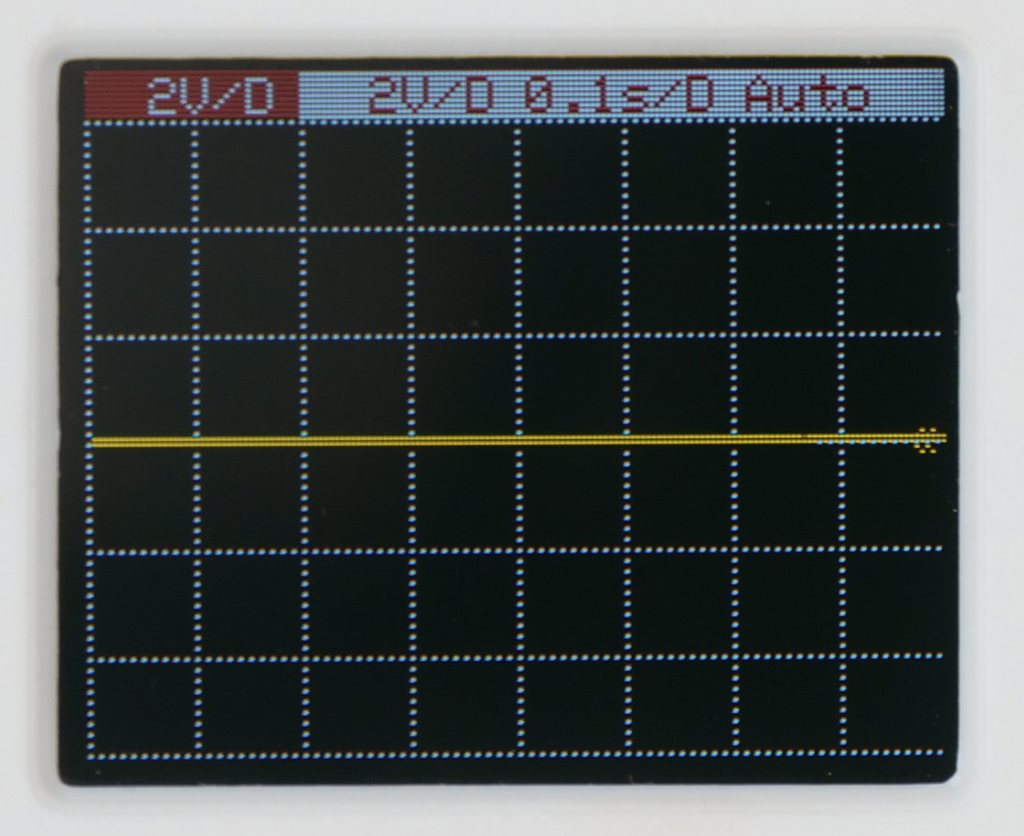
Activity: Visualising digital signal
Start evive and navigate to Mini Oscilloscope.

Slide 15
Activity: Visualising digital signal
Press the switch repetitively to see the digital signal.

