Slide 1
ABC of Analog Signal

Slide 2
What is Signal?

Slide 3
What is Signal?
Signal, in general, is a measurable quantity used to convey information, like you waving your hand to say goodbye to your friends or you nodding your head to say yes.
Note that while waving goodbye, your hand is in a certain position at one time and in a different position at another time.
Hence, the variation of a quantity with time can be termed as a signal.
In electronics, we can control current, resistance and voltage, and out of these, voltage is comparatively easy to control. Therefore, whenever we send a signal to a machine, it is generally in terms of voltage that varies with time.

Slide 4
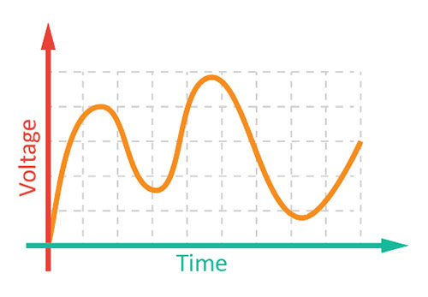
Analog Signal
Analog signal is a signal that represents all the possible values in a given range as it varies with respect to time.

Slide 5
Visualising Analog Signal
It is easier to visualize an analog signal on a graph.
A graph is a mathematical diagram which depicts the relationship between two quantities. It consists of two axes: the x-axis and the y-axis.

Slide 6
Visualising Analog Signal
When being used for representing analog signals, the x-axis represents time and the y-axis represents the signal.
For an analog signal, the graph is always smooth, and continuous.

Slide 7
Potentiometer

Slide 8
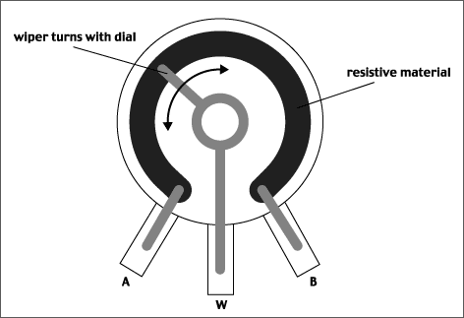
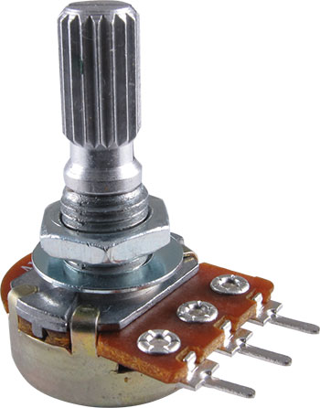
Potentiometer
A potentiometer is nothing but a variable resistor.
Since the movement of the slider or the knob is smooth and continuous, the change in the value of the resistance is smooth.
As the resistance changes, the voltage also changes.

Slide 9
evive Potentiometer
evive has 2 potentiometers. Potentiometer 1 is connected to analog pin A9 and potentiometer 2 to A10.

Slide 10
Visualizing Analog Signal

Slide 11
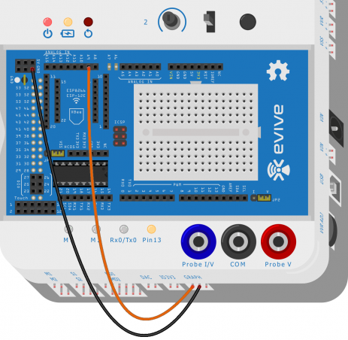
Activity: Visualising analog signal
We will visualize the voltage output of a potentiometer 1.

Slide 12
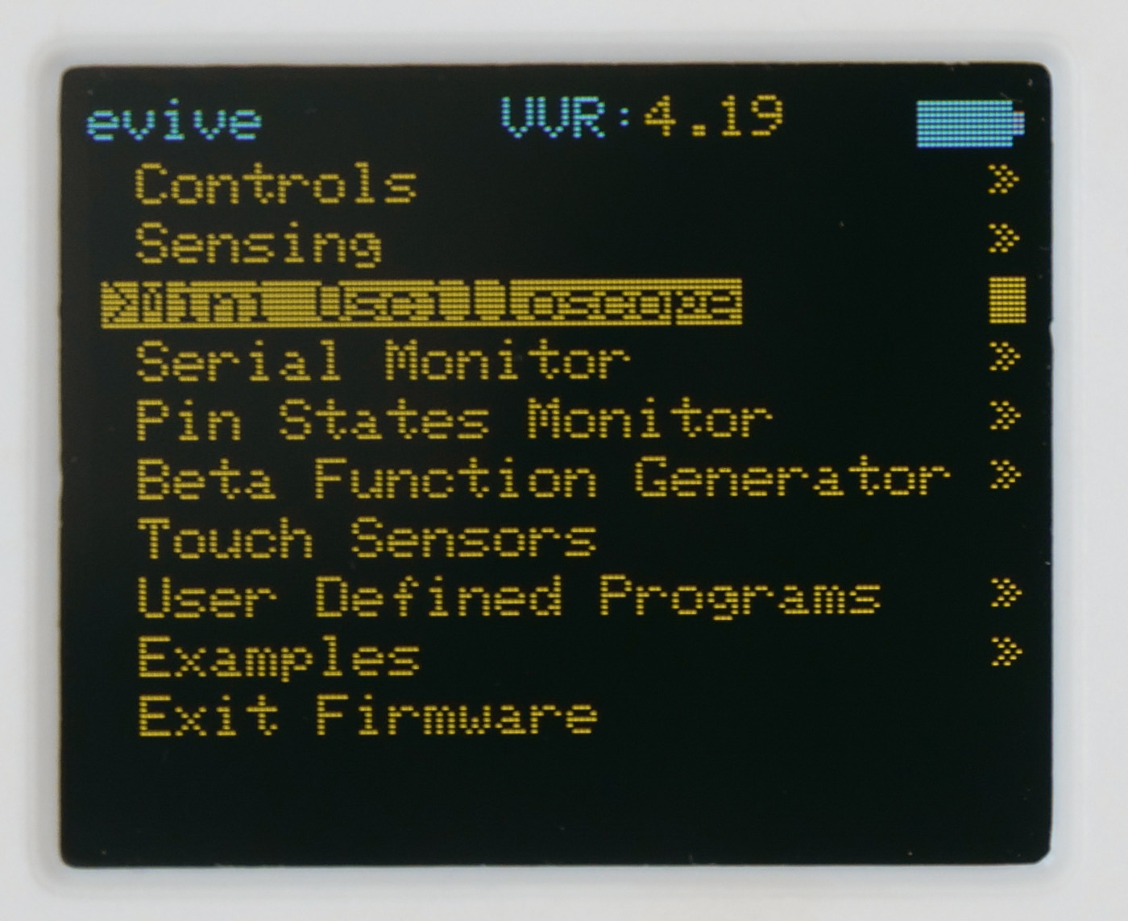
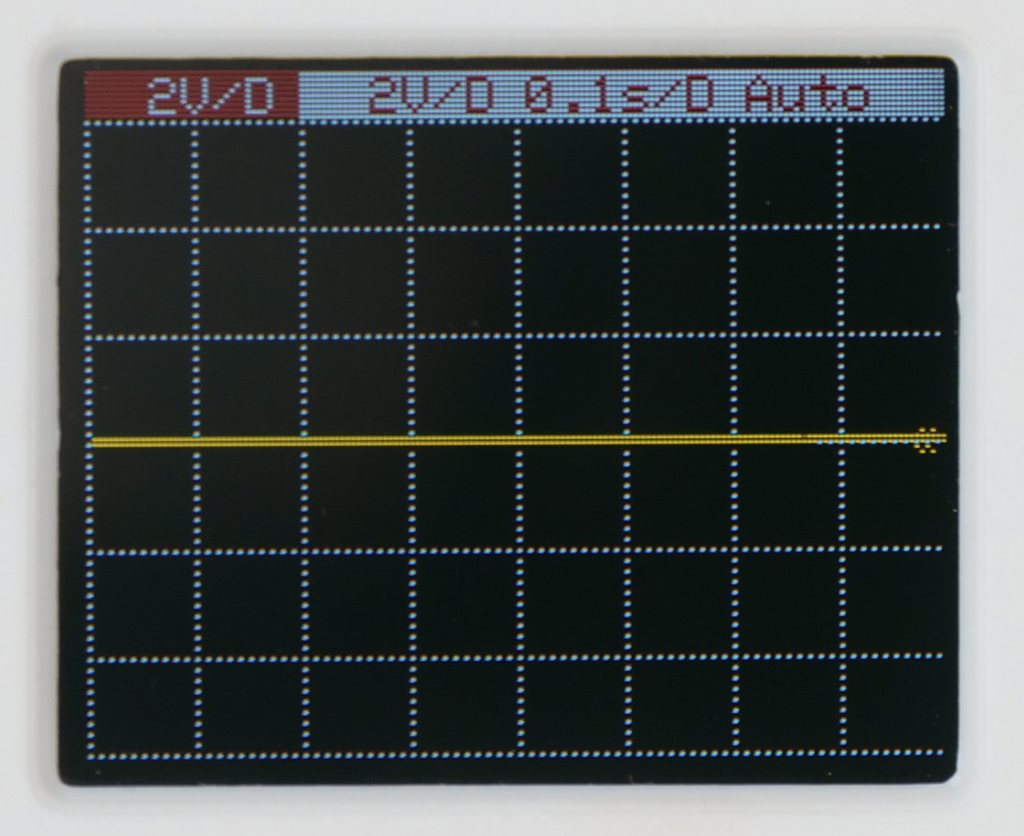
Activity: Visualising analog signal
Start evive and navigate to Mini Oscilloscope.

Slide 13
Activity: Visualising analog signal
Rotate the Potentiometer to visualise the analog signal.

