Slide 1
Series & Parallel Configuration

Slide 2
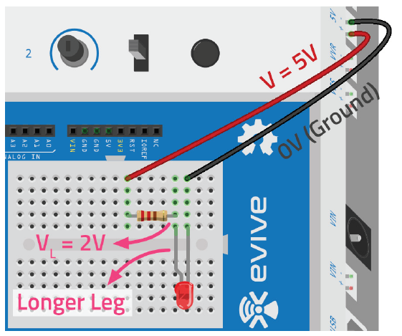
Revision
Ohm’s law suggests that current increases
when the voltage increases or
when the resistance decreases,
It is mathematically expressed as V=IR.
LEDs are like tiny light-bulbs which glow when current passes through them.
Single resistor LED circuit.

Slide 3
Series Configuration

Slide 4
What Is Series Configuration?
Two resistors are in series when they are connected one after another.
In this configuration, the same current flows through both the resistors but the voltage is divided across them.

Slide 5
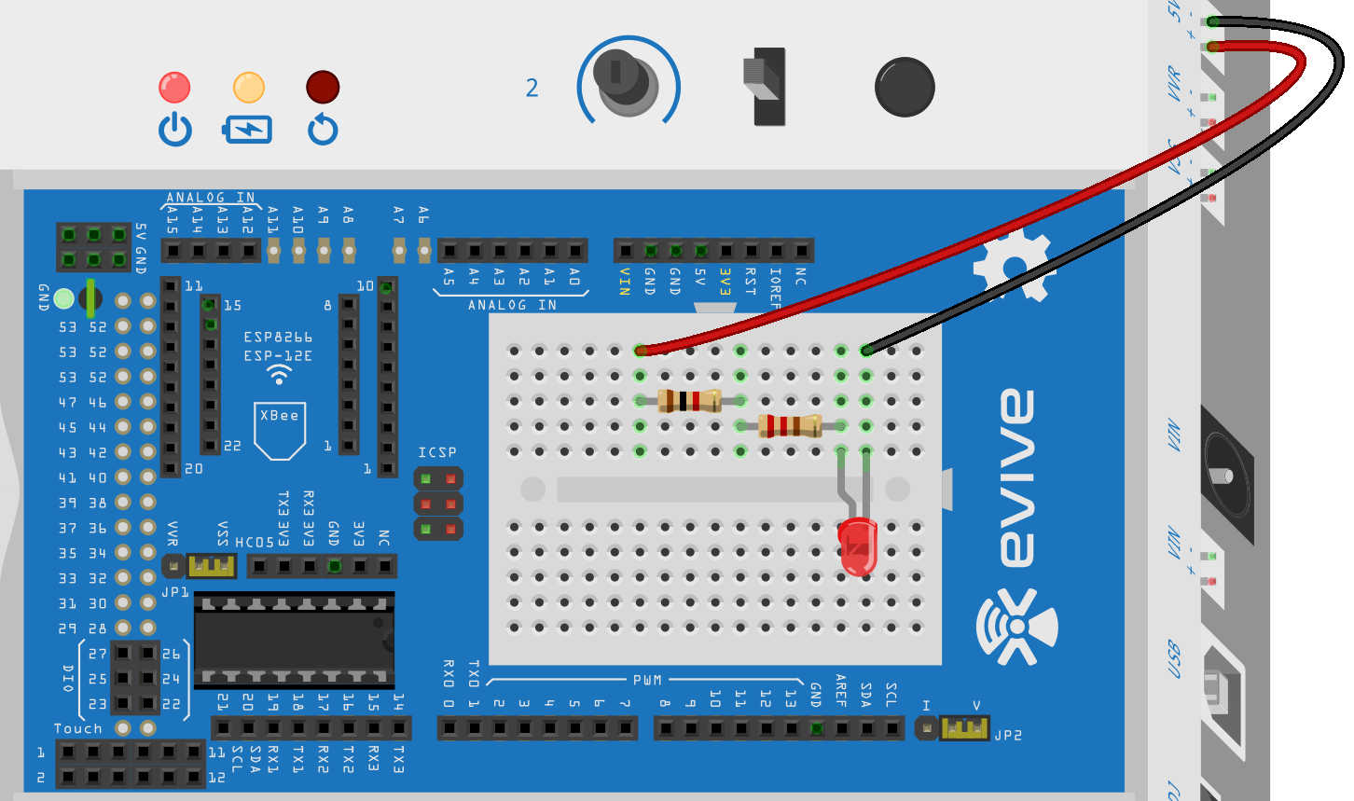
Series Configuration
Make the LED circuit using one 220 Ohm & one 1K Ohm resistor.

Slide 6
Series Configuration
Switch on evive and see what happens!
The LED’s brightness will be considerably less than before.
This happens since the resistance values of the resistors directly add up in a series configuration, thus increasing the total resistance in the circuit.
This, in turn, decreases the current flowing through the circuit.

Slide 7
Parallel Configuration

Slide 8
What Is Parallel Configuration?
Two resistors are said to be in parallel if their respective legs are connected to the same point (also called node).
The voltage across the resistors is the same but the total current flowing through the circuit is divided between them according to their resistance.

Slide 9
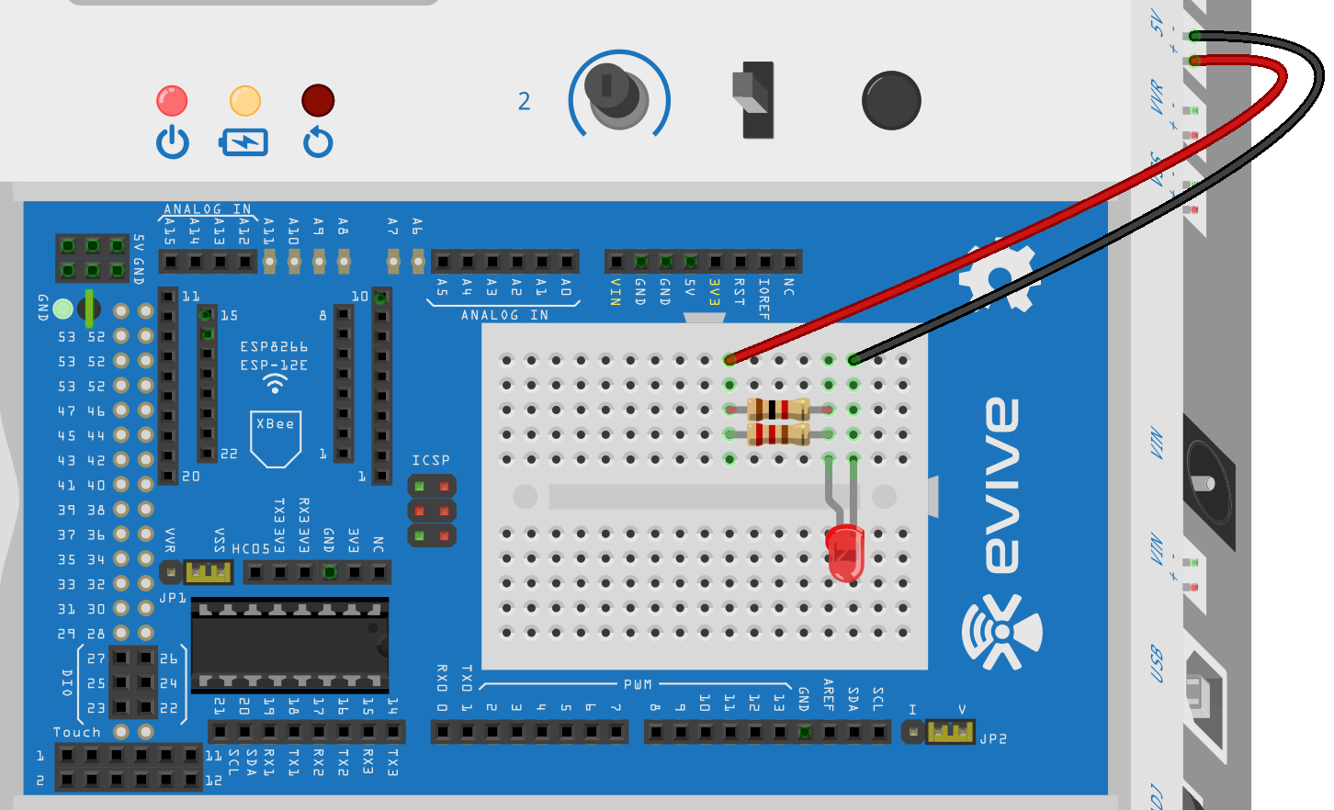
Parallel Configuration
Make the LED circuit using one 220 Ohm & one 1K Ohm resistor.

Slide 10
Parallel Configuration
When you switch evive on this time, you will observe that the LED will glow the brightest this time.
This is because the total resistance of the circuit is even lower than the smallest individual resistance.
In our case, it will be even less than 220Ω.

Slide 11
Conclusion
Using two resistors in series, you can increase the value of the resistance, hence decrease the flow of current. Hence, the LED glows less.
Using two resistors in parallel, you can decrease the value of the resistance, hence increase the flow of current. Hence, the LED glows more.

