Slide 1
Gripper

Slide 2
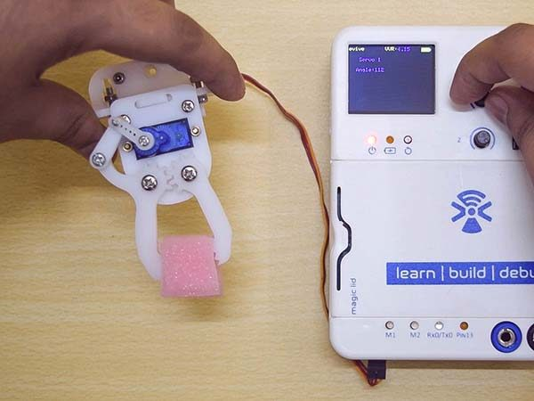
Gripper
A gripper is a device which enables the holding of an object to be manipulated. The easier way to describe a gripper is to think of the human hand. Just like a hand, a gripper enables holding, tightening, handling and releasing of an object.

Slide 3
Assembly

Slide 4
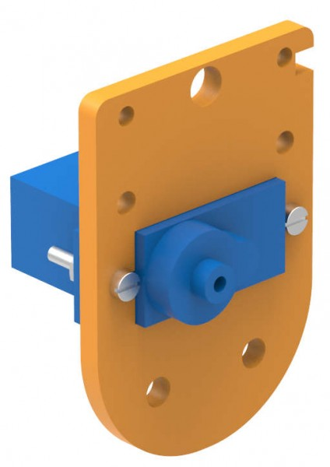
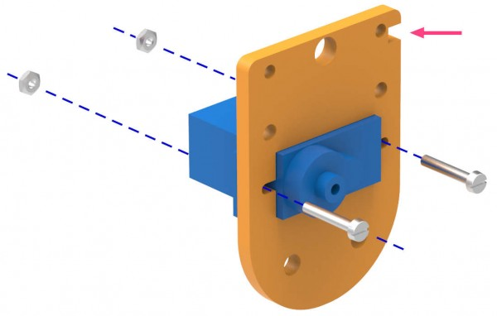
Assembly 1:
Insert one of the two servo motors that you have, in the rectangular slot of the Gripper Base Plate.
Fasten the servo to the plate using 12mm M2 bolts and M2 nuts.

Slide 5
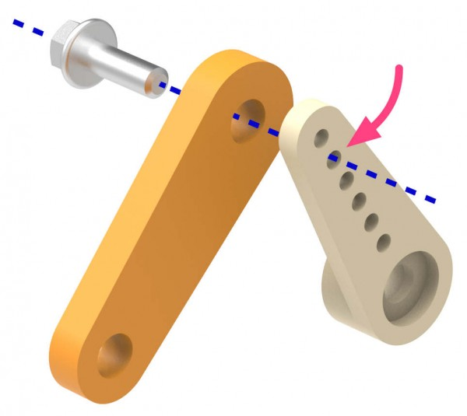
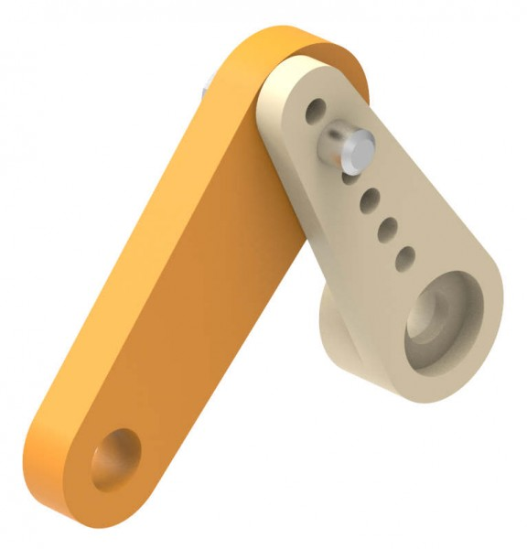
Assembly 2:
Set the servo angle as 45° using evive’s control menu.
Now, fasten the Gripper Link to the second hole of the single sided servo horn using an M2 screw (available with the servo motor). Keep the joint slightly loose so that this assembly can move easily.

Slide 6
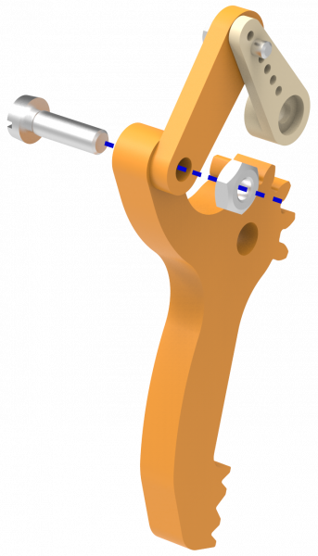
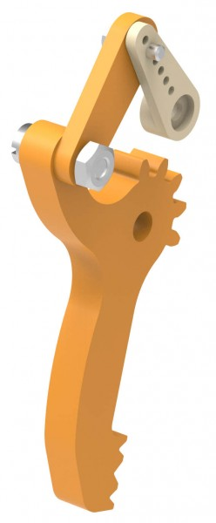
Assembly 3:
Mount the Gripper link to Gripper Claw 1 using 12mm M3 bolts and M3 nuts.

Slide 7
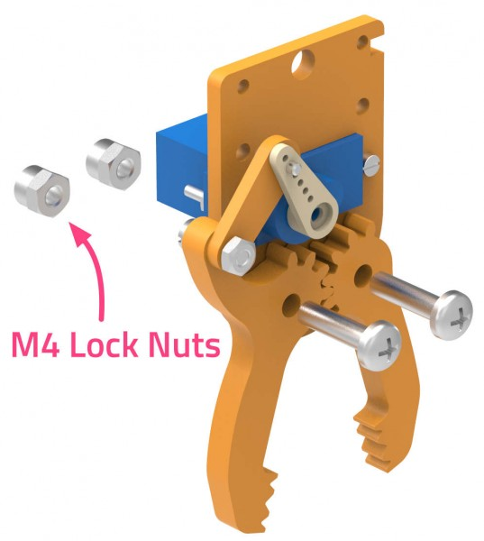
Assembly 4:
Fasten the entire assembly to the Gripper Base Plate – Servo Motor assembly such that the single sided servo horn locks onto the free servo head as shown in the corresponding figure.
Place the two gripper claws such the gears mate i.e. the gear teeth fix into each other.
Now, fasten both the claws to the Gripper Plate using 16mm M4 bolts and M4 nuts.

Slide 8
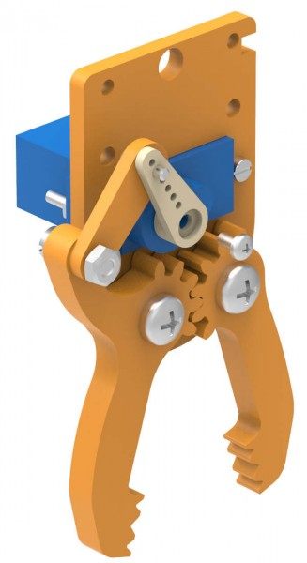
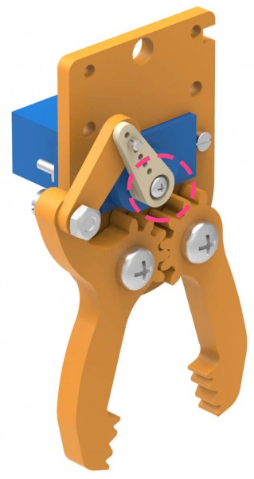
Assembly 5:
Fasten the servo horn to the servo head using the M2 screw available in the servo accessories (available with the servo motor).
Your Gripper is Ready.

Slide 9
Circuitry

Slide 10
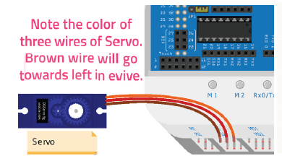
Circuitry
Connect the servo motor to servo port 1 (S1).

Slide 11
Controlling Gripper using menu

Slide 12
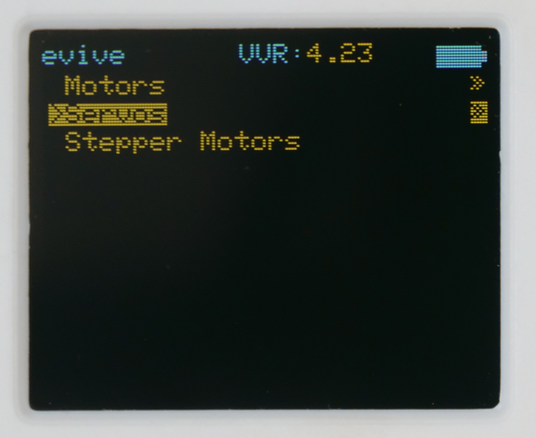
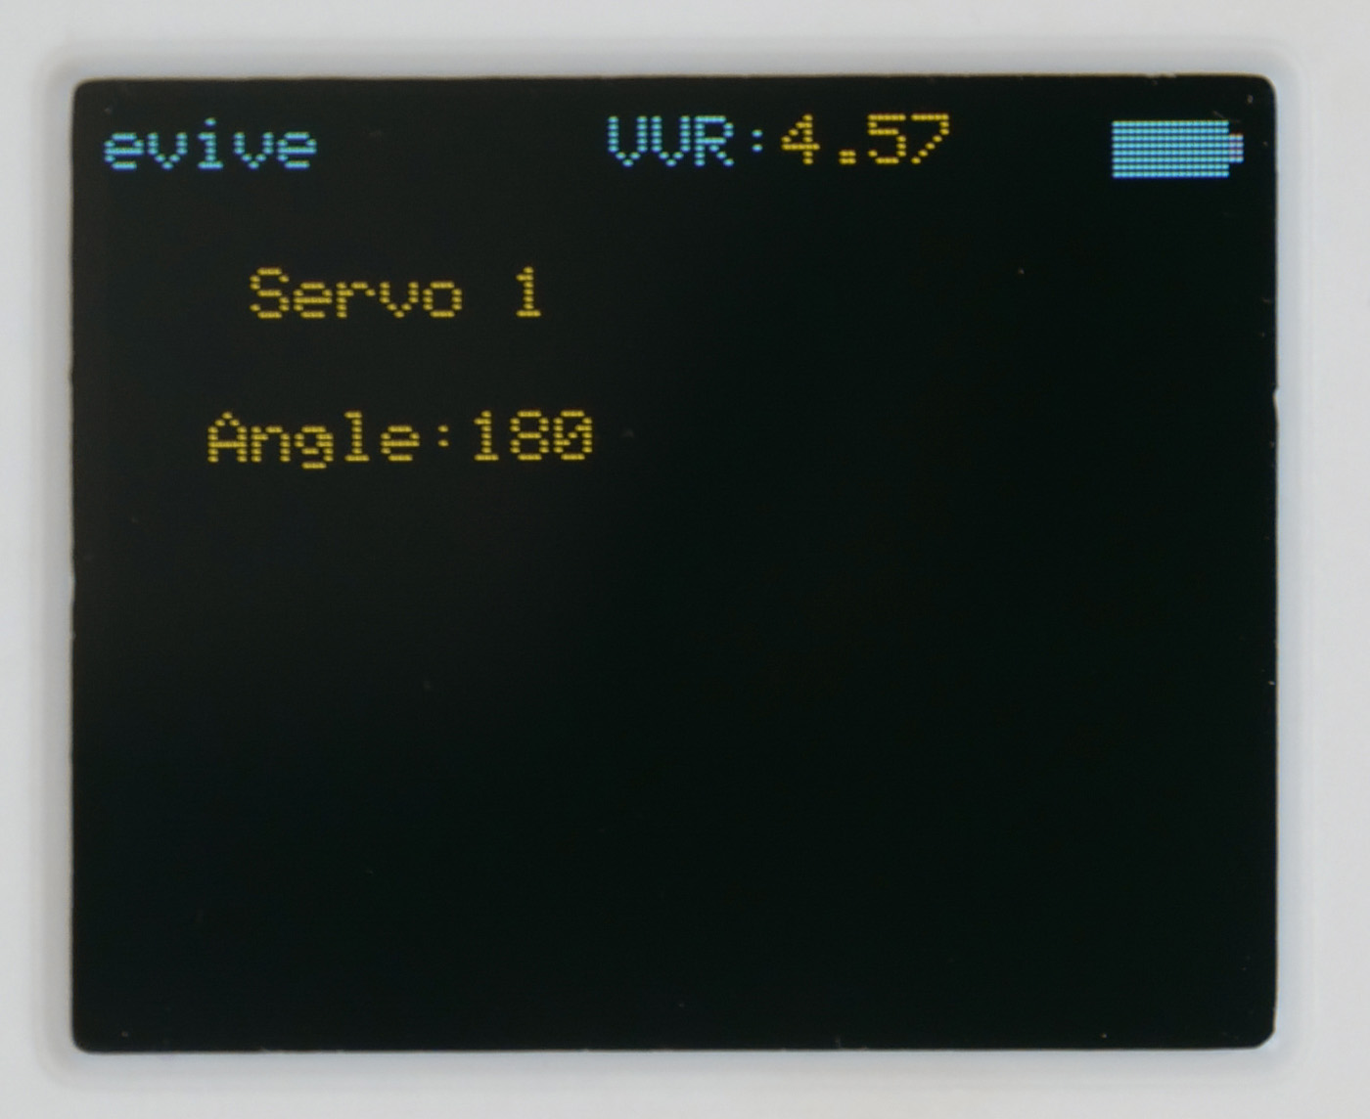
Controlling Gripper
Connect the servo motor to evive one more time, and vary the servo angle between 45° and 90° using the evive control menu.
The gripper claws should open at 45° and close at 90°.
If it doesn’t, then set the servo angle again as 45° and adjust the orientation of the servo horn and the gripper claws such that the assembly works properly.

Slide 13
Programming

Slide 14
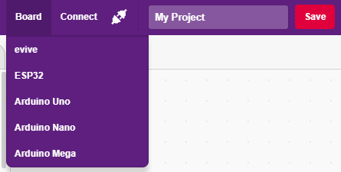
Interfacing evive with PictoBlox
Connect evive to your laptop/PC and open PictoBlox.
In PictoBlox, go to the menu and click on the Boards Select the evive.

Slide 15
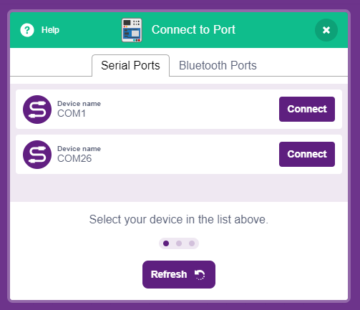
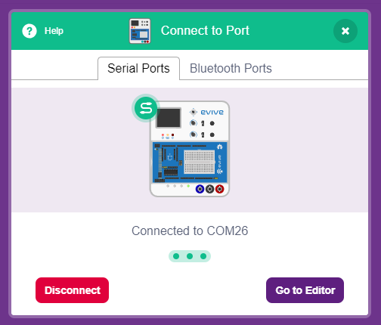
Interfacing evive with PictoBlox
Once you’ve selected the board, click on the Connect tab and connect the board.

Slide 16
Upload Firmware
You have to upload the firmware into the device before interacting with it.
Click on Upload Firmware button.
Once you successfully uploaded the firmware you will see evive logo on evive display.

Slide 17
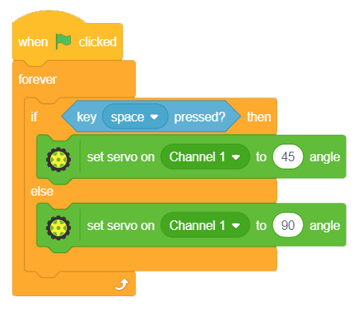
Script
In this script we want to open the gripper only when the SPACE key is pressed, otherwise close the gripper.

