Slide 1
Follow Me Robot Programming

Slide 2
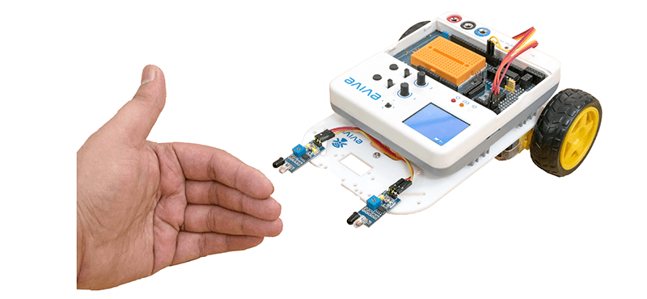
Follow Me Robot
Follow me robot is an autonomous robot, which uses two IR sensors to follow the object in front of the robot.

Slide 3
Logic Control

Slide 4
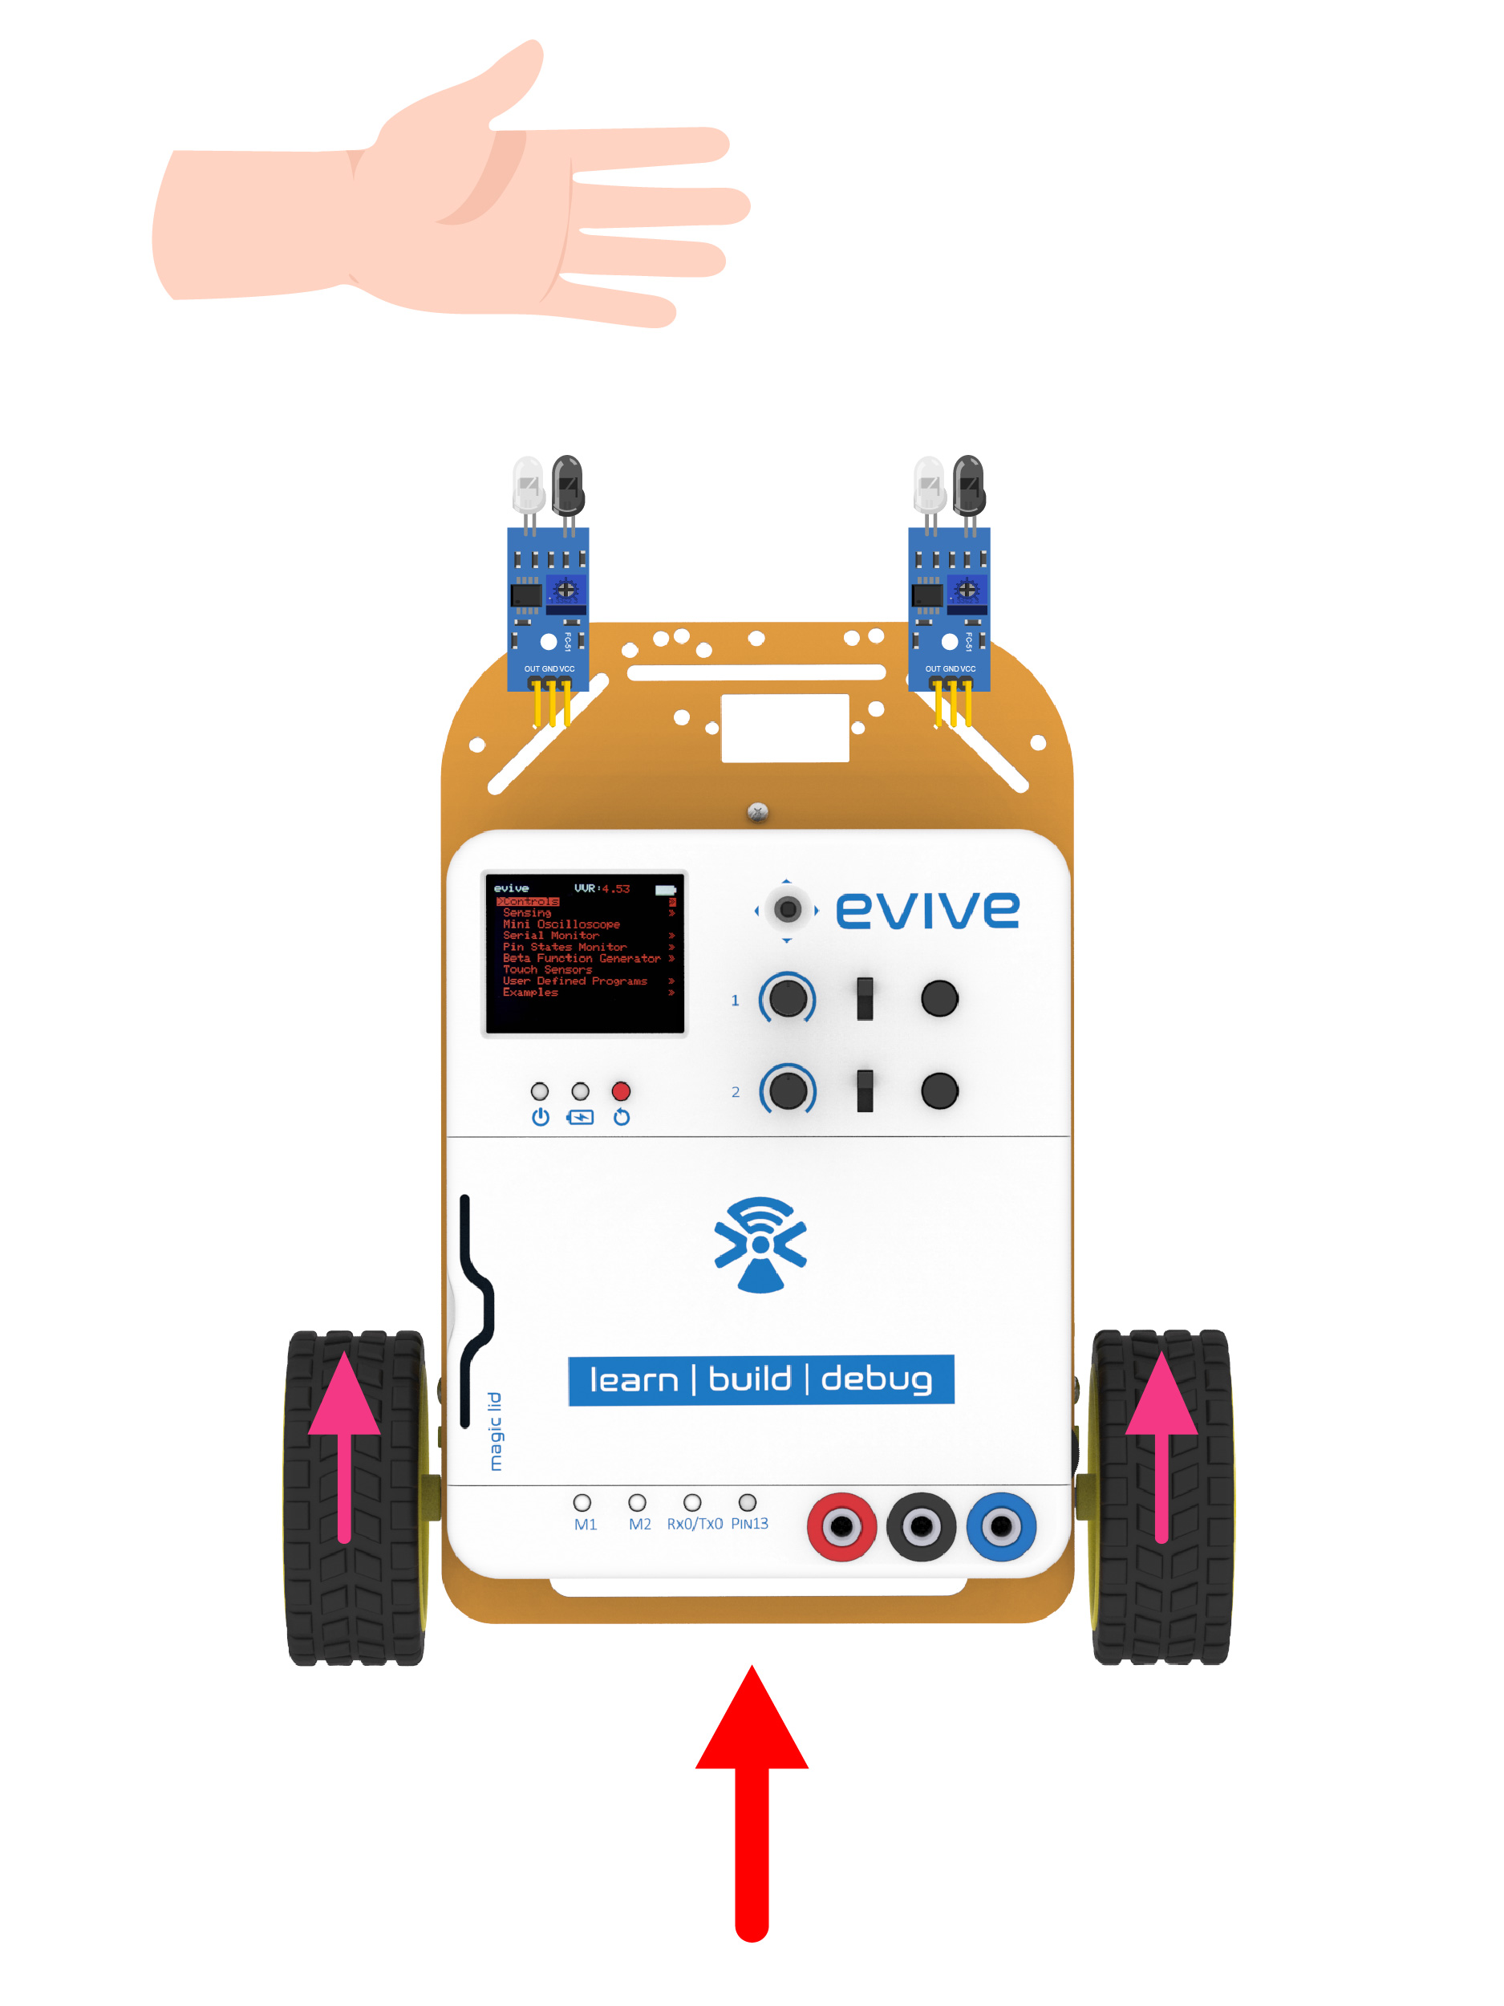
Logic
How, or rather when the robot follows anything depends on the state of the two sensors.
If both sensors are ON, that means the object is in front; the robot should move in the forward direction.

Slide 5
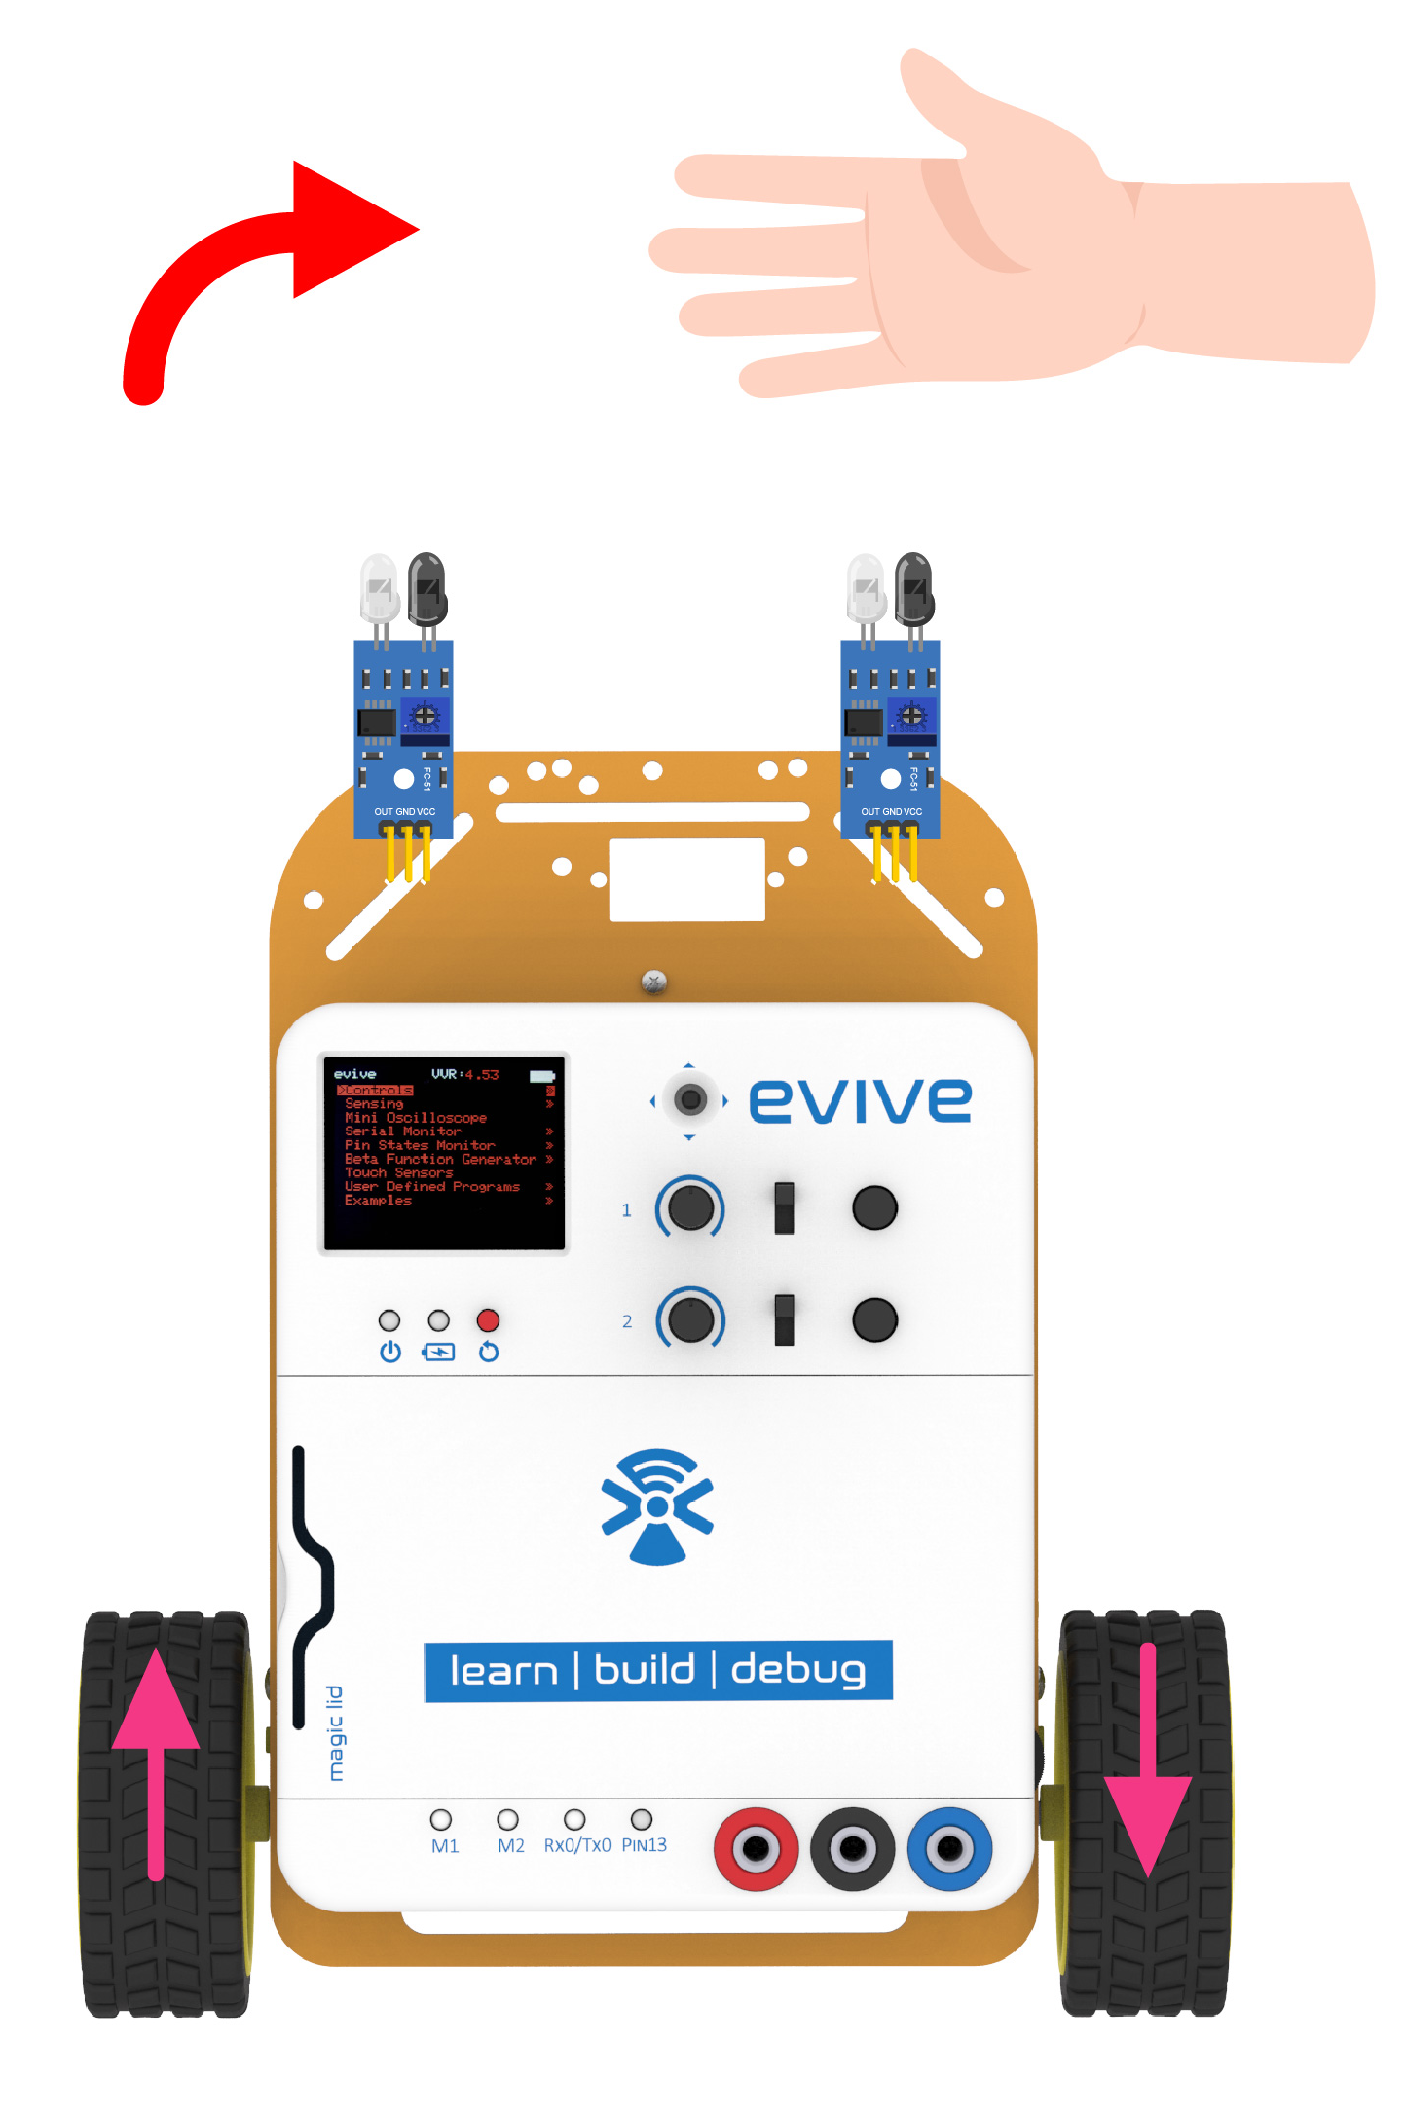
Logic
If only the sensor on the right is ON, it means the object is in the right, and hence the robot should turn right.

Slide 6
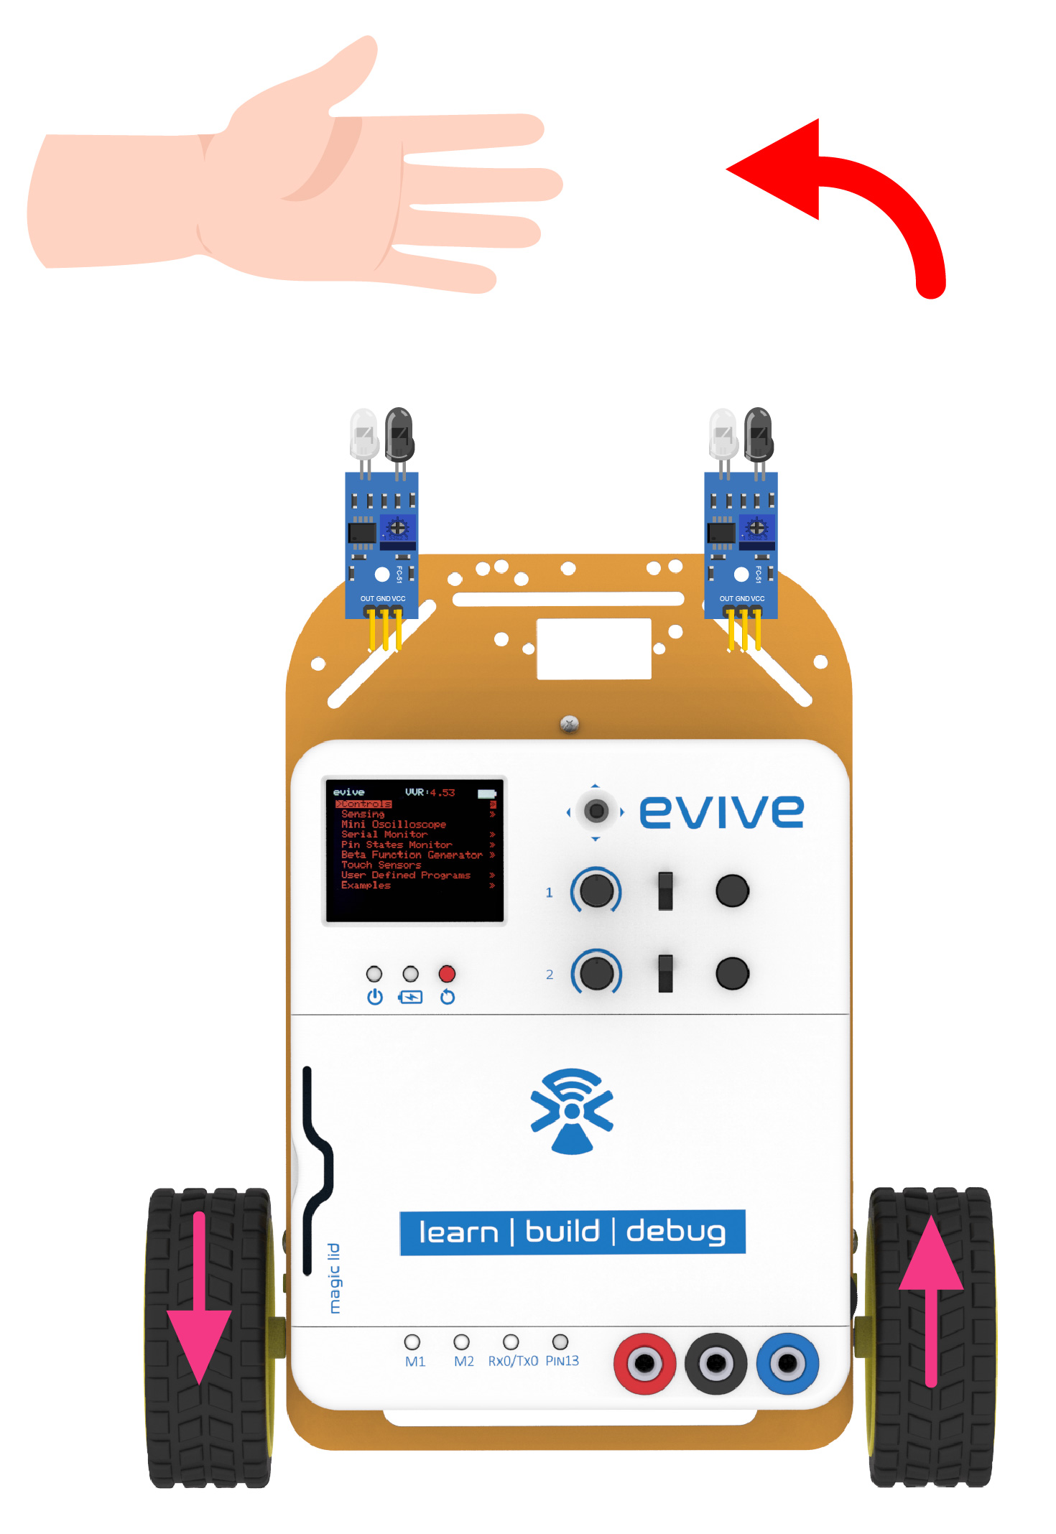
Logic
Similarly, when the object is to its left, only the sensor on the left will be ON and the robot should turn left.

Slide 7
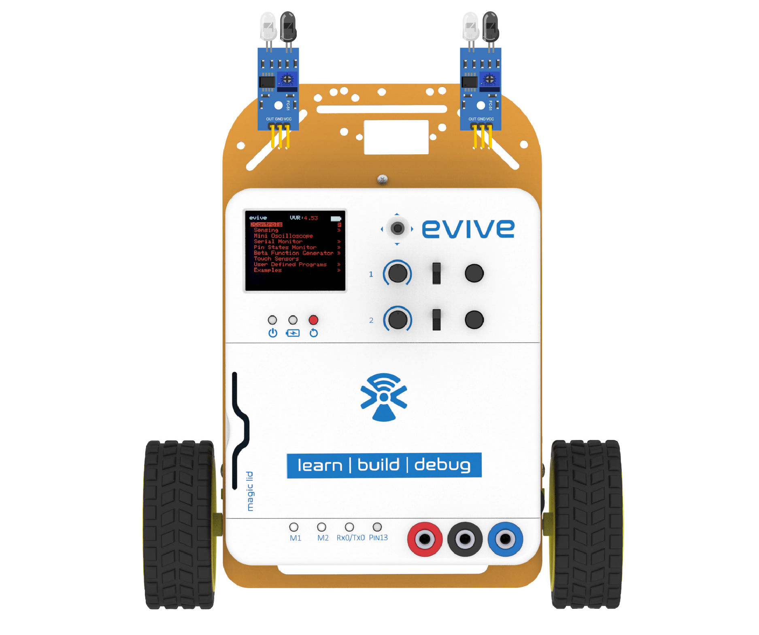
Logic
If there is no object within 10cm, both sensors will be OFF. Therefore, the robot should stop.

Slide 8
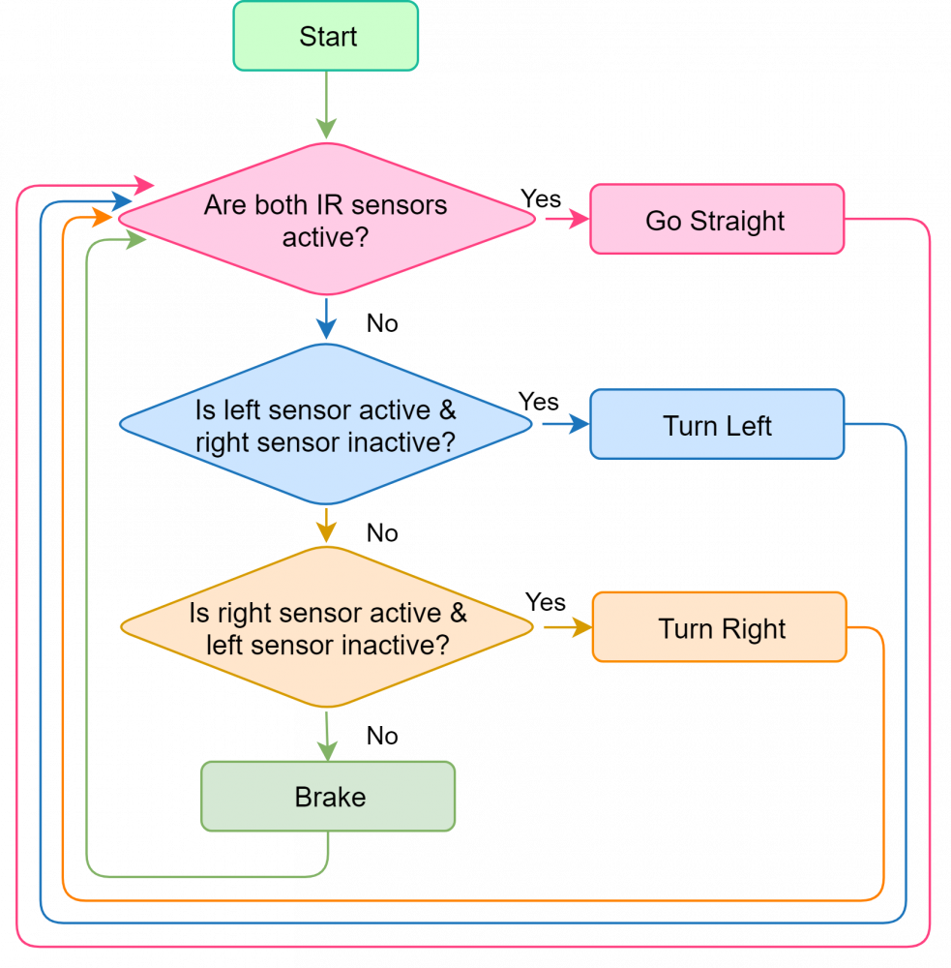
Logic

Slide 9
Programming

Slide 10
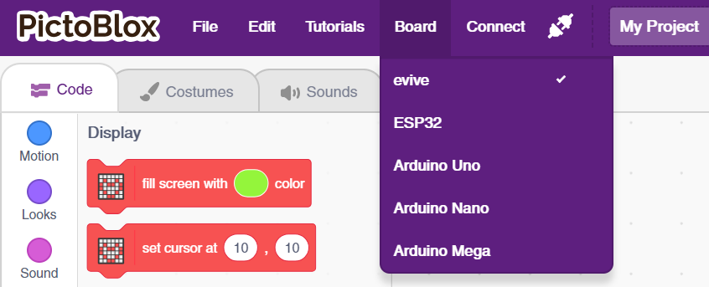
Select Board
Select evive as Board

Slide 11
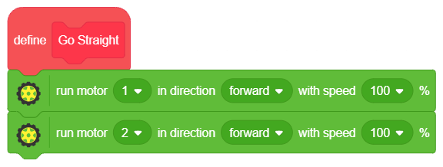
Go Straight
Go to the Data&Blocks palette and create a block named Go Straight.
Go to the Actuators extension and drag and drop the run motor () in direction () with speed () block below the Go Straight definition hat block; set the motor as 1, the direction as forward, and speed as 100 %.
Repeat Step 2; this time set the motor as 2.

Slide 12
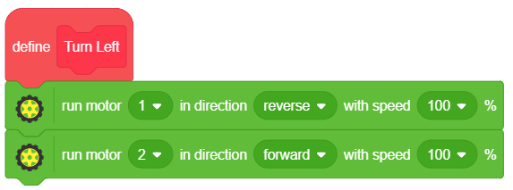
Turn Left
Go to the Data&Blocks palette and create a block named Turn Left.
Go to the Actuators extension and drag and drop the run motor () in direction () with speed () block below the Turn Left definition hat block; set the motor as 1, the direction as reverse, and speed as 100 %.
Repeat Step 2; this time set the motor as 2 & direction as forward.

Slide 13
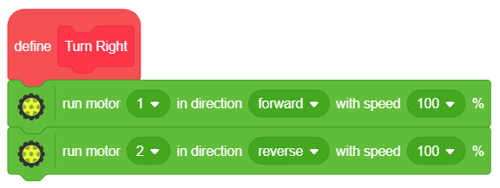
Turn Right
Go to the Data&Blocks palette and create a block named Turn Right.
Go to the Actuators extension and drag and drop the run motor () in direction () with speed () block below the Turn Right definition hat block; set the motor as 1, the direction as forward, and speed as 100 %.
Repeat Step 2; this time set the motor as 2 & direction as reverse.

Slide 14
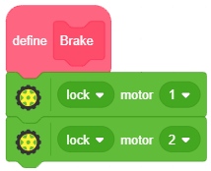
Brake
Go to the Data&Blocks palette and create a block named Brake.
Go to the Actuators extension and drag and the drop the () motor () block below the Brake definition hat block and set the motor as 1 and condition lock.
Repeat Step 2; this time set the motor as 2.

Slide 15
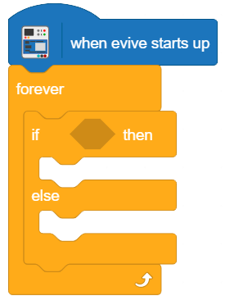
Setting up loop
Drag and drop when evive starts up block from evive extension.
Snap forever block from control palette below when evive starts up block.
Snap if then block from control palette inside the forever block.

Slide 16
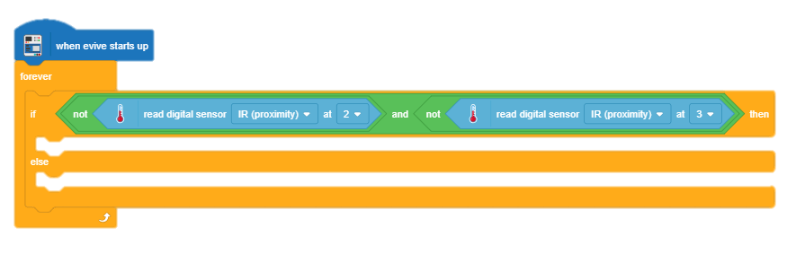
Main Script
To check the states of the sensors, we'll use the and, and not blocks.
For the first case, where both sensors are active, drag and drop the () and () block from the Operators palette in the space in the if arm of the if-else block.

Slide 17
Main Script
Next, take two not () block and drop them into the two spaces of the () and () block.
In the first not () block drag and drop the read state of digital pin () block from the evive extension and set the digital pin as 2.
Repeat the process for the second not () block; this time, set the digital pin as 3.

Slide 18
Main Script
Drag and drop the Go Straight block from the Data&Blocks palette below if arm as shown in the main script.
Below the else arm of the if-else block, drag and drop another if-else block.
Do this for other two cases as well.

Slide 19
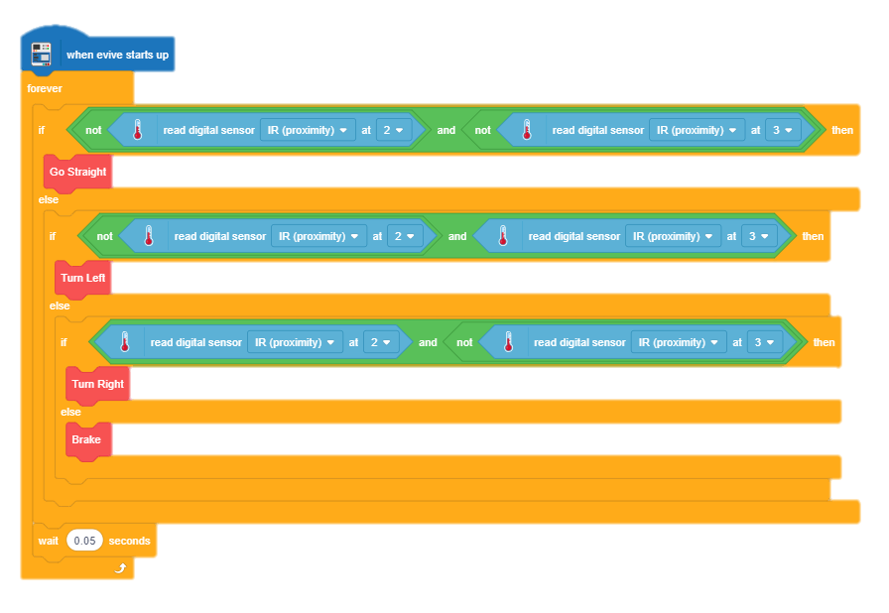
Main Script

Slide 20
Uploading the code
Select the mode a Upload Mode.

Slide 21
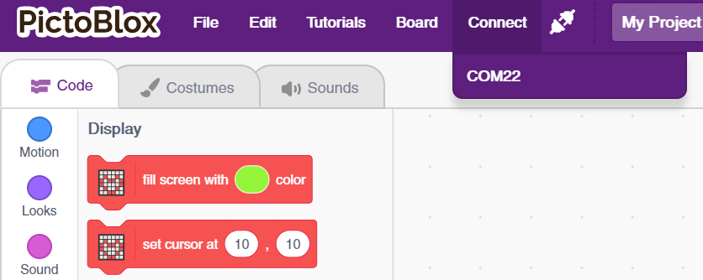
Uploading the code
Connect evive to computer and choose the appropriate COM port.

Slide 22
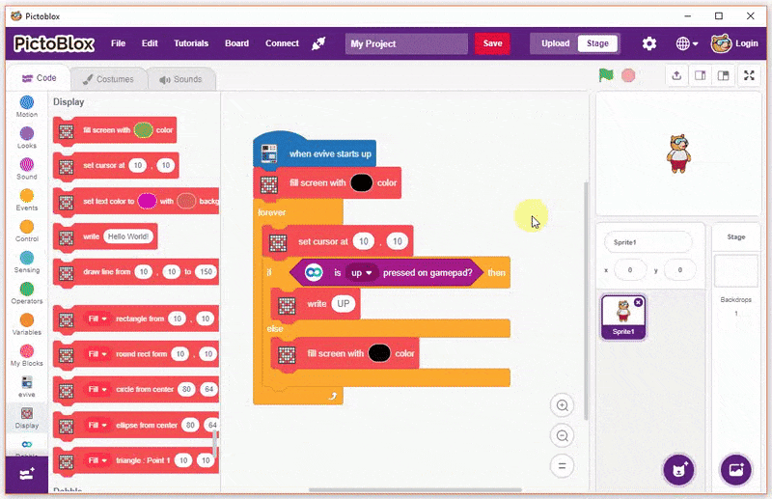
Uploading the code
Click on upload code button.

