Slide 1
Follow Me Robot Assembly and Circuitry

Slide 2
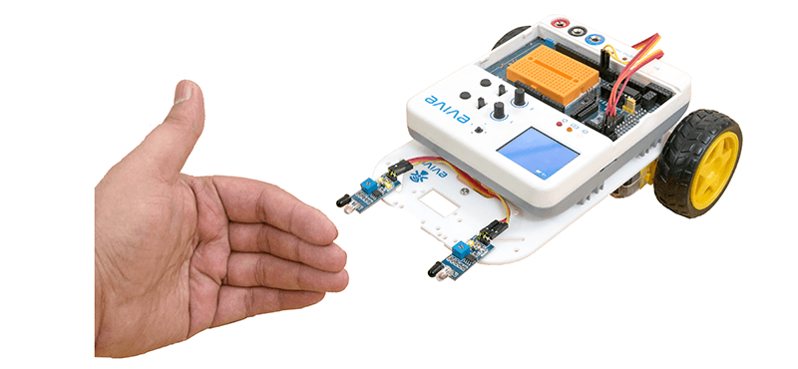
Follow Me Robot
Follow me robot is an autonomous robot, which uses two IR sensors to follow the object in front of the robot.

Slide 3
Assembly of the Robot

Slide 4
Start with Basic Structure

Slide 5
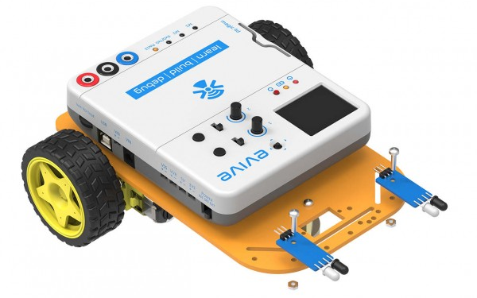
STEP 6
Fasten the two sensors at the top of the chassis using 12mm M3 bolts and M3 nuts, as shown in the figure below:

Slide 6
Assembly is done

Slide 7
Calibrating Motor using Menu

Slide 8
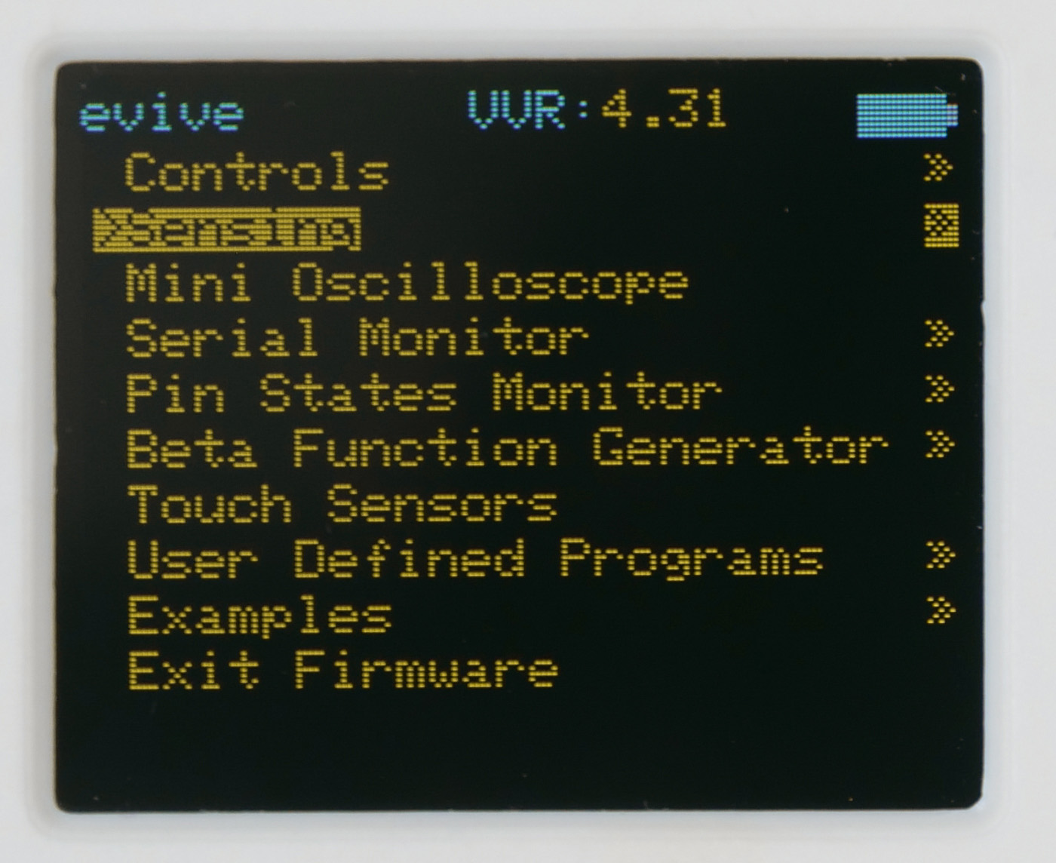
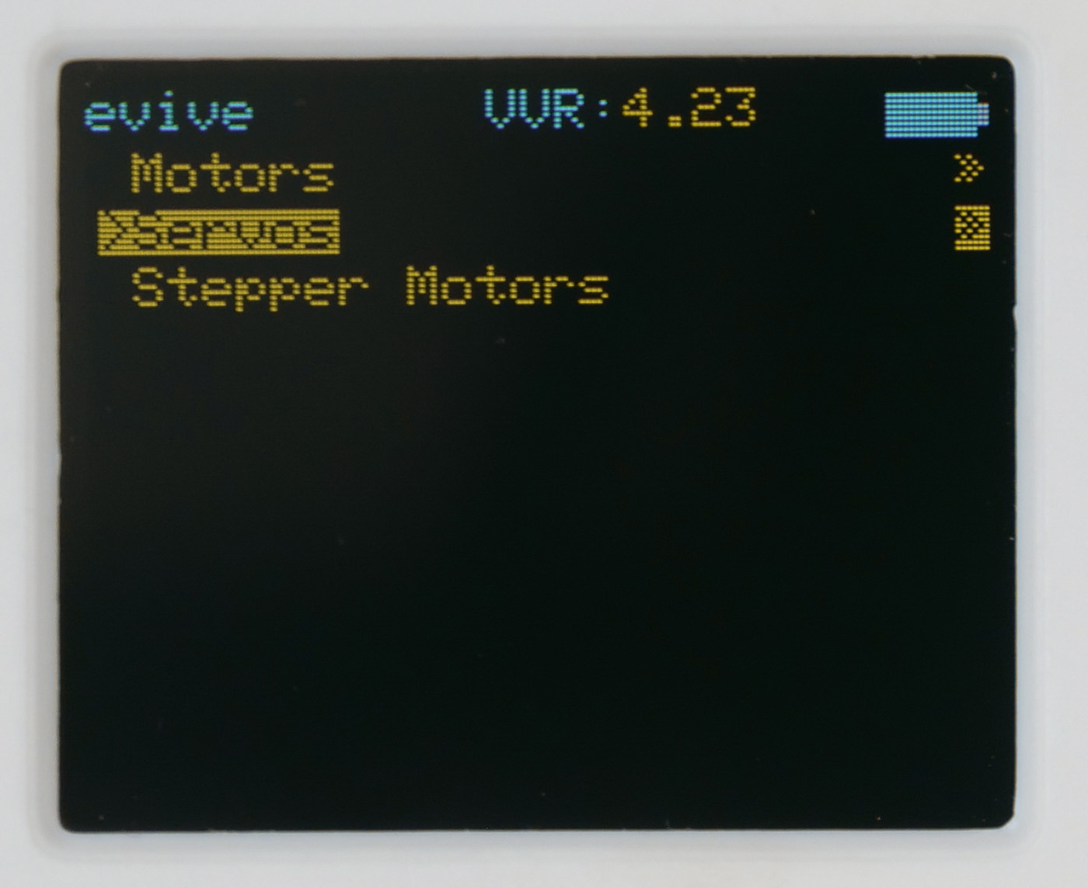
Calibrating Motor using Menu
Switch ON your evive.
The first option in the menu that appears on the screen is Controls; select that option by pressing the control button to the right.
Once you select it, you’ll see three more options, namely Motors, Servos, and Stepper Motors; select Motors.

Slide 9
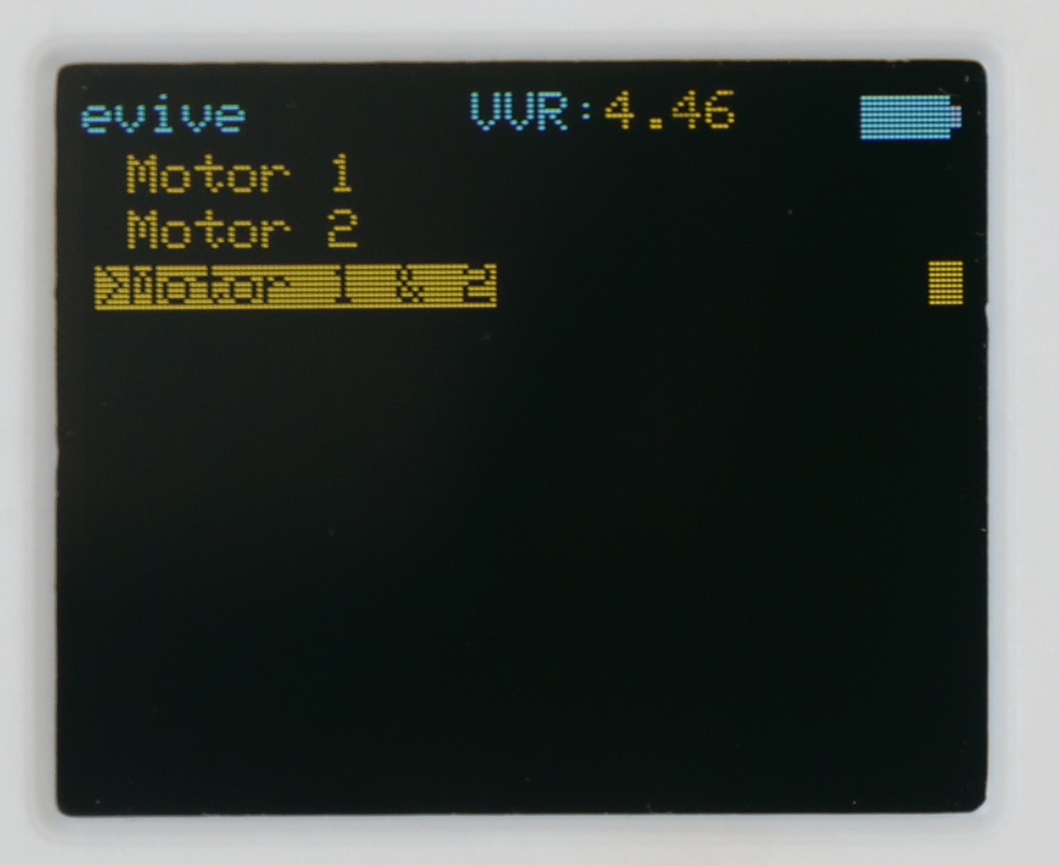
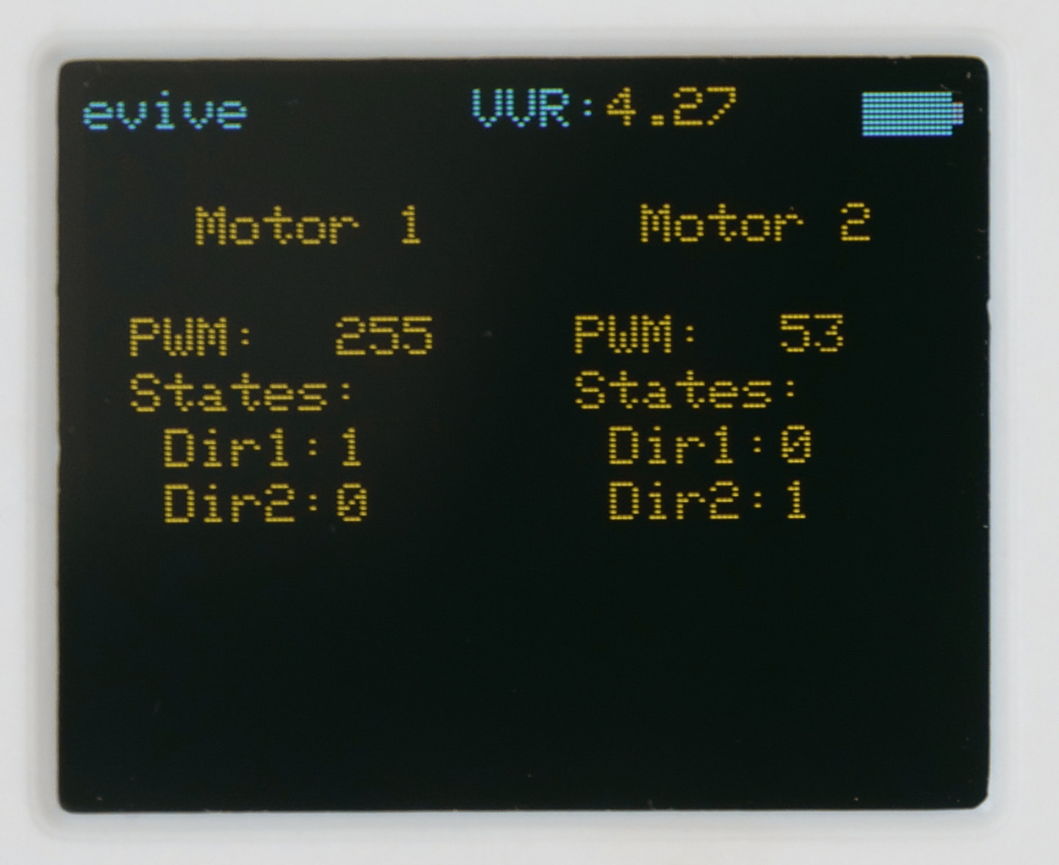
Calibrating Motor using Menu
From the three options that now appear on the screen, select Motor 1 & 2. The following screen will appear:

Slide 10
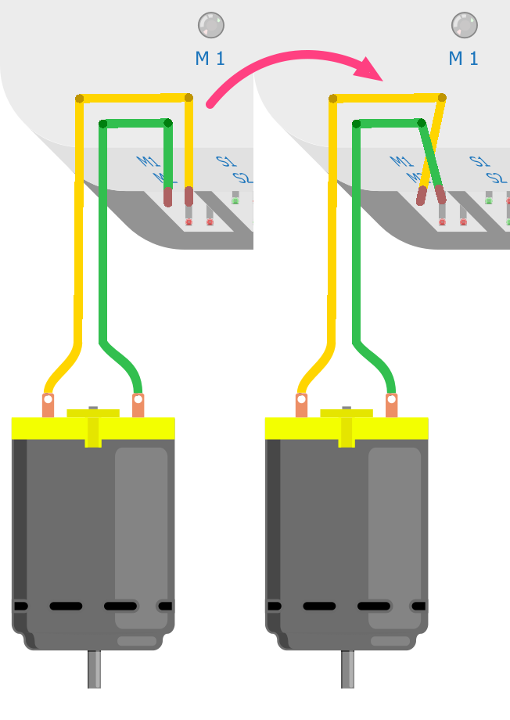
Calibrating Motor using Menu
Run the motor 1 in the forward direction. If the left motor starts running in the forward direction, then everything is ok.
If the motor is running backwards, then swap the wires to change the direction.

Slide 11
Calibrating Motor using Menu
But if instead of left motor, right motor is running, then swap the motor connections.

Slide 12
Calibrating Motor using Menu
Stop motor 1 and run motor 2 in forward direction. If the right motor is running forward, then its ok, otherwise swap the motor 2 wires.
Now, try to run the motor forward, backward, left and right using evive menu.

Slide 13
IR Sensor Connections

Slide 14
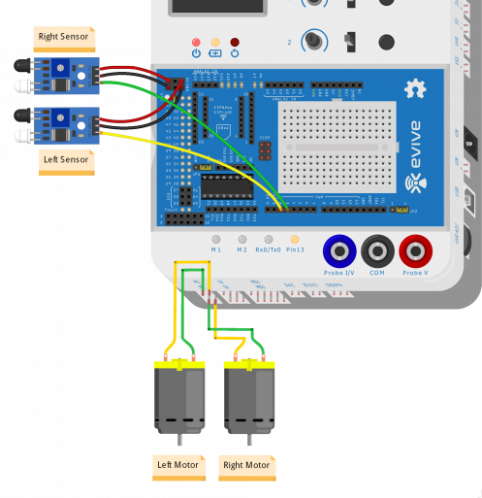
Circuit IR Sensors – Right sensor
VCC of the sensor with 5V on evive.
GND of the sensor with GND on evive.
Signal pin of the sensor with digital pin 3 on evive.

Slide 15
Circuit IR Sensors – Right sensor
VCC of the sensor with 5V on evive.
GND of the sensor with GND on evive.
Signal pin of the sensor with digital pin 2 on evive.

Slide 16
Calibrating IR Sensor

Slide 17
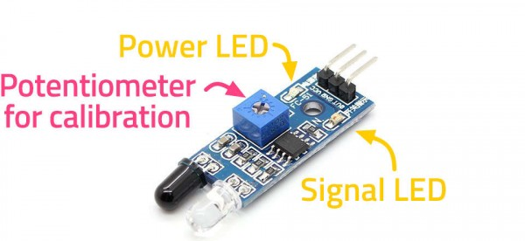
Why calibrate?
Because if the sensors are not calibrated, the robot might not do what it has been asked to, i.e. follow the object.
An IR sensor is a proximity sensor or a ‘nearness’ sensor that detects objects within a given distance, without touching them.
The sensor you’re using detects objects present within a range of 5-10 cm from it.

Slide 18
IR sensor
An IR sensor has two small LED indicators – one for power, which is ON the entire time the sensor is ON; the other is the Signal LED which detects the object.
The signal LED has two states or situations:
ON (Active) when it detects an object
OFF (Inactive) when it doesn’t detect any object

Slide 19
Working
Transmitter LED emits infrared light.
Receiver LED is sensitive to infrared light and detects it.
If there is not object in front, Receiver LED does not receive any IR light.

Slide 20
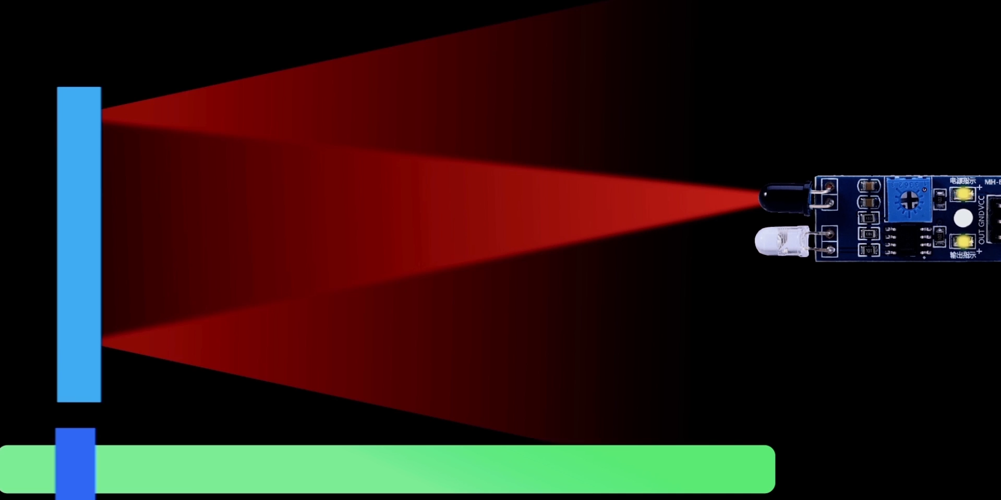
Working
When a object comes near the IR sensor, light gets reflected and falls on receiver, which it detects and LED glows.

Slide 21
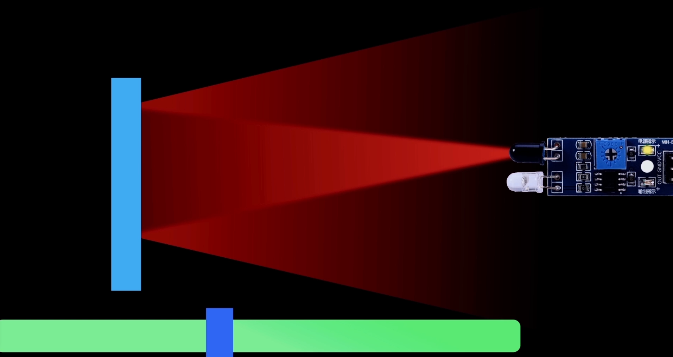
Working
Calibration means setting a value for amount of light or the distance of the object, such that if the object is farther than the threshold sensor would not detect it, and if it is close it will detect it.

Slide 22
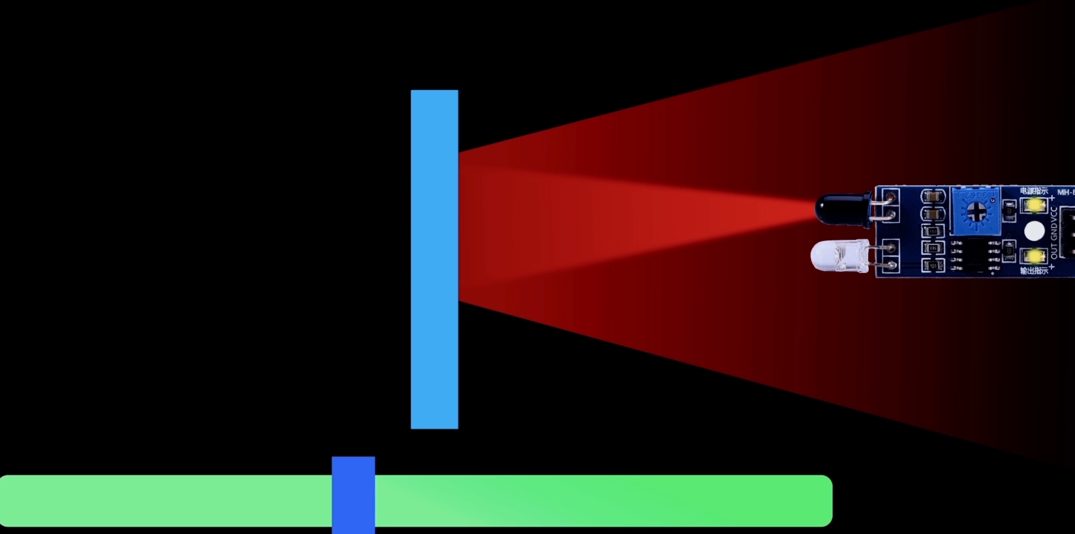
Working
Calibration means setting a value for amount of light or the distance of the object, such that if the object is farther than the threshold sensor would not detect it, and if it is close it will detect it.

Slide 23
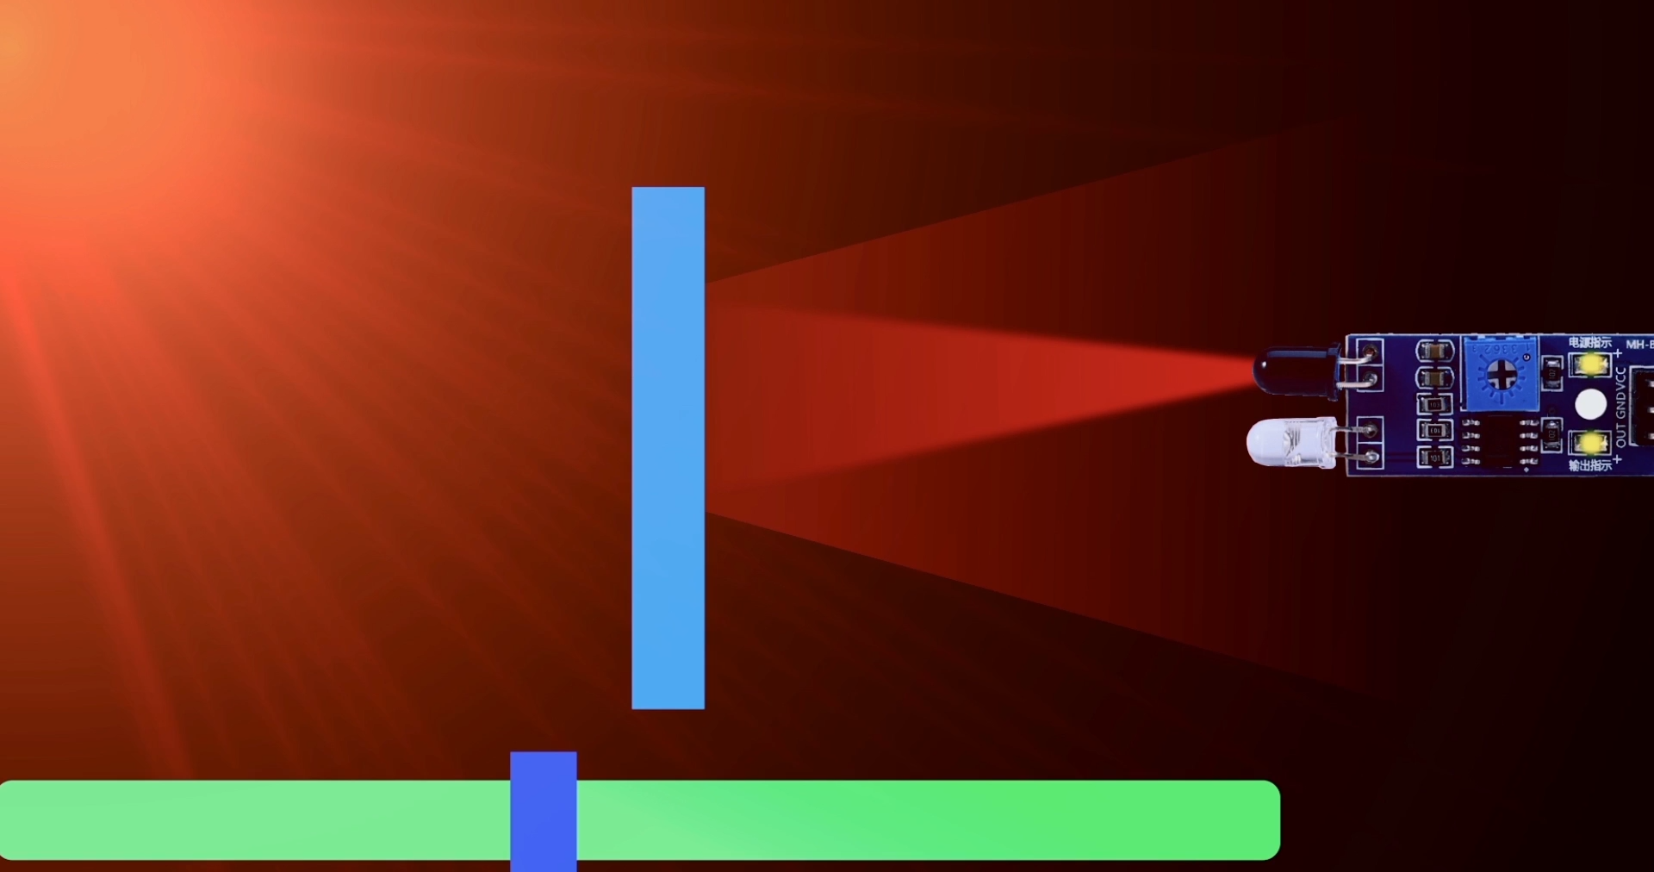
Working
IR sensor do not work in sunlight, as there are already IR rays in sunlight.

Slide 24
Calibration
To calibrate your sensor, place an object at least 15cm away from the robot.
If the signal LED is OFF, the sensor is working properly. Otherwise gently turn the potentiometer (that tiny blue cube with a screw in it) with a screwdriver in the anti-clockwise direction such that the LED turns OFF.
Similarly, place an object about 5cm from the sensor. If the signal LED is ON, then it is working properly. Otherwise turn the potentiometer in the clockwise direction such that the LED turns ON.
And you’re done; your sensor is calibrated.

