Slide 1
Smartphone Controlled Robot

Slide 2
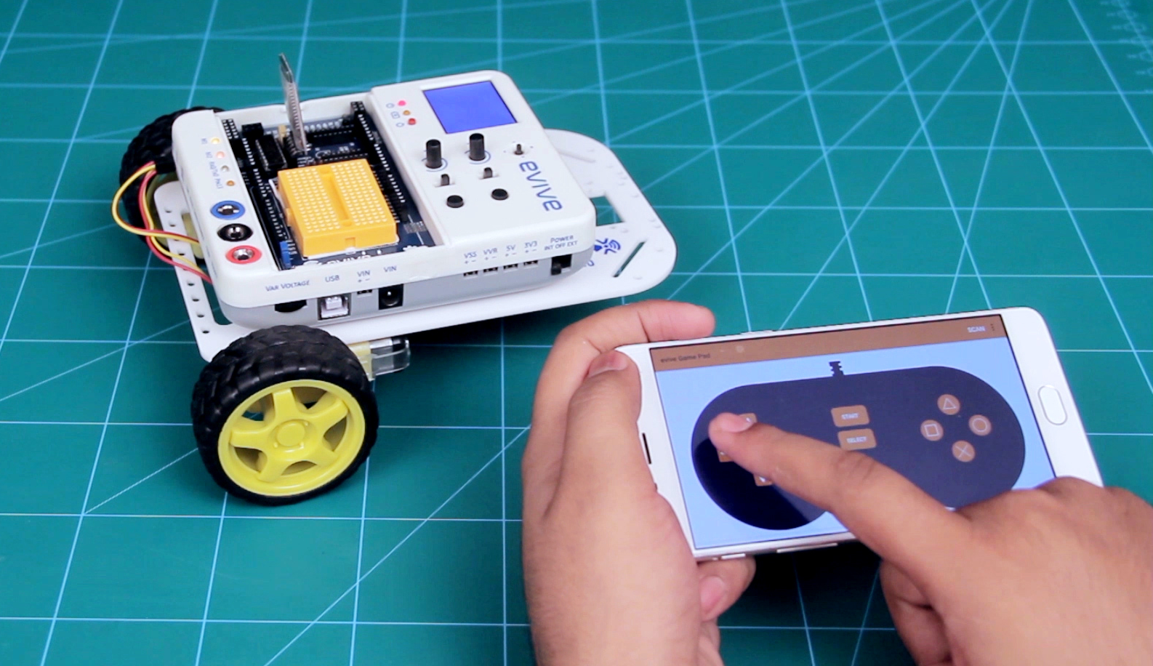
Smartphone Controlled Robot
In a smartphone-controlled robot, the motion of the robot is controlled using the inputs of a smartphone app – Dabble. We will use the gamepad module to control the robot.

Slide 3
Logic Control

Slide 4
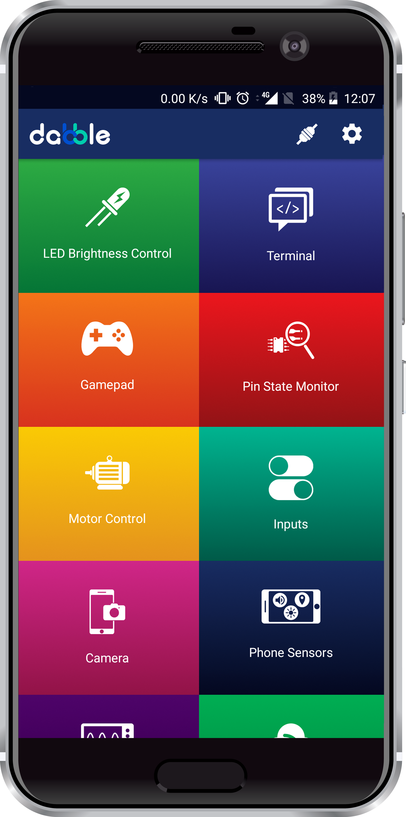
Dabble App
Download the Dabble app from here:

Slide 5
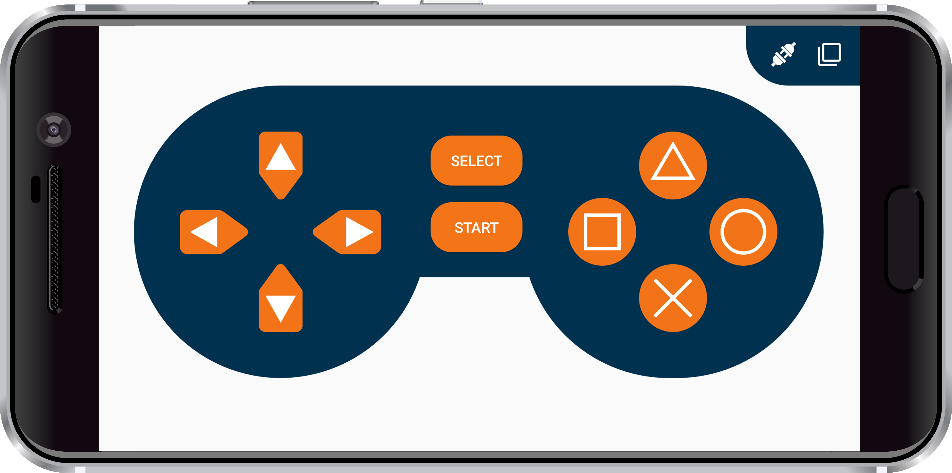
Gamepad Module
The GamePad Module is one of the input modules, using which user can give commands to the device using buttons.
The digital mode is the default mode when the module opens. It has 10 digital buttons whose data is sent to the device when they are pressed or released.

Slide 6
Gamepad Module
Actions to be performed by the Robot:
Up – Go forward
Down – Go backward
Left – Turn left
Right – Turn right
No button pressed - Brake

Slide 7
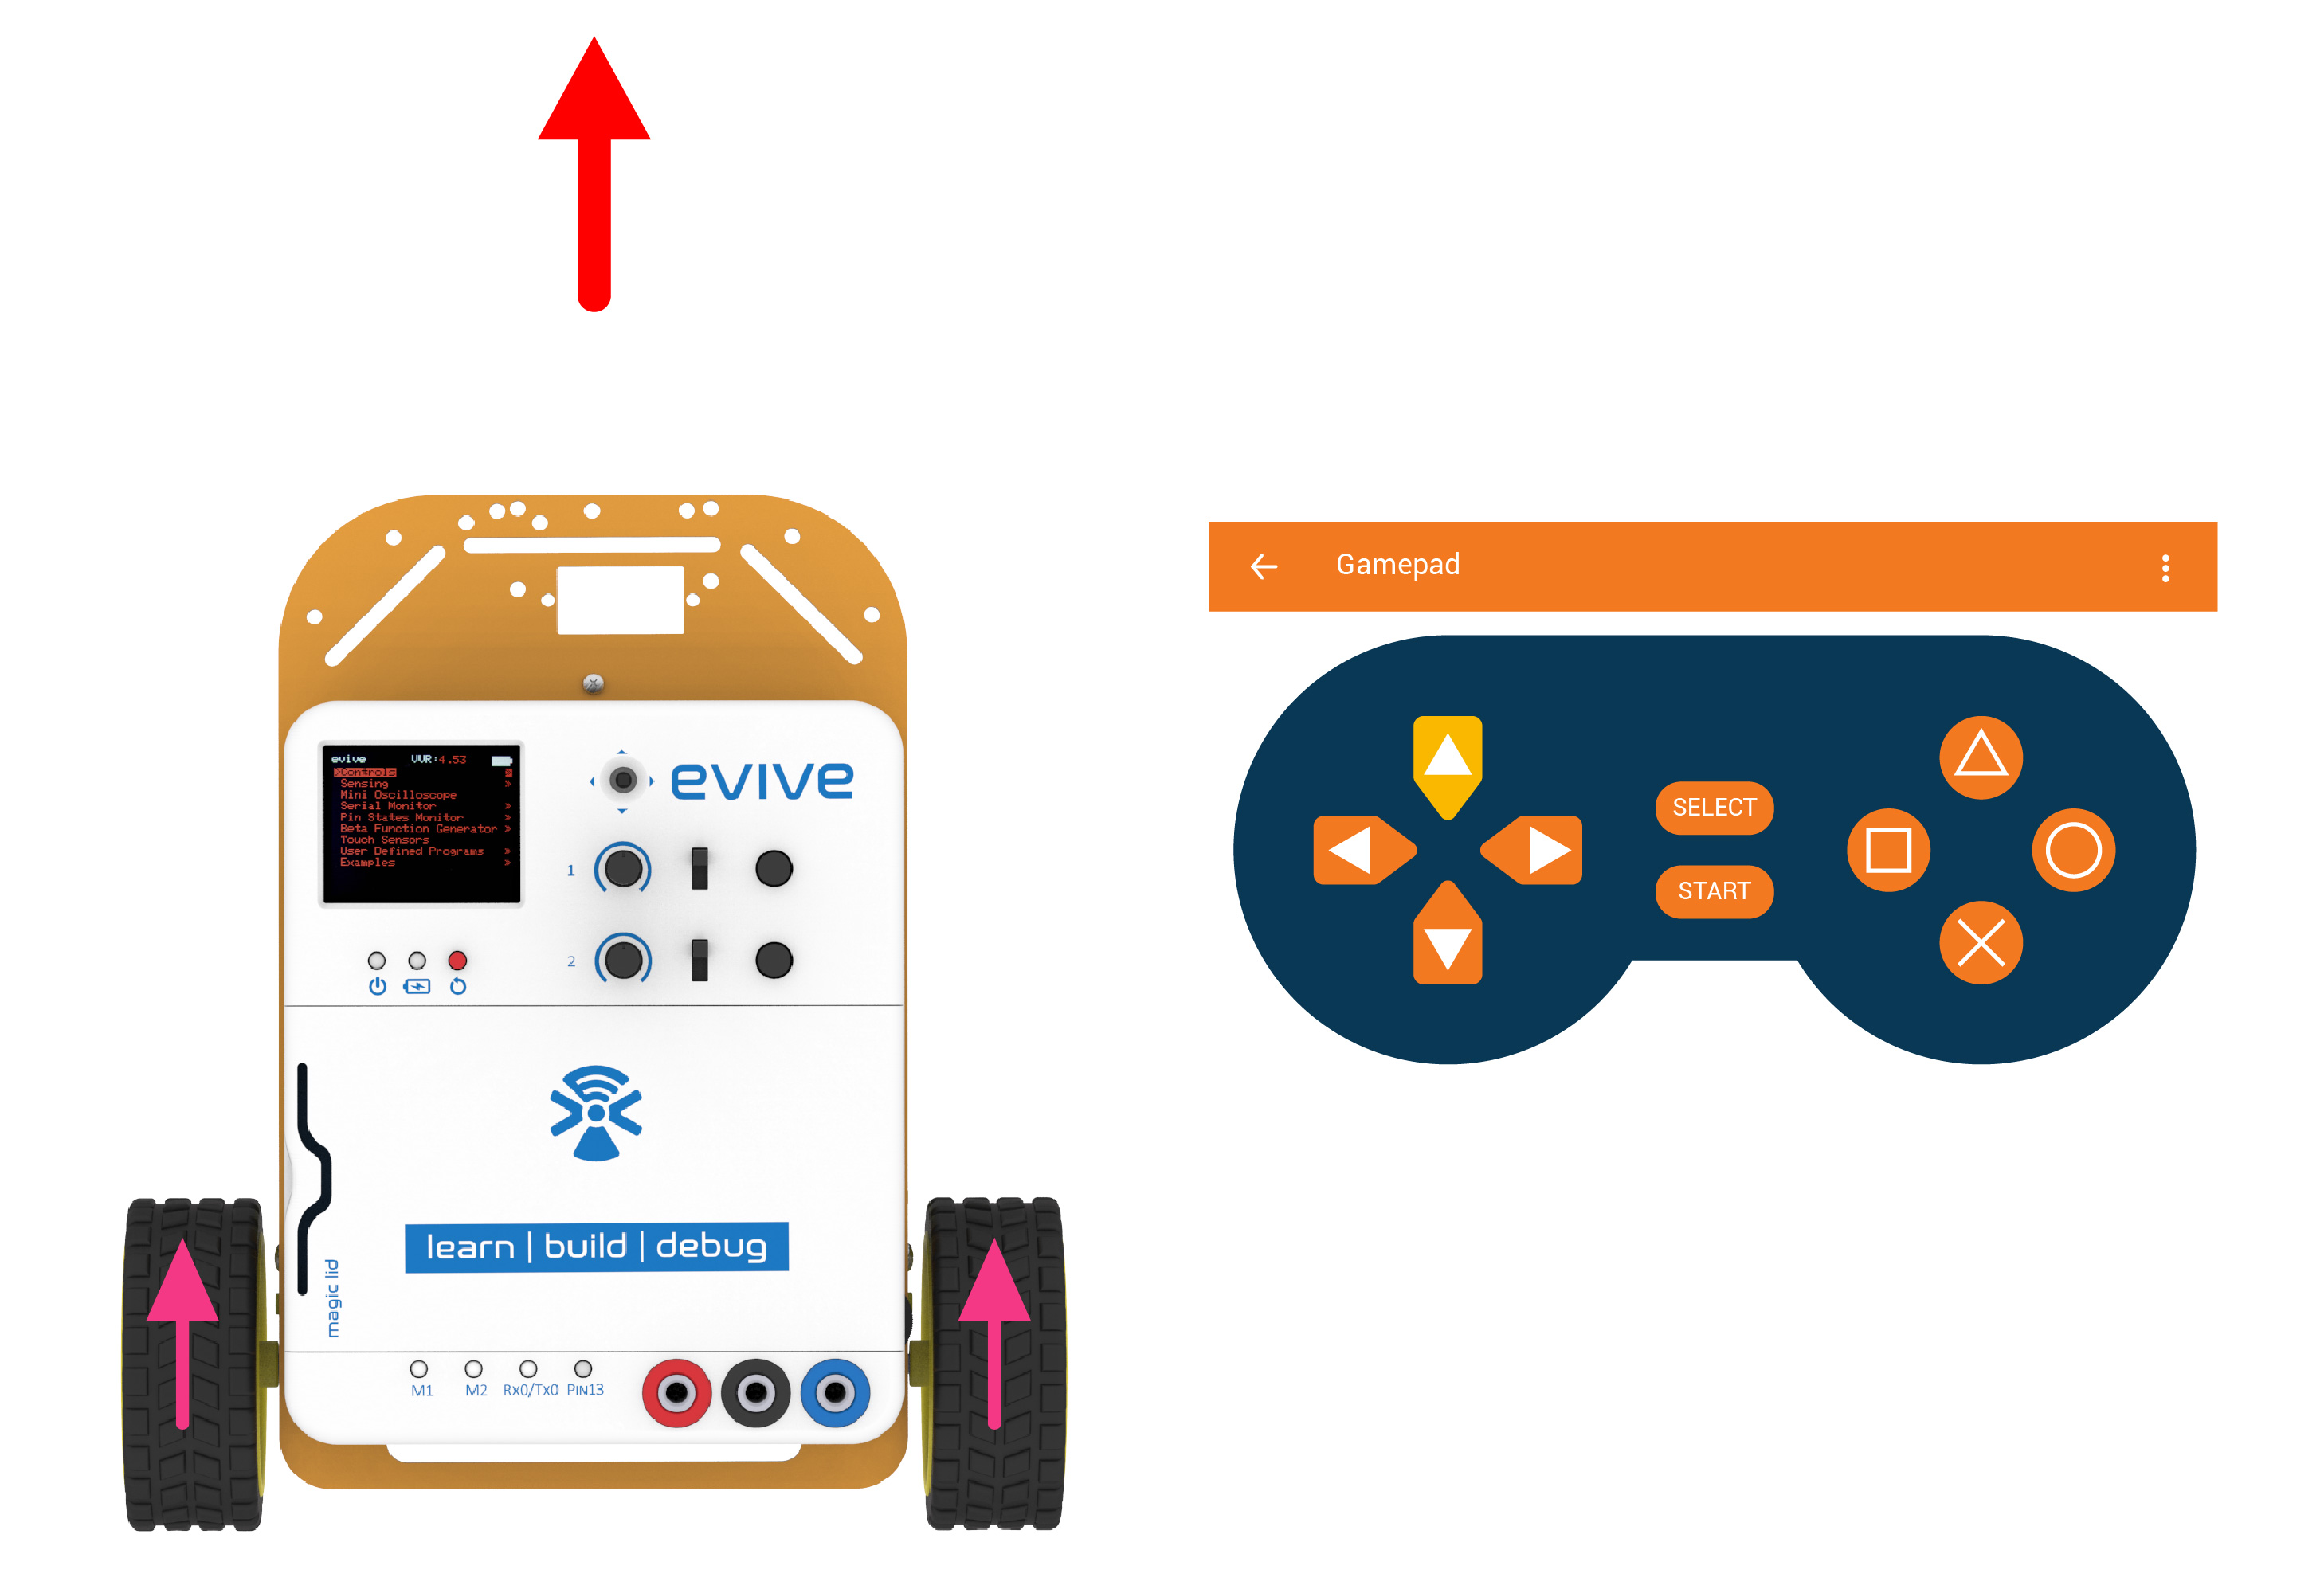
Forward

Slide 8
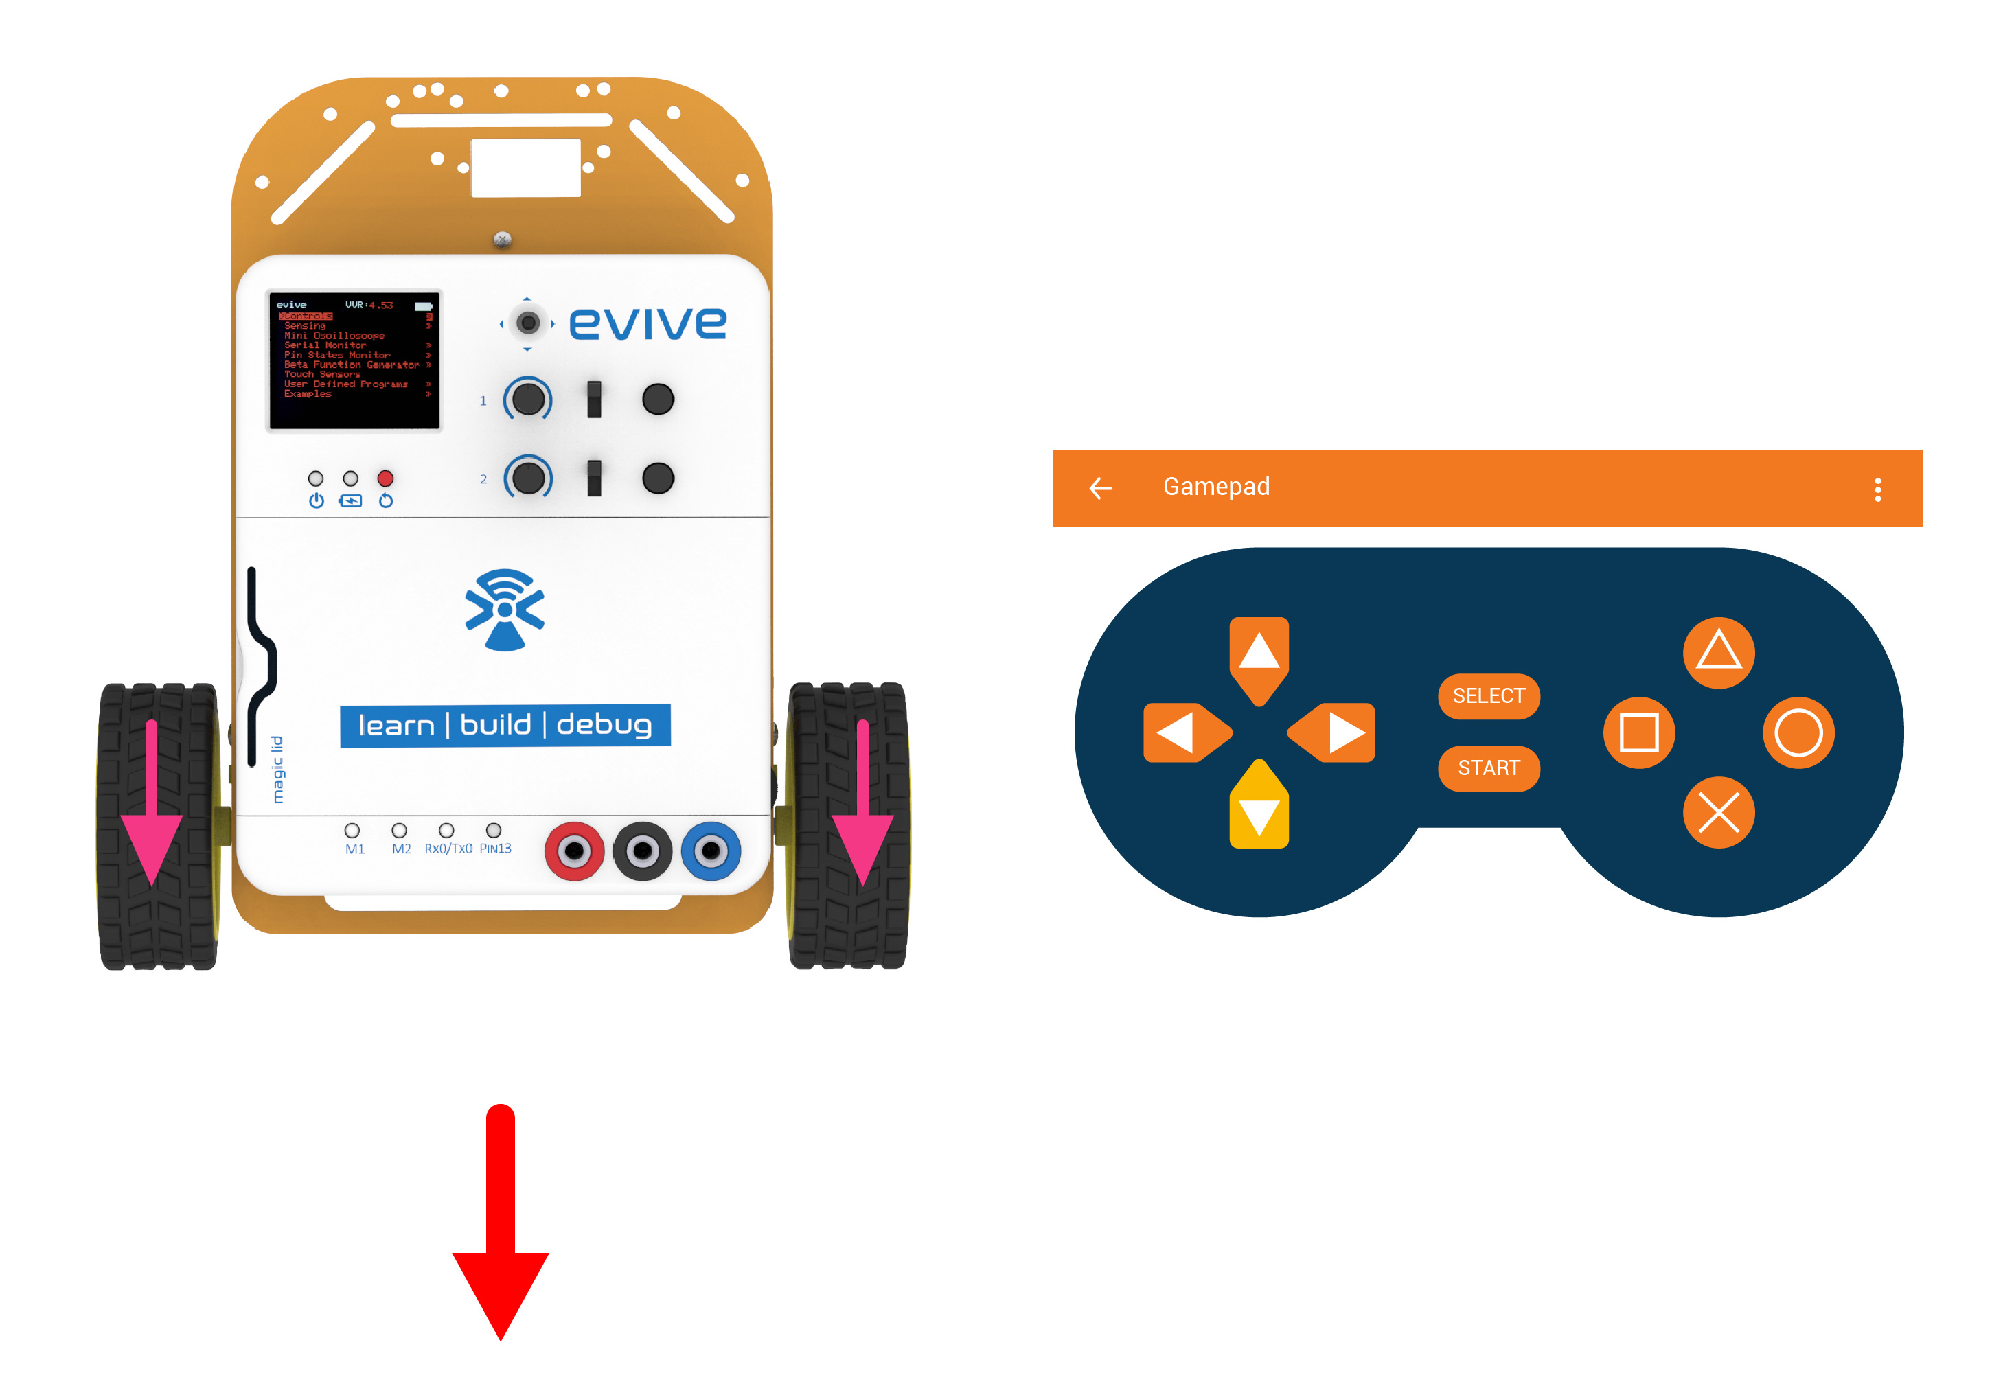
Backward

Slide 9
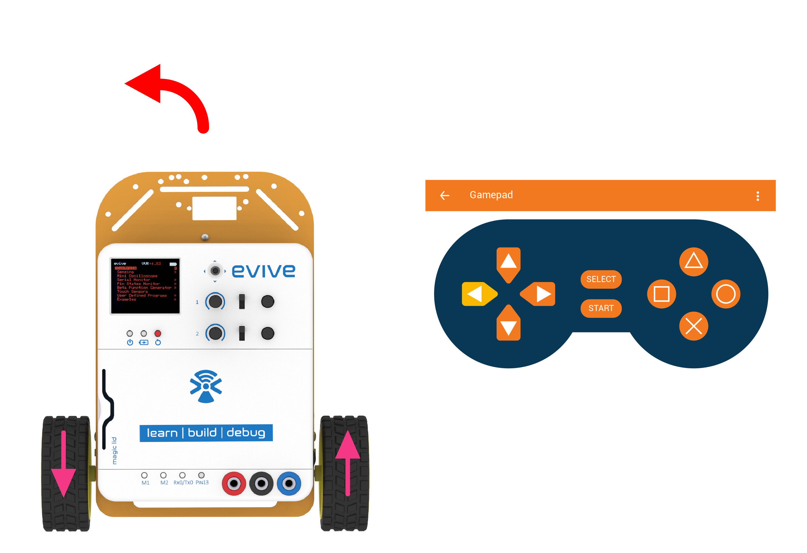
Left

Slide 10
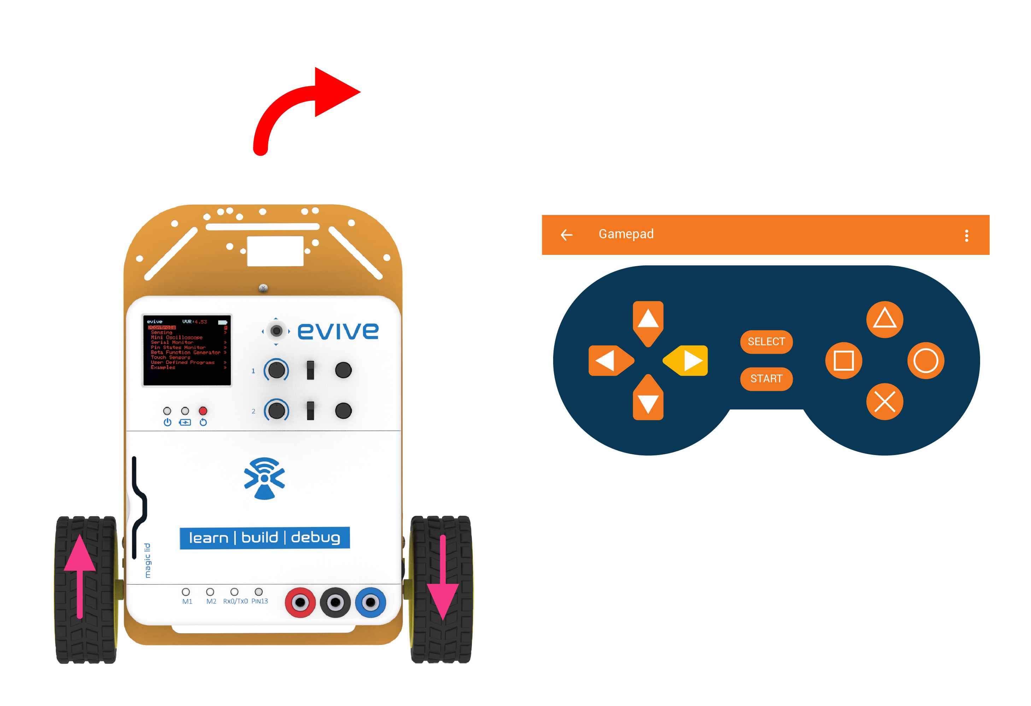
Right

Slide 11
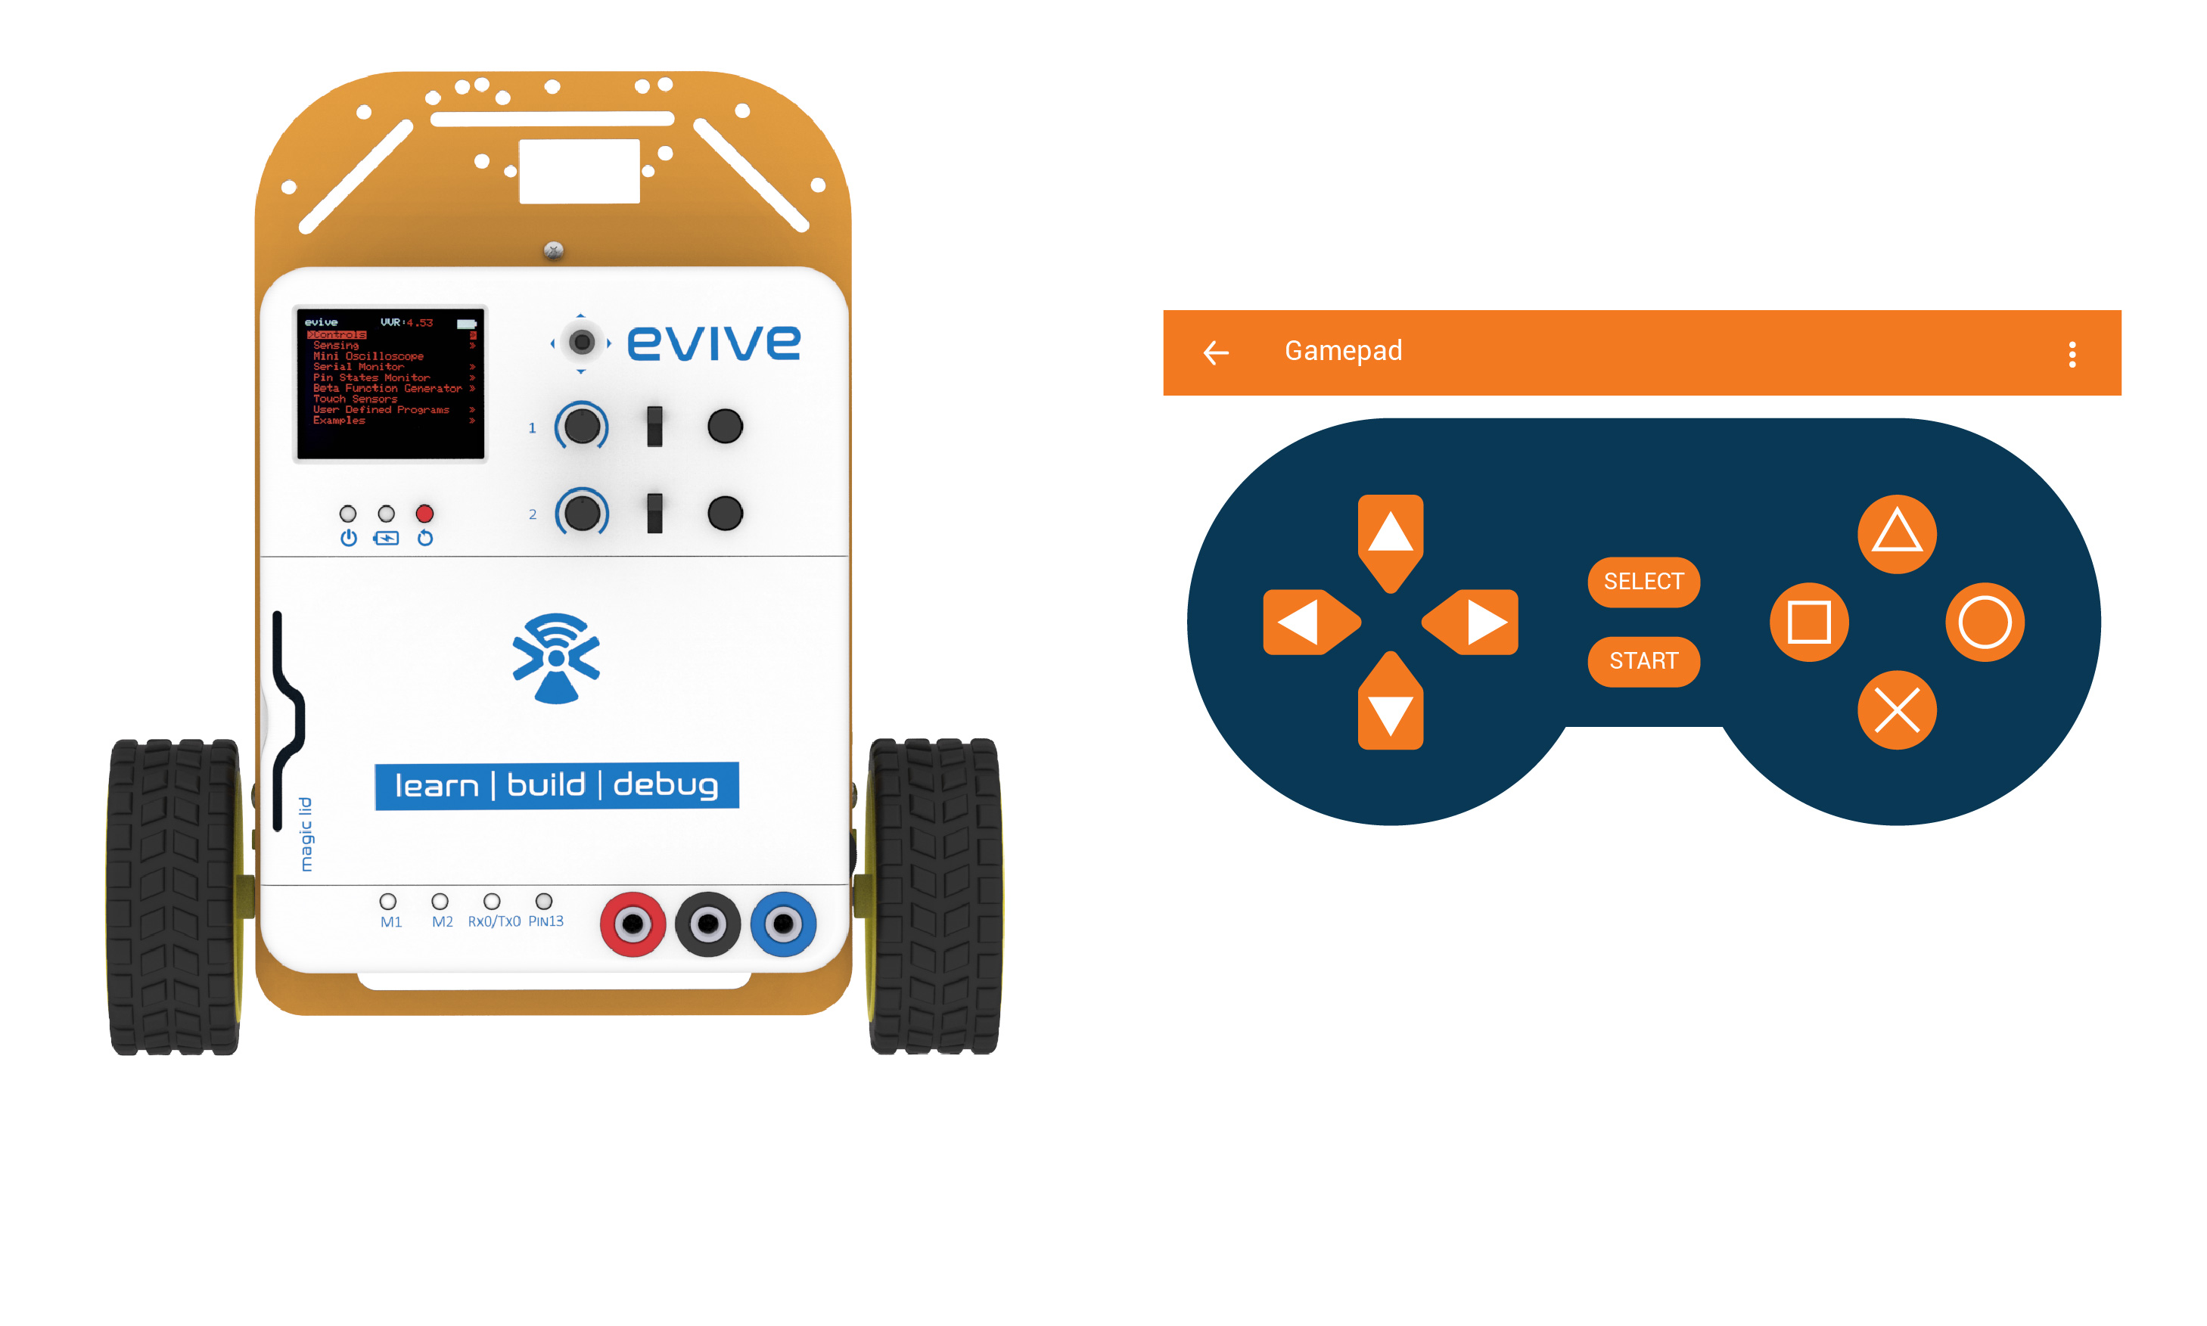
Brake

Slide 12
Programming

Slide 13
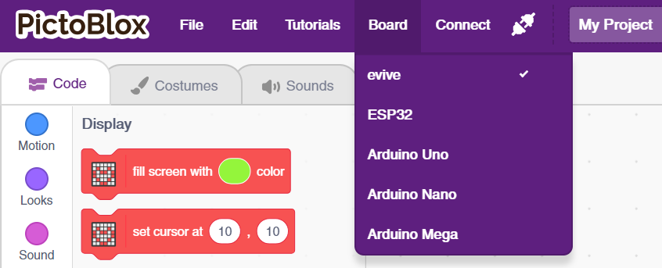
Select Board
Select evive as Board

Slide 14
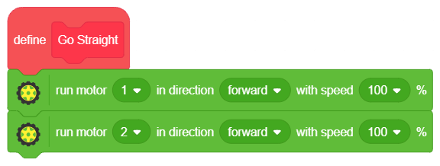
Go Straight
Go to the Data&Blocks palette and create a block named Go Straight.
Go to the Actuators extension and drag and drop the run motor () in direction () with speed () block below the Go Straight definition hat block; set the motor as 1, the direction as forward, and speed as 100 %.
Repeat Step 2; this time set the motor as 2.

Slide 15
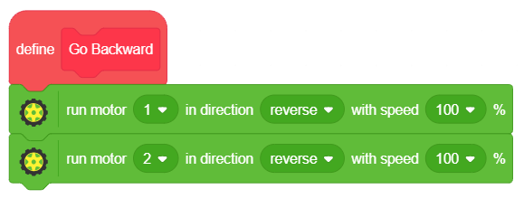
Go Backward
Go to the Data&Blocks palette and create a block named Go Backward.
Go to the Actuators extension and drag and drop the run motor () in direction () with speed () block below the Go Backward definition hat block; set the motor as 1, the direction as reverse, and speed as 100 %.
Repeat Step 2; this time set the motor as 2 & direction as reverse.

Slide 16
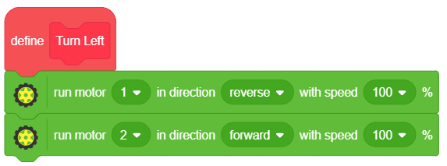
Turn Left
Go to the Data&Blocks palette and create a block named Turn Left.
Go to the Actuators extension and drag and drop the run motor () in direction () with speed () block below the Turn Left definition hat block; set the motor as 1, the direction as reverse, and speed as 100 %.
Repeat Step 2; this time set the motor as 2 & direction as forward.

Slide 17
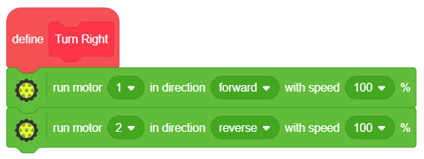
Turn Right
Go to the Data&Blocks palette and create a block named Turn Right.
Go to the Actuators extension and drag and drop the run motor () in direction () with speed () block below the Turn Right definition hat block; set the motor as 1, the direction as forward, and speed as 100 %.
Repeat Step 2; this time set the motor as 2 & direction as reverse.

Slide 18
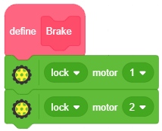
Brake
Go to the Data&Blocks palette and create a block named Brake.
Go to the Actuators extension and drag and the drop the () motor () block below the Brake definition hat block and set the motor as 1 and condition lock.
Repeat Step 2; this time set the motor as 2.

Slide 19
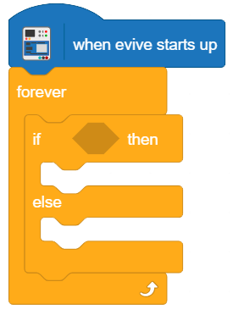
Setting up loop
Drag and drop when evive starts up block from evive extension.
Snap forever block from control palette below when evive starts up block.
Snap if then block from control palette inside the forever block.

Slide 20
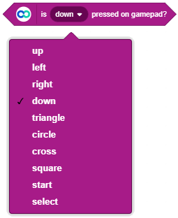
Is () pressed on gamepad?
Is () pressed on gamepad? block reports whether the selected button is pressed or not?
If the block is pressed, then it return 1, else 0.

Slide 21
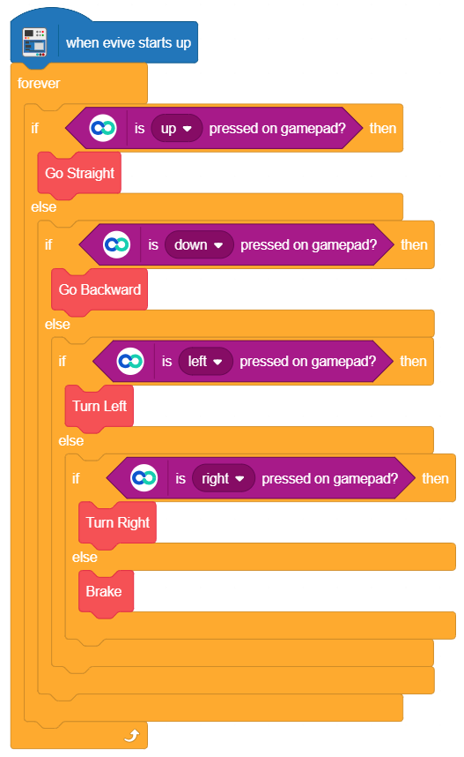
Main Program

Slide 22
Uploading the code
Select the mode a Upload Mode.

Slide 23
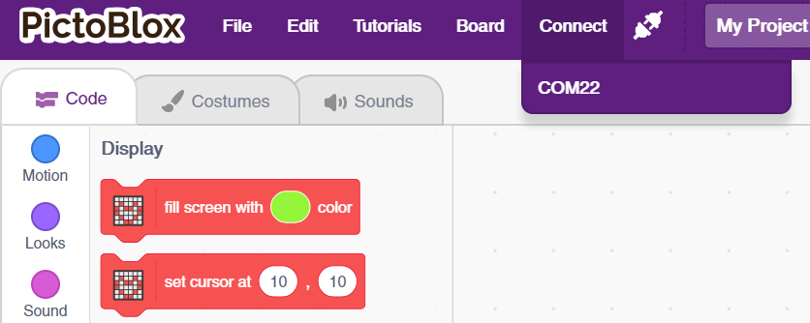
Uploading the code
Connect evive to computer and choose the appropriate COM port.

Slide 24
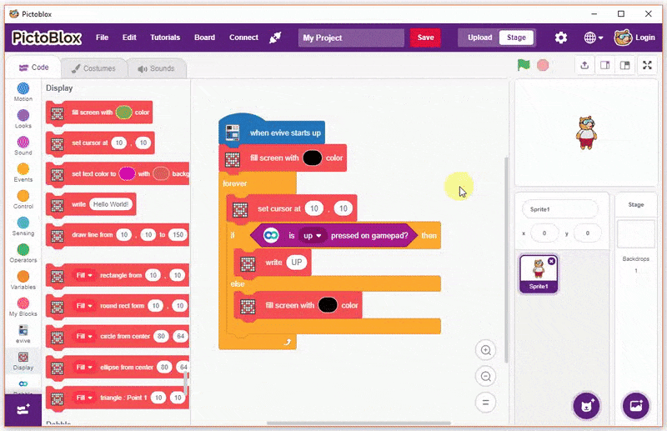
Uploading the code
Click on upload code button.

Slide 25
Controlling Robot

Slide 26
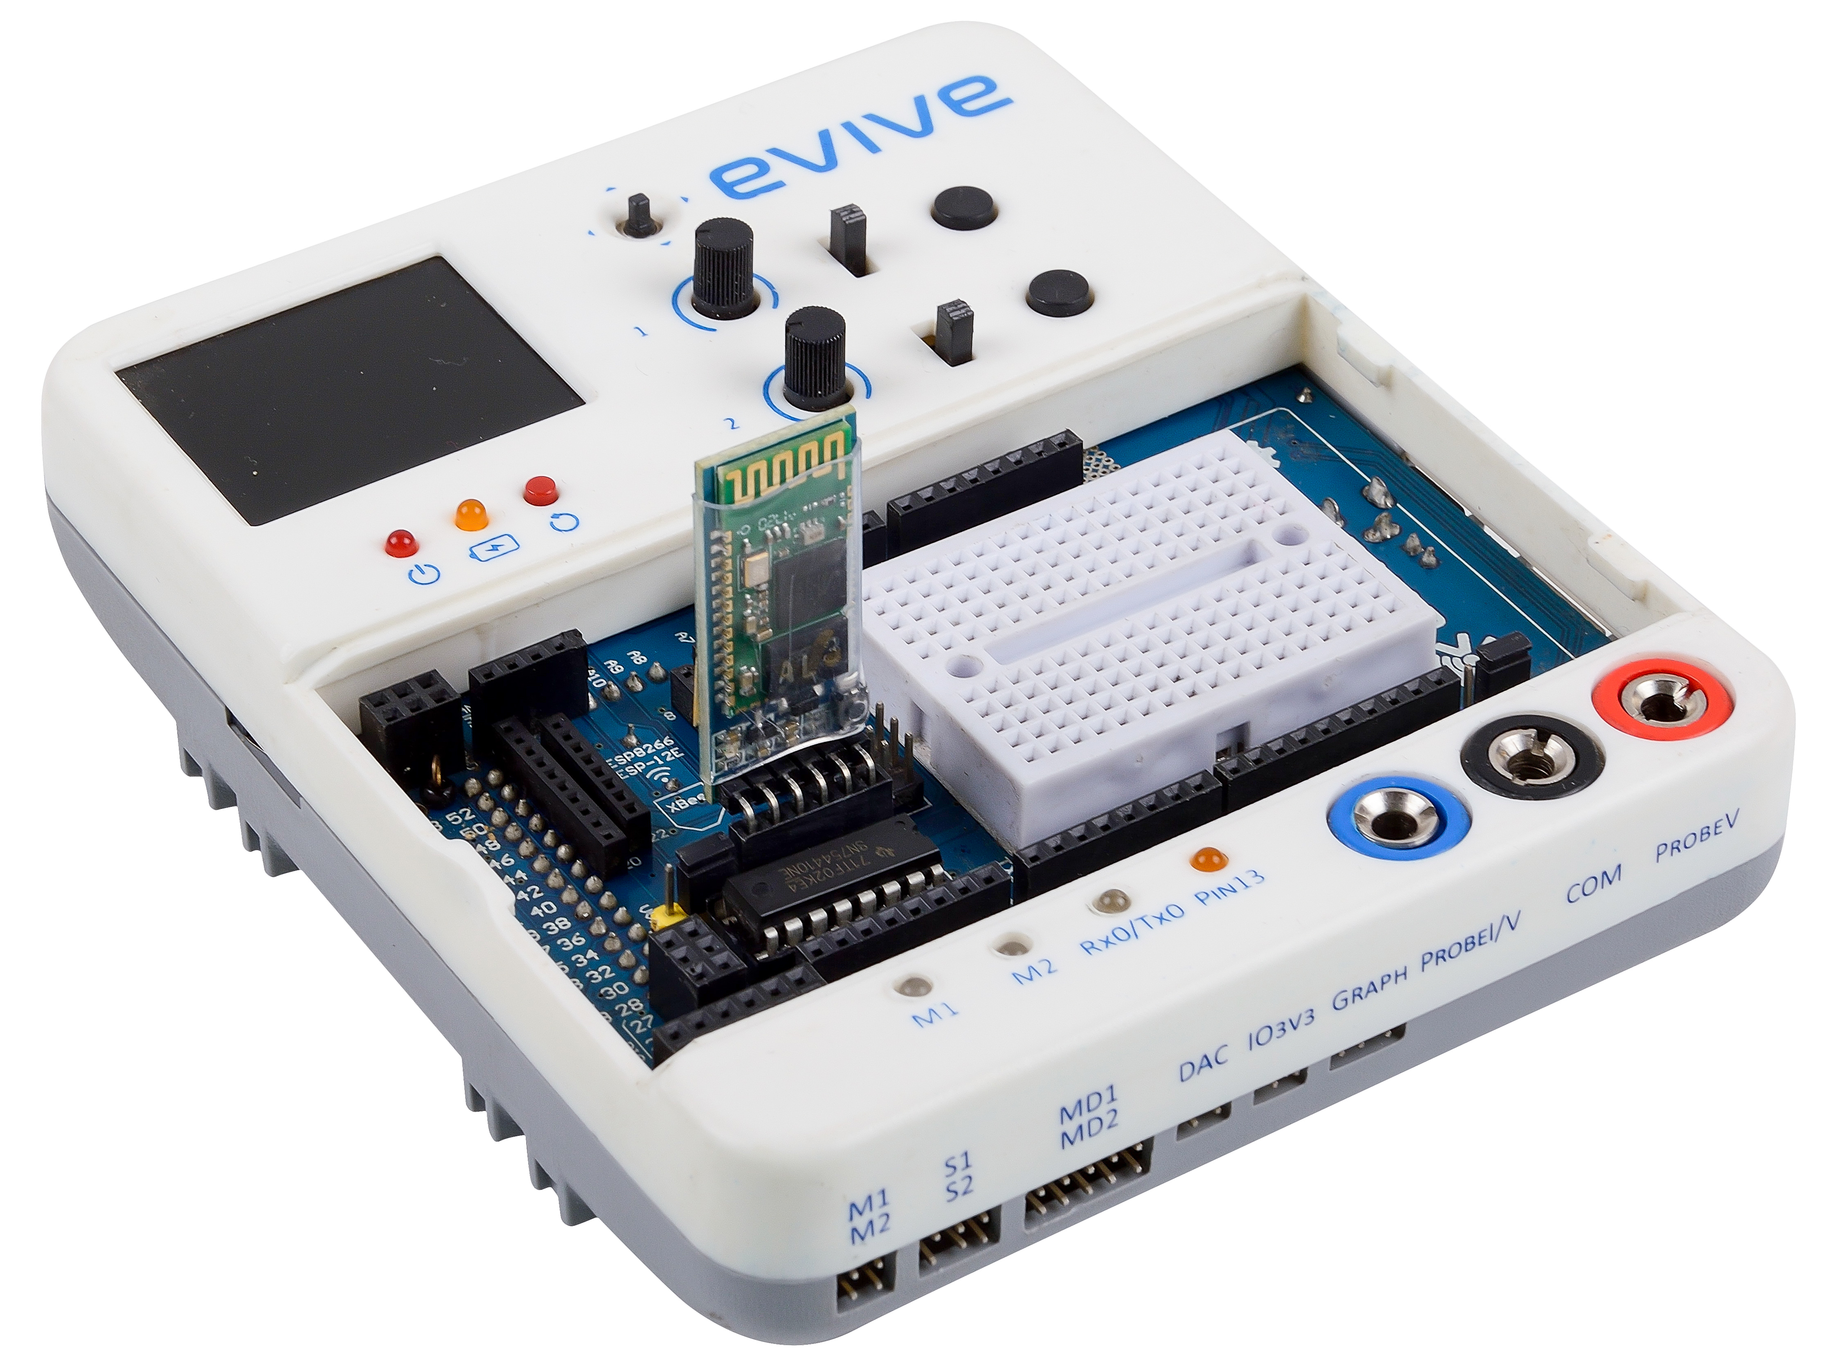
Connect the Bluetooth (HC 05)

Slide 27
Connecting to smartphone
Turn on evive.
Click on connect icon on top right corner of dabble.

Slide 28
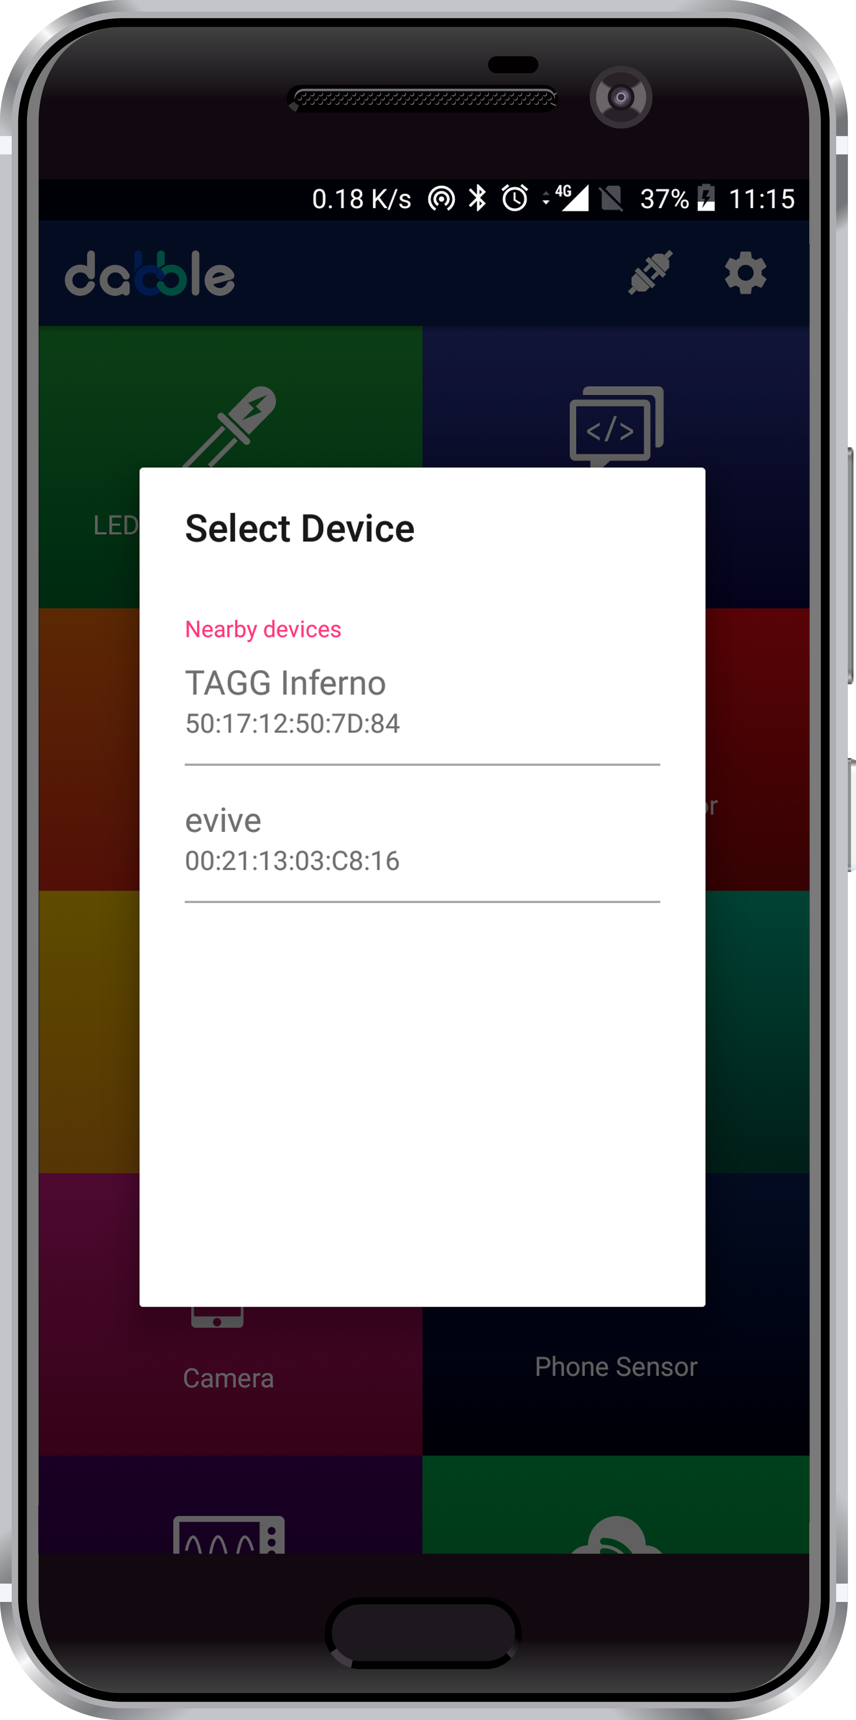
Connecting to smartphone
List of available devices will come.
Select the appropriate Bluetooth module from the list.

Slide 29
Debugging the Robot

Slide 30
Debugging
If on clicking the up button, robot is not going forward, then follow the steps:
Ensure that left motor is connected to M1 and right to M2.
Click on up button and identify, which wheel is moving in reverse direction.
If left motor is moving in reverse direction, take the motor cable out and connect it reverse manner.
If right motor is moving in reverse direction, take the motor cable out and connect it reverse manner.
Test your robot. It will work fine now.

