Slide 1
Smartphone Controlled Robot Circuitry

Slide 2
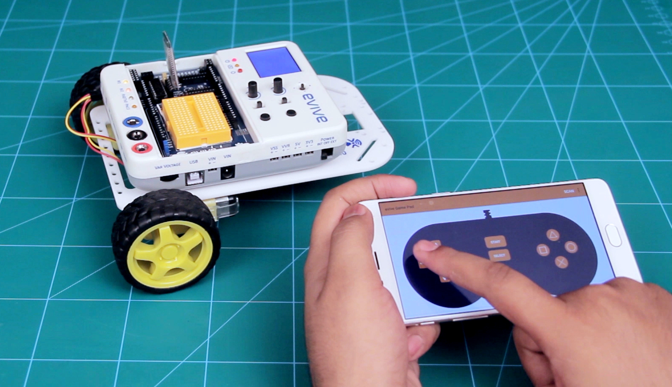
Smartphone Controlled Robot
In a smartphone-controlled robot, the motion of the robot is controlled using the inputs of a smartphone app – Dabble. We will use the gamepad module to control the robot.

Slide 3
Circuitry

Slide 4
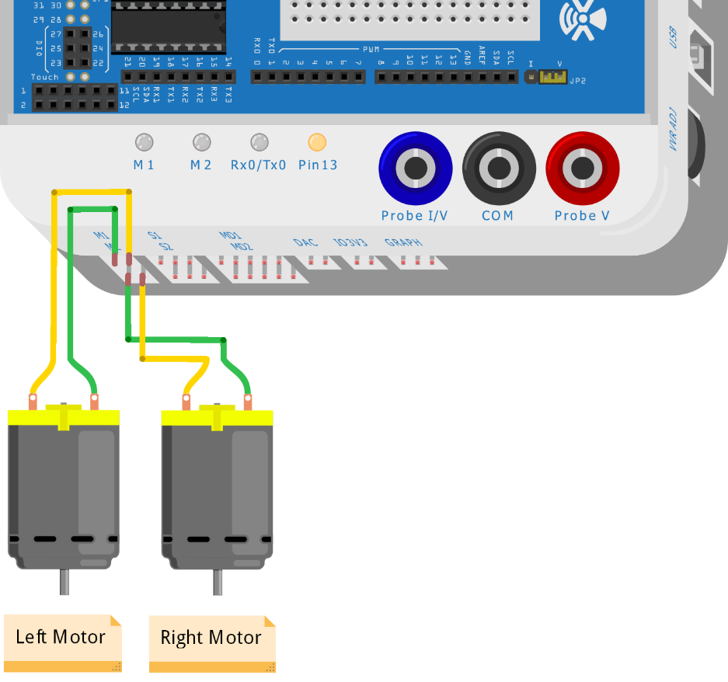
Connect the Motors

Slide 5
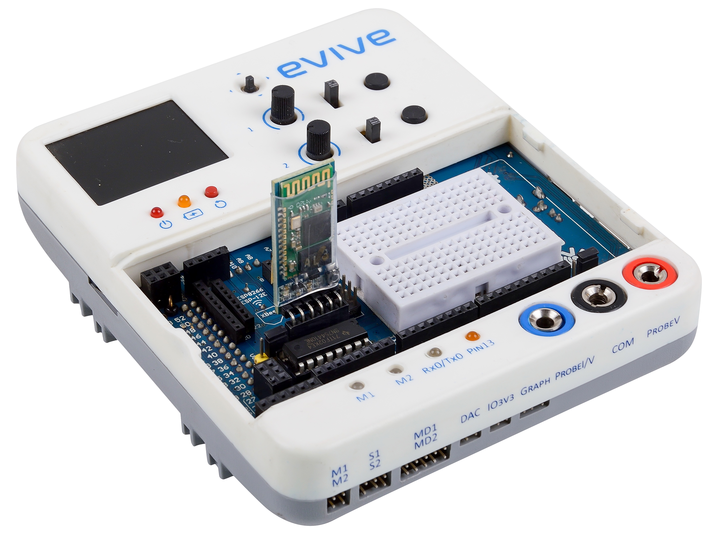
Connect the Bluetooth (HC 05)

Slide 6
Controlling Robot using evive Menu

Slide 7
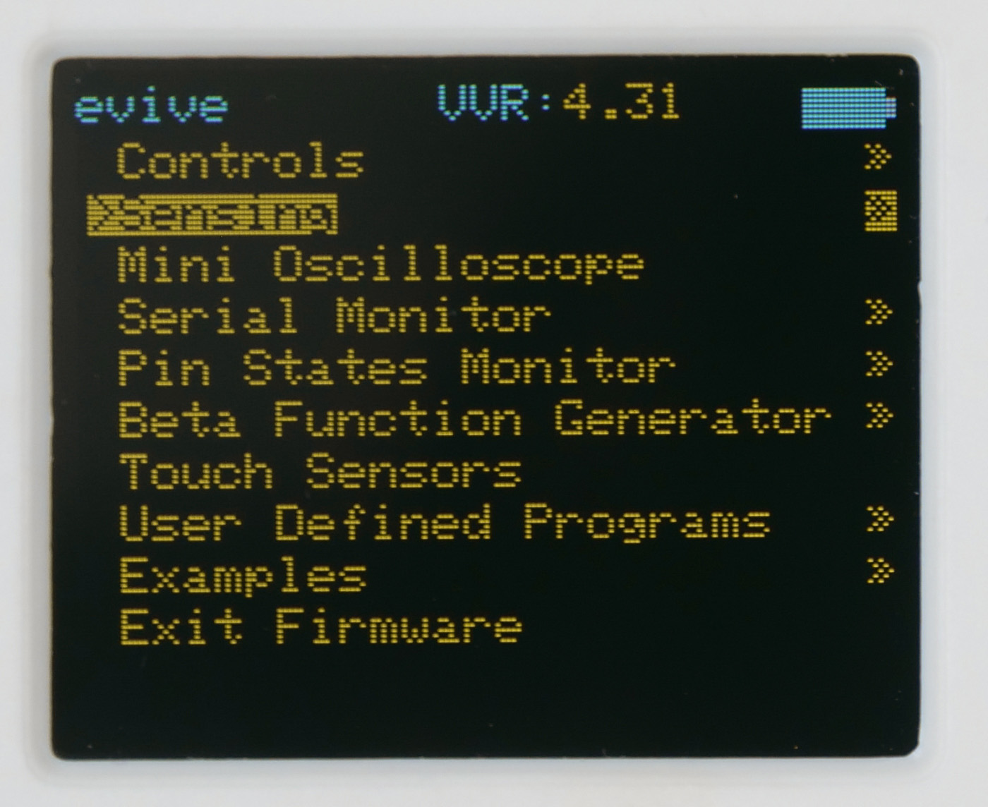
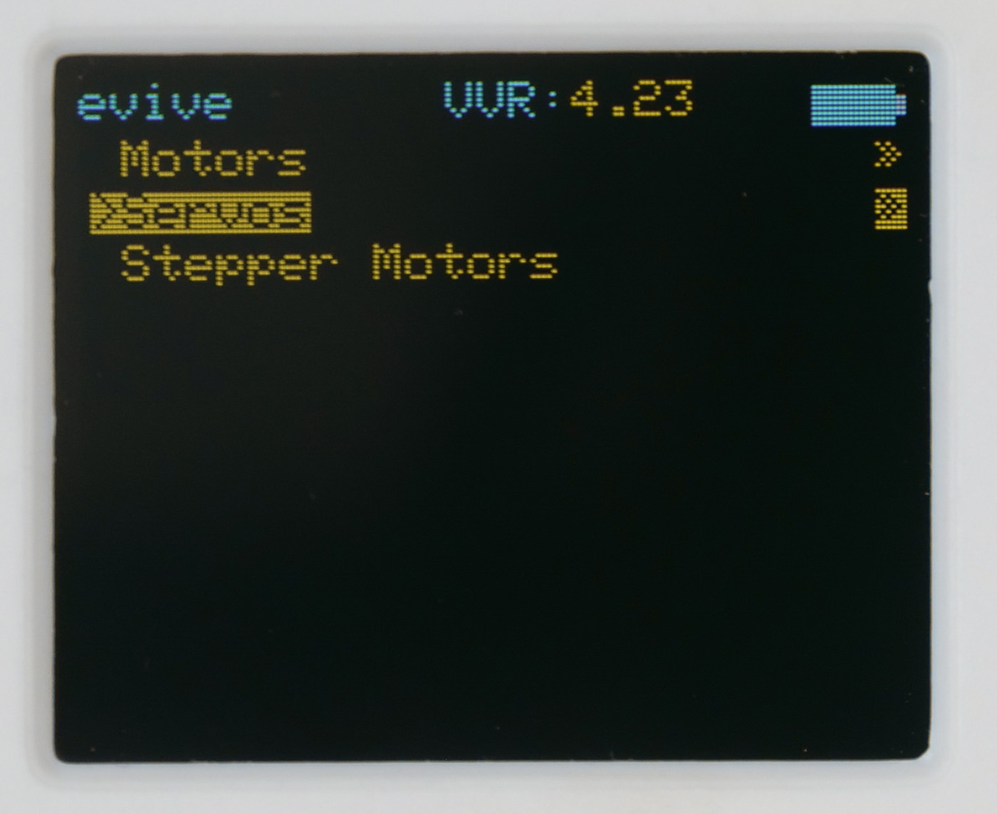
Controlling Robot using evive Menu
Switch ON your evive.
The first option in the menu that appears on the screen is Controls; select that option by pressing the control button to the right.
Once you select it, you’ll see three more options, namely Motors, Servos, and Stepper Motors; select Motors.

Slide 8
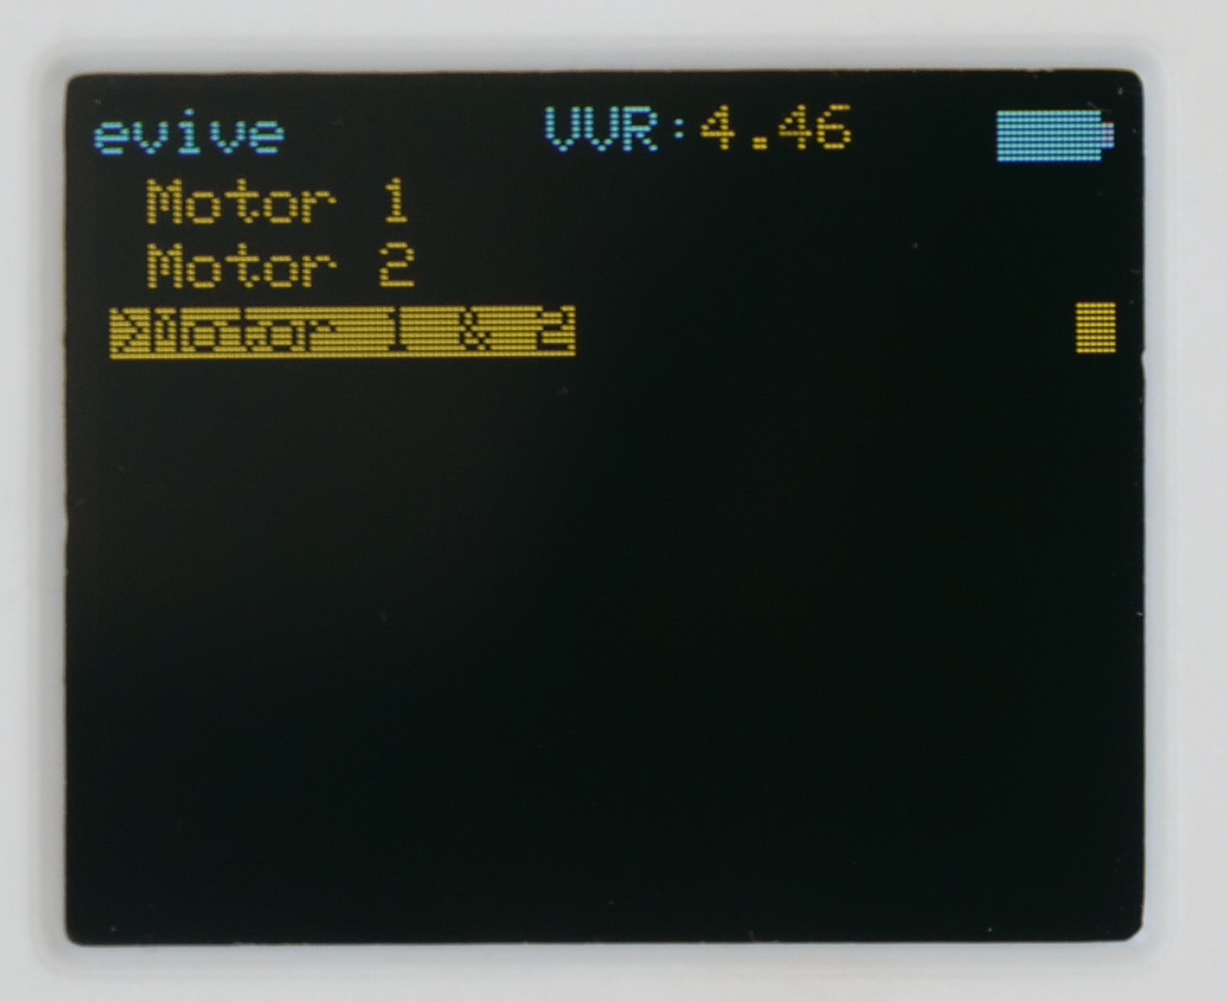
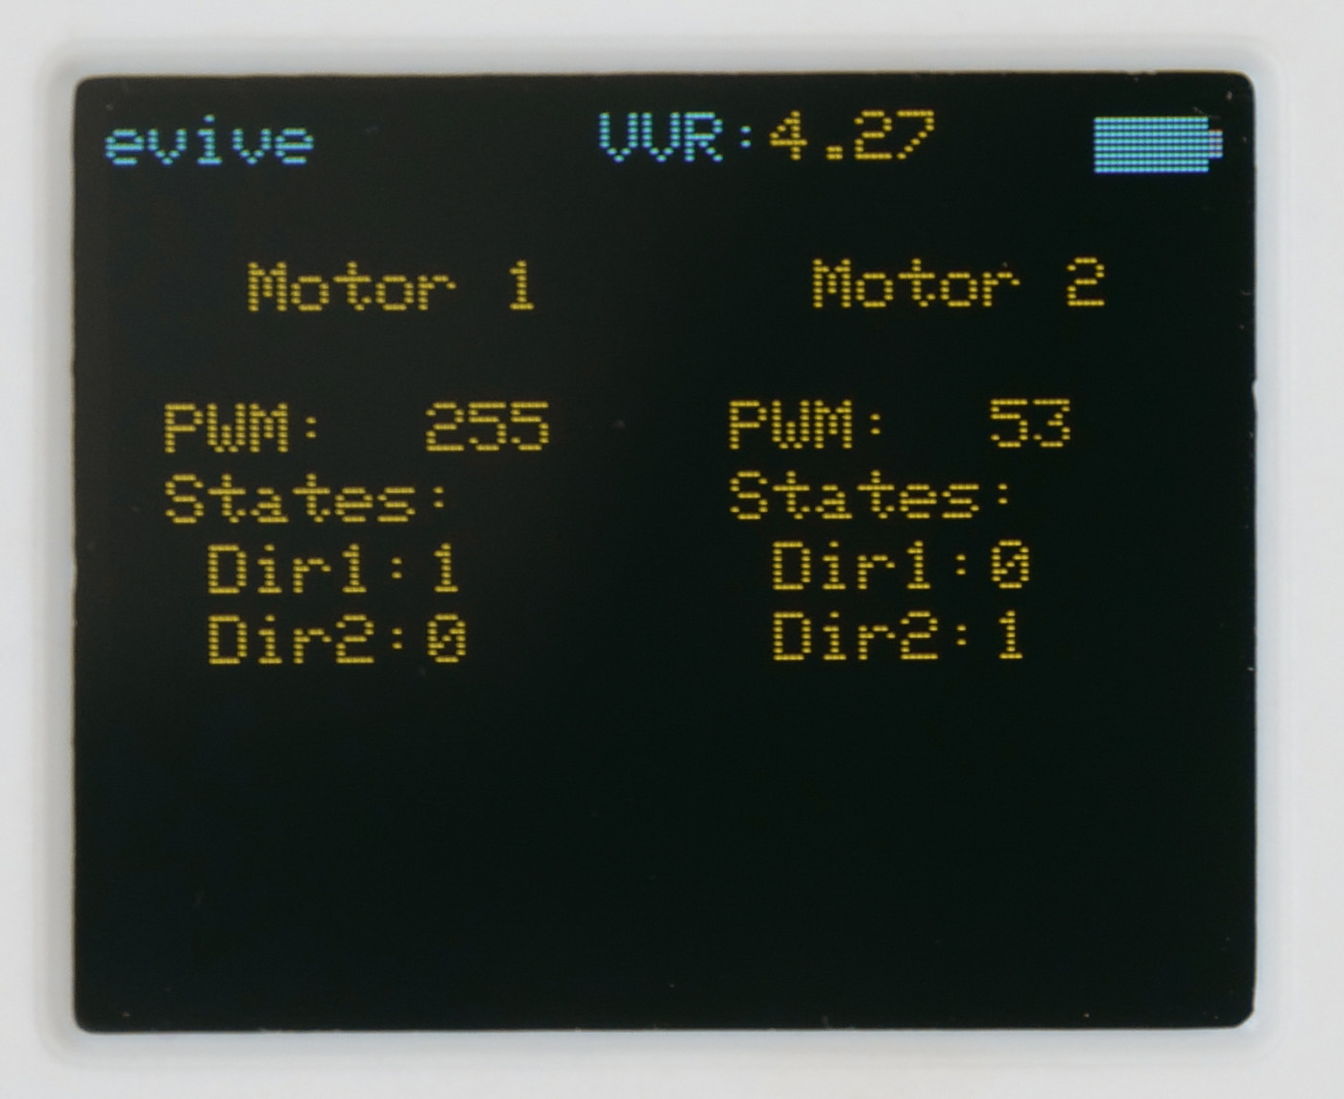
Controlling Robot using evive Menu
From the three options that now appear on the screen, select Motor 1 & 2. The following screen will appear:

Slide 9
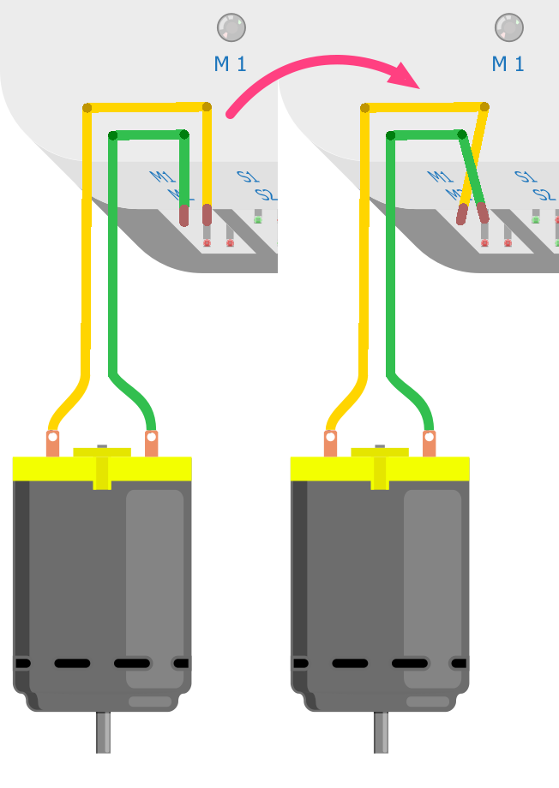
Controlling Robot using evive Menu
Run the motor 1 in the forward direction. If the left motor starts running in the forward direction, then everything is ok.
If the motor is running backwards, then swap the wires to change the direction.

Slide 10
Controlling Robot using evive Menu
But if instead of left motor, right motor is running, then swap the motor connections.

Slide 11
Controlling Robot using evive Menu
Stop motor 1 and run motor 2 in forward direction. If the right motor is running forward, then its ok, otherwise swap the motor 2 wires.
Now, try to run the motor forward, backward, left and right using evive menu.

Slide 12
Logic behind Control

Slide 13
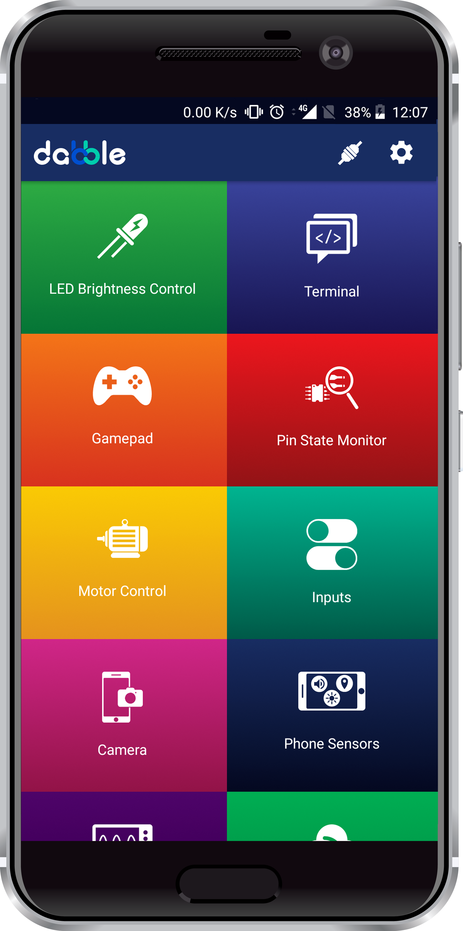
Dabble App
Download the Dabble app from here:

Slide 14
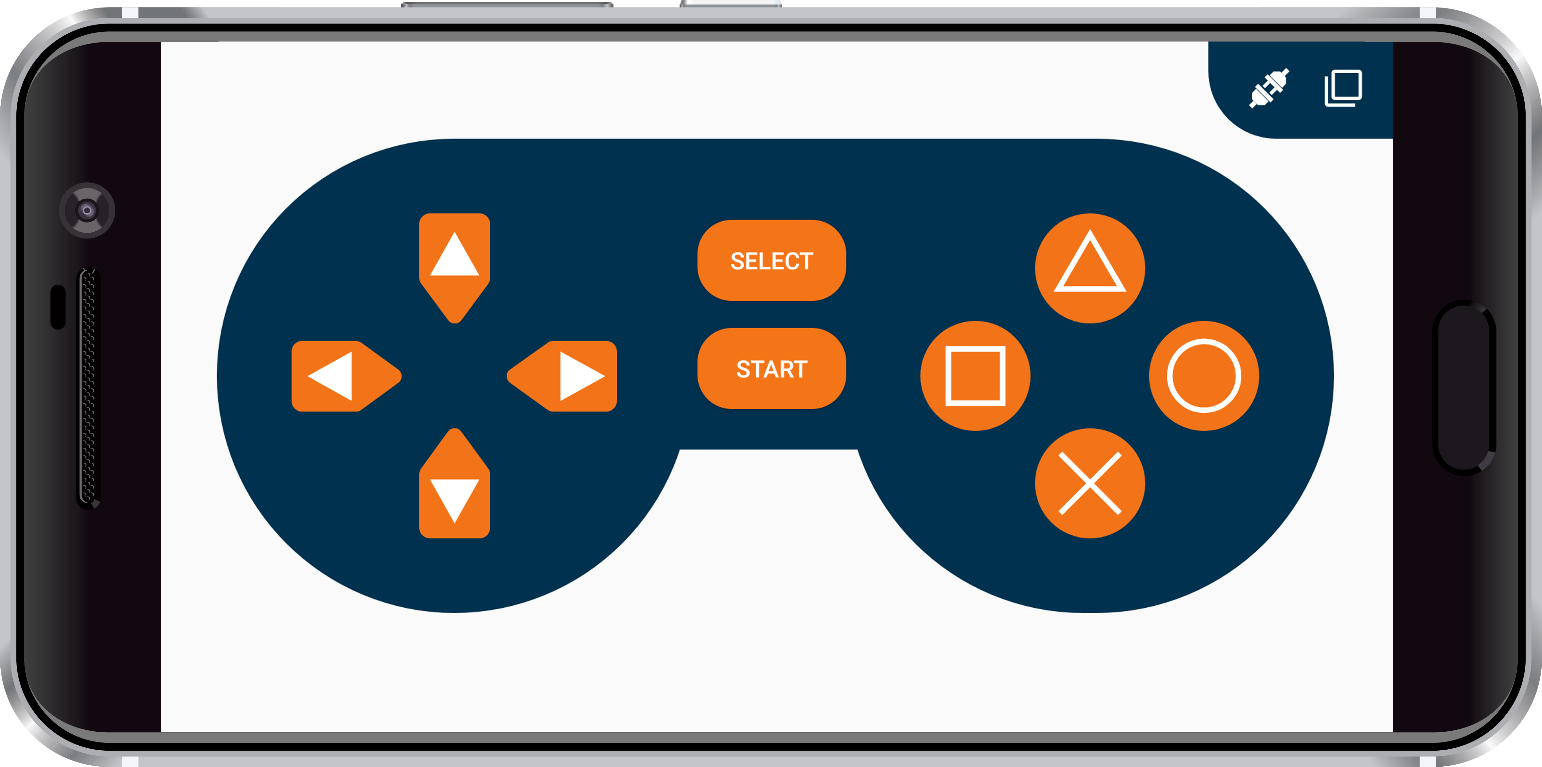
Gamepad Module
The GamePad Module is one of the input modules, using which user can give commands to the device using buttons.
The digital mode is the default mode when the module opens. It has 10 digital buttons whose data is sent to the device when they are pressed or released.

Slide 15
Gamepad Module
Actions to be performed by the Robot:
Up – Go forward
Down – Go backward
Left – Turn left
Right – Turn right
No button pressed - Brake

Slide 16
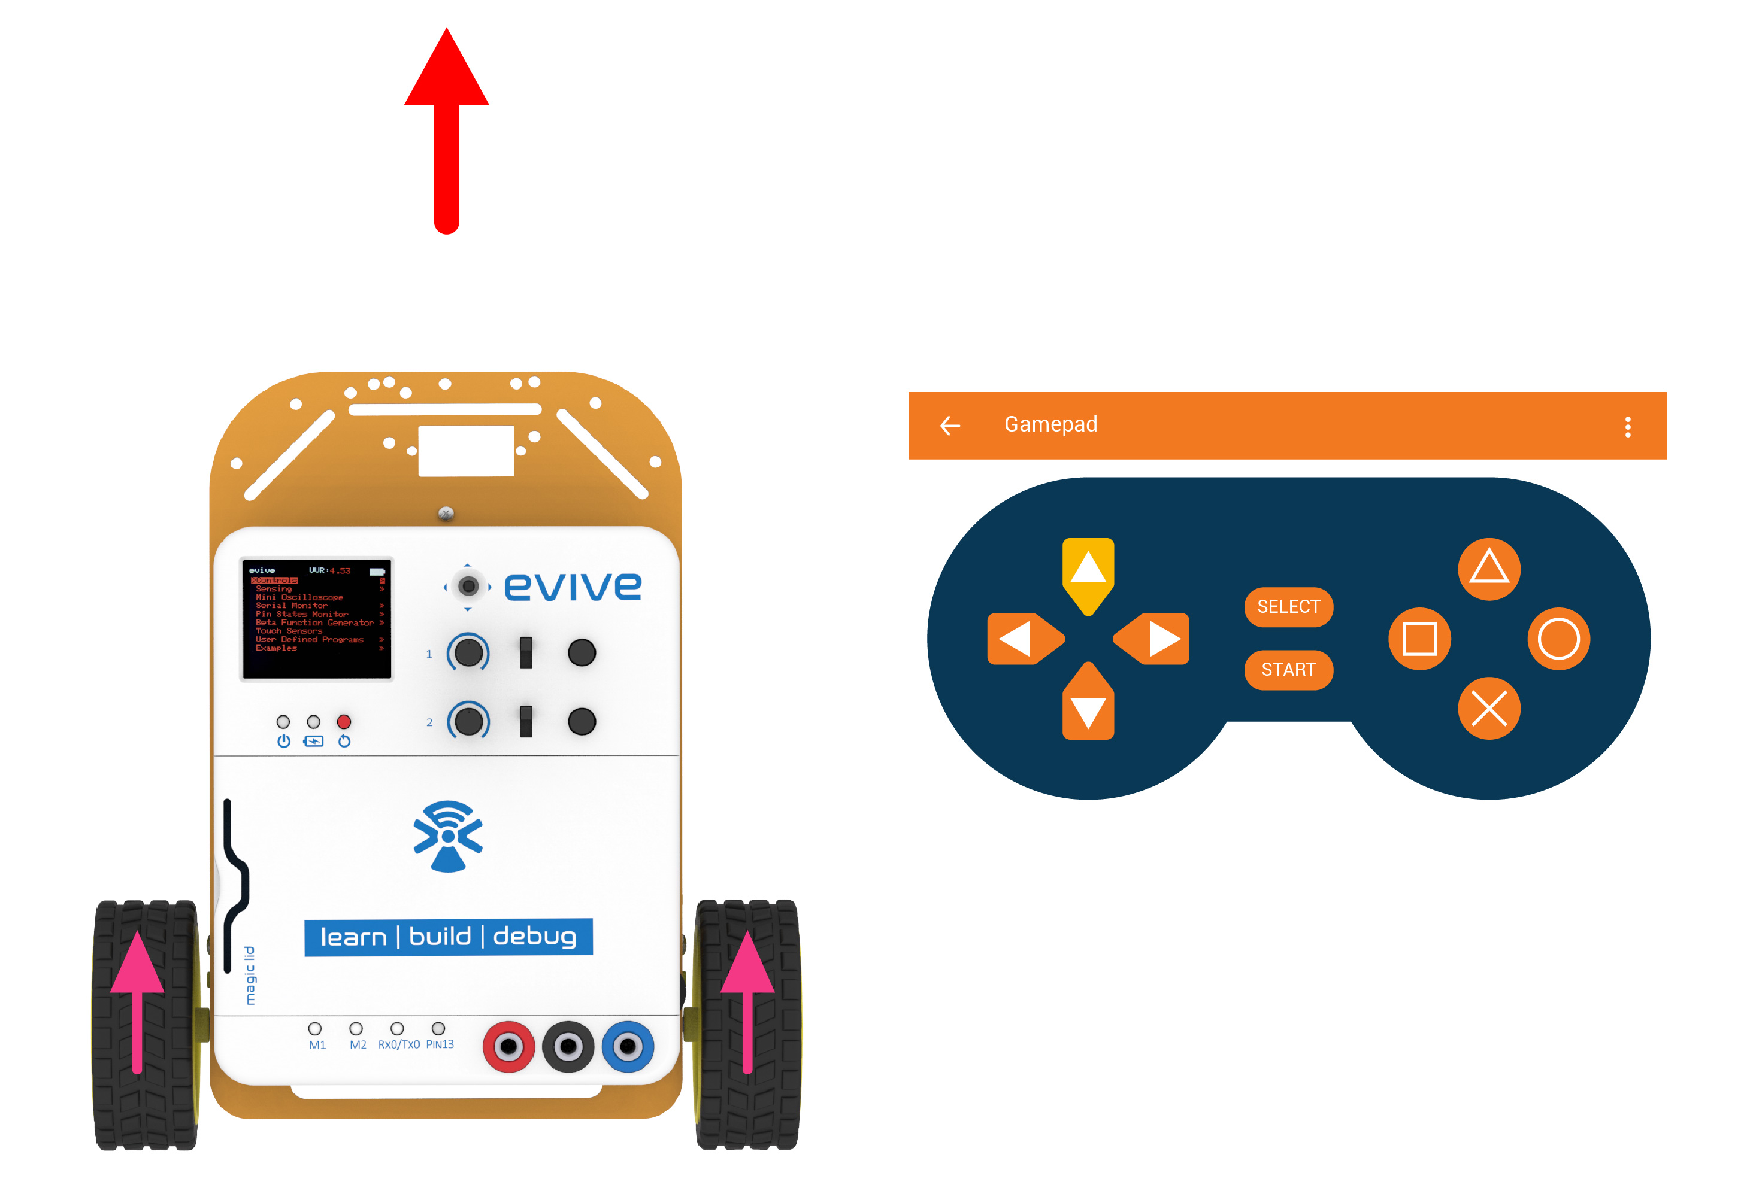
Forward

Slide 17
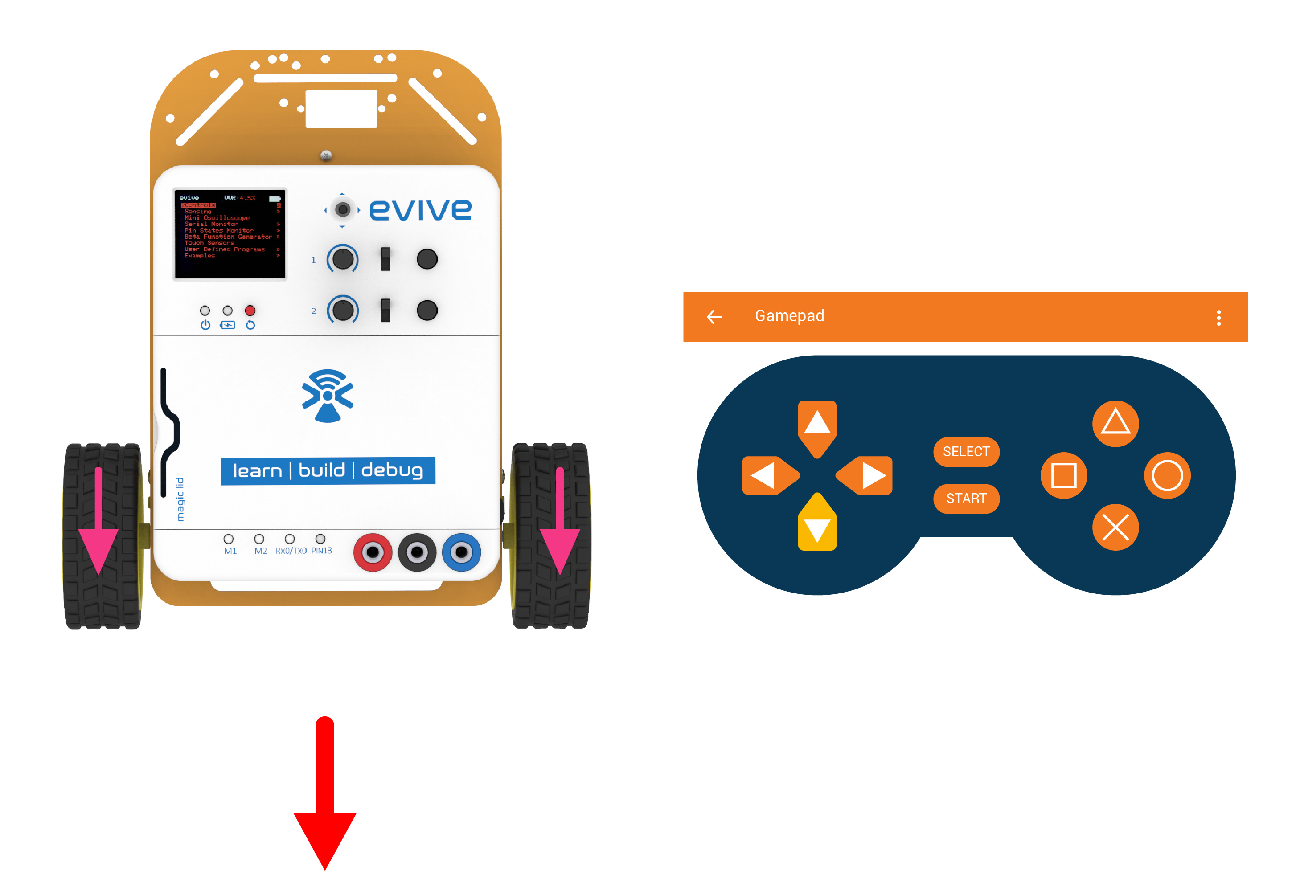
Backward

Slide 18
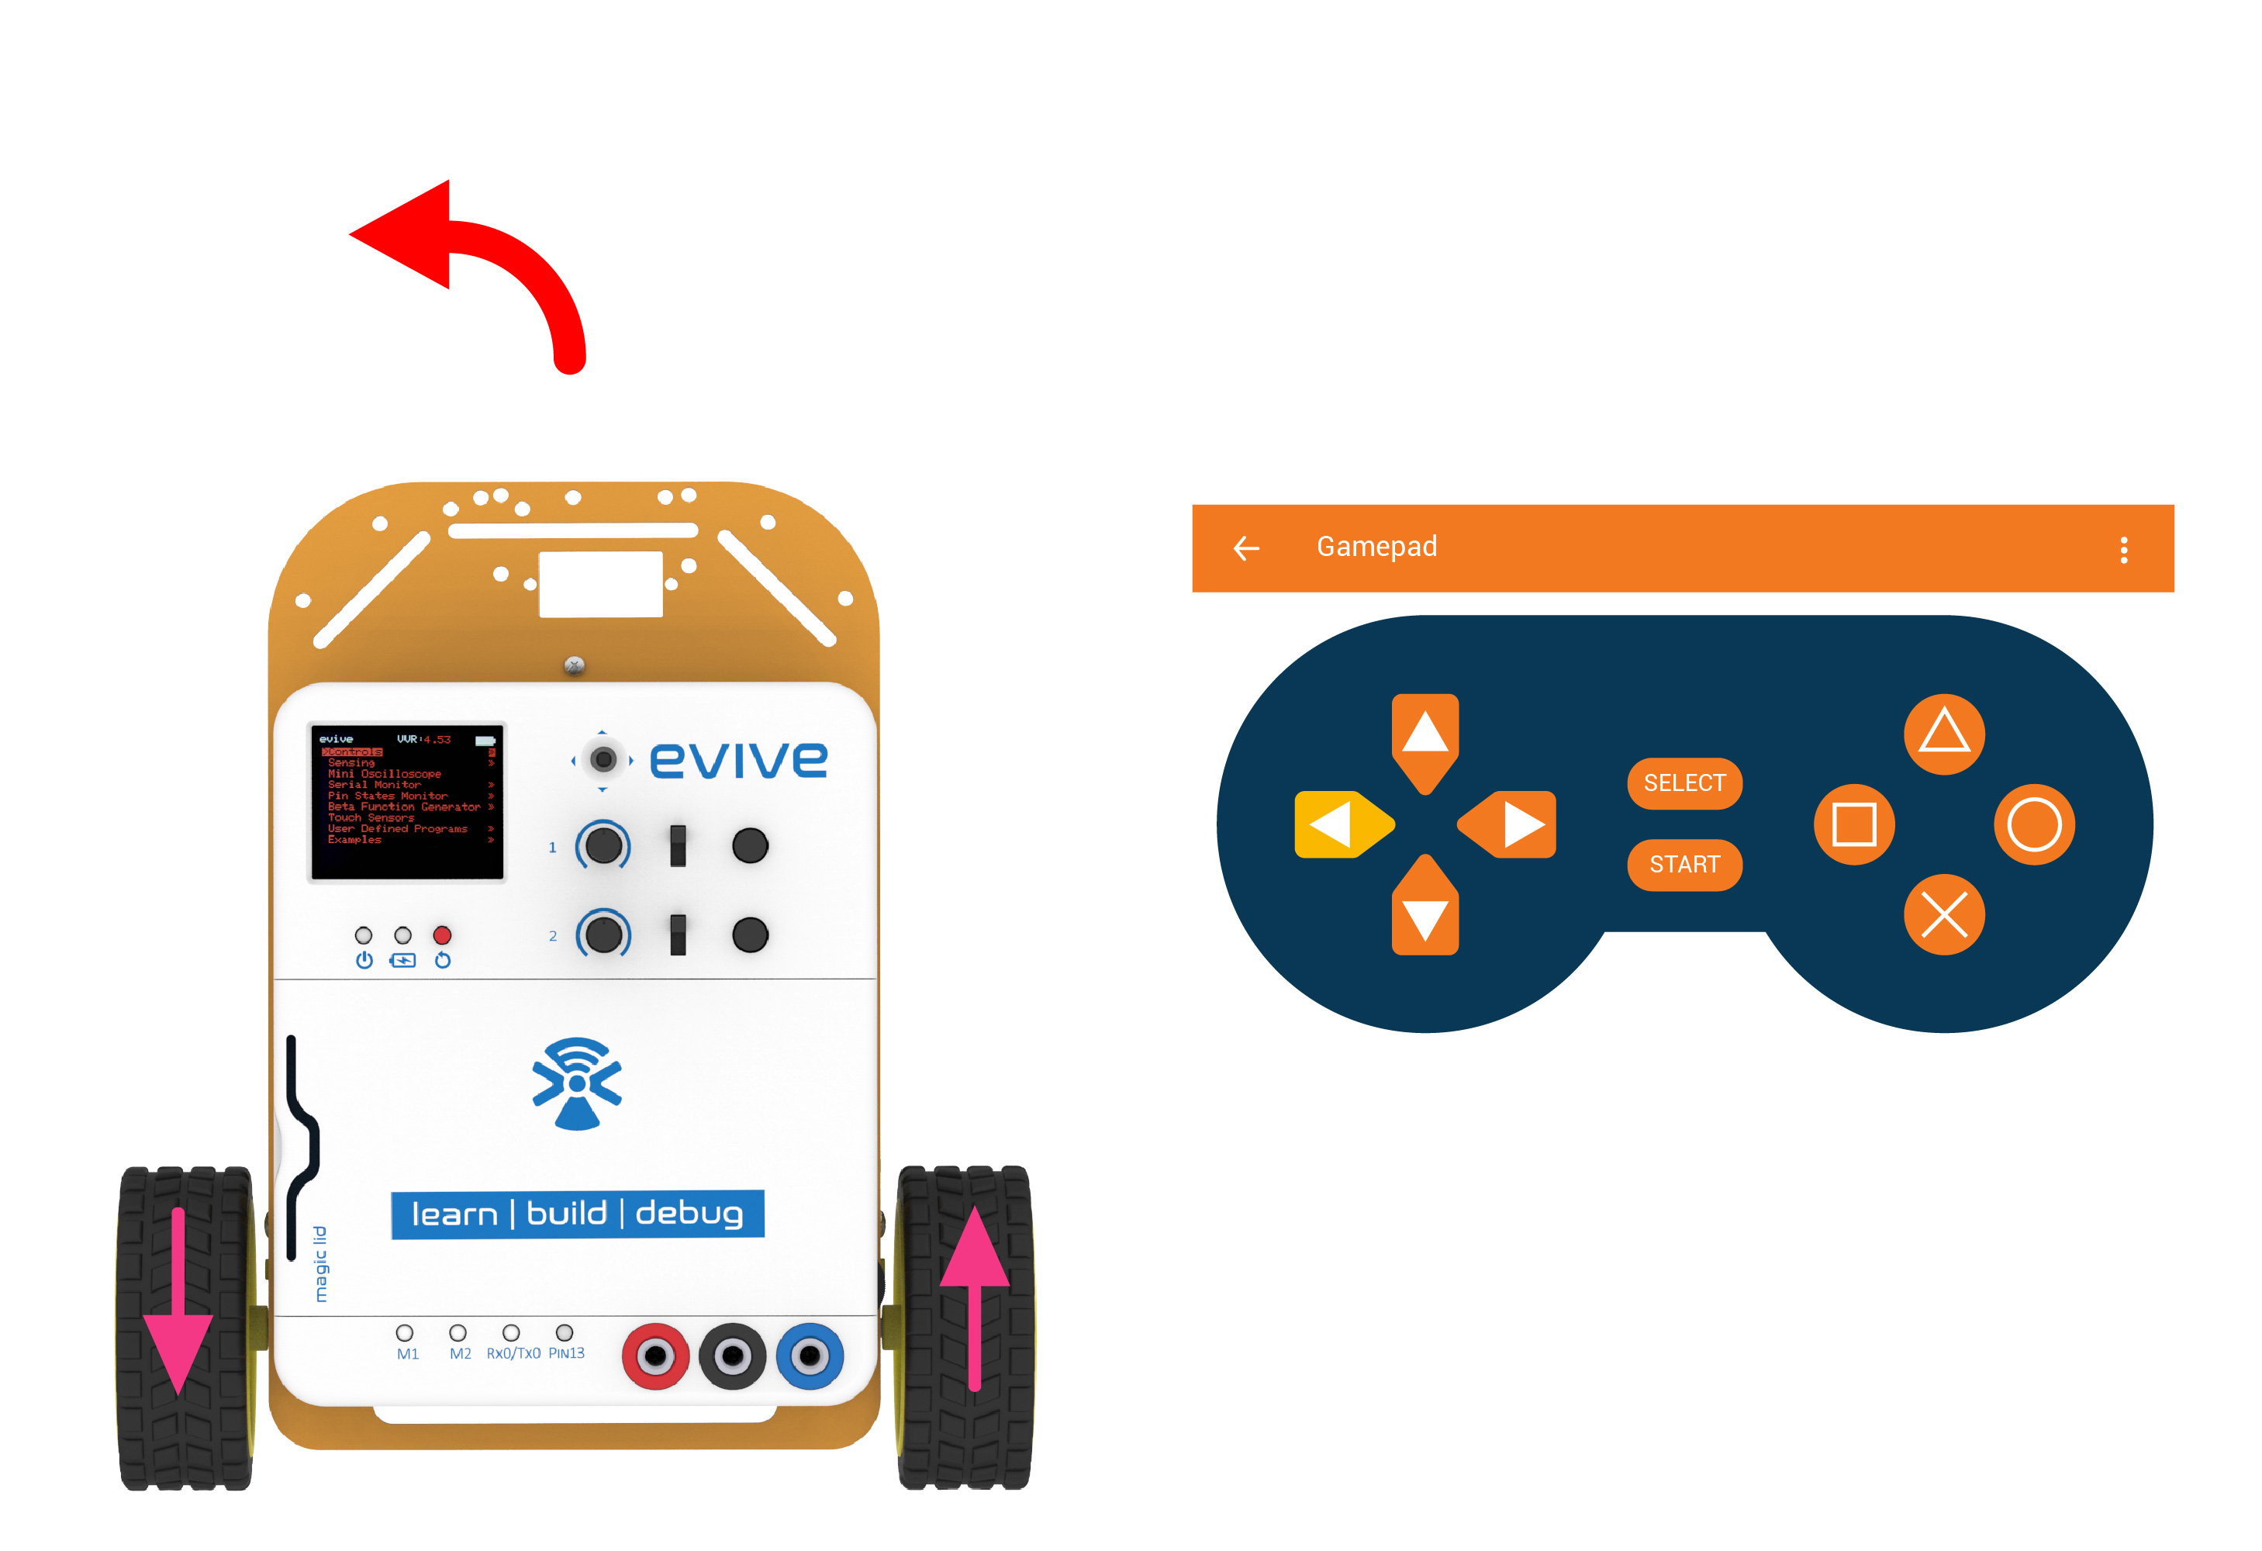
Left

Slide 19
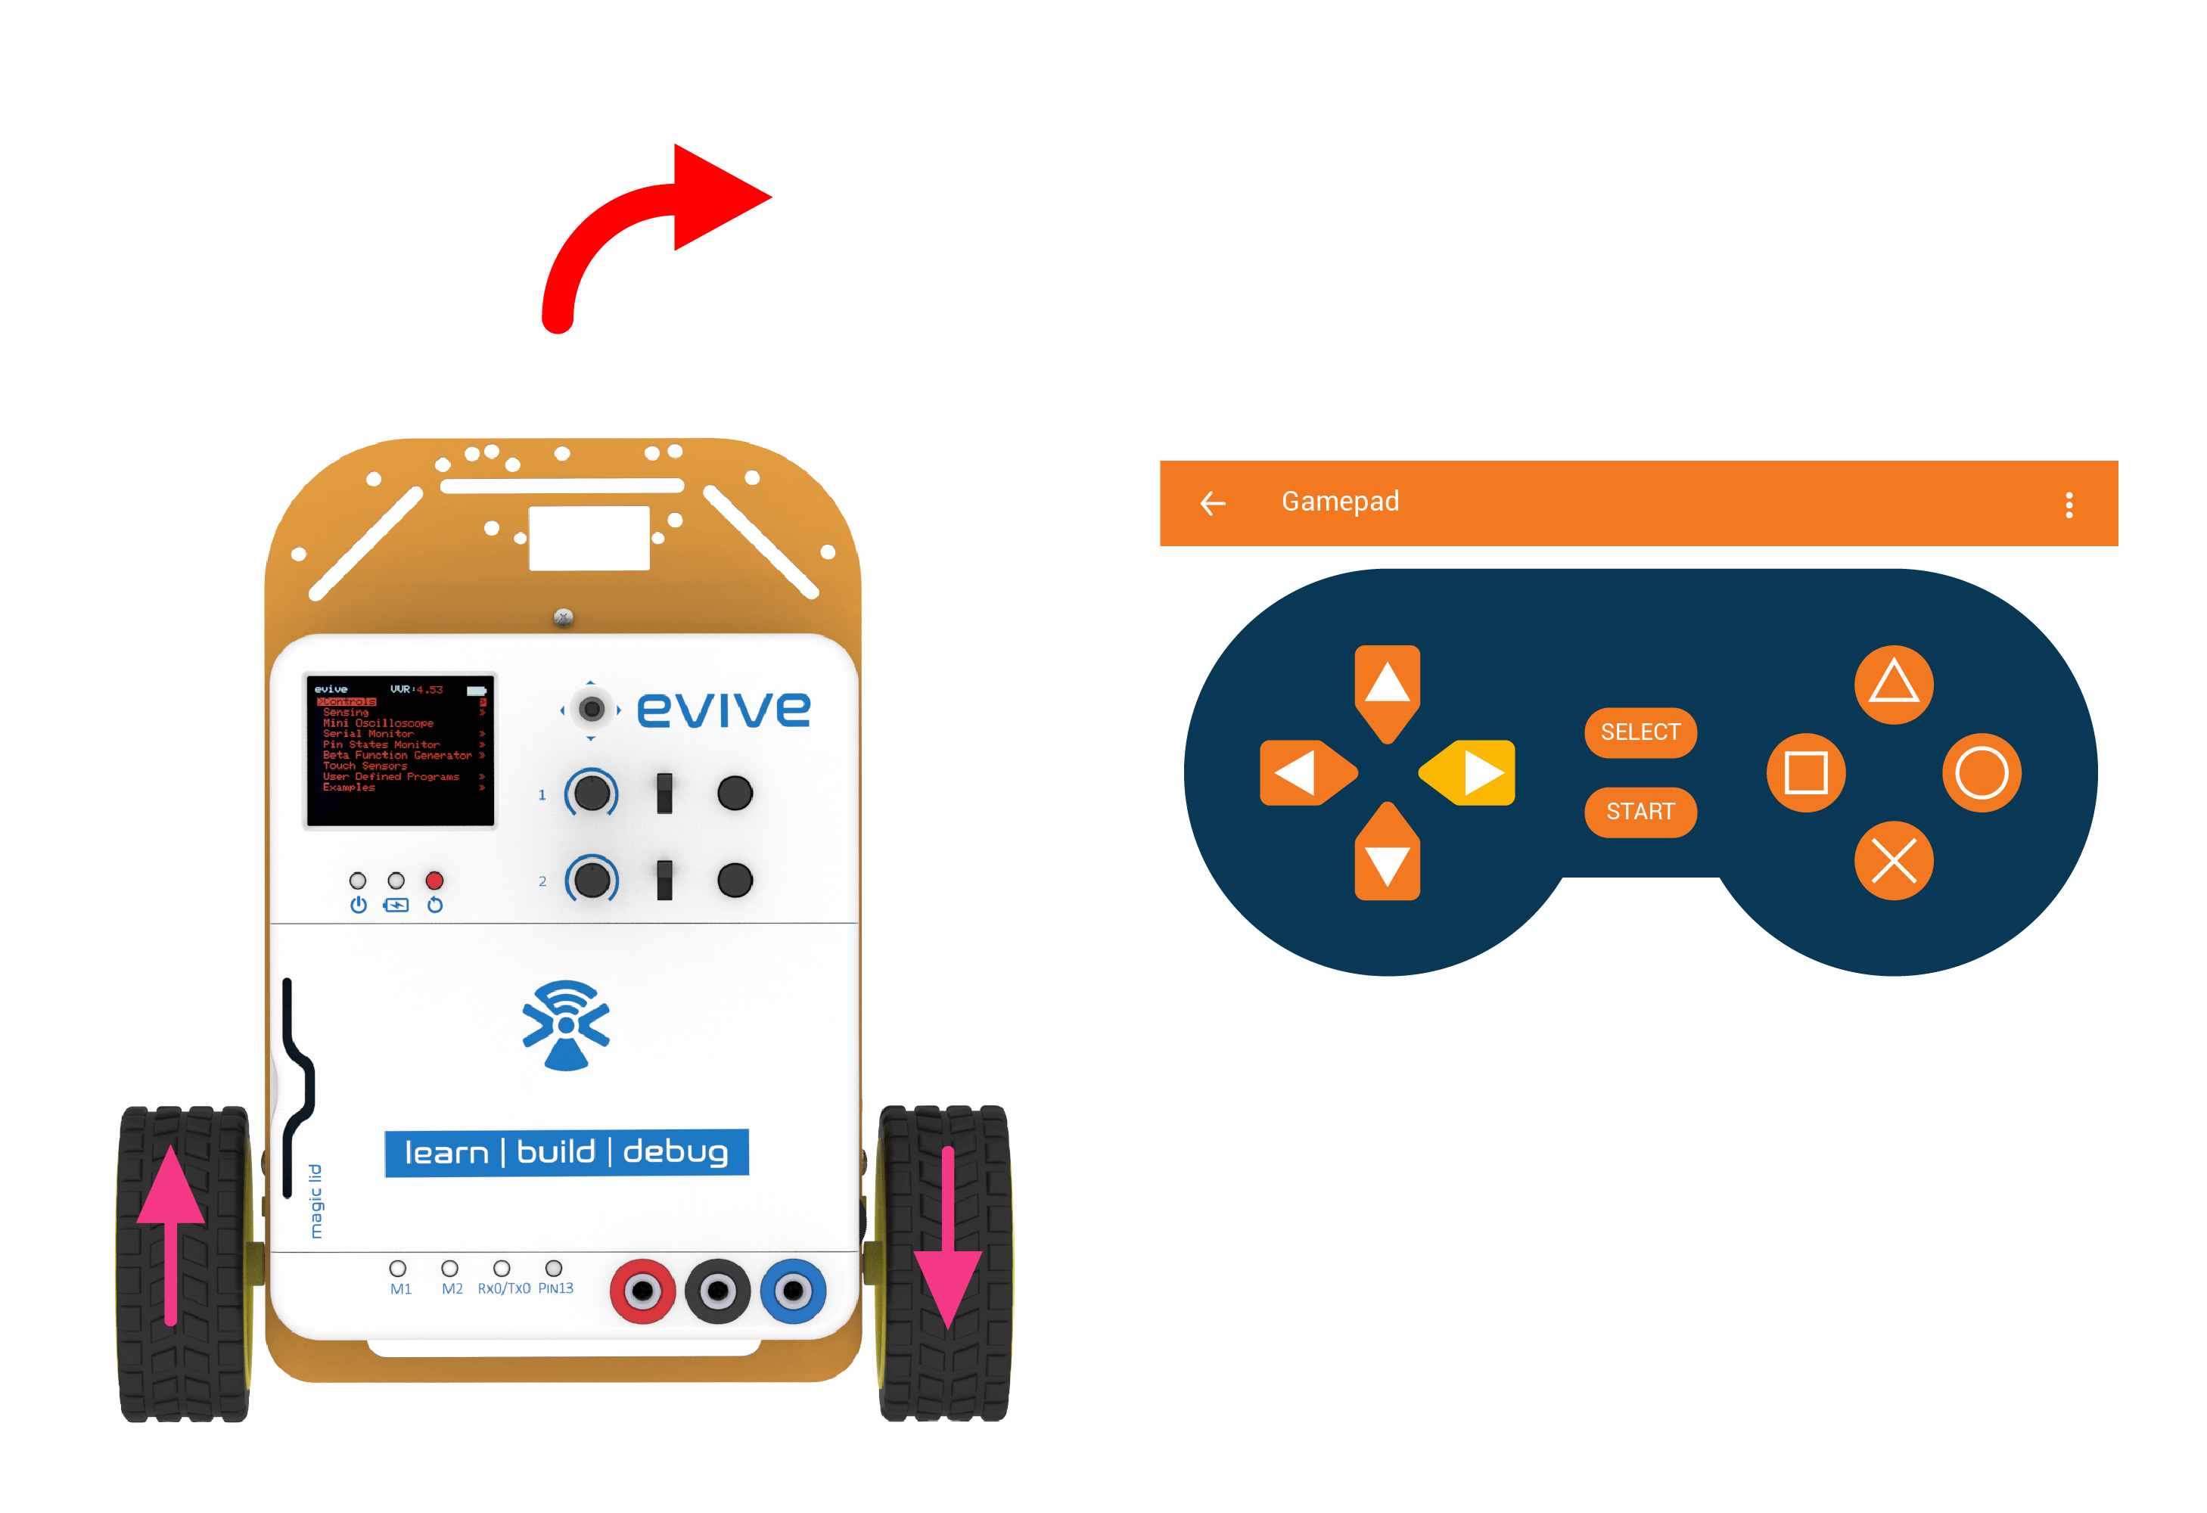
Right

Slide 20
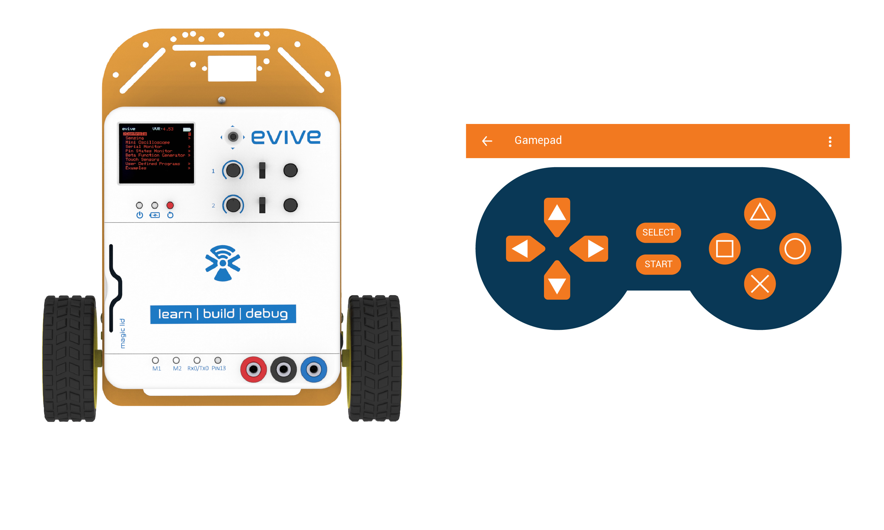
Brake

