Slide 1
Smartphone Controlled Robot Assembly

Slide 2
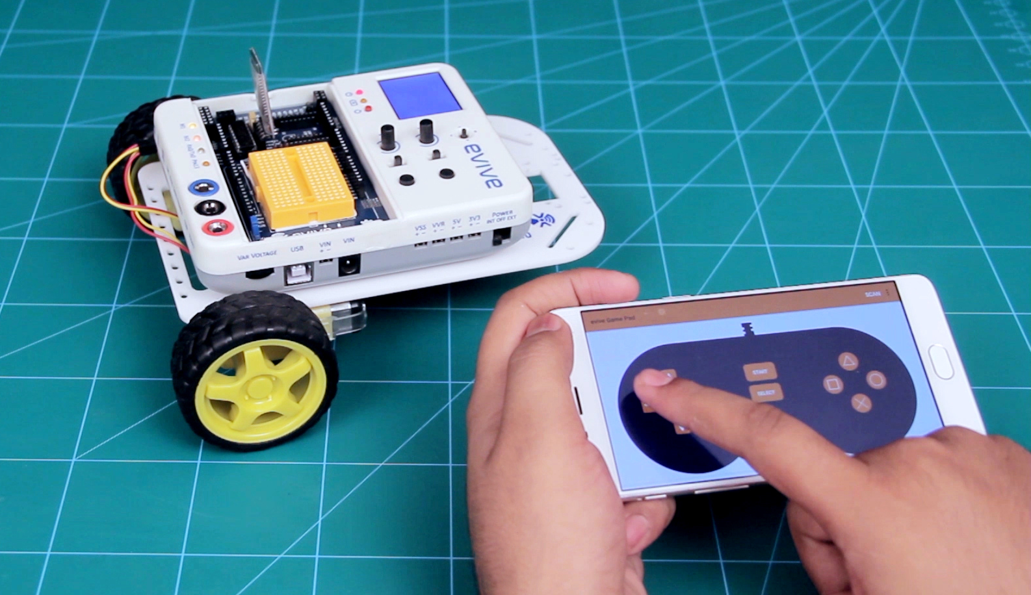
Smartphone Controlled Robot
In a smartphone-controlled robot, the motion of the robot is controlled using the inputs of a smartphone app – Dabble. We will use the gamepad module to control the robot.

Slide 3
Assembly of the Robot

Slide 4
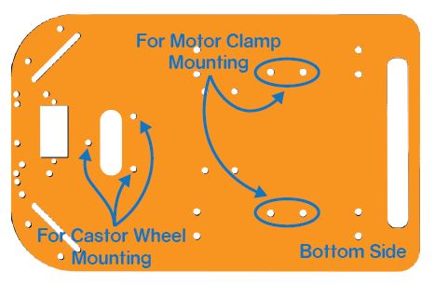
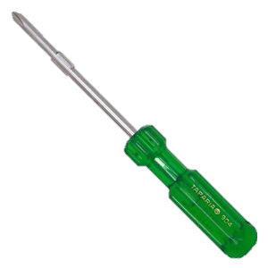
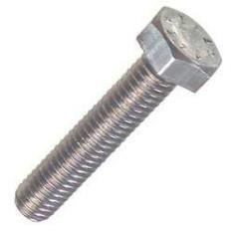
Components
Wheel
DC Motor
Motor Bracket
Base Plate
Bolt
Nut
Screw Driver

Slide 5
Base Plate
You will mount the motor clamps and the caster wheel directly to the base plate. You have to mount motor on the opposite side of the evive logo.

Slide 6
STEP 1
Fix the motor mounting brackets to the chassis using M3 bolts of 8mm length and M3 nuts.

Slide 7
STEP 1
Fix the motor mounting brackets to the chassis using M3 bolts of 8mm length and M3 nuts.

Slide 8
STEP 2
Attach the two motors, one to each bracket, side by side and fasten using M3 bolts of 25mm length and M3 nuts.

Slide 9
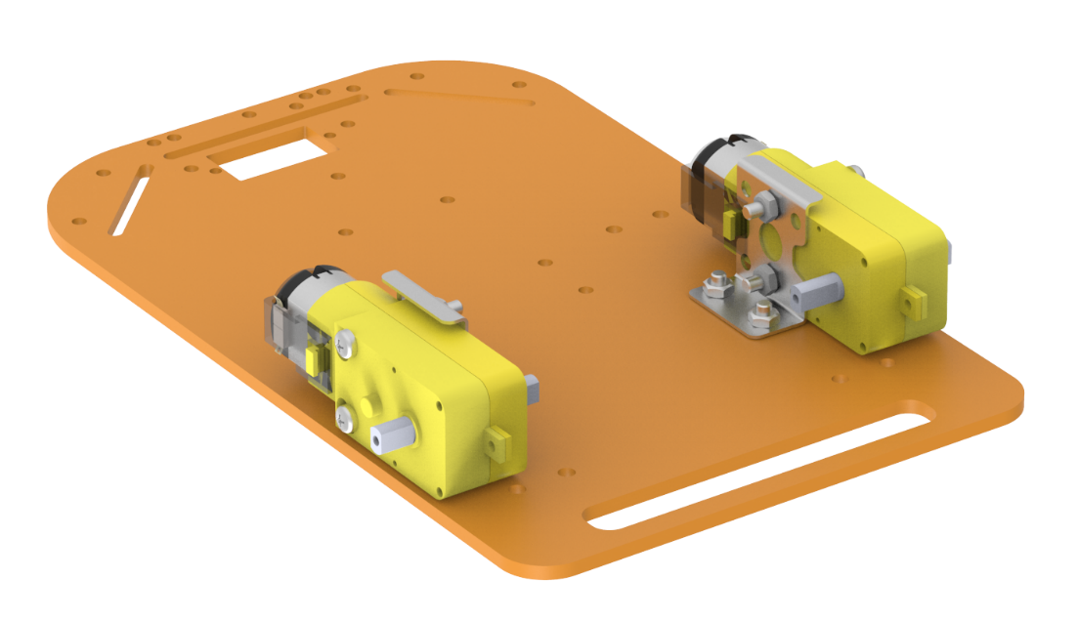
STEP 2
Attach the two motors, one to each bracket, side by side and fasten using M3 bolts of 20mm length and M3 nuts.

Slide 10
STEP 3
Now, fit the wheels into the motor shafts.

Slide 11
STEP 3
Now, fit the wheels into the motor shafts.

Slide 12
STEP 4
Mount the M3 standoffs (20 mm) on the chassis using M3 bolts of 8mm length.

Slide 13
STEP 4
Mount the M3 standoffs (20 mm) on the chassis using M3 bolts of 8mm length.

Slide 14
STEP 5
Bring the Castor on top of the standoffs in the configuration shown and fasten using M3 bolts of 12 mm length.

Slide 15
STEP 5
Bring the Castor on top of the standoffs in the configuration shown and fasten using M3 bolts of 12 mm length.

Slide 16
STEP 6
Using the holes on the back of evive, fasten it to the chassis using M3 bolts of 12mm length.

Slide 17
STEP 6
Using the holes on the back of evive, fasten it to the chassis using M3 bolts of 12mm length.

Slide 18
STEP 6
Using the holes on the back of evive, fasten it to the chassis using M3 bolts of 12mm length.

Slide 19
Your Robot is Ready !

