Slide 1
Introduction to Robots Part 2

Slide 2
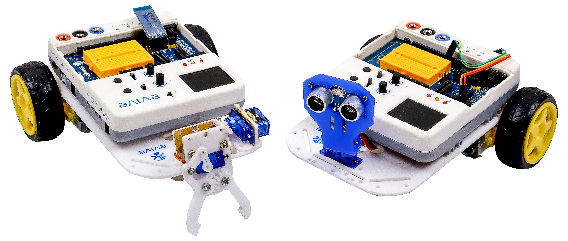
What is Robot?
Powered by Electricity.
Programmed to carry out certain tasks, like cleaning, etc.
Senses the environment using sensors and reacts accordingly on its own.

Slide 3
Basic Components of Robot - Skeleton

Slide 4
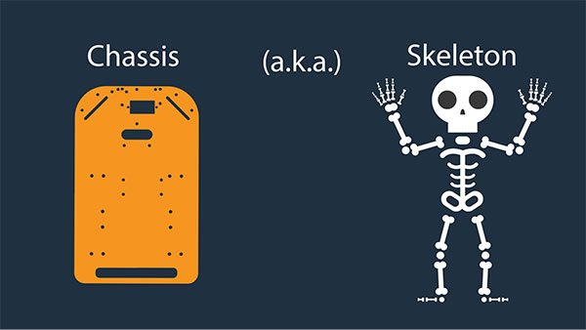
THE ‘SKELETON’

Slide 5
THE ‘SKELETON’
What is a body without a skeleton? Nothing but a soft sac, without the rigidity, and the shape that defines it.
Here, the only difference between the robot and us is that it is not exactly a spongy sac; it is a hard sac, with a lot of dismantled parts.
Our skeleton has bones, a robot’s skeleton is a robot chassis or simply a chassis – it is a frame (in our case a base plate) onto which everything - the actuators, the effectors, the wheels, the castor, the grippers, the brain - is attached and supported.

Slide 6
Basic Components of Robot - Sensors

Slide 7
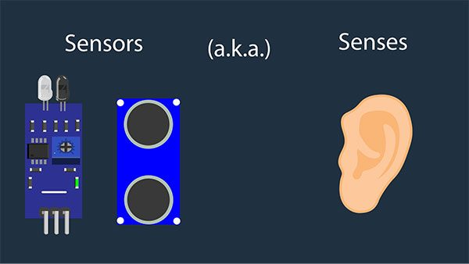
THE ‘SENSES’

Slide 8
THE ‘SENSES’
A sensor is a device that detects input from the outside world and responds to it.
Just like we have many different types of senses and different ‘sensors’ for them, such as eyes for seeing, ears for hearing, nose for smelling, tongue for tasting, and skin for touching, robots are also capable of sensing different things such as light, sound, and temperature, and have many different sensors for them.

Slide 9
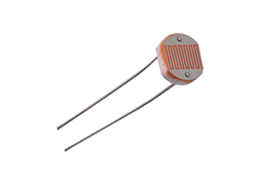
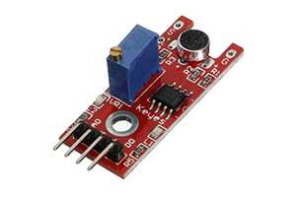
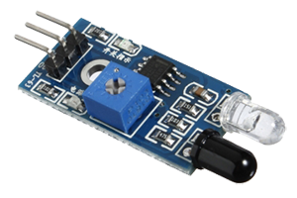
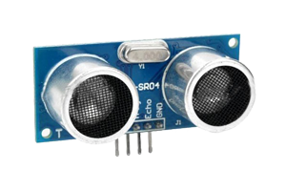
THE ‘SENSES’
Light Sensors
Sound Sensors
Proximity Sensors
Distance Sensors

Slide 10
Basic Components of Robot - Brain

Slide 11
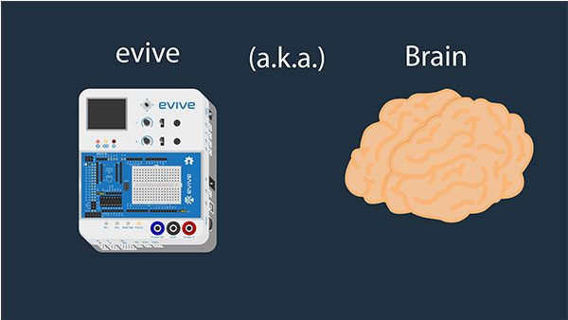
THE ‘e-BRAIN’

Slide 12
THE ‘e-BRAIN’
The robot has detected all that is happening around it. Now, it has to respond to it. But it needs to make sure that it does to correctly. Who or what is going to tell him what to do, and how to respond in the right way?
The brain is responsible for controlling all the senses, and, functions of the body, such as thinking (I think, therefore I am), eating, sleeping, and moving the arms and the legs.
The robot’s brain also does the same. It controls what it thinks, what it does, and how it moves its arms and legs.

Slide 13
Basic Components of Robot - Commands

Slide 14
THE ‘e-BRAIN’

Slide 15
THE ‘e-BRAIN’
At this moment, our robot’s got everything; right from the brain down to the feet. But since it is not exactly a human, it still doesn’t know as of yet what to do and how to do it.
You will give commands to the robot and ask it to do what you want him to, and he has to follow them!
These commands that we are talking about are nothing but the instructions that are given by writing a program for the specified task.

Slide 16
Different Types of Robots

Slide 17
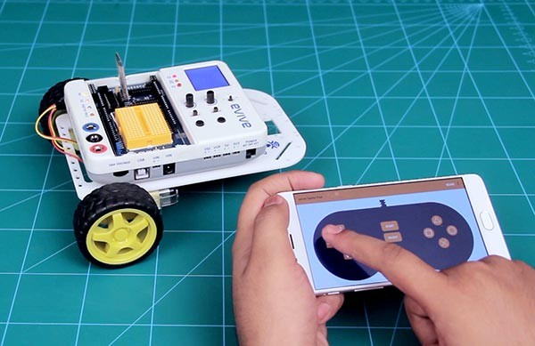
Smartphone Controlled Robot
This robot will follow your commands via Bluetooth and go where you want him to go.

Slide 18
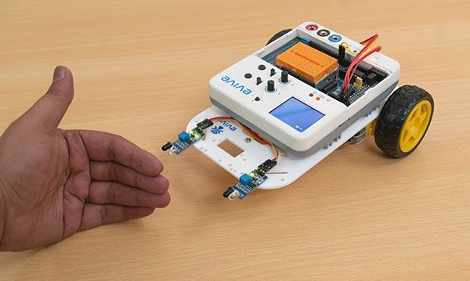
Follow Me Robot
This robot will follow you, or anybody else that comes in front of it.

Slide 19
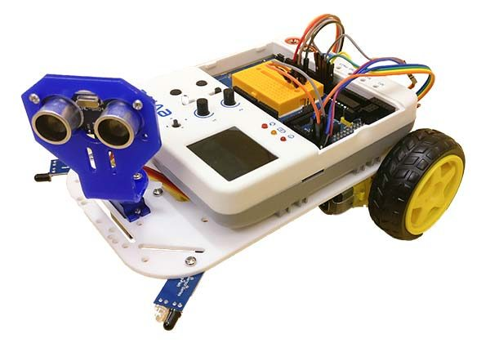
Obstacle Avoiding Robot
This robot avoids obstacle and move autonomously.

Slide 20
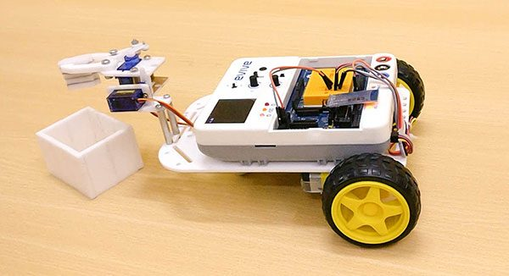
Pick and Place Robot
This robot will pick objects for you and place them where you want.

Slide 21
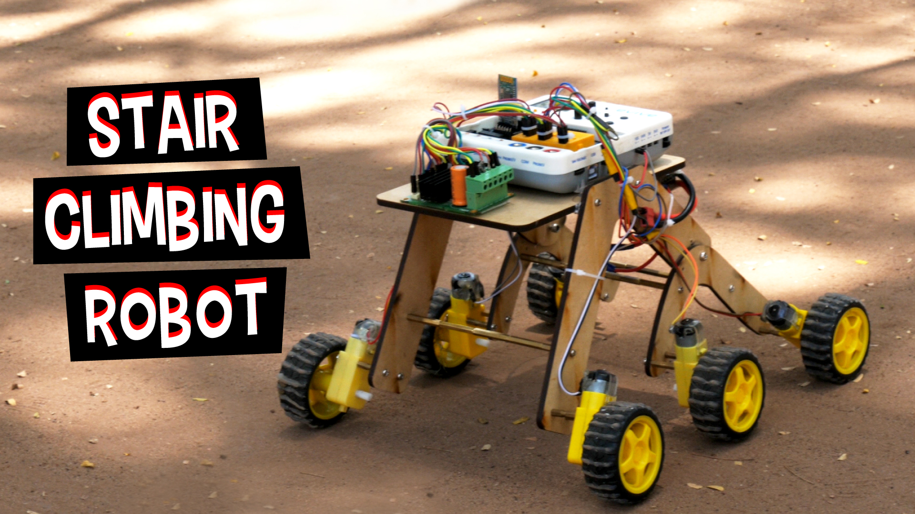
Stair Climbing Robot
This robot can work in uneven ground terrains like stairs and rock.

Slide 22
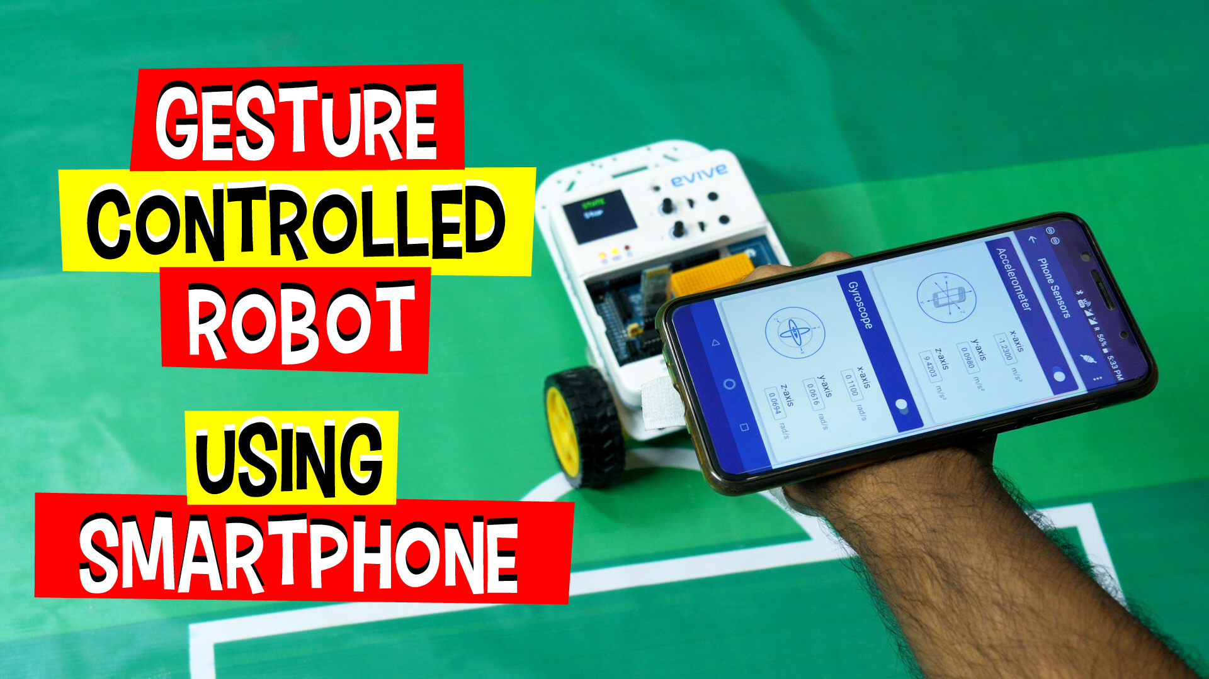
Gesture Controlled Robot
This robot moves according the gesture you make on your smartphone, like moving forward when you tilt it forward.

Slide 23
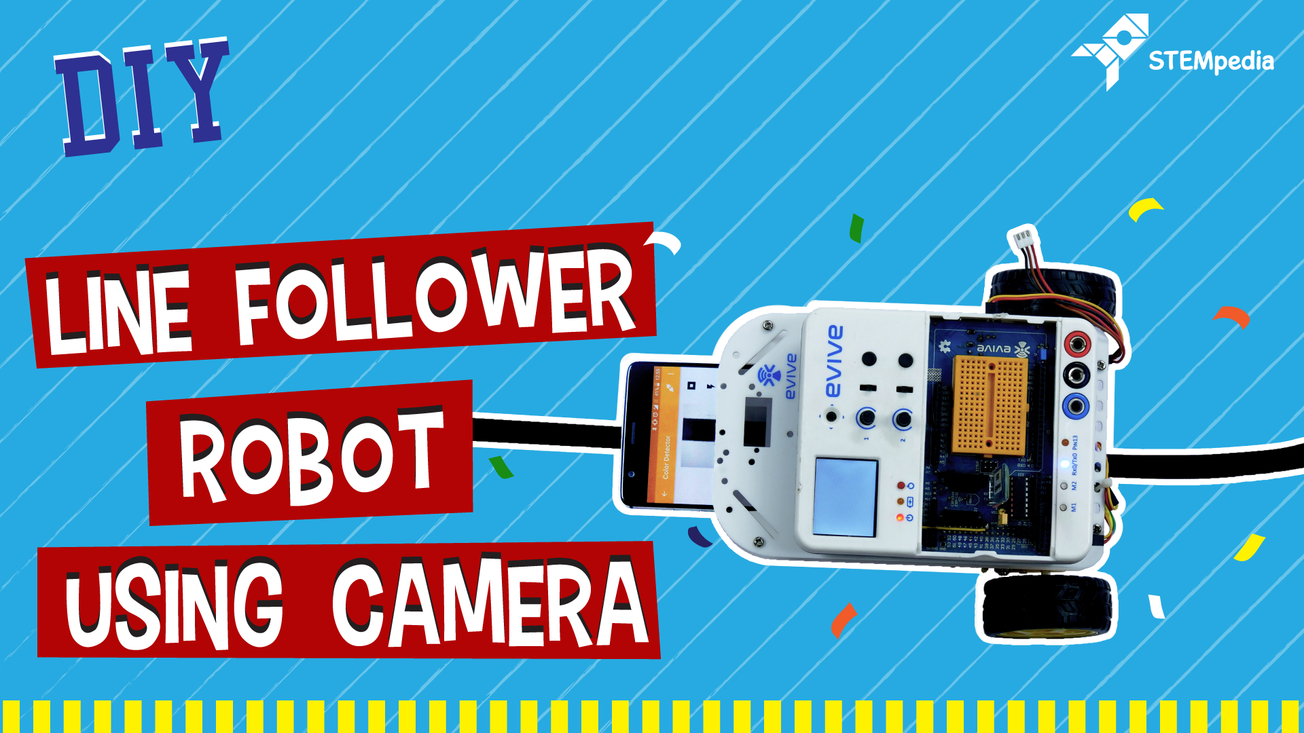
Line Following Robot
This robot works autonomously. It has only one work, follow the black line.

Slide 24
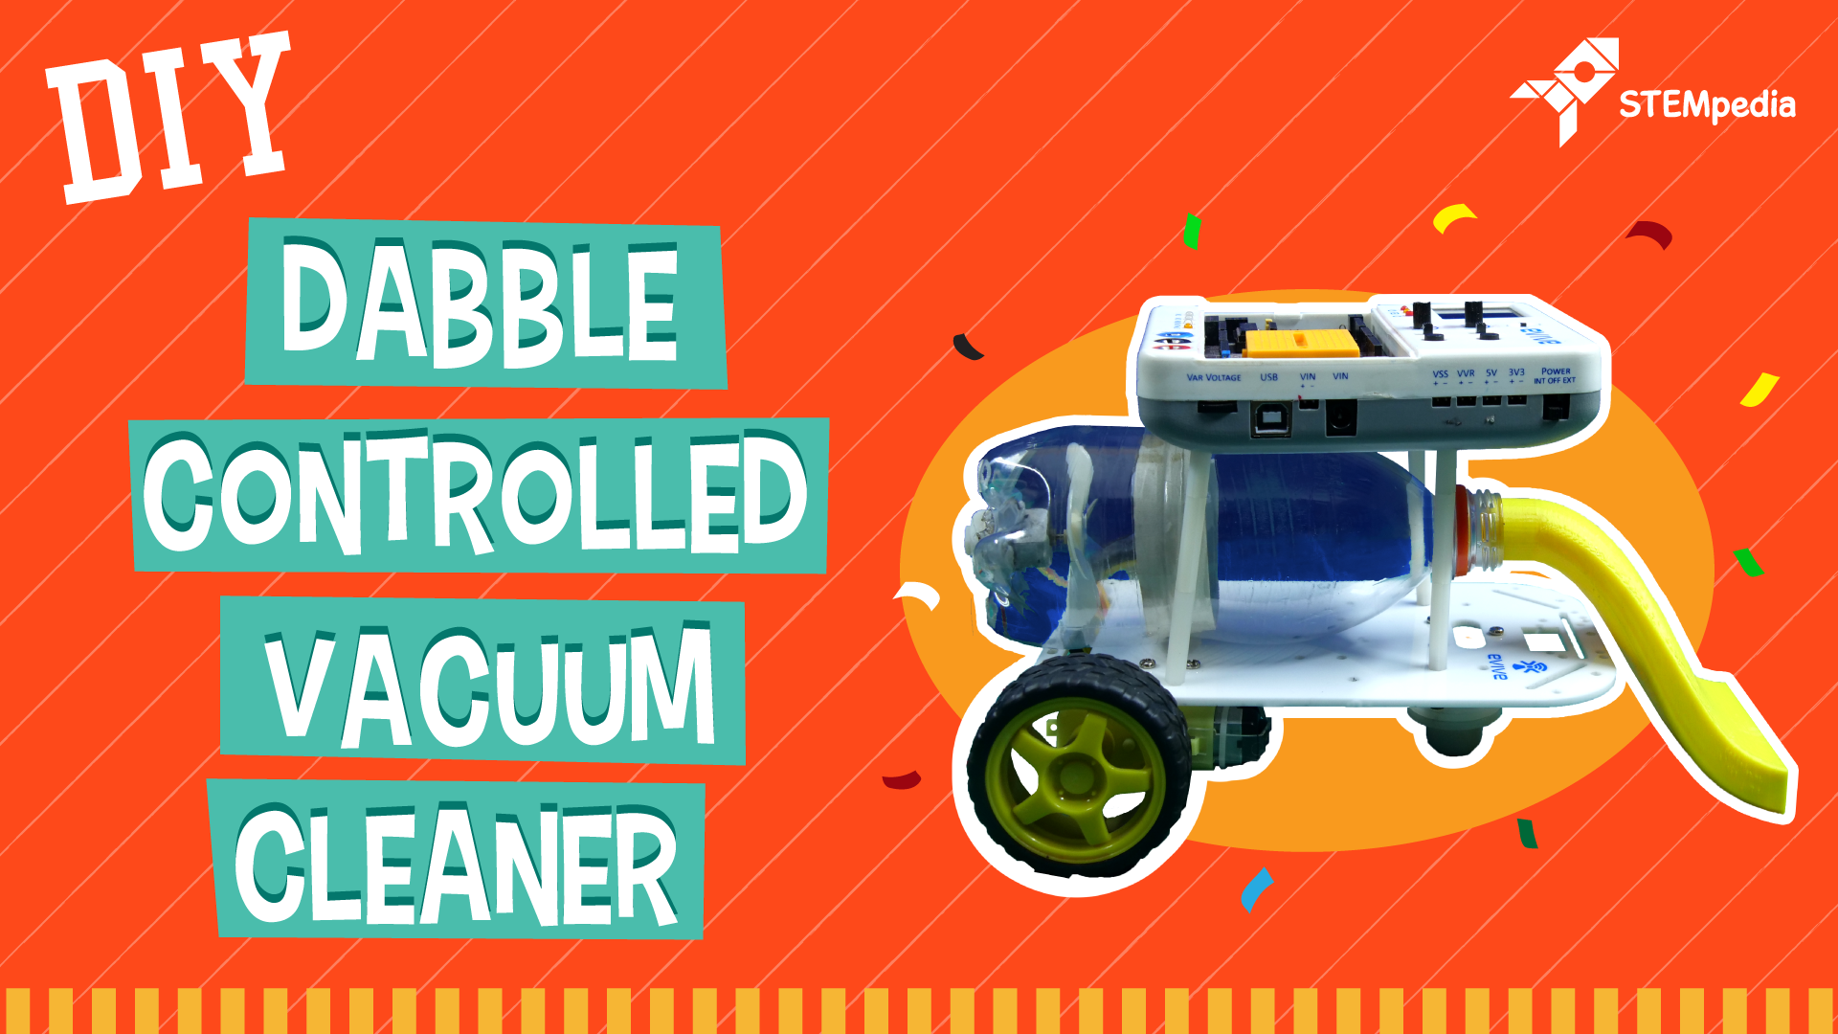
Dust Cleaning Robot
This robot has a DIY vacuum cleaner attached to it. This is controlled using smartphone and can clean your room.

