Slide 1
Introduction to Robots Part 1

Slide 2
What is Robot?

Slide 3
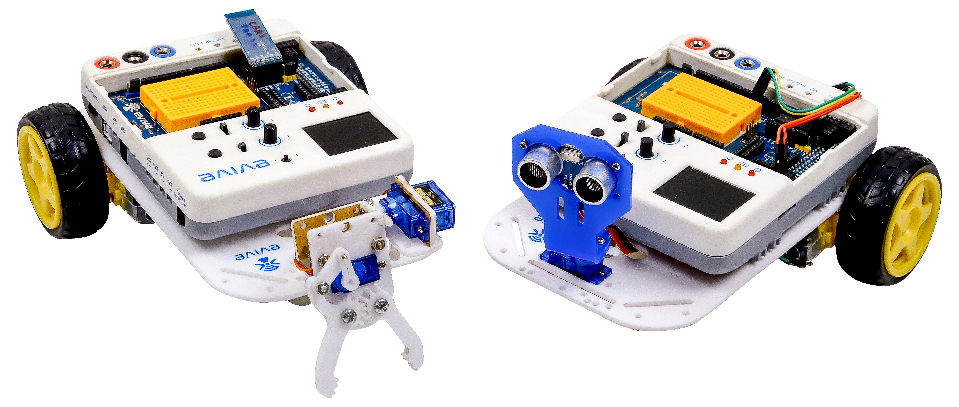
What is Robot?
Powered by Electricity.
Programmed to carry out certain tasks, like cleaning, etc.
Senses the environment using sensors and reacts accordingly on its own.

Slide 4
Classification of Robots
A robot can be controlled by humans, either directly, or remotely, from a place far away.
A robot can take decisions and work entirely on its own; such robots are called ‘autonomous robots’.
here also exist robots that can move from one place to another; they are known as ‘mobile robots’.
There are robots, autonomous robots, mobile robots, and then, there are autonomous mobile robots like obstacle avoiding robots.

Slide 5
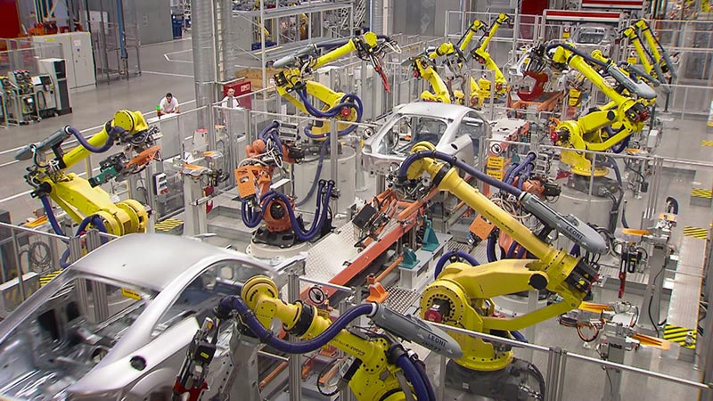
Application of Robots
Industry: For handling and moving materials.

Slide 6
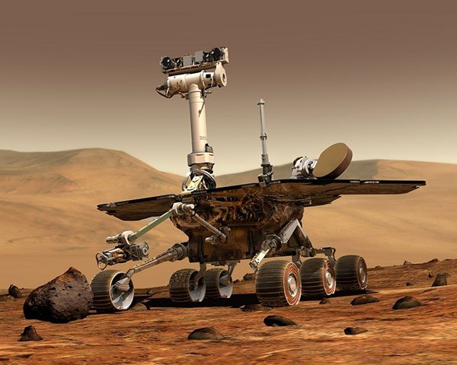
Application of Robots
Space: For exploring outer space. E.g., the Curiosity Rover

Slide 7
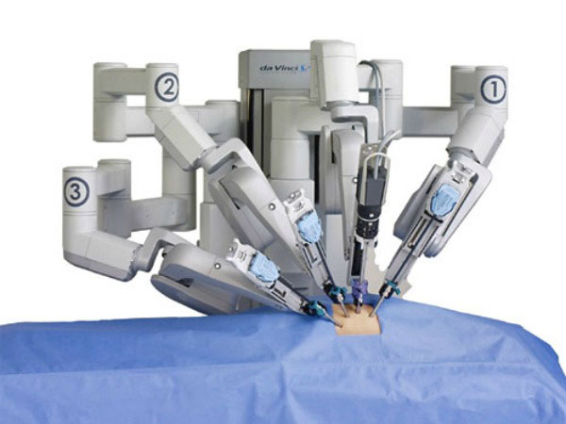
Application of Robots
Hospital: Surgical robots, réhabilitation robots, pharmacy robots, etc.

Slide 8
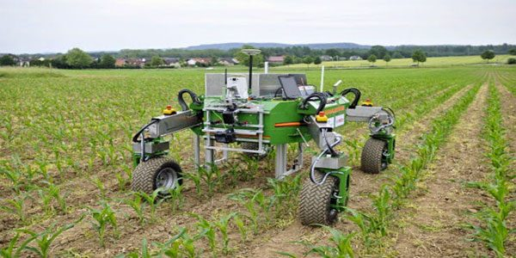
Application of Robots
Agriculture: For tasks such as vegetable and fruit picking.

Slide 9
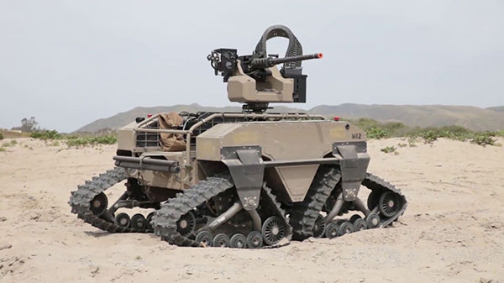
Application of Robots
Military: Bomb discarding robots, drone explorations, etc.

Slide 10
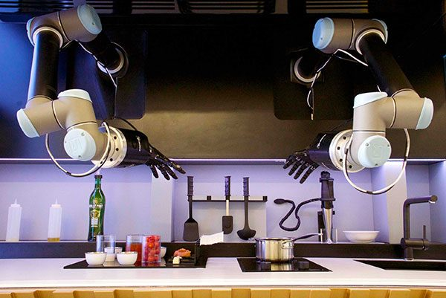
Application of Robots
Households: For cooking, cleaning, and washing purposes.

Slide 11
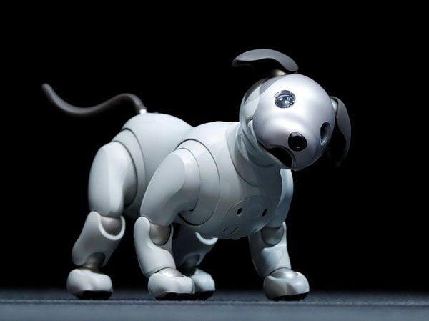
Application of Robots
Entertainment: Humanoids, robot dogs, etc. E.g. Aibo the robot dog.

Slide 12
Basic Components of Robot - Hands

Slide 13
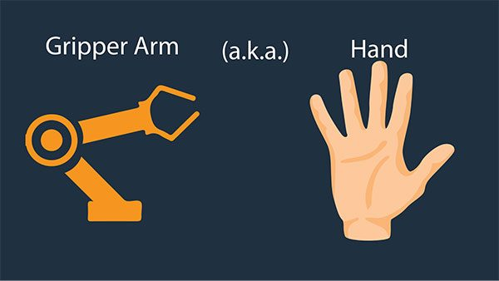
THE ‘HANDS’

Slide 14
THE ‘HANDS’
Robot hands are known as end-effectors.
There different types of end effectors for different purposes.
The most common type is a gripper. A gripper allows the robot to hold objects, carry them, and then release them.
Grippers come in many sizes and styles so that the correct ones can be used according to the work to be done.

Slide 15
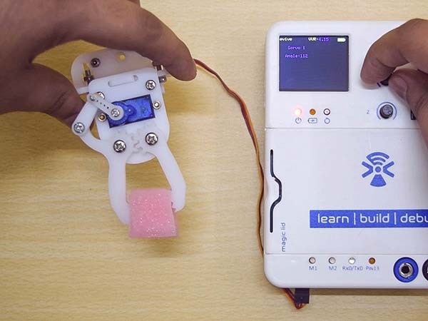
THE ‘HANDS’

Slide 16
Basic Components of Robot - Feet

Slide 17
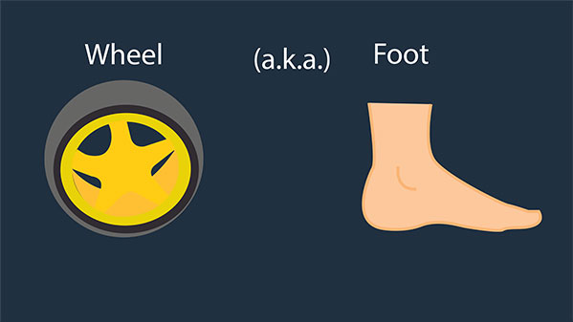
THE ‘FEET’

Slide 18
THE ‘FEET’
Robots need something that will help in moving around.
Mobile robots move with the help of wheels (generally, but not necessarily).
These wheels are attached to the DC motors (actuators) that turn them, thus helping the robot go places.

Slide 19
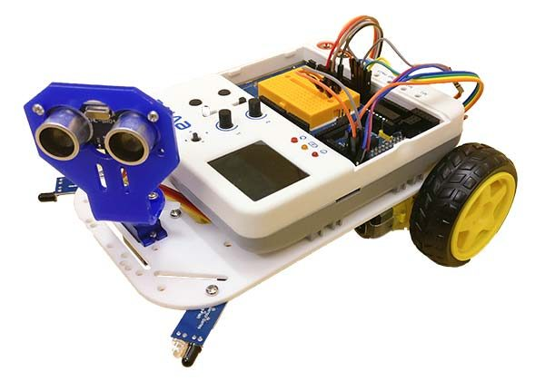
THE ‘FEET’

Slide 20
THE ‘FEET’
For a moving object to be stable, you need at least 3 contact points with the surface on which it is moving.
For e.g. in a car, you have four wheels, but in a bicycle, there are only two wheels.
A cyclist can control the bicycle only when he is cycling, but if he stops he can’t balance the cycle without resting one of his feet on the ground.
In our mobile robot, we will have 2 wheels and one caster wheel touching the ground. A caster wheel has a small round sphere, which rolls freely on the ground. It is passive and can move in any direction.

Slide 21
Basic Components of Robot - Muscles

Slide 22
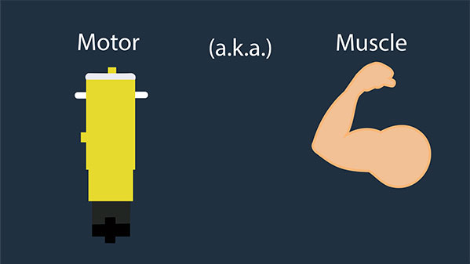
THE ‘MUSCLES’

Slide 23
THE ‘MUSCLES’
A robot also has muscles. They are known as actuators.
The actuator helps the brain of the robot to respond to the surrounding environment.
It helps the robot to move its hands (grippers), and its feet (wheels and the castor).
The robots that you will be making consist of DC (direct current) motors and servo motors as electrical actuators.

