Slide 1
DIY Smart LED Street Light

Slide 2
DIY Smart LED Street Light
In this session, you will make a Smart Street Light, in which, the LED light will glow when the light will go below certain limit.

Slide 3
Street Light

Slide 4
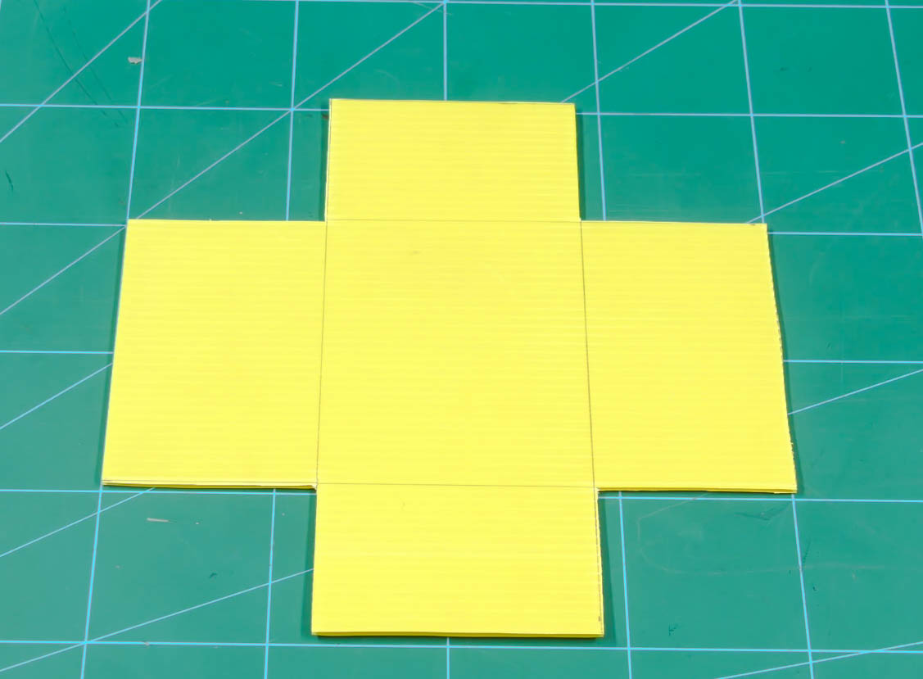
Making the Street Light
Take a corrugated sheet of the size 20cm*20cm.
Make a rectangle of 10cm*8cm in the center of our sheet.
Remove the corners so that your sheet looks like a plus sign, similar to the one shown in the below image.

Slide 5
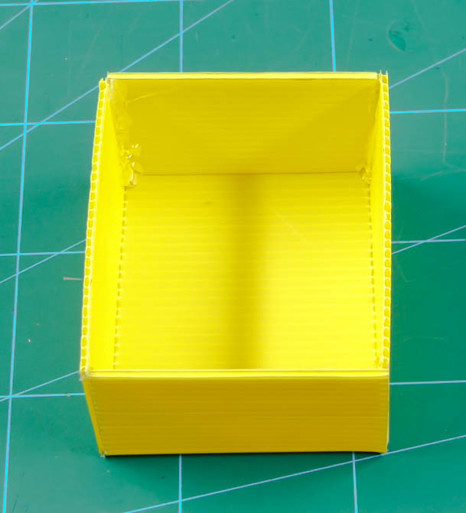
Making the Street Light
Fold along the markings done using a ruler.
And finally, glue them together using hot glue.
With this, your base is completed.

Slide 6
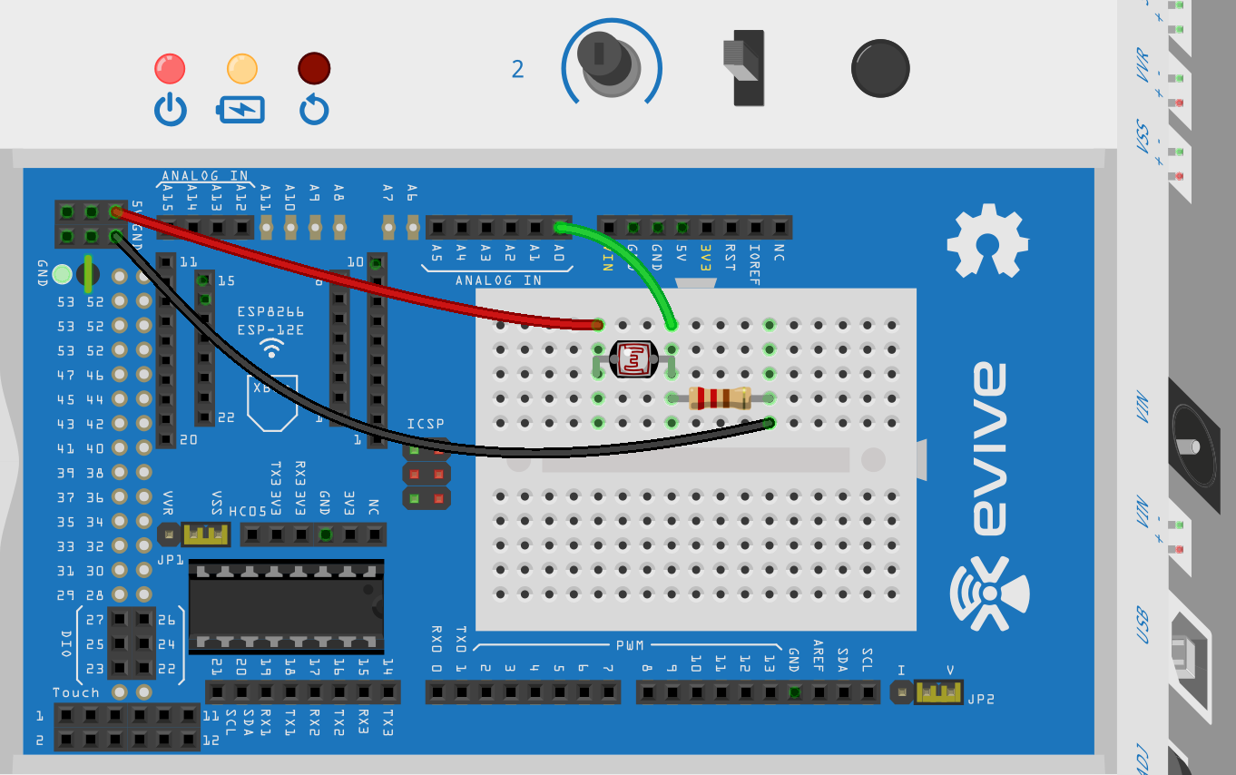
Testing the LDR
Connect LDR with evive as given below. Use 10KOhm Resistor.

Slide 7
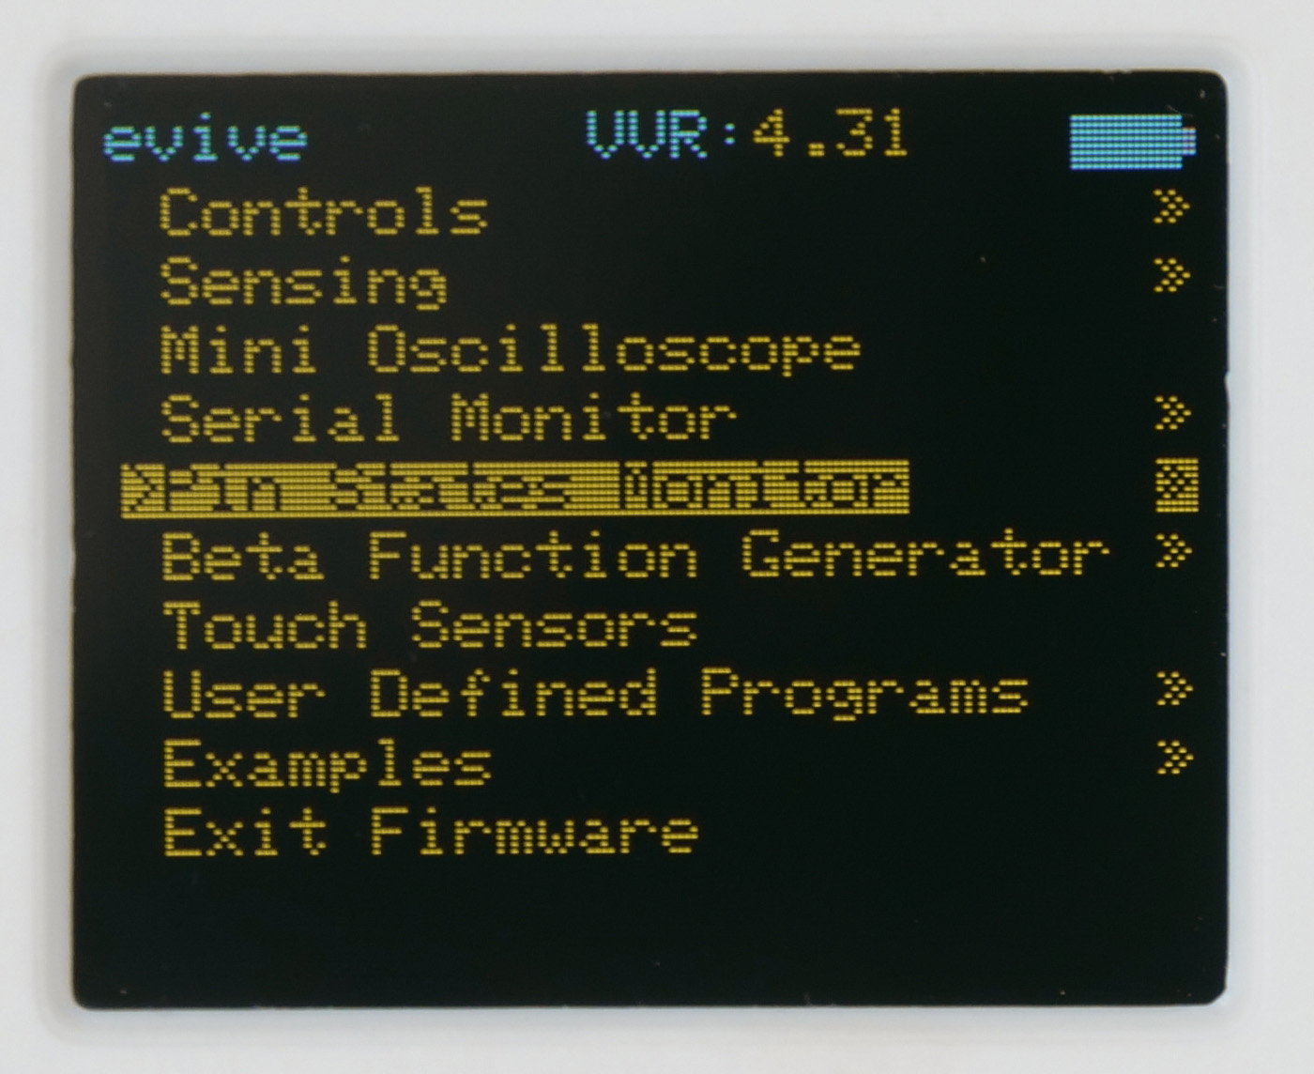
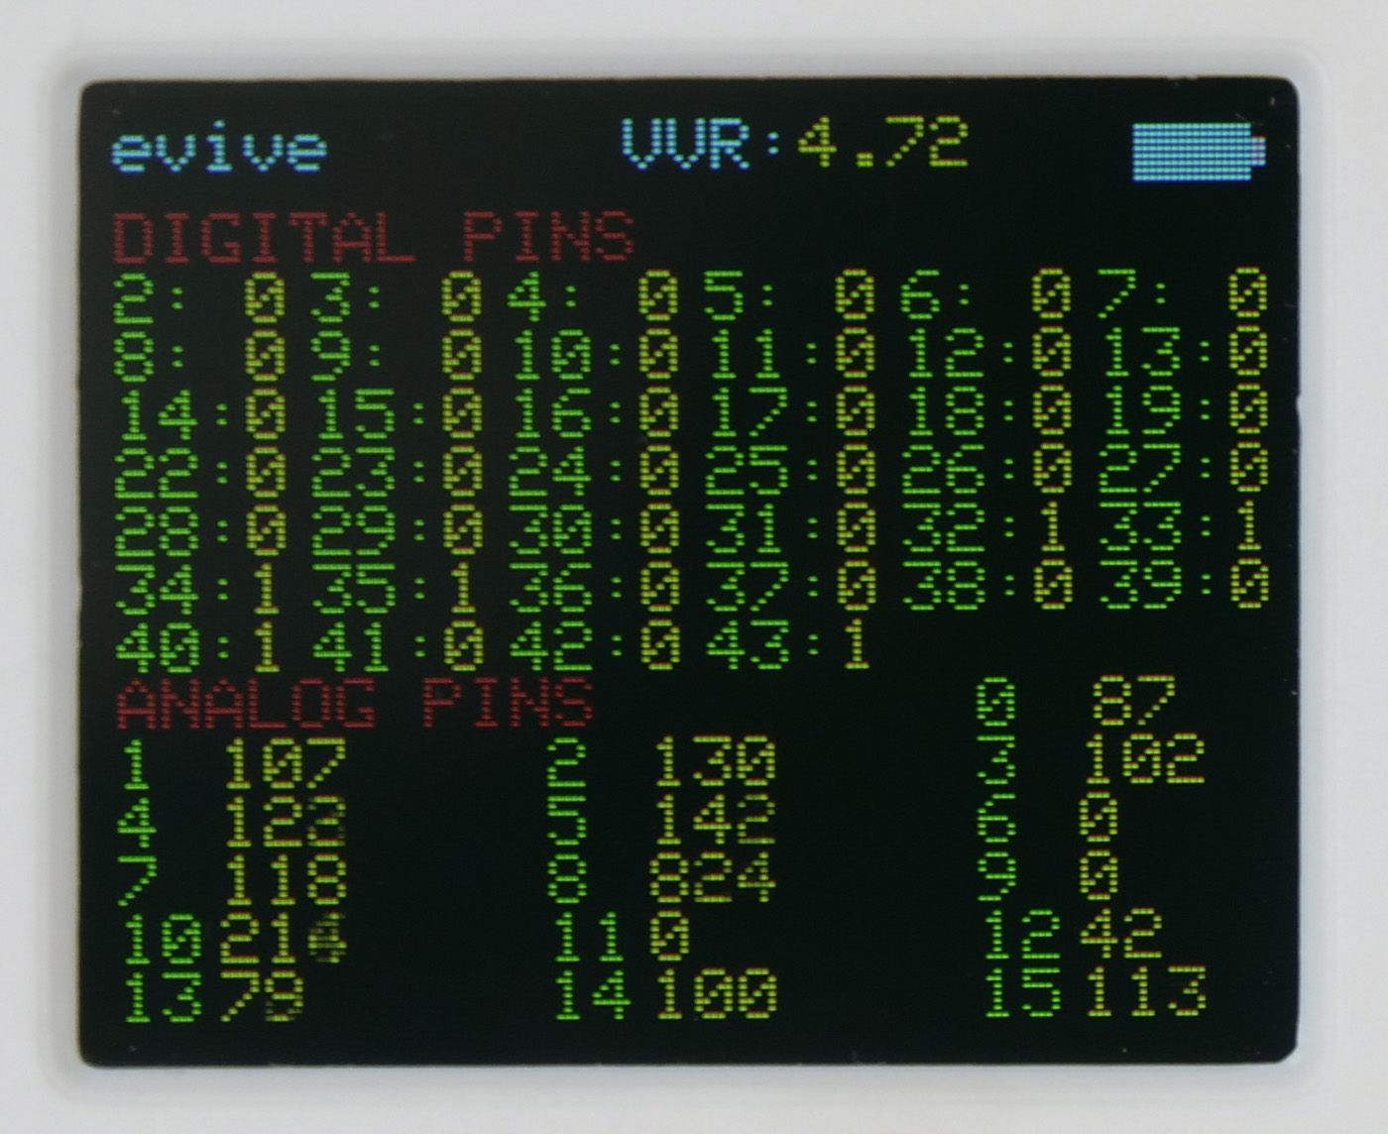
Pin State Monitor
Turn ON evive and navigate to Pin State Monitor.
Get the reading of light on A0 pin. Also get the see the reading for light on and light off by covering the sensor with hand.

Slide 8
Making the Street Light
Cut a small portion of the straw to make the arm. Make a slit of approximately 1cm at one end of it. This will help fix our head to the pole.

Slide 9
Making the Street Light
Create two holes into the U-shaped corrugated sheet or the lampshade of our Smart Street light using the header of the male jumper cable.
Insert the LDR legs into the given hole so that it sits tightly on the top of our lamp.

Slide 10
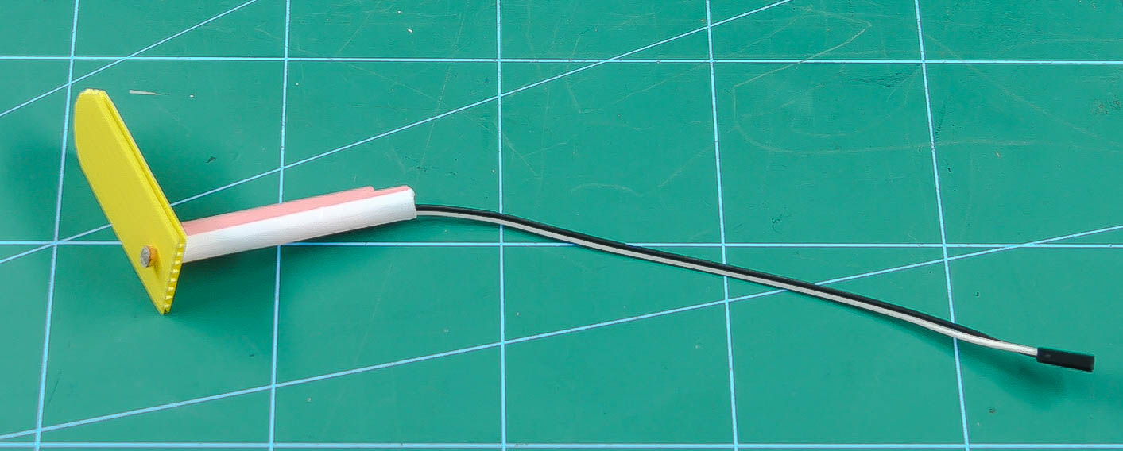
Making the Street Light
Connect the legs of LDR with a jumper cable and pass the wires through the arm.

Slide 11
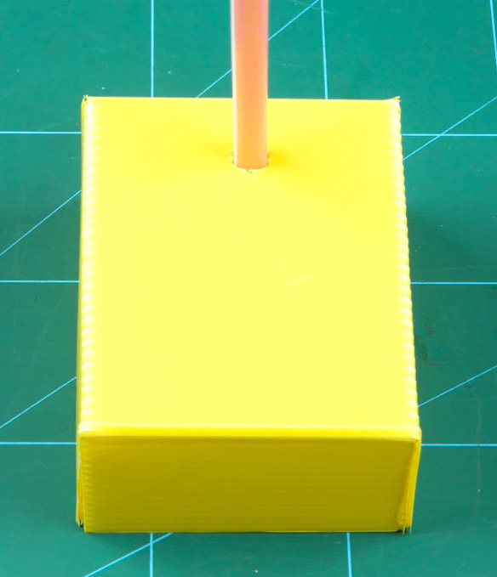
Making the Street Light
Add the LED to the other jumper cable and pass it through jumpers.
Make a hole of size of the straw in the platform and glue a straw (new to be used for pole) on the platform.

Slide 12
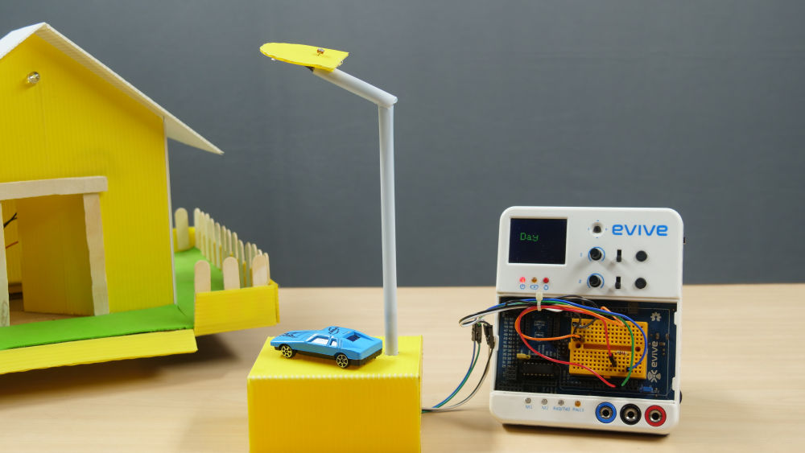
Making the Street Light
For connections, we would need to extend the jumper cables.
Pass the wires through the pole and attach LDR straw to pole.

Slide 13
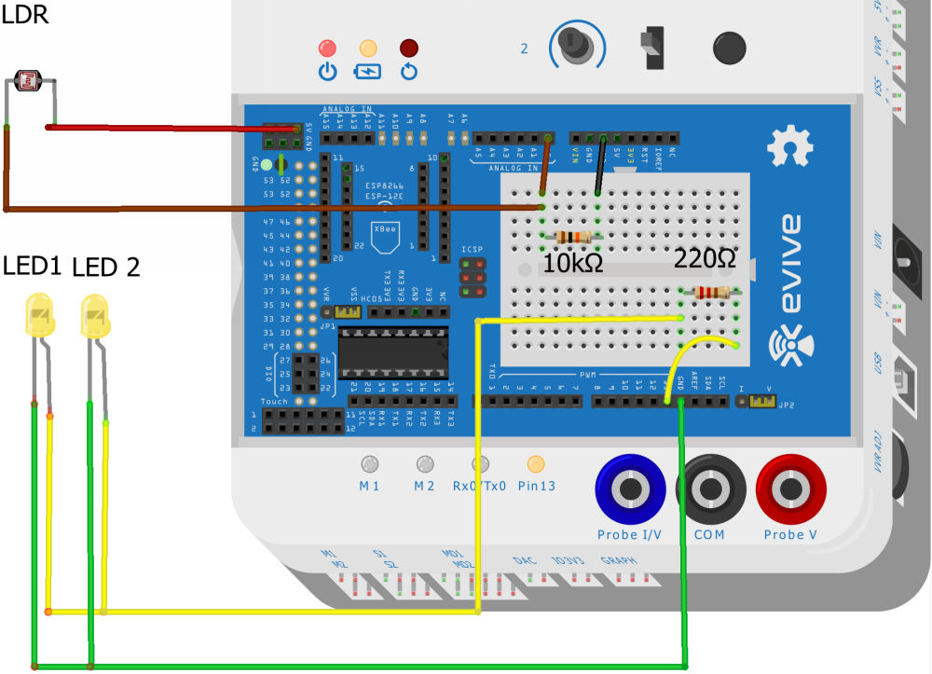
Circuitry
Make the circuit given below.

Slide 14
Logic
We have to set a threshold value of the reading for LDR, which will decide when its DAY and when its NIGHT.
So, if we set the threshold value to 500, then all the reading less than 500 will correspond to NIGHT and reading greater than 500 will correspond to DAY.
Again, when its DAY, we have to switch OFF the LED and when its NIGHT, we have to switch ON the LED.
Try to make the PictoBlox code for this logic.

Slide 15
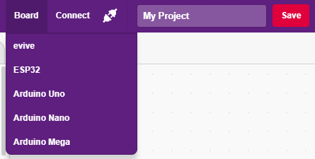
Interfacing evive with PictoBlox
Connect evive to your laptop/PC and open PictoBlox.
In PictoBlox, go to the menu and click on the Boards Select the evive.

Slide 16
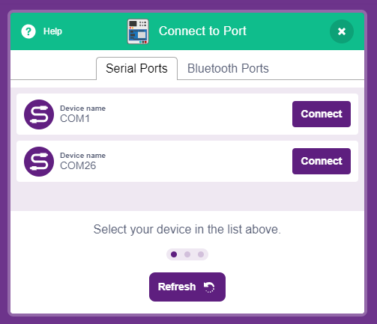
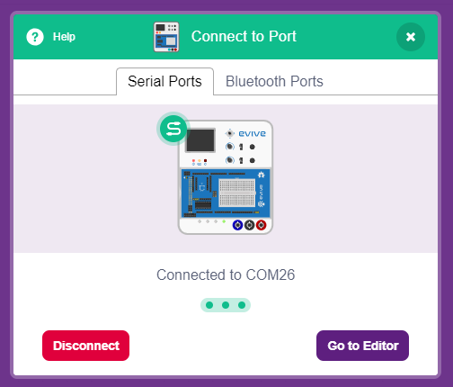
Interfacing evive with PictoBlox
Once you’ve selected the board, click on the Connect tab and connect the board.

Slide 17
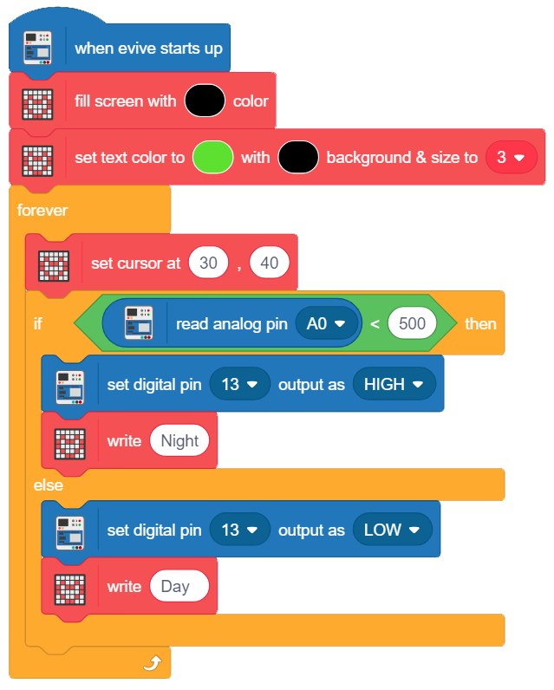
PictoBlox Program
Make the following program.
Upload it once done.

