Slide 1
Ultrasonic Sensor with evive

Slide 2
What is Ultrasonic Sensor?

Slide 3
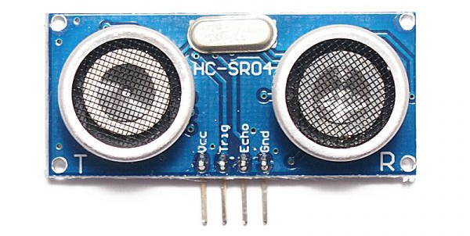
Ultrasonic Sensor
An ultrasonic sensor is a device that detects an object and measures the distance to it. It measures the distance by emitting ultrasound and receiving the wave that the object reflects.

Slide 4
Ultrasonic Sensor
By recording the time elapsed between the sound wave being generated and the sound wave bouncing back, it is possible to calculate the distance between the sensor and the object.

Slide 5
Distance Calculation Formula
The distance can be calculated with the following formula: Distance L = 1/2 × T × C
Where L is the distance, T is the time between the emission and reception, and C is the sonic speed. (The value is multiplied by 1/2 because T is the time for go-and-return distance.)

Slide 6
Connecting Ultrasonic Sensor to evive

Slide 7
Ultrasonic Sensor
The HC-SR04 Ultrasonic Module has 4 pins:
VCC
Trig
Echo
Ground (GND)
The Ground (GND) and the VCC pins of the module must be connected to the Ground and the 5V pins on evive respectively and the Trig and Echo pins to any 2 Digital I/O pins.

Slide 8
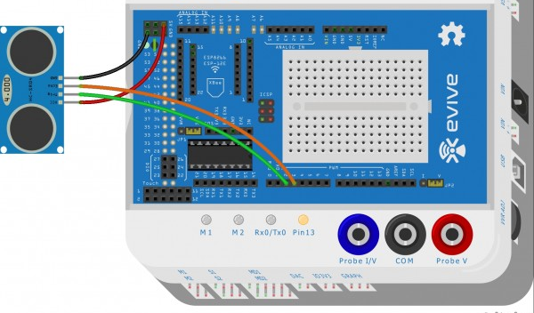
Circuit Diagram
Connect the Trig Pin of Ultrasonic sensor to digital pin 2.
Connect the Echo Pin of Ultrasonic sensor to digital pin 3.

Slide 9
Activity 1: Displaying the distance on the evive

Slide 10
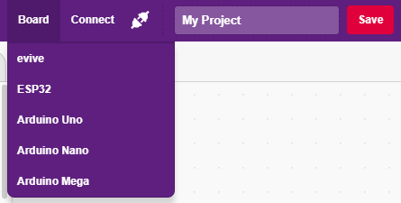
Interfacing evive with PictoBlox
Connect evive to your laptop/PC and open PictoBlox.
In PictoBlox, go to the menu and click on the Boards Select the evive.

Slide 11
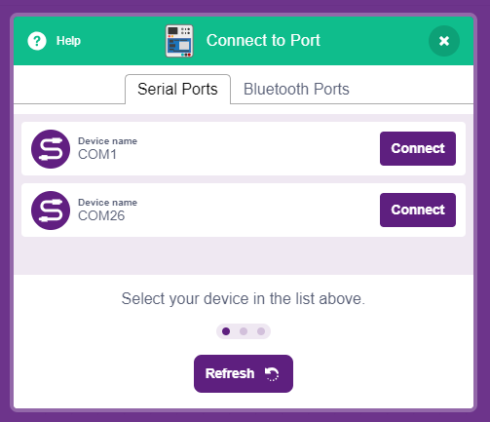
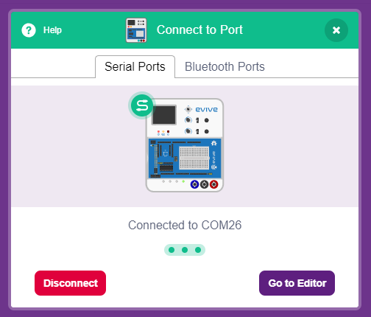
Interfacing evive with PictoBlox
Once you’ve selected the board, click on the Connect tab and connect the board.

Slide 12
Blocks
Get ultrasonic sensor distance (cm) trig () echo () block is a reporter block available in sensors extension.
The block reports the distance of the nearest object from an ultrasonic sensor. It returns distance in cm.
The trigger pin and echo pin are connected to a digital pin of evive which can be selected from the drop-down menu.

Slide 13
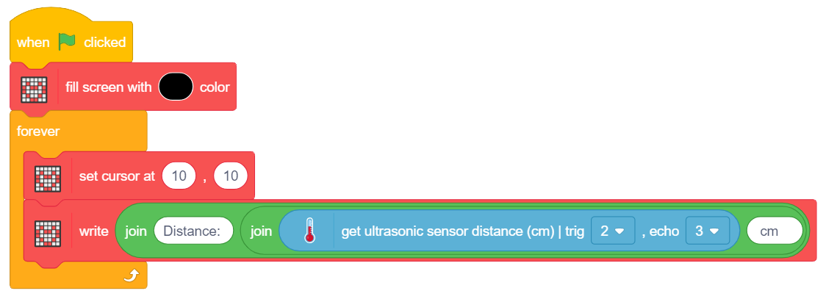
PictoBlox Program
In this program we are displaying the distance in cm on the evive display.
Run the script.

Slide 14
Activity 2: Distance Alarm System

Slide 15
Distance Alarm System
In this Distance Alarm System, we will notify the user the distance of the object by changing the sound. This can be used by blind people or by someone who is parking the car.
When the distance gets closer to 150 cm, evive buzzer will make a low pitch sound.
When the distance is between 100 to 150 cm, it will increase the pitch.
When the distance is between 50 to 100 cm, it will increase the pitch even more.
When the distance is less than 50, it will have maximum pitch. Try to code this yourself first.

Slide 16
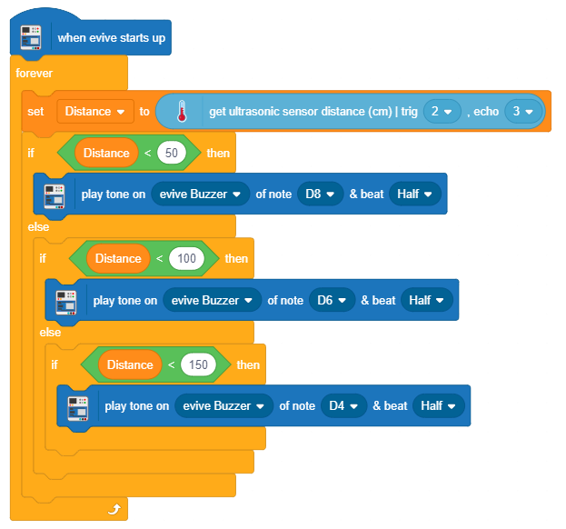
Distance Alarm System

