Slide 1
Controlling DC Motor using PictoBlox

Slide 2
Controlling DC Motor using PictoBlox
In this session, we will learn how to control a DC motor using PictoBlox programming by doing the following activities:
Setting the direction and speed of the motor input by the user.
Controlling the DC motor using potentiometer and a slide switch.

Slide 3
What is DC Motor?

Slide 4
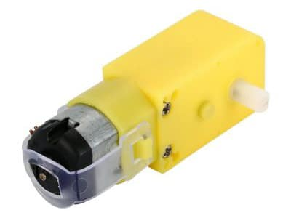
DC Motor
Any motor, in general, takes in electricity from one end and uses it to rotate the rod at its other end.
You can control two things in a DC motor:
Speed of rotation
Direction of rotation

Slide 5
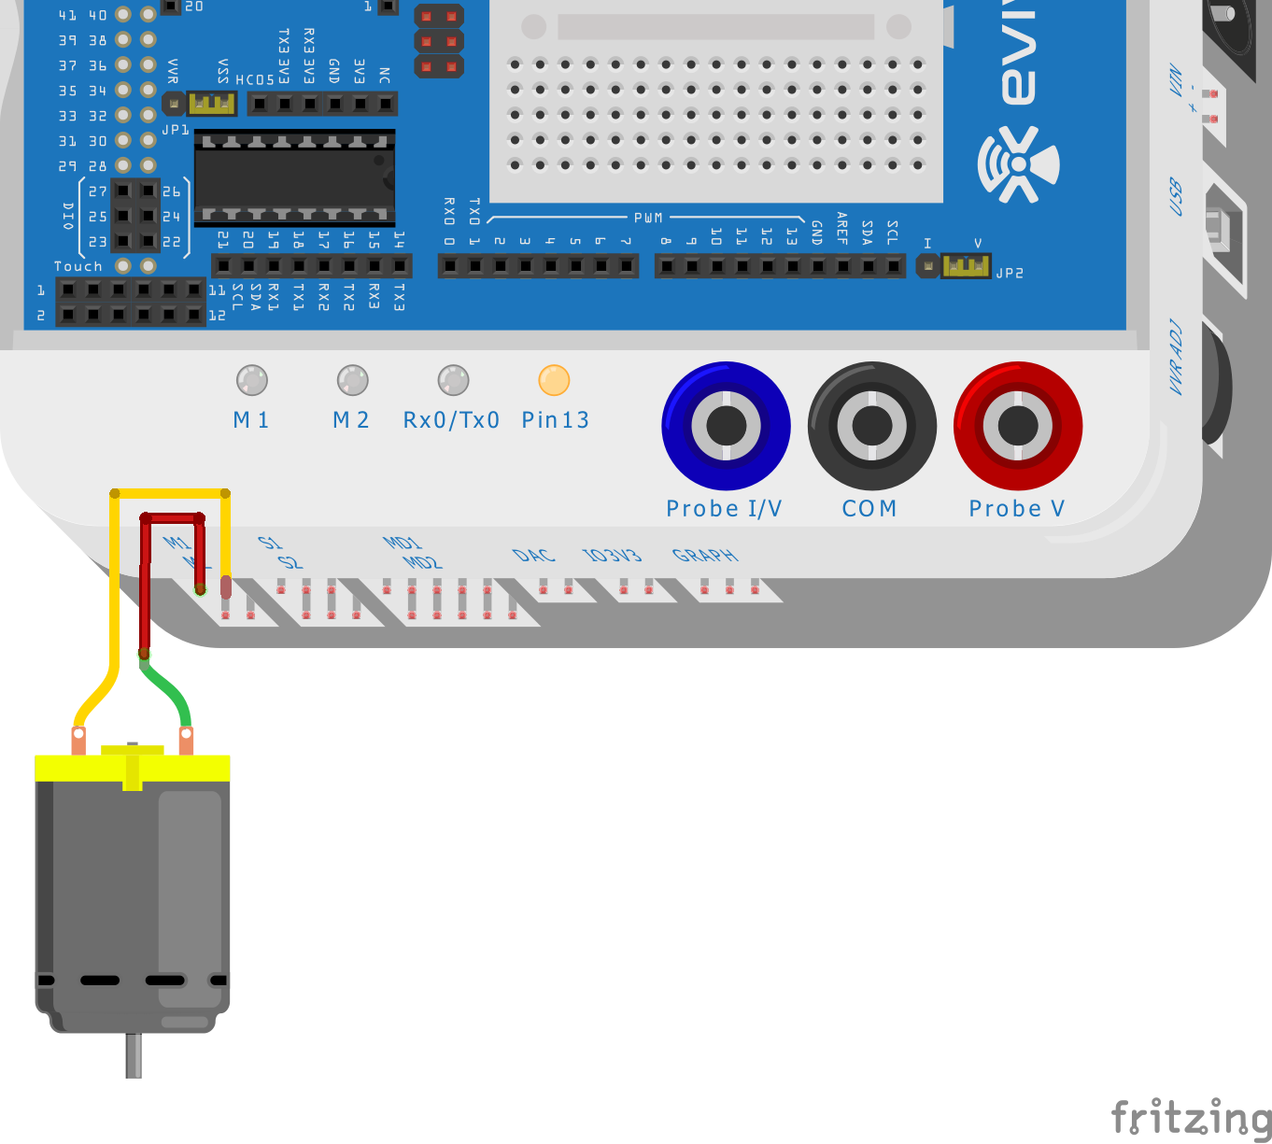
Circuit Diagram
Take the motor and insert the wires attached to it in the first motor channel, i.e. M1.
Attach a wheel to visualize the rotation of the motor.

Slide 6
DC Motor Controlling Block

Slide 7
How to control DC motor?
DC motor runs when a voltage is provided on the terminals.
But we cannot connect the motor to any digital pin directly to control the motor because it takes more current.
This is why we use motor drivers to control motor.
The motor driver take the logic from evive, power source from the internal or the external batteries and provide voltage to DC motor according to the logic.
evive has a inbuilt motor driver allowing you to control upto 2 DC motors.

Slide 8
How to control DC motor?
For every DC motor control, we have to use 3 pins of evive:
2 digital pins to specify the direction.
1 PWM pin to specify the speed of rotation.
Direction Pin 1 State | Direction Pin 2 State | Motor Function
LOW | LOW | Motor is free
LOW | HIGH | Motor rotates in one direction
HIGH | LOW | Motor rotates in another direction
HIGH | HIGH | Motor is stalled

Slide 9
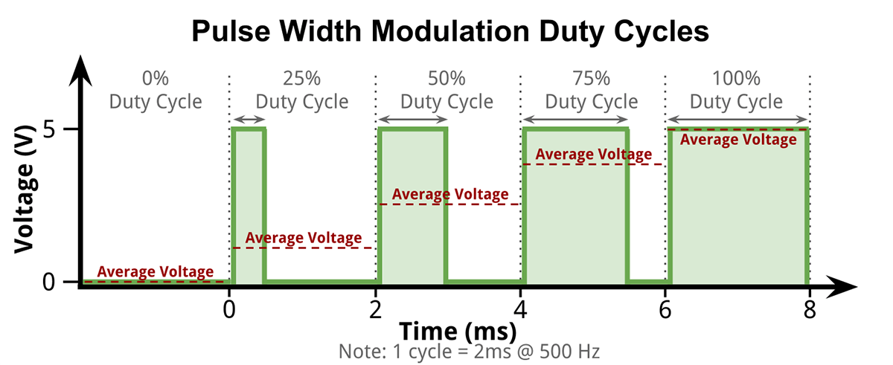
How to control speed of DC motor?
PWM is a technique for getting analog results with digital means. Digital control is used to create a square wave, a signal switched between on and off.
This signal gets decoded by the motor driver.

Slide 10
Block
Run motor () in direction () with speed () % block is a stack block which is available in the Actuators palette.
The block takes the motor port, the direction of rotation (forward or reverse) and speed of rotation (between 0 to 100 %) as input from the user and rotates the motor accordingly.

Slide 11
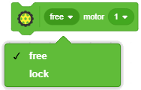
Block
() motor () block is a stack block available in actuators extension.
The block free or locks the motor connected to the selected slot.
Lock: In this case, the motor also resists any rotational movement. This is like the brake.
Free: In this case, the motor if free for any rotational movement. This is like the clutch.

Slide 12
Activity 1: Setting the direction and speed of the motor input by the user

Slide 13
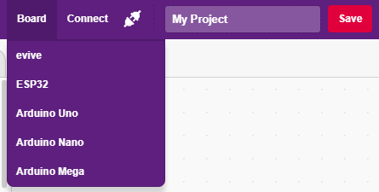
Interfacing evive with PictoBlox
Connect evive to your laptop/PC and open PictoBlox.
In PictoBlox, go to the menu and click on the Boards Select the evive.

Slide 14
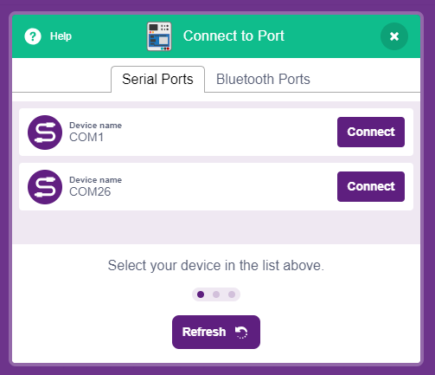
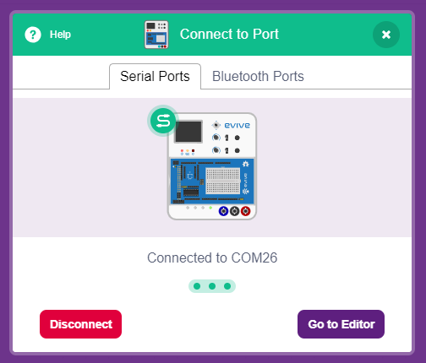
Interfacing evive with PictoBlox
Once you’ve selected the board, click on the Connect tab and connect the board.

Slide 15
Upload Firmware
You have to upload the firmware into the device before interacting with it.
Click on Upload Firmware button.
Once you successfully uploaded the firmware you will see evive logo on evive display.

Slide 16
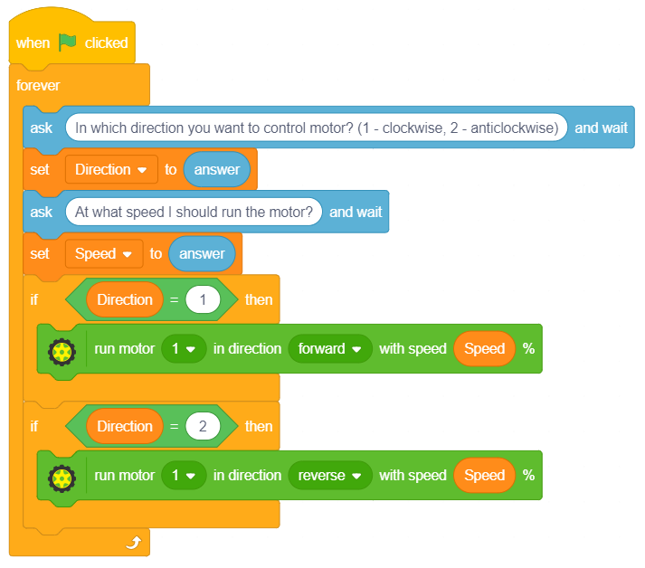
PictoBlox Program
Make the following program. Tobi will ask the user to set the speed and direction.
Make two variables to store speed and direction of the motor.

Slide 17
Activity 2: Controlling the DC motor using potentiometer and a slide switch.

Slide 18
Controlling the DC Motor
In this activity, we will controlling the DC motor in the same way we control it in the evive Menu.
Using potentiometer 1, we will set the speed of the motor and using the slide switch, we will set the direction of the rotation.
If slide switch is up – Motor run forward.
If slide switch is down – Motor runs backward.
If slide switch is in middle – Motor will be free.
Try to make the program by yourself first.

Slide 19
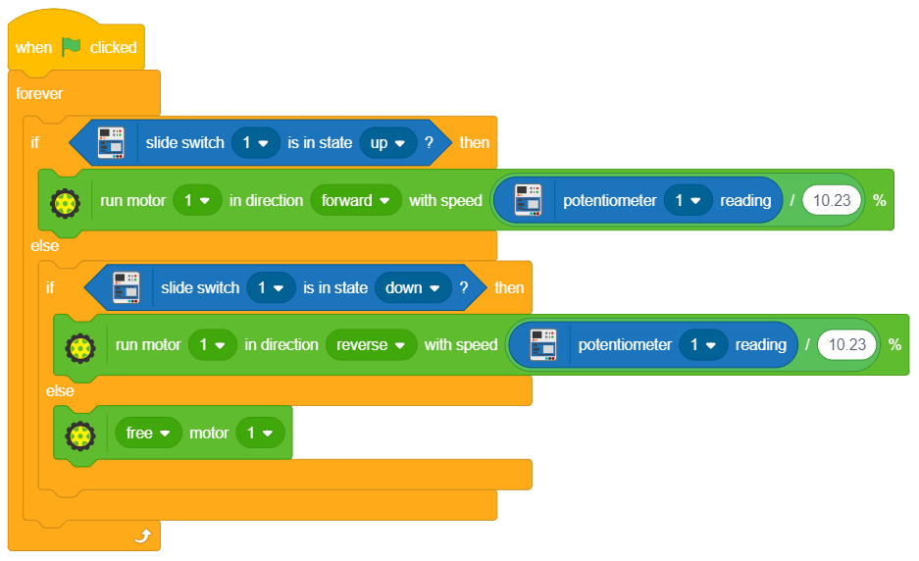
PictoBlox Program
Make the following program.

