Slide 1
RGB LED Strip Controlling individual LEDs

Slide 2
What is RGB LED Strip?

Slide 3
RGB LED Strip
RGB LED strip is flexible circuit board with full color LEDs soldered on.

Slide 4
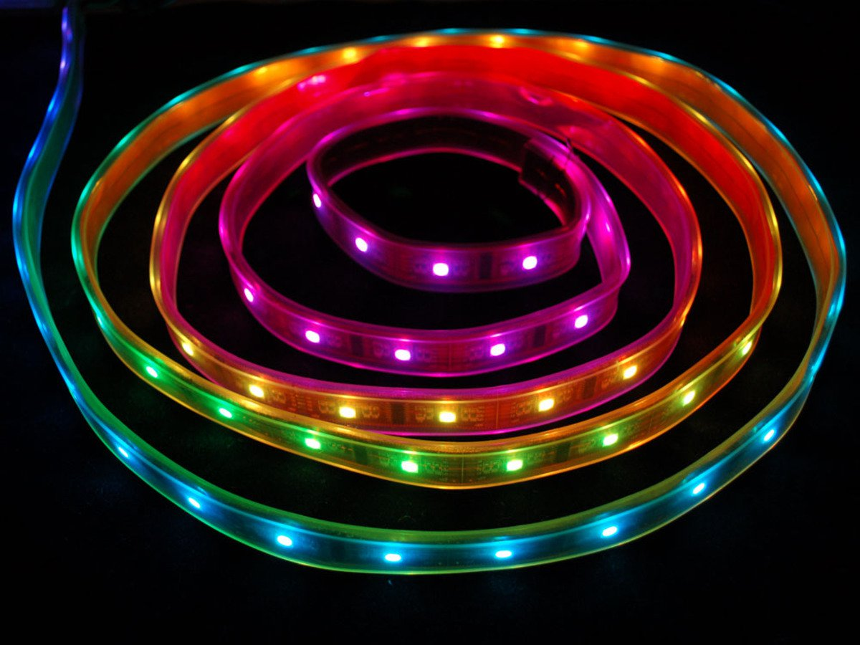
Digital RGB LED Strip
The Digital-type strips have a chip for each LED, to use the strip you have to send digitally coded data to the chips. However, this means you can control each LED individually!
We are using digital type strip in this session.

Slide 5
Connecting RGB LED to evive

Slide 6
Circuit Diagram
Connect GND of LED strip to GND of evive.
Connect 5V of LED strip to 5V of evive.
Connect Din pin of the LED strip to digital pin 2 of evive.

Slide 7
Blocks to Control RGB LED Strip

Slide 8
Lighting Extension
Lighting Extension enables you to manipulate colors of an RGB LED strip.
You can add the extension from the extension library.

Slide 9
Lighting Extension
Initialise RGB strip () with () LED pixels on pin () block initializes the RGB LED strip to the selected digital pin.
The user also has to specify the number of LED pixels in the RGB LED.
The user can initialize up to 5 LED strips at a time.

Slide 10
Lighting Extension
Set RGB strip () LED pixel () color () block sets the selected RGB LED strip's pixel (specified in the block) to a color selected from the color picker.
Show RGB strip () block refreshes the LED state once all the pixel's color has been specified. The color of the strip will not change until you execute this block.

Slide 11
Activity 1: Controlling Individual LEDs

Slide 12
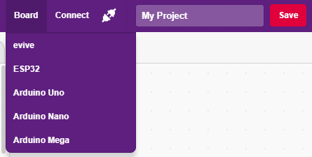
Interfacing evive with PictoBlox
Connect evive to your laptop/PC and open PictoBlox.
In PictoBlox, go to the menu and click on the Boards Select the evive.

Slide 13
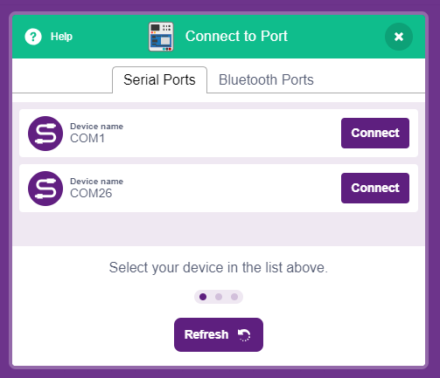
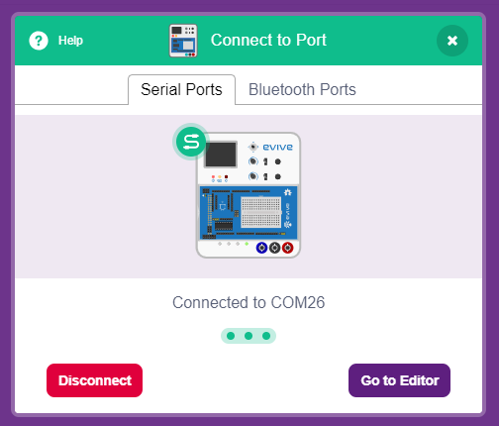
Interfacing evive with PictoBlox
Once you’ve selected the board, click on the Connect tab and connect the board.

Slide 14
Upload Firmware
You have to upload the firmware into the device before interacting with it.
Click on Upload Firmware button.
Once you successfully uploaded the firmware you will see evive logo on evive display.

Slide 15
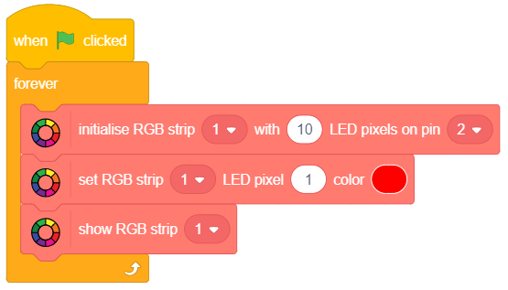
PictoBlox Program
Make the following script. We are just giving colour to first LED and then showing the colour.

Slide 16
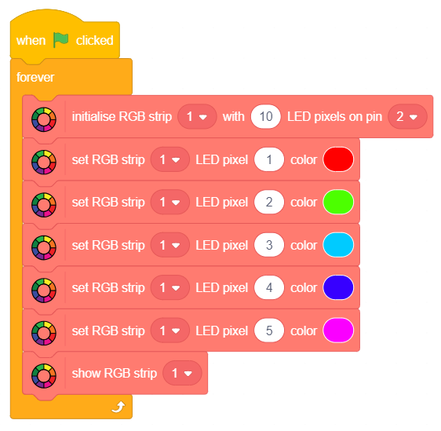
PictoBlox Program
Make the following script. Give different colour to each LEDs.

Slide 17
Activity 2: Making a Pattern

Slide 18
PictoBlox Program
In this activity, you are going to make a pattern. In this pattern, LEDs will glow one by one from 1 to 10.
So, for 1 second first LED will glow, then it will be white and the second LED will glow the color for another 1 second.
This will go till the last LED and then repeat.
Try to make this pattern by yourself first. (Hint use repeat and variable to track LED)

Slide 19
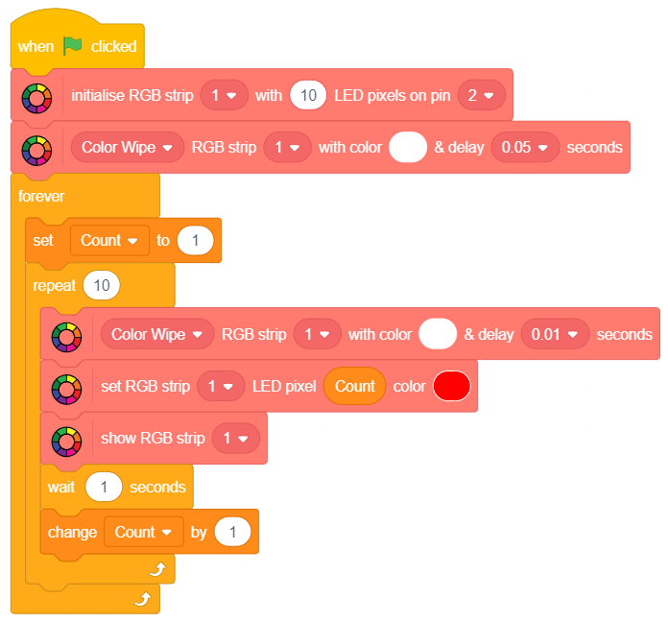
PictoBlox Program

