Slide 1
RGB LED Strip

Slide 2
What is RGB LED Strip?

Slide 3
RGB LED Strip
RGB LED strip is flexible circuit board with full color LEDs soldered on.

Slide 4
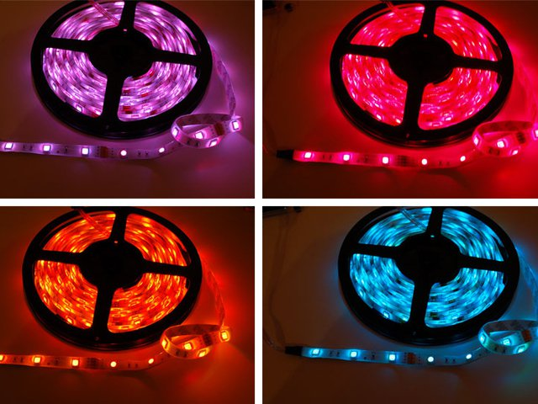
Types of RGB LED Strip
There are two basic kinds of LED strips, the "analog" kind and "digital" kind.
Analog-type strips have all the LEDs connected in parallel and so it acts like one huge tri-color LED.
You can set the entire strip to any color you want, but you can't control the individual LED's colors.

Slide 5
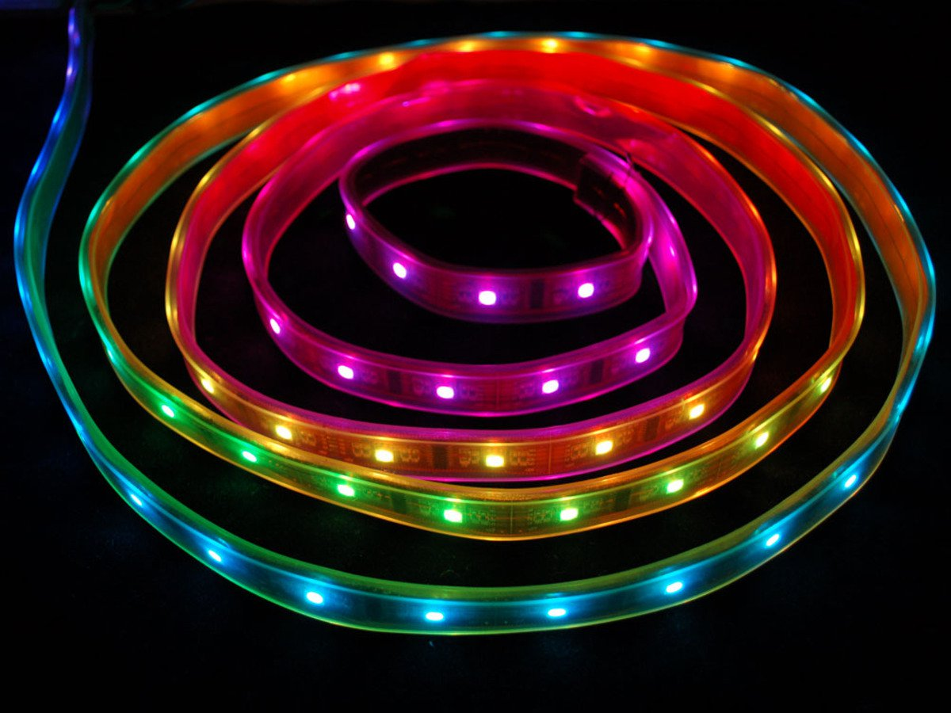
Types of RGB LED Strip
The Digital-type strips work in a different way. They have a chip for each LED, to use the strip you have to send digitally coded data to the chips. However, this means you can control each LED individually!
We are using digital type strip in this session.

Slide 6
Connecting RGB Strip to evive

Slide 7
Circuit Diagram
Connect GND of LED strip to GND of evive.
Connect 5V of LED strip to 5V of evive.
Connect Din pin of the LED strip to digital pin 2 of evive.

Slide 8
Blocks to Control RGB LED Strip

Slide 9
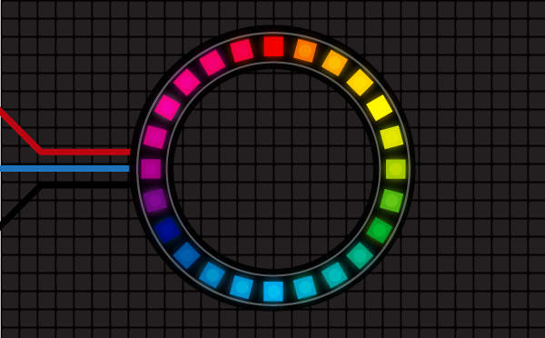
Lighting Extension
Lighting Extension enables you to manipulate colors of an RGB LED strip.
You can add the extension from the extension library.

Slide 10
Lighting Extension
Initialise RGB strip () with () LED pixels on pin () block initializes the RGB LED strip to the selected digital pin.
The user also has to specify the number of LED pixels in the RGB LED.
The user can initialize up to 5 LED strips at a time.

Slide 11
Lighting Extension
() RGB strip () with color () & delay () seconds block executes two patterns on the selected RGB Strip: Color Wipe and Theater Chase, of the specified color (from the color picker) and delay.

Slide 12
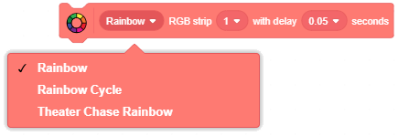
Lighting Extension
() RGB strip () with delay () seconds block executes three predefined patterns on the selected RGB Strip: Rainbow, Rainbow Cycle and Theater Chase Rainbow.
We will learn about other blocks in the next session.

Slide 13
Activity: Testing the Different Patterns

Slide 14
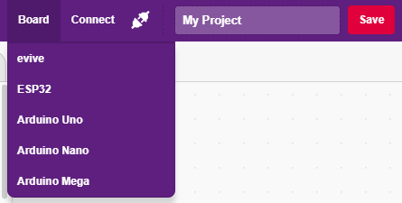
Interfacing evive with PictoBlox
Connect evive to your laptop/PC and open PictoBlox.
In PictoBlox, go to the menu and click on the Boards Select the evive.

Slide 15
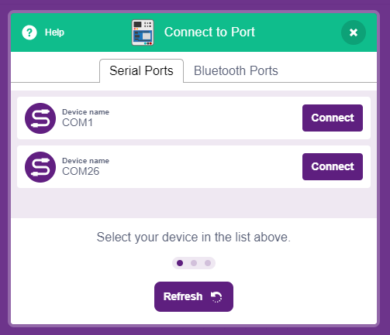
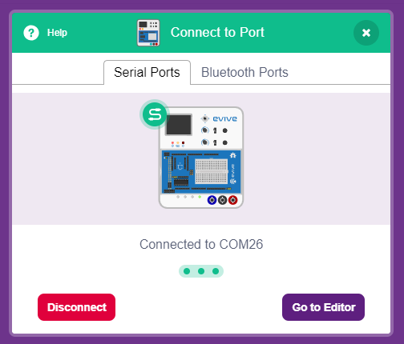
Interfacing evive with PictoBlox
Once you’ve selected the board, click on the Connect tab and connect the board.

Slide 16
Upload Firmware
You have to upload the firmware into the device before interacting with it.
Click on Upload Firmware button.
Once you successfully uploaded the firmware you will see evive logo on evive display.

Slide 17
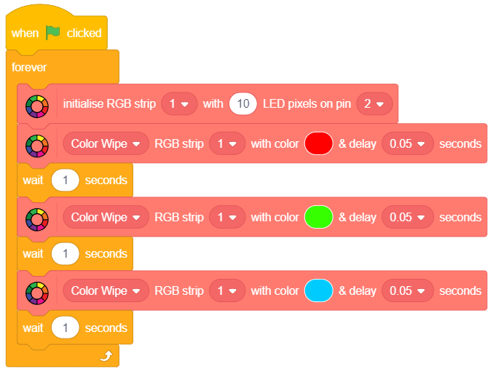
PictoBlox Program
Make the following script:

Slide 18
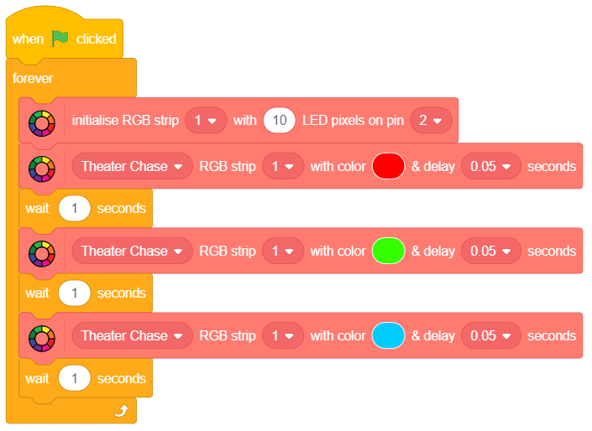
PictoBlox Program
Make the following script:

Slide 19
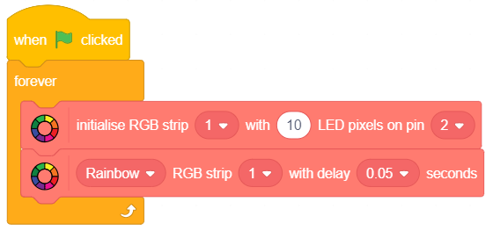
PictoBlox Program
Make the following script:

Slide 20
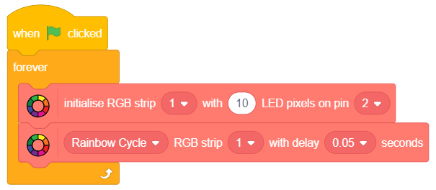
PictoBlox Program
Make the following script:

Slide 21
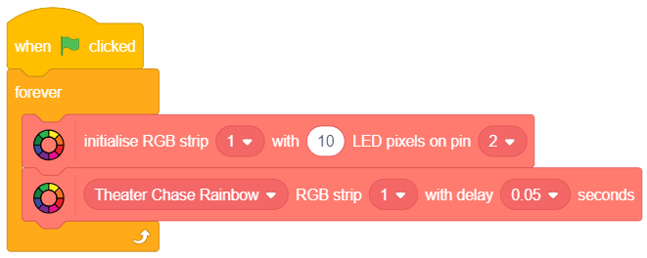
PictoBlox Program
Make the following script:

