Slide 1
The Hungry Shark

Slide 2
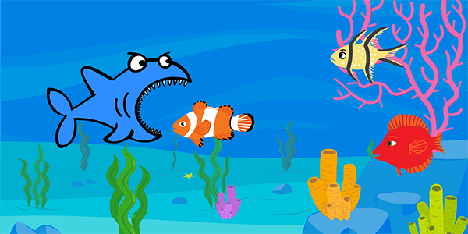
The Hungry Shark
In this activity you will make a game in PictoBlox where the aim of the game is to feed the shark as many fish as you can by controlling it with evive’s potentiometer.

Slide 3
Setting up the Stage

Slide 4
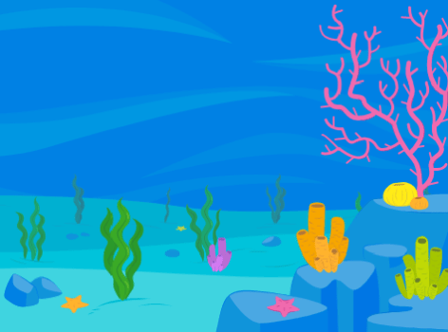
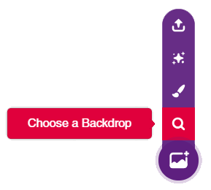
Setting up the Stage
Click on the purple colored icon which says Choose a Backdrop.
Select the underwater backdrop from the library.

Slide 5
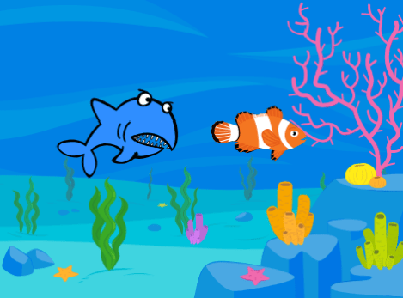
Bringing in the Sprites
In this game, we need two sprites: the shark and the fish. Open the sprite library as we did in the previous chapter and choose the fish and Shark2 sprites.

Slide 6
Assigning Movements to Shark

Slide 7
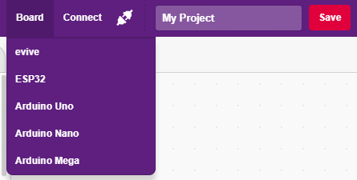
Interfacing evive with PictoBlox
Connect evive to your laptop/PC and open PictoBlox.
In PictoBlox, go to the menu and click on the Boards Select the evive.

Slide 8
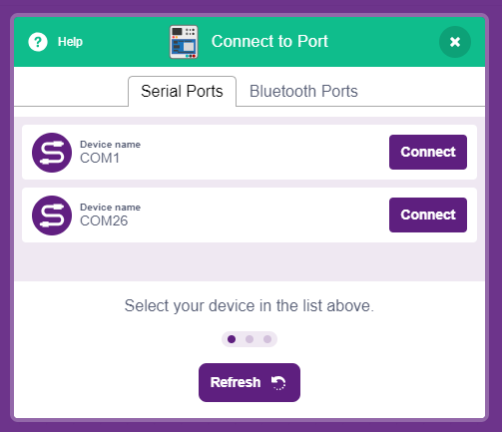
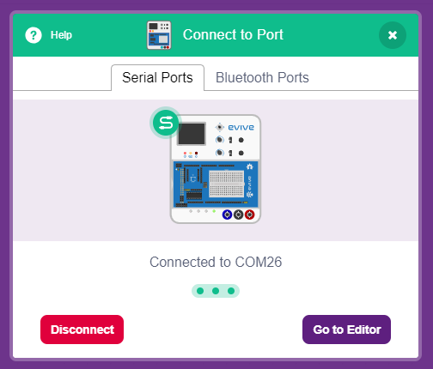
Interfacing evive with PictoBlox
Once you’ve selected the board, click on the Connect tab and connect the board.

Slide 9
Upload Firmware
You have to upload the firmware into the device before interacting with it.
Click on Upload Firmware button.
Once you successfully uploaded the firmware you will see evive logo on evive display.

Slide 10
Assigning Movements to Shark
We will control the shark movement using potentiometer.
The shark will start from a fixed center point and will keep on moving until game is over.
User can only change the direction of the shark using Point in direction block.
Make a variable Score to track no of fish shark has eaten in the game.

Slide 11
Assigning Movements to Shark
We want to control the direction of the shark using the potentiometer, but here is a catch: the potentiometer gives values in the range of 0 to 1023 and our shark can rotate only 360°.
Therefore, we will map the potentiometer values using the following mathematical formula: Shark’s direction = (Potentiometer value *360)/1023

Slide 12
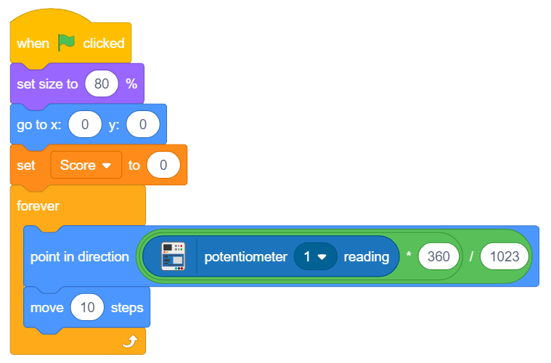
Assigning Movements to Shark
Shark’s direction = (Potentiometer value *360)/1023

Slide 13
Fish ‘N’ (Their) Scripts

Slide 14
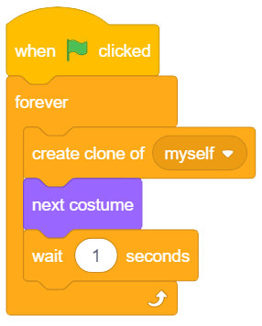
Cloning the Fish
It’s time to write the scripts for the fish. Make sure that the fish sprite is selected.
Make the code to clone the fish every 1 second.

Slide 15
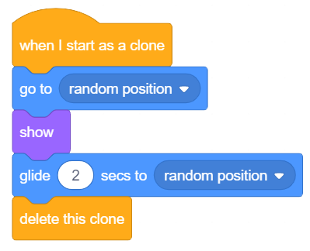
Assigning Movements to the Clones
The clone will show up at a random point on the stage and will move a random point in 2 seconds. This adds uncertainty and makes game fair.
After the movement, we will delete the clone.

Slide 16
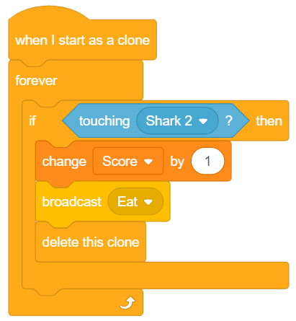
Eating the Fish
Every time the shark eats a fish, the Score should increase.
In this script we are detecting when the clone touches the shark, then increase the score and delete the clone.

Slide 17
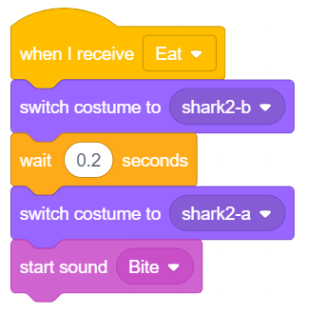
Eating Animation
When the fish sprite broadcasts the message Eat, we want the shark sprite to make a sound and to look as if it has eaten the fish. Follow the steps below to write a script for the same.
Make sure that the shark sprite is selected.

Slide 18
Game is Ready! But

Slide 19
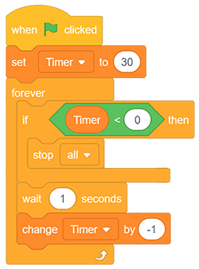
Addon
To make the game more challenging, you can time the game. Try adding another script for the timer!
There are various ways in which you can write the timer script. One of them is shown below:

