Slide 1
Beetle in the Maze

Slide 2
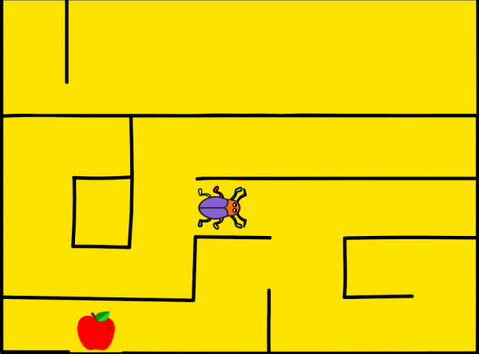
Beetle in the Maze
In this activity you will make an animated game in PictoBlox where beetle needs help to come out of the maze without touching the boundaries.

Slide 3
Setting up the Stage

Slide 4
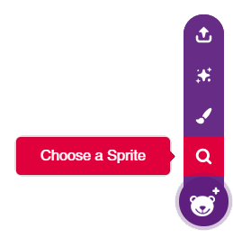
Setting up the Stage
Right below the stage, you will see a purple button with a bear on it. Take the cursor over it and select Choose a Sprite; the sprite library will open.
Select the beetle sprite from the library.

Slide 5
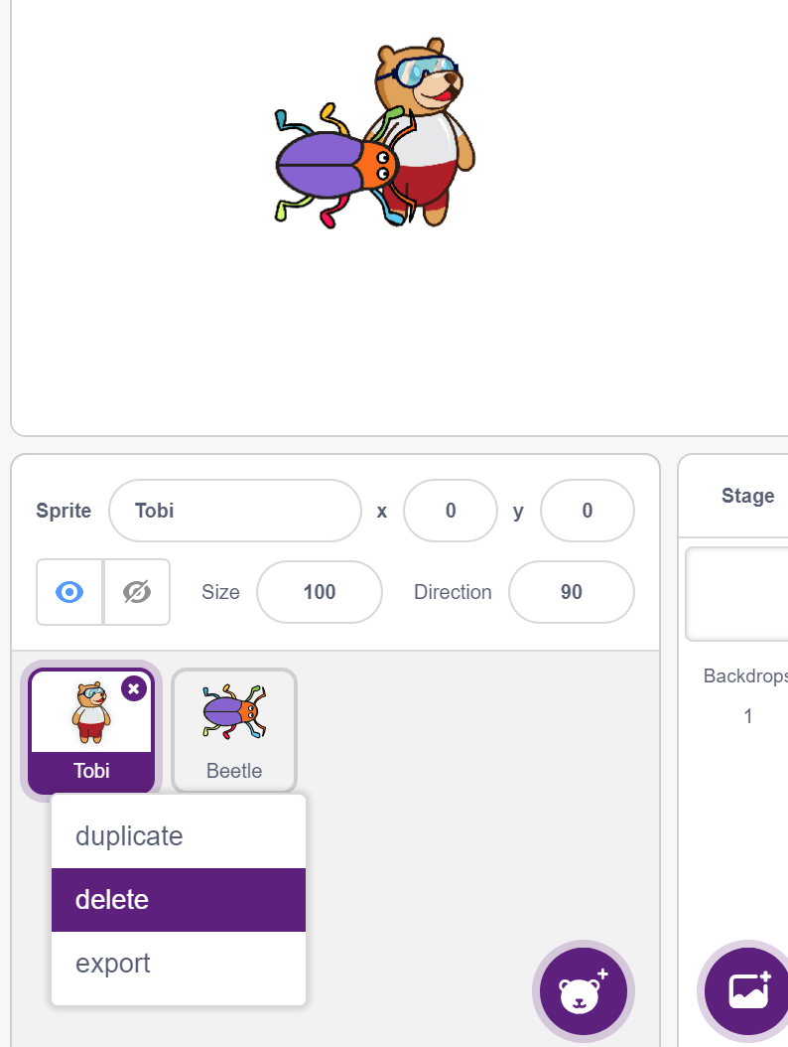
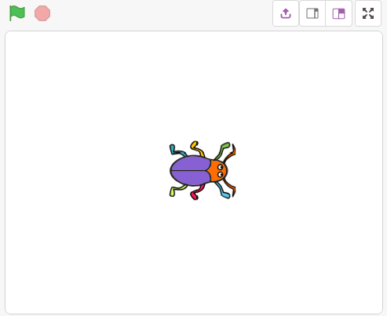
Setting up the Stage
Now, there are two sprites: beetle and Tobi.
Right click on the icon for Tobi (below the stage) and click on the delete option.

Slide 6
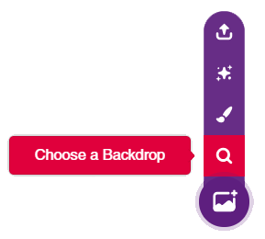
Setting up the Stage
Click on the purple colored icon which says Choose a Backdrop.
Select the maze backdrop from the library.

Slide 7
Giving the Beetle Its Moves

Slide 8
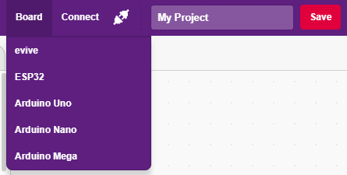
Interfacing evive with PictoBlox
Connect evive to your laptop/PC and open PictoBlox.
In PictoBlox, go to the menu and click on the Boards Select the evive.

Slide 9
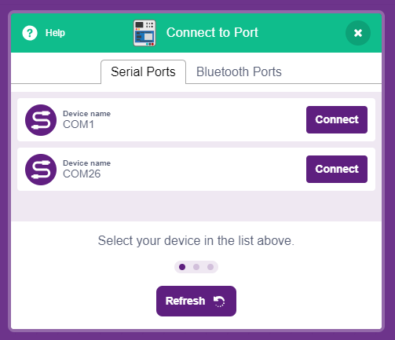
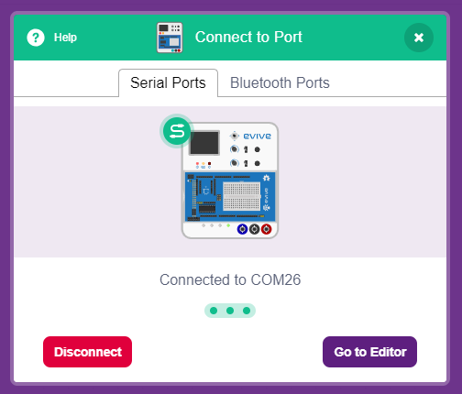
Interfacing evive with PictoBlox
Once you’ve selected the board, click on the Connect tab and connect the board.

Slide 10
Upload Firmware
You have to upload the firmware into the device before interacting with it.
Click on Upload Firmware button.
Once you successfully uploaded the firmware you will see evive logo on evive display.

Slide 11
Giving the Beetle Its Moves
We will control the Beetle movement using Navigation Key of evive.
The beetle must move in the direction we push the key.
navigation key is in state () ? block checks if the navigation key is in one of the four particular directions. The direction for which you wish to check is your choice and can be chosen from the drop down on the block.

Slide 12
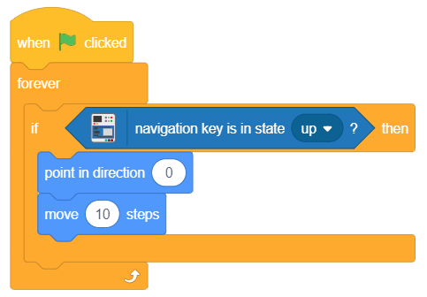
Giving the Beetle Its Moves
Write the code to move the beetle in up direction & test:
Try to make the code for other directions.

Slide 13
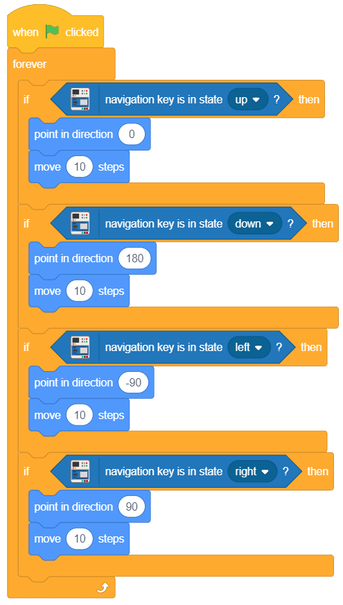
Giving the Beetle Its Moves
For ‘down’, set the direction as 180.
For ‘right’, set the direction as 90.
For ‘left’, set the direction as -90.

Slide 14
Sensing the environment

Slide 15
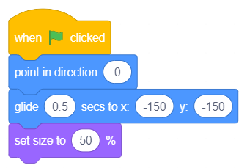
Sensing the environment
Now, it’s time to write the script for safely taking the beetle to the end of the maze.
Make the code to initialize the game, so that every time game starts at one position.

Slide 16
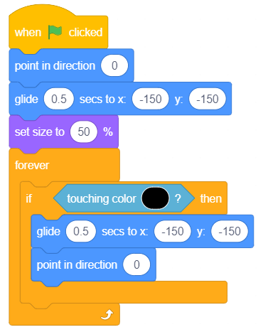
Sensing the environment
Now we will add the condition when the beetle touch maze, it will go back to its original position.
Using the color picker, pick the maze color.

Slide 17
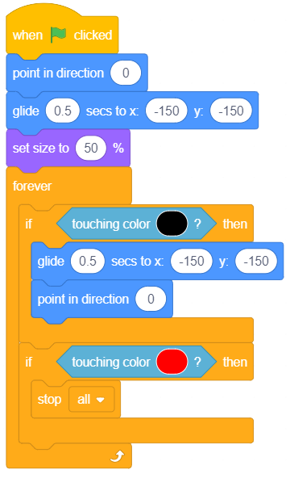
Sensing the environment
Now we will add the condition to end the game. Game ends when the beetle touches the apple.
Using the color picker, pick the apple color.
Game is complete now. Play!

