Slide 1
Physical Computing evive Display – Text Manipulation

Slide 2
evive Display

Slide 3
evive Display
evive has a 1.8” TFT Display which is mainly used for visual feedback. The display has a 160 x 128 color pixels.

Slide 4
evive Display palette

Slide 5
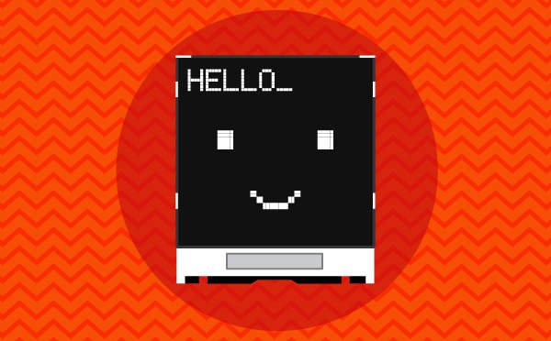
evive Display palette
evive Display palette allows you to control the display on evive screen (change colour, font size, and font colour), draw shapes, write text, and display values on the screen.

Slide 6
evive Display palette: Exploring Blocks

Slide 7
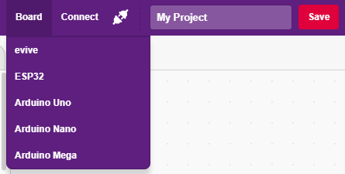
Interfacing evive with PictoBlox
Connect evive to your laptop/PC and open PictoBlox.
In PictoBlox, go to the menu and click on the Boards Select the evive.

Slide 8
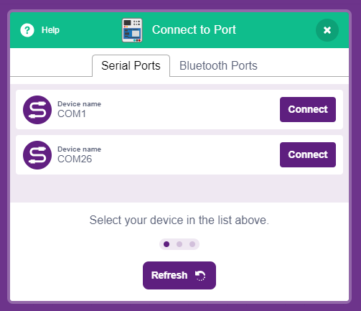
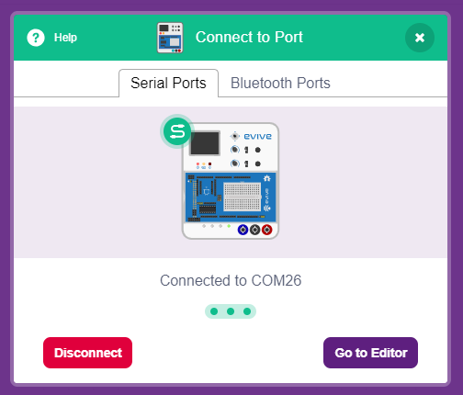
Interfacing evive with PictoBlox
Once you’ve selected the board, click on the Connect tab and connect the board.

Slide 9
Upload Firmware
You have to upload the firmware into the device before interacting with it.
Click on Upload Firmware button.
Once you successfully uploaded the firmware you will see evive logo on evive display.

Slide 10
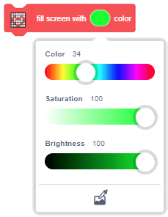
Exploring Blocks – Fill Screen
Fill screen with () color block is used to change the color of the entire TFT screen of evive. You can select the color from the color picker.

Slide 11
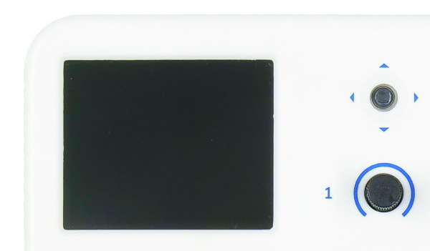
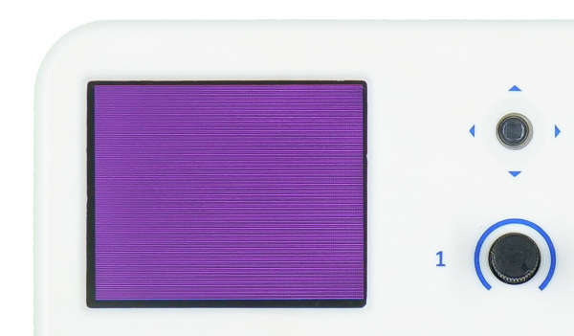
Exploring Blocks – Fill Screen
Select 2-3 colors and change the screen color.

Slide 12
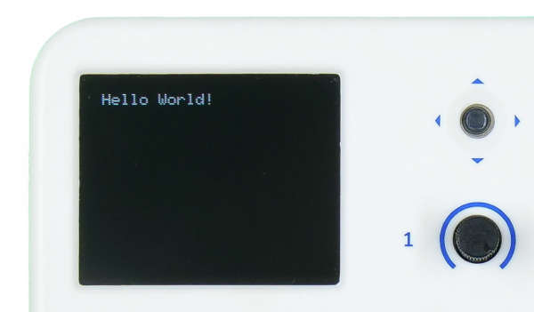
Writing on the Display
The block is used to write text on evive’s TFT display.

Slide 13
Writing on the Display
Set cursor at (), () block sets the cursor at the specified coordinate in the TFT Display of evive.
Origin (0,0) is at the top left corner of the screen. Positive X-direction is to right while positive Y-direction is downward.
Once the cursor has moved to the specified coordinate, you can write text using that point as the reference.
The limits for the X and the Y coordinates are:
X: 0 to 159
Y: 0 to 127

Slide 14
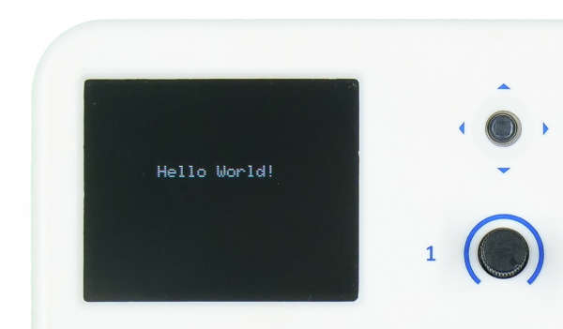
Writing on the Display
Cursor at 10, 10 position
Cursor at 50, 60 position

Slide 15
Writing on the Display
Set text color () with () background & size () block sets a text color (choose from the color selector), a particular background color (choose from the color selector) and the text size (value varying from 1 to 7) for the text.

Slide 16
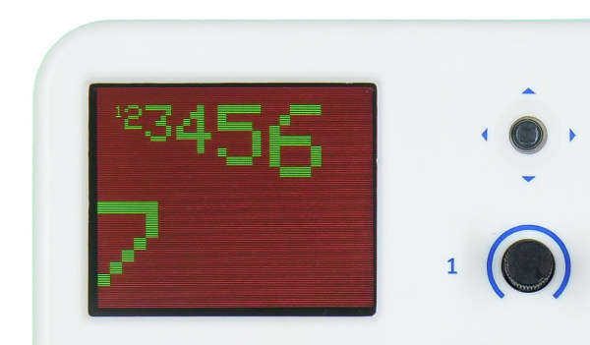
Writing on the Display – Color & Size

Slide 17
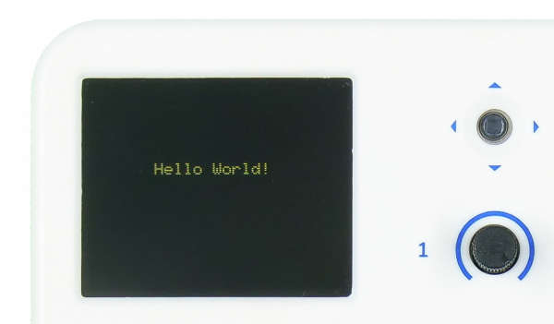
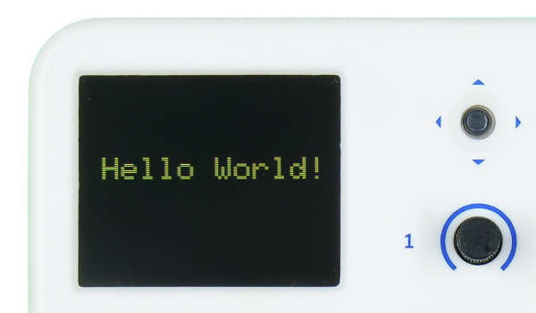
Writing on the Display
Hello World with text size 1 and yellow color.
Hello World with text size 2.

Slide 18
Activity: Displaying Potentiometer Reading on Screen

Slide 19
Displaying Potentiometer Reading
One of the most important application of evive display is to show sensor readings.
In this activity, you will show both the potentiometer readings on the Display. It should be written like this on the display:
Pot 1: ____
Pot 2: ____
Try it yourself first.

Slide 20
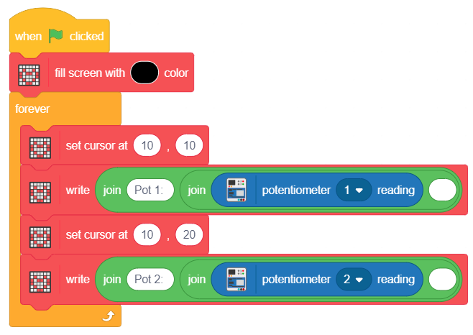
Displaying Potentiometer Reading
Make the following script:

