Slide 1
Physical Computing Analog Input

Slide 2
Analog Input

Slide 3
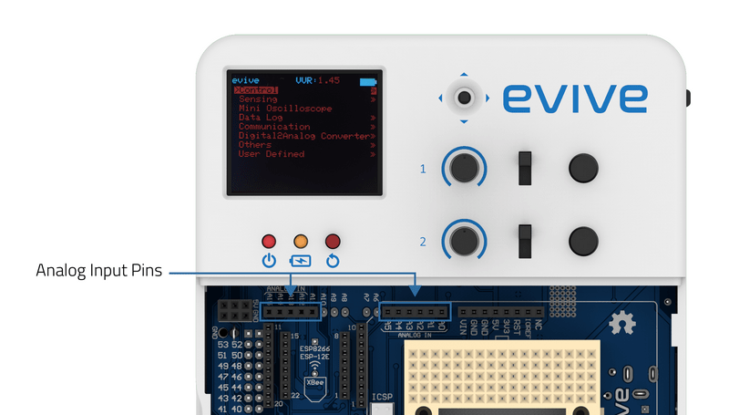
Analog Input
evive has 10 analog pins available for the user, A0 to A5 & A12 to A15.

Slide 4
Analog Read
Read analog pin () is a reporter block found in evive blocks.
The block returns the value of analog pins available in the connected hardware.
Analog reading is of 10 bit resolution, hence the range of value is 0 to 1023. This range is mapped to the voltage of the pin (normally 0 to 5V).
If the value received is 512, the voltage value will be around 2.5V.

Slide 5
Reading Potentiometer

Slide 6
Reading Potentiometer
evive has 2 potentiometers connected to analog pin A9 and A10.

Slide 7
Reading Potentiometer
Potentiometer () reading block is an evive block and a stack block.
This block returns the analog output of either of the potentiometer (from 0-1023).

Slide 8
Activity: Making a mouse move around using Potentiometer

Slide 9
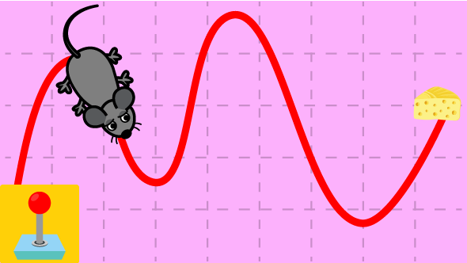
Mouse movement
In this activity we will move a mouse sprite using the potentiometer.

Slide 10
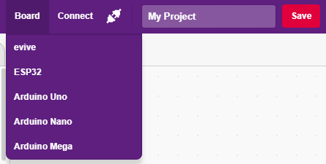
Interfacing evive with PictoBlox
Connect evive to your laptop/PC and open PictoBlox.
In PictoBlox, go to the menu and click on the Boards Select the evive.

Slide 11
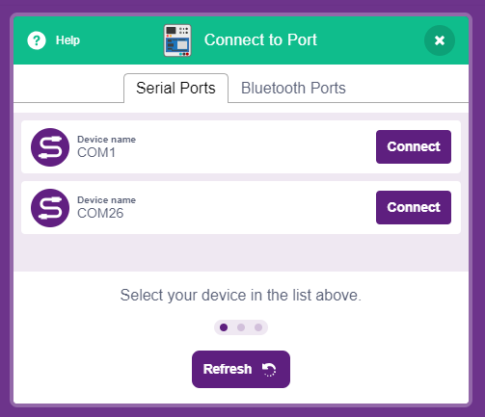
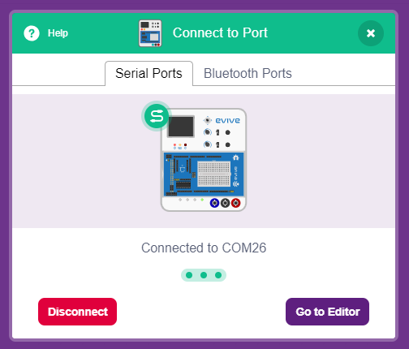
Interfacing evive with PictoBlox
Once you’ve selected the board, click on the Connect tab and connect the board.

Slide 12
Upload Firmware
You have to upload the firmware into the device before interacting with it.
Click on Upload Firmware button.
Once you successfully uploaded the firmware you will see evive logo on evive display.

Slide 13
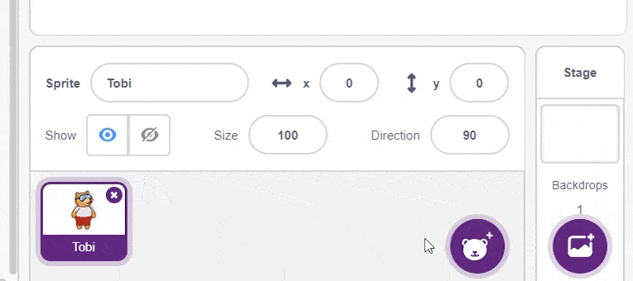
Adding the sprite
Add the mouse sprite into the project and delete the Tobi sprite.

Slide 14
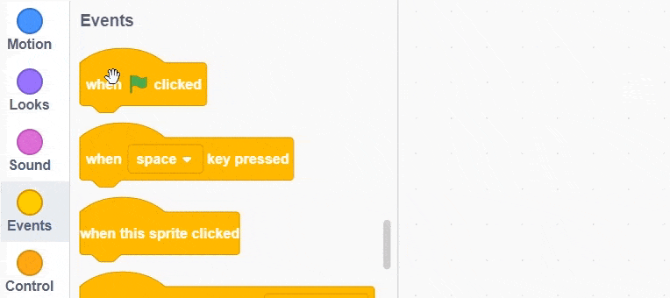
Script
To run the script add when flag clicked block and add a forever block to run the blocks inside it repeatedly.

Slide 15
Script
To change the direction of the mouse, we will use the point in direction () block.
Since the direction vary from 0 to 360 degrees and potentiometer value varies from 0 1023, we have to map the values.
Hence, Direction = ((Potentiometer Value) * 360) / 1023
We will use the operators block to do the above operation.

Slide 16
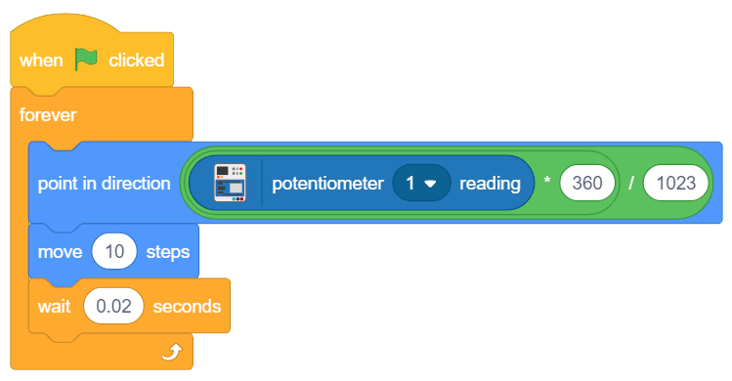
Final Script
Here is the final script for the activity:

Slide 17
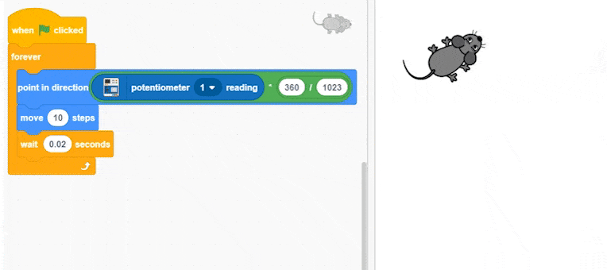
Running the Script
Click on the green flag to run the script.

Slide 18
Activity: Controlling the Brightness of LED

Slide 19
Controlling the Brightness of LED
In this activity, you will control the brightness of LED.
You will use 2 evive blocks:
Potentiometer () reading – To get the input. Range is 0 – 1023.
Set PWM pin () output as () – To set the brightness of the LED. Range is 0 – 255.
Since the range is not same, we have to map both. For our case it will be PWM = (Potentiometer Reading)/4

Slide 20
Controlling the Brightness of LED
Since the range is not same, we have to map both. For our case it will be PWM = (Potentiometer Reading)/4

Slide 21
Upload Mode

Slide 22
Upload Mode
Upload mode allows you to write scripts and upload it to the board so that you can use even when it is not connected your computer, for example, you need to upload a script for making moving robots.
In this case, evive will run offline according to the program and it cannot interact with the stage.

Slide 23
when evive starts up
when evive starts up block is an evive extension block and a Hat block.
Scripts that wear this block gets converted into Arduino code when you are in Upload Mode.
This block is used when one has to upload a code into evive.

Slide 24
Upload code
Make the script for brightness control using when evive starts up block.
Switch to upload mode and upload the code.

