Slide 1
Physical Computing Digital Input

Slide 2
Digital Input

Slide 3
Digital Input
Using read digital pin () block, you can check the digital state of the pin.
It returns 1 if pin is HIGH
It returns 0, if pin is LOW

Slide 4
Reading State of Tactile Switch

Slide 5
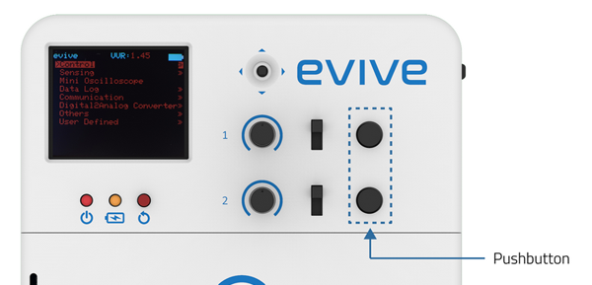
Reading State of Tactile Switch
evive has 2 tactile switches which are internally connected to digital pin 38 and 39.
When the switch is pressed, the voltage on the pin is HIGH and when it is not pressed, voltage is LOW.

Slide 6
Reading State of Tactile Switch
Tactile switch () pressed? is an evive block and a Boolean block.
This block checks if either of them is pressed. The switch whose state you want to check can be chosen from the drop-down menu on this block.
It returns “true” if the switch is pressed and “false” if the switch is not pressed.

Slide 7
Activity: Making Tobi Rotate when Switch 1 is Pressed

Slide 8
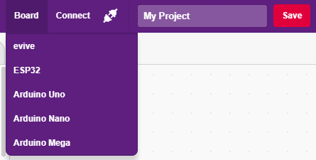
Interfacing evive with PictoBlox
Connect evive to your laptop/PC and open PictoBlox.
In PictoBlox, go to the menu and click on the Boards Select the evive.

Slide 9
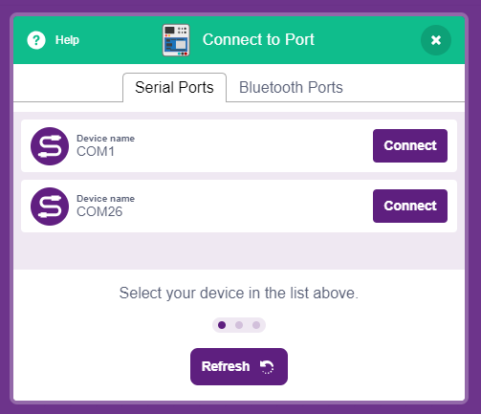
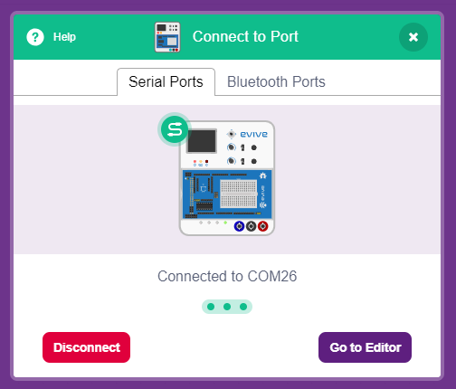
Interfacing evive with PictoBlox
Once you’ve selected the board, click on the Connect tab and connect the board.

Slide 10
Upload Firmware
You have to upload the firmware into the device before interacting with it.
Click on Upload Firmware button.
Once you successfully uploaded the firmware you will see evive logo on evive display.

Slide 11
Tobi Rotate
In this program, you have to make Tobi rotate when you press tactile switch 1.
First try to do it yourself.

Slide 12
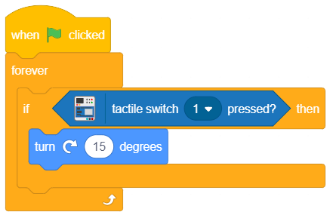
Tobi Rotate
In this program, you have to make Tobi rotate when you press tactile switch 1.
Assignment: Add script for making Tobi rotate anticlockwise when switch 2 is pressed.

Slide 13
Reading State of Slide Switch

Slide 14
Reading State of Slide Switch
evive has two slide switches both of which have 3 states :
Slide up (state 1)
Slide down (state 2)
Middle (OFF)

Slide 15
Reading State of Slide Switch
Slide switch () is in the state ()? is an evive block and a Boolean block.
The block check takes the slide switch number (1 or 2) and state to be checked for (Up or Down) as input and returns “True” if the slide switch is in the specified state and “False” if it is not in the specified state.
Slide switch is mostly used to change the mode of operation, like direction of the motor, or mode of the game.

Slide 16
Activity: Slide Switch Mode Example

Slide 17
Slide Switch Mode Example
In this activity, you have make a script where the motion of Tobi has 3 modes:
When tactile switch 1 is pressed, Tobi will move by 10 steps.
When tactile switch 1 is pressed, Tobi will turn by 90 degrees.
When tactile switch 1 is pressed, Tobi will do nothing.
You have to use slide switch to change the mode of operation.

Slide 18
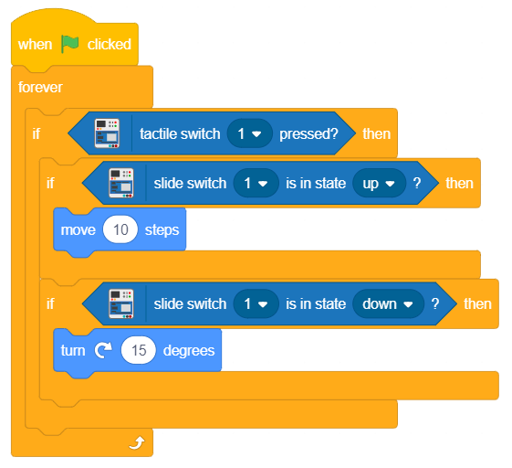
Slide Switch Mode Example
This one of the many solutions.

