Slide 1
Physical Computing Analog Output

Slide 2
Analog Output

Slide 3
Analog Output (PWM)
evive’s analog output is in the form of a digital signal that is just very fast, and by very fast we mean VERY fast.
A digital output can take either of the two values: HIGH or LOW.
To get analog output, what we can do is switch between the two values, at a VERY fast rate; this rate is known as frequency.
Frequency is the number of times the switching between HIGH and LOW takes place in 1 second.
If we switch the signal between these two values, say, 500 times in 1 second, the output will appear to be continuous; it will appear as if it is an analog signal.

Slide 4
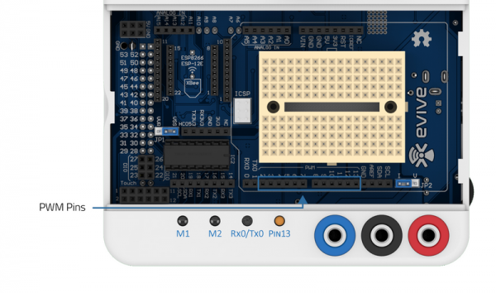
Analog Output (PWM)
We are generating analog voltage output using digital pins which are special.
They are known as PWM pins, which is the short form of Pulse Width Modulation.

Slide 5
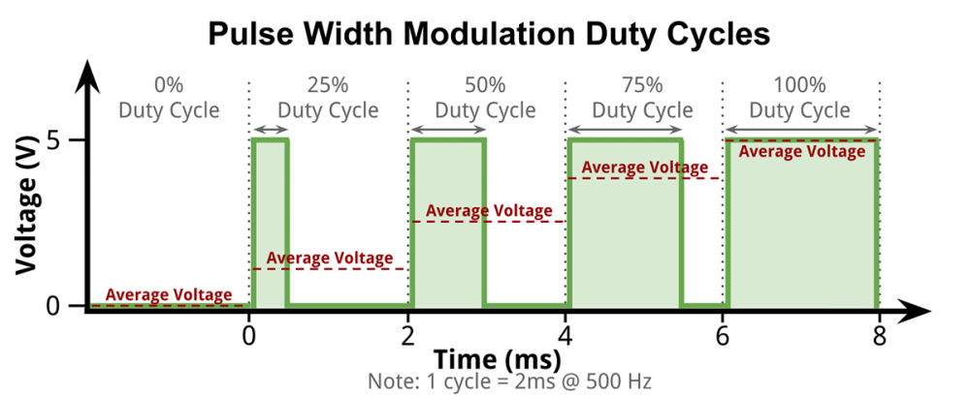
Analog Output (PWM)
If for this whole time, the voltage is LOW, then the output voltage is 0V and if the voltage is HIGH, the output voltage is 5V.
What happens when for some time the pin is HIGH and for some time is LOW. Then accordingly, it generates an average voltage.

Slide 6
Equation
Average voltage = (Time for which signal is HIGH * Value of HIGH + Time for which signal is LOW * Value of LOW)/Total Time
Average voltage = (Time for which signal is HIGH * Value of HIGH)/Total Time

Slide 7
Equation
Average voltage = (Time for which signal is HIGH * Value of HIGH)/Total Time
If the voltage is HIGH for 0.5 ms and LOW for 1.5 ms, then the average voltage output is 1.25V.

Slide 8
Block for Analog Output

Slide 9
Set PWM pin () output as ()
The process of obtaining 0V to 5V from 0 to 255 is called scaling.
If you want 0 V give 0 PWM
If you want 1V give 51 PWM
If you want 2.5V give 128 PWM
If you want 4V give 204 PWM
If you want 5V give 255 PWM

Slide 10
Activity: Controlling the Brightness of a LED

Slide 11
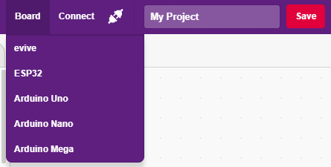
Interfacing evive with PictoBlox
Connect evive to your laptop/PC and open PictoBlox.
In PictoBlox, go to the menu and click on the Boards Select the evive.

Slide 12
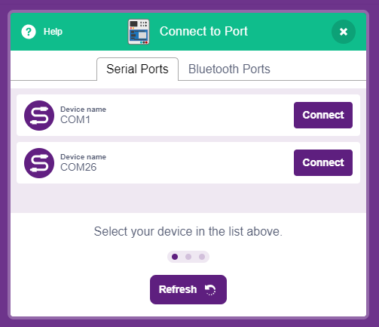
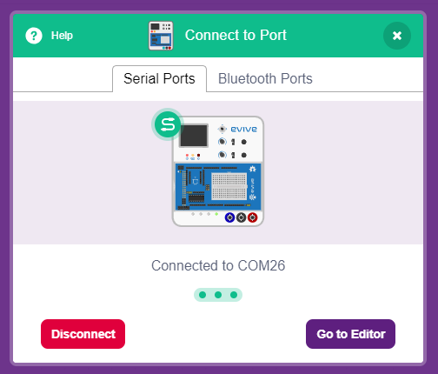
Interfacing evive with PictoBlox
Once you’ve selected the board, click on the Connect tab and connect the board.

Slide 13
Upload Firmware
You have to upload the firmware into the device before interacting with it.
Click on Upload Firmware button.
Once you successfully uploaded the firmware you will see evive logo on evive display.

Slide 14
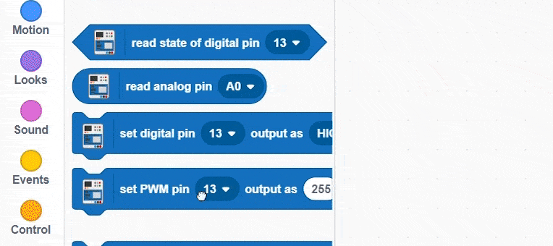
Testing the Block
Drag and drop the set PWM block and change the brightness of the LED connected to pin 13.

Slide 15
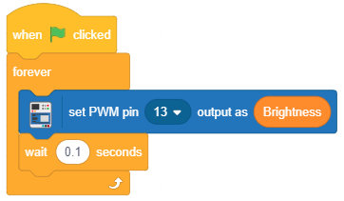
Controlling the brightness of LED
Make a variable named Brightness & make the following script.

Slide 16
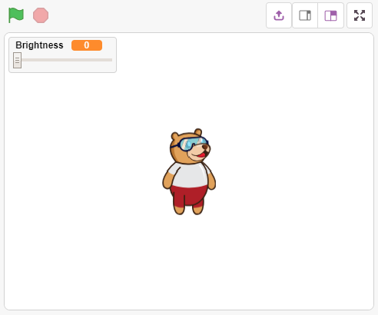
Controlling the brightness of LED
On the stage click on variable to get the slider. Now change the value of brightness.

