Slide 1
Physical Computing Digital Output

Slide 2
Interfacing evive with PictoBlox

Slide 3
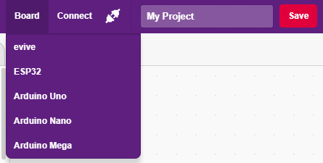
Interfacing evive with PictoBlox
Connect evive to your laptop/PC and open PictoBlox.
In PictoBlox, go to the menu and click on the Boards Select the evive.

Slide 4
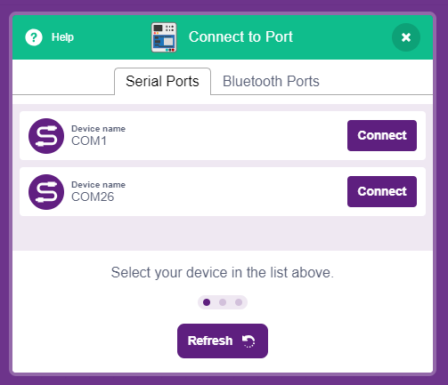
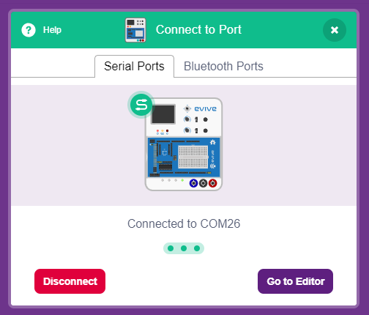
Interfacing evive with PictoBlox
Once you’ve selected the board, click on the Connect tab and connect the board.

Slide 5
Stage Mode

Slide 6
Stage Mode
In this mode, you can write scripts for the sprite and boards like evive to interact with sprites in real-time.
If you disconnect the board with PictoBlox, you cannot interact with the board anymore. In this mode, you can make games and animation interacting with evive.

Slide 7
Upload Firmware
You have to upload the firmware into the device before interacting with it.
Click on Upload Firmware button.
Once you successfully uploaded the firmware you will see evive logo on evive display.

Slide 8
Digital Output

Slide 9
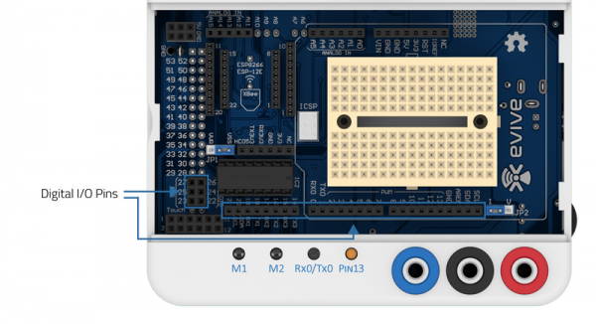
Digital Output
The digital pins, according to the binary logic, can have two possible values:
1 i.e. 5V: When the evive instructs the output to be HIGH.
0 i.e. 0V: When the evive instructs the output to be LOW.

Slide 10
Digital Output
The block sets the digital state of the specified digital pin to either “High” or “Low”.
If the output is High, the pin will be at 5V and if the output is Low the pin will be at 0V.

Slide 11
Activity: Blinking a LED

Slide 12
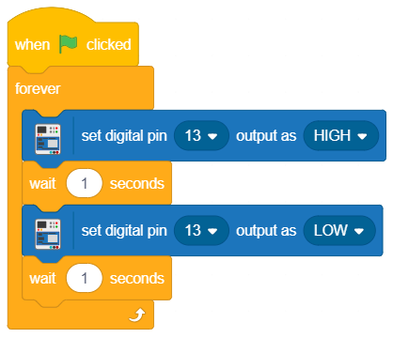
Blinking LED
In this activity we will make LED blink.
For 1 second it will be ON and for 1 seconds it will be OFF. This will repeat forever.

Slide 13
Activity: Controlling LED using Space Key

Slide 14
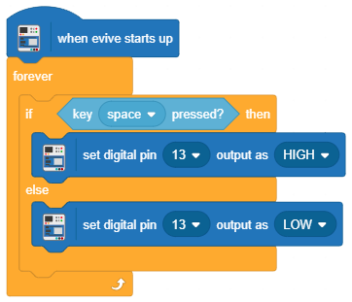
Controlling LED using space button
In this activity we will control the Pin 13 LED using space key.

