Slide 1
Touch Sensor Conductor or Insulator?

Slide 2
What is a Conductor?

Slide 3
Conductors
Some materials allow electric current to flow more freely than others. These materials are called conductors.
This is due to the free charge on the conductor, which can move.
When there is no voltage, the charge is equally distributed across the material.

Slide 4
Conductors
Example: Silver, gold, iron, sea water, fruits and vegetables.

Slide 5
What is an Insulator?

Slide 6
Insulator
The opposite of a conductor is an insulator. An insulator opposes the flow of electricity.
Insulators are important to keep us safe from electricity. The wire that carries electricity to your computer or television is covered with a rubber-like insulator that protects you from getting electrocuted.
Insulator does not distribute charge.

Slide 7
Insulator
Good insulators include glass, the air, and paper.

Slide 8
How Touch Sensors Work?

Slide 9
Touch Sensors
Capacitive touch sensors are sensitive to charge. They monitor the charge level of the object and tell the evive.
So if you have an object which has 5 free charges, then it will tell evive 5 charges.

Slide 10
Touch Sensors
But when another conductor touches the object, the number of free charge increases on the channel.
So now there are 10 charges. This change in free charge is detected in touch sensor.
However this only work for conductors and not for insulators. Because free charge.

Slide 11
Activity: Testing the Touch Sensor

Slide 12
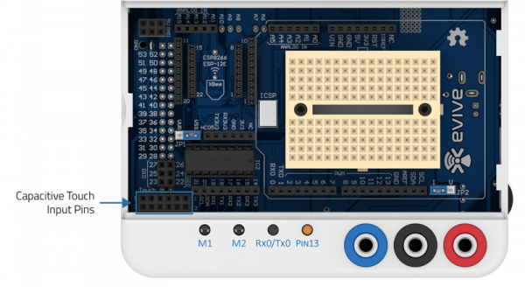
Touch Sensors
Connect a Male to Male jumper to evive touch channel.

Slide 13
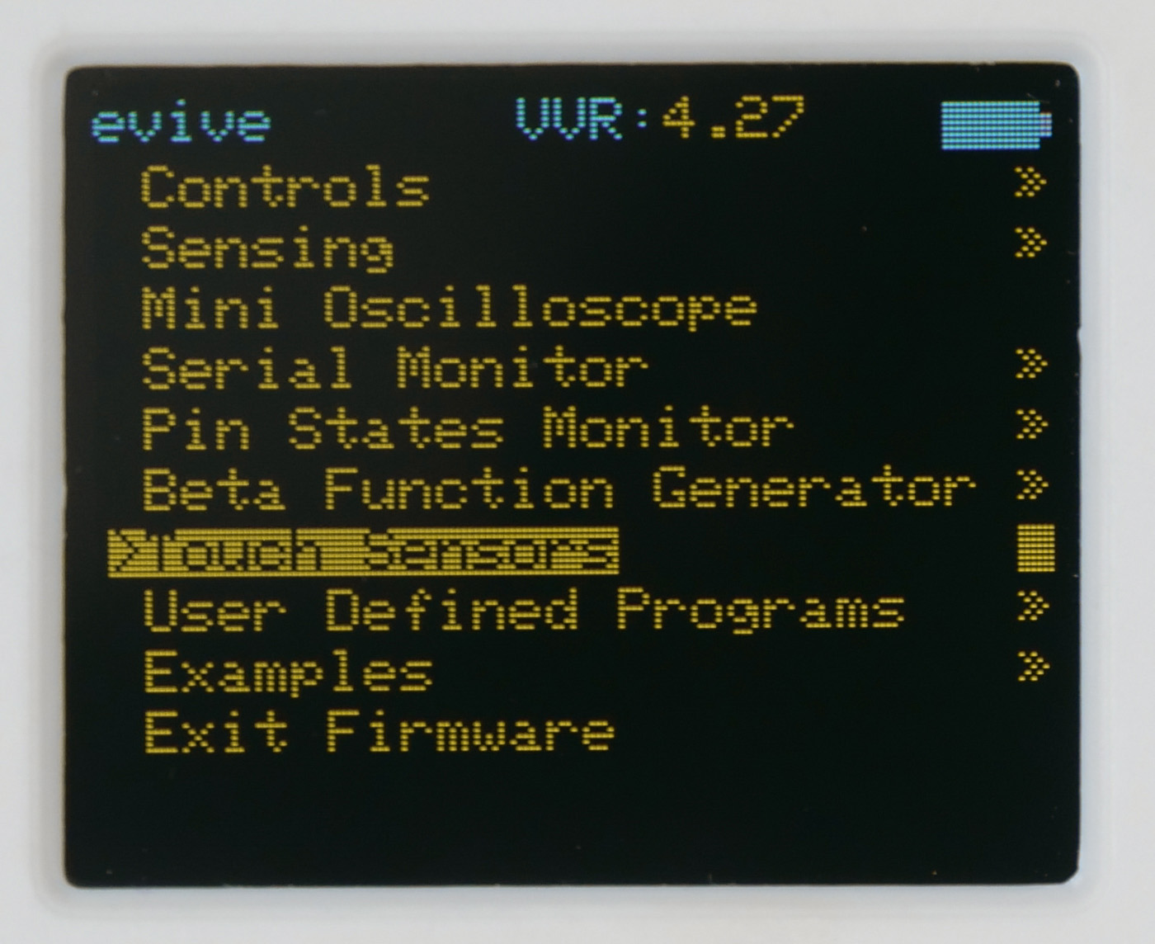
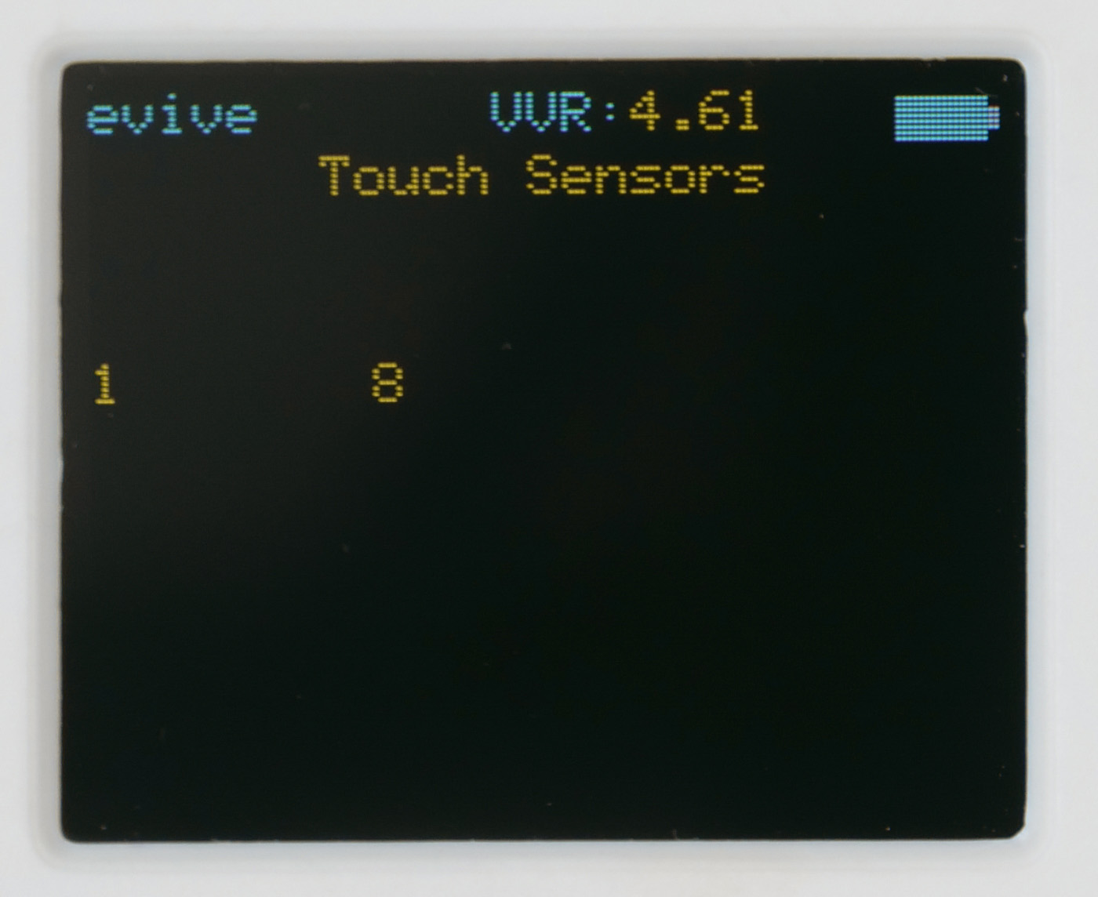
Touch Sensors
Turn on evive. You will see the menu. If not center press on evive navigation key.
Go to the Touch Sensors option. Now touch the free end of the sensor. Sound will come when you touch it.

Slide 14
Important thing to remember
Number of charge available in an object can vary. Like a small spoon will have less charge than a steel plate. This is neutralized by initializing the channel whenever you enter the touch sensor menu.
So, if your sensor it not detecting the object, then try to go back into the main menu and go to touch channel.
This will reset the value.

Slide 15
Activity: Conductors vs Insulator

Slide 16
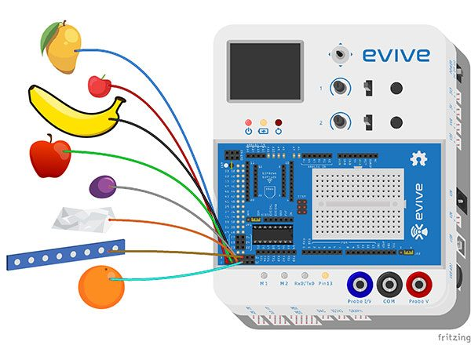
Activity: Conductors vs Insulators
Connect different objects around you using jumpers.
After connecting objects find out which object detect touch and which do not by touching them.
If the object detect touch then its conductor, else Insulator.

