Slide 1
Basics of Sensors

Slide 2
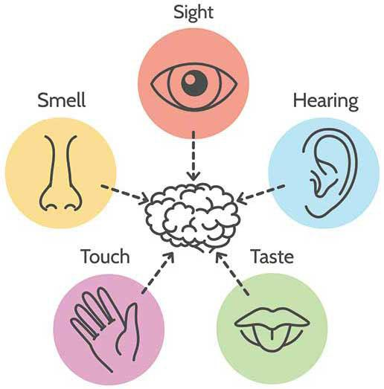
Human Senses

Slide 3
Sensors
A Sensor converts the physical parameter (for example: temperature, blood pressure, humidity, speed, etc.) into a signal which can be measured electrically.
Let’s explain the example of temperature. The mercury in the glass thermometer expands and contracts the liquid to convert the measured temperature which can be read by a viewer on the calibrated glass tube.

Slide 4
Example of sensors
Temperature sensor, e.g. thermometer
Ultrasonic sensor
Light sensor, e.g. LDR
IR sensor
Touch sensor, e.g. the touch screen of a smartphone
Many more

Slide 5
Classification of Sensor
Digital Sensor - Sensors that gives output in either in HIGH or LOW are digital signal. Usually they have only two states or two voltage reading.
We use digital pins of evive to take input from the sensor.
Example: IR Sensor
Analog Sensor – Sensors that gives output in a given voltage range are known as analog sensors.
We use analog pins of evive to take input from the sensor.
Example: Light Dependent Resistors

Slide 6
Digital Pins of evive

Slide 7
Analog Pins of evive

Slide 8
Light Dependent Resistor

Slide 9
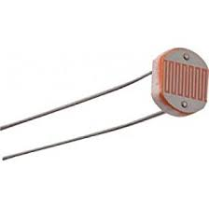
Light Dependent Resistor
An LDR, short for light dependent resistor, is a resistor whose resistance changes as the light falling on it changes.
This property allows us to use them for making light sensing circuits.
Resistance of the LDR decreases with increasing light intensity.

Slide 10
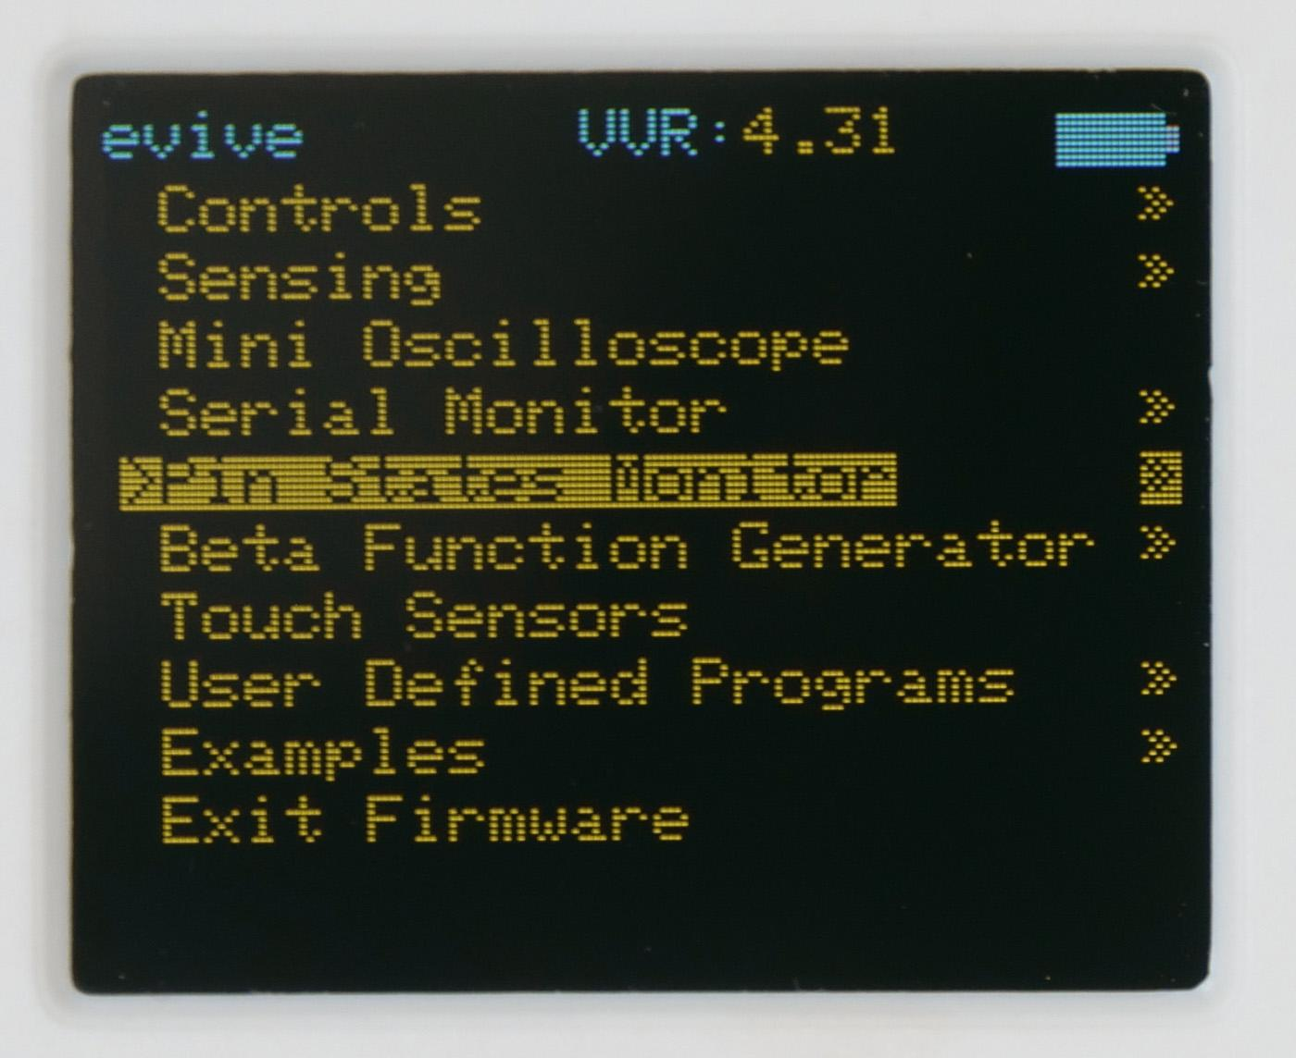
Monitoring Digital and Analog Pins
Among the various options in evive’s control menu is a Pin State Monitor.
This monitor displays the states, or the values of all the pins – both digital and analog.

Slide 11
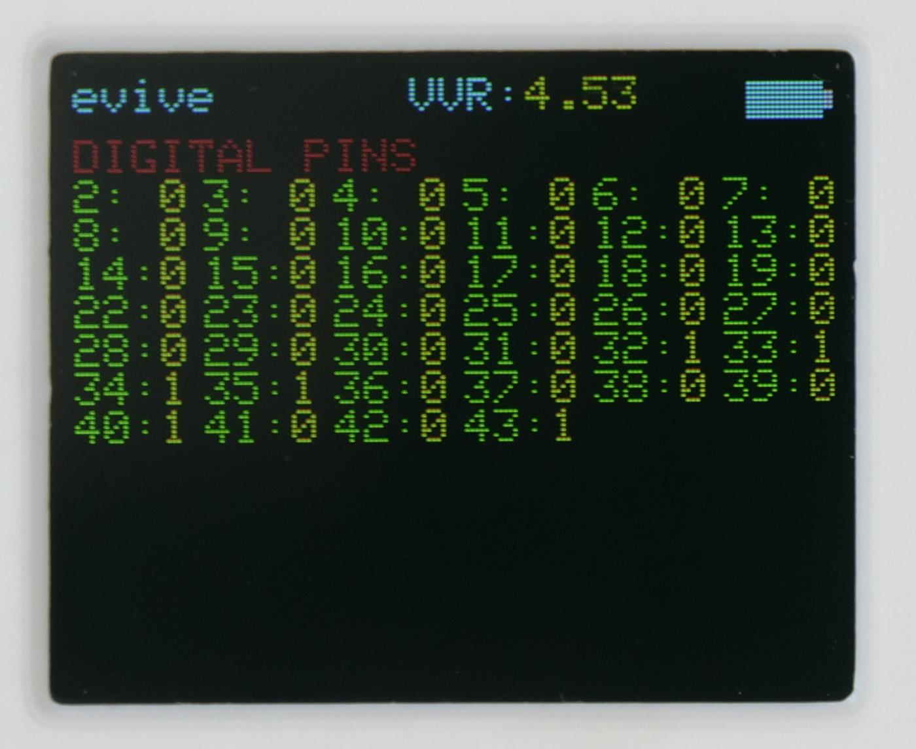
Monitoring Digital and Analog Pins
Digital Pin States: This option displays only the states of the digital pins, i.e. it shows whether a pin is at 0 or at 1.

Slide 12
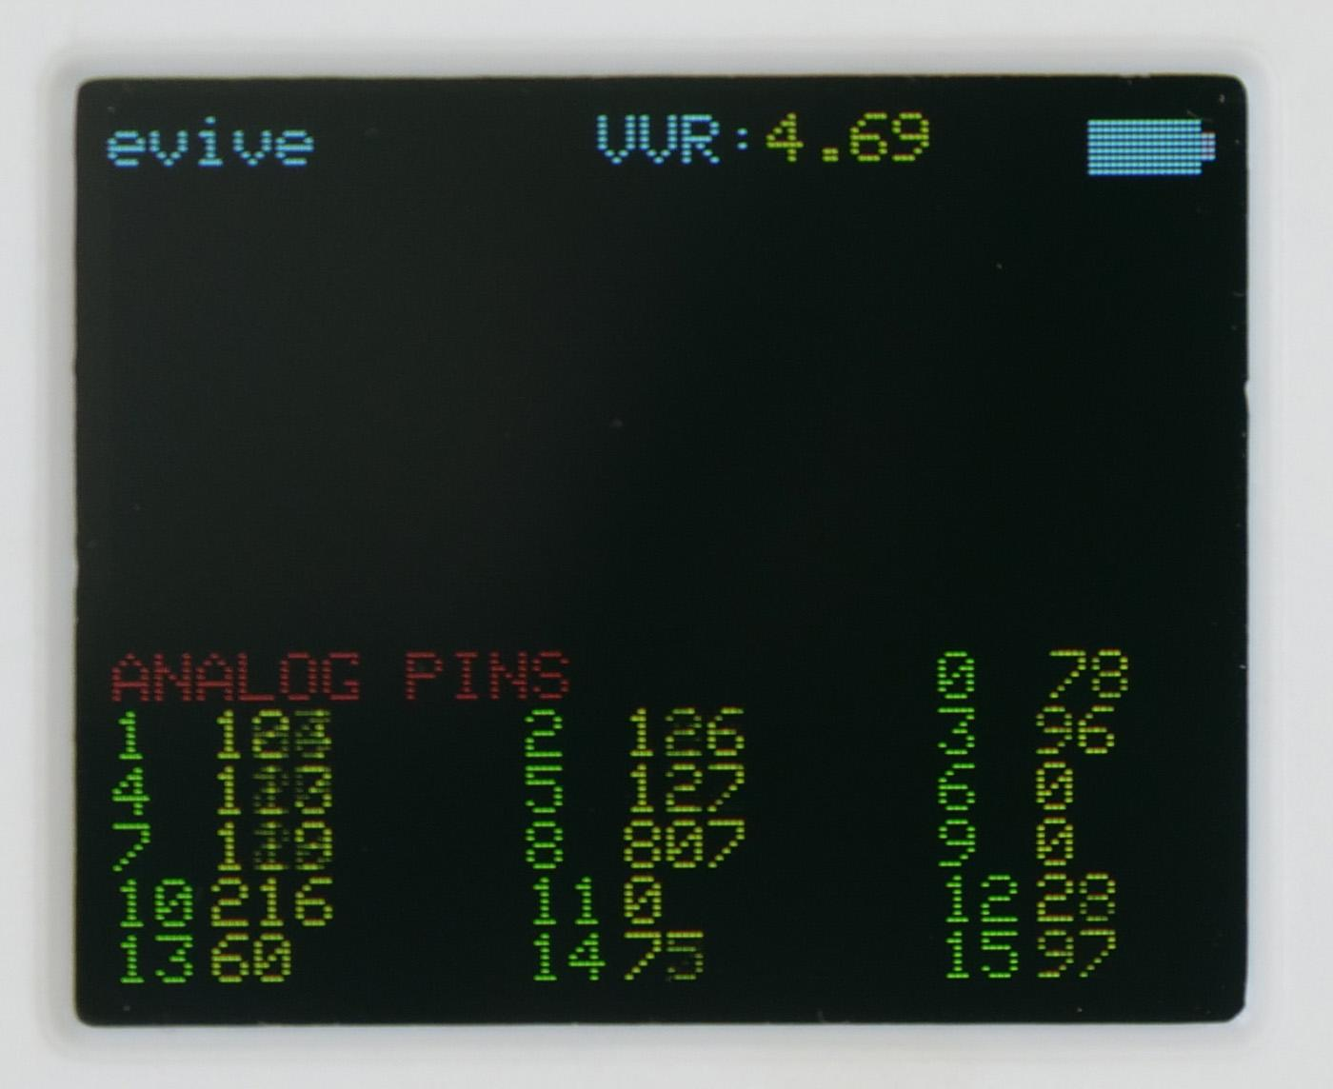
Monitoring Digital and Analog Pins
Analog Pin States: This option shows what value does each analog pin have between 0 and 1023. 0 – 1023 is a different way of representing the voltage values that the analog pins can have, i.e. 0 – 5V. Here 0V means 0, and 5V means 1023.

Slide 13
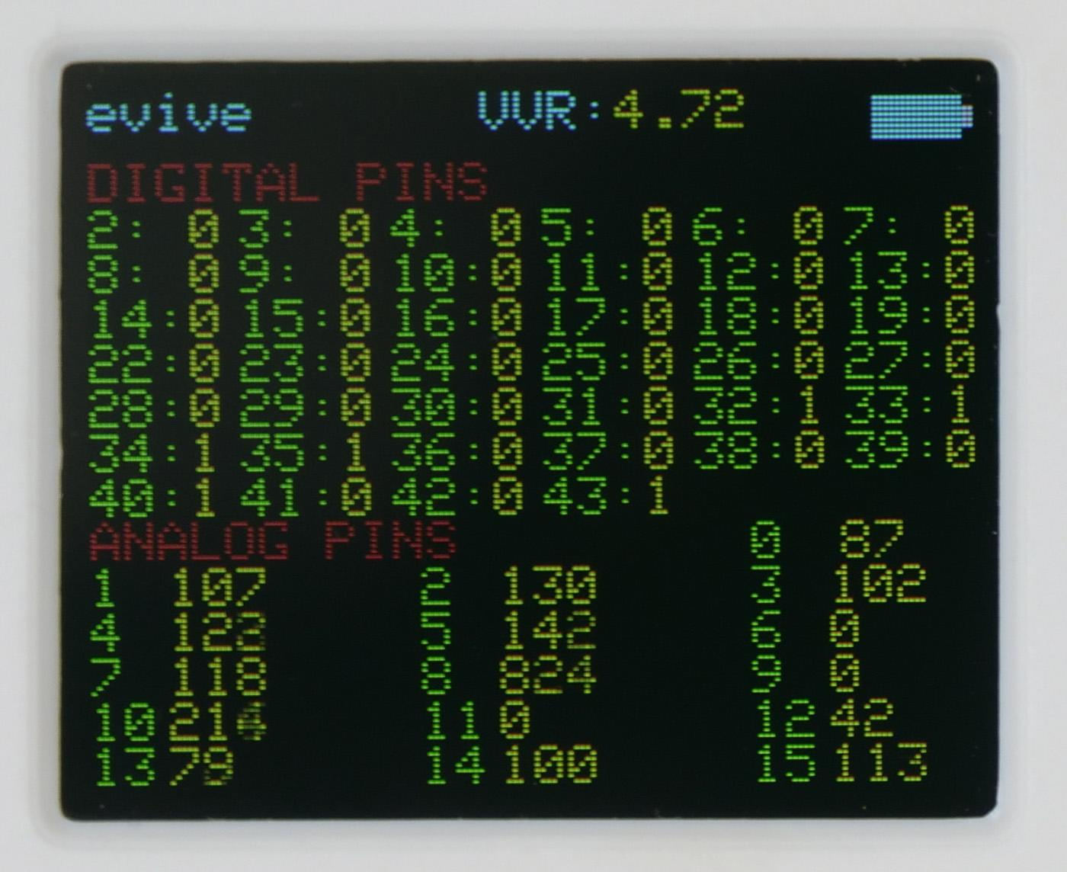
Monitoring Digital and Analog Pins
Digital & Analog States: This option is a combination of the previous two; it shows the states of both the digital and the analog pins.

Slide 14
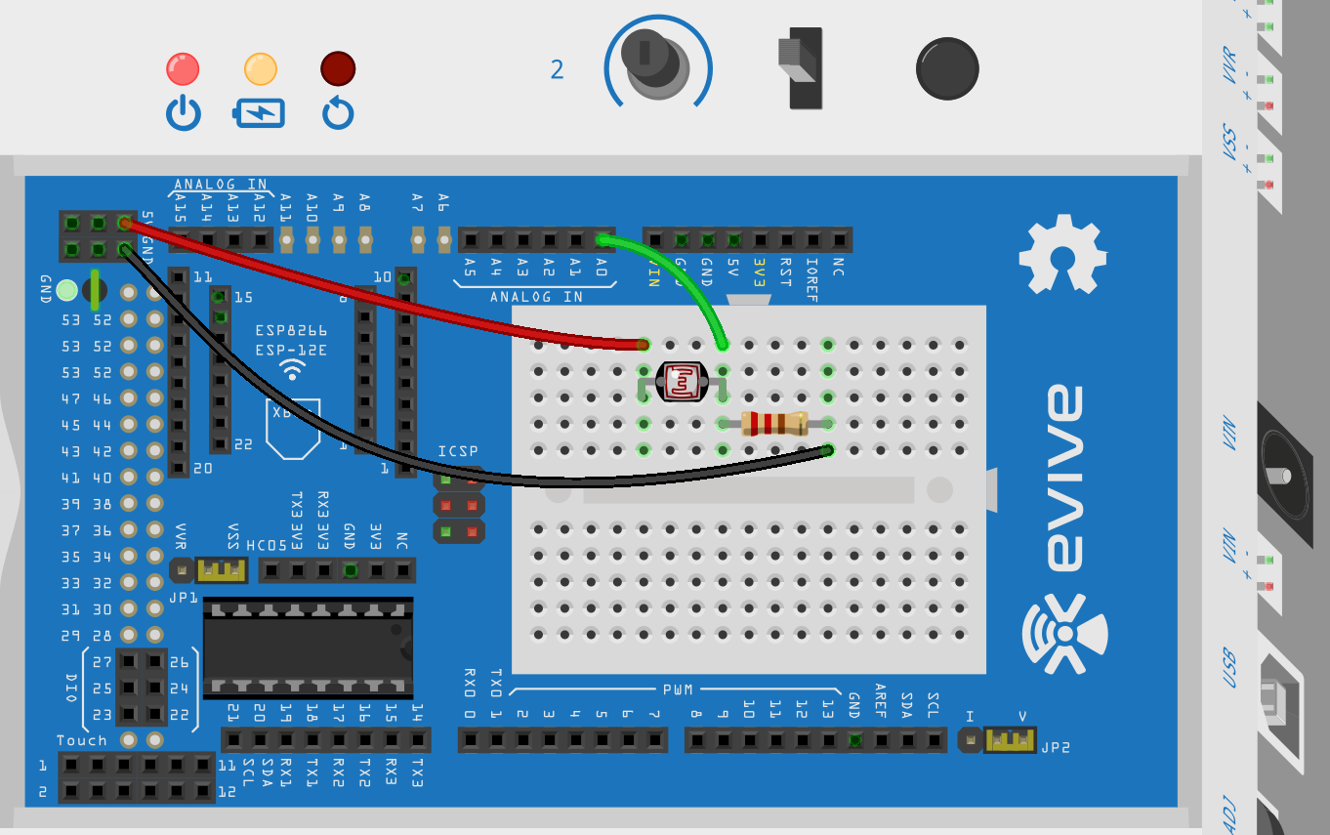
Visualising LDR sensor

Slide 15
Visualising LDR sensor
You can observe that the sensor senses the intensity of light that falls on it, and changes the resistance depending on it.
Using this simple circuit, you can make a system that can be used to turn ON and OFF the lights of the room.
But to create this system you require programming, i.e. writing a code, or a set of instructions to control the system.

