Slide 1
Introduction to Servo Motors

Slide 2
The need for a Servo Motor
DC Motors rotates in 360 and you can control the speed and the direction of motor.
But what if you want to move the motor at an angle?
There is no way you can do precisely using DC motor.
In servo motor you can control the angle with precision.

Slide 3
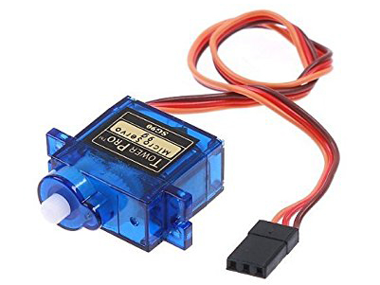
Servo Motor
A servo motor is a device that is used to rotate or push parts of a machine to which it is rotating with precision.
Unlike DC motors, they generally rotate to an angle and then stop.

Slide 4
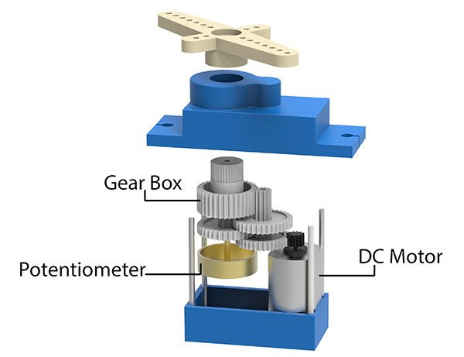
Components of Servo Motor
If you pull apart a servo motor, you'll find the following inside it:
A DC Motor
A Potentiometer

Slide 5
Components of Servo Motor
A gear train i.e. a series of gears that are connected such that their teeth are engaged/interconnected.

Slide 6
Components of Servo Motor
A control circuit: This circuit is the actual brain behind the precise working of the servo. It controls how much the servo should move or rotate depending upon the input it receives.

Slide 7
Controlling
Servo Motor

Slide 8
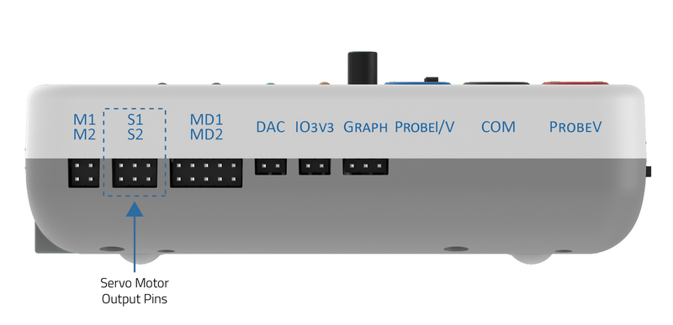
Controlling a Servo Motor using evive
You can control 2 Servo Motor directly with evive using Menu.

Slide 9
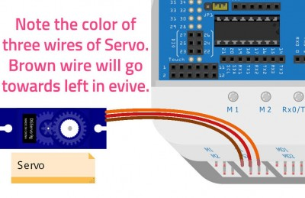
Controlling a Servo Motor using evive
Take the servo motor and insert the wires attached to it in the first servo motor channel, i.e. S1.

Slide 10
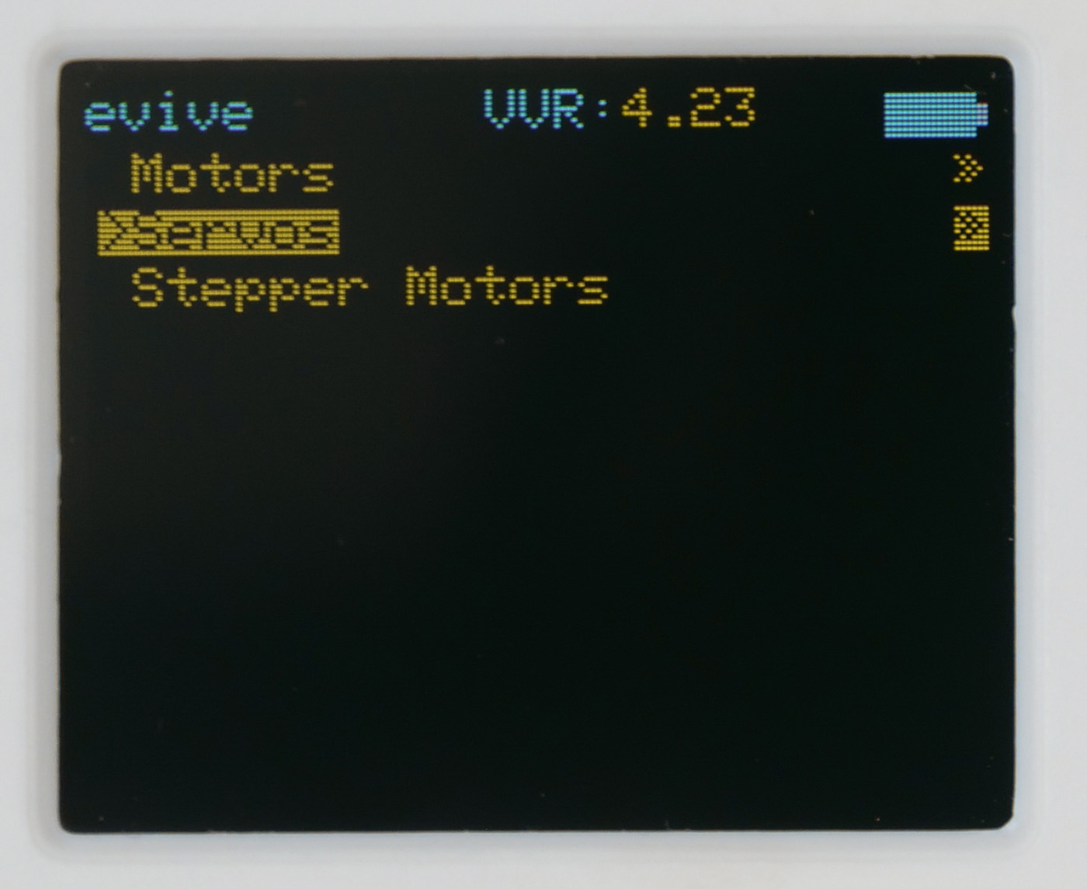
Controlling a Servo Motor using evive
Switch on your evive. The first option in the menu that appears on the screen is Controls; select that option by pressing the control button to the right.
Once you select it, you’ll see three more options, namely Motors, Servos, and Stepper Motors; select Servos.

Slide 11
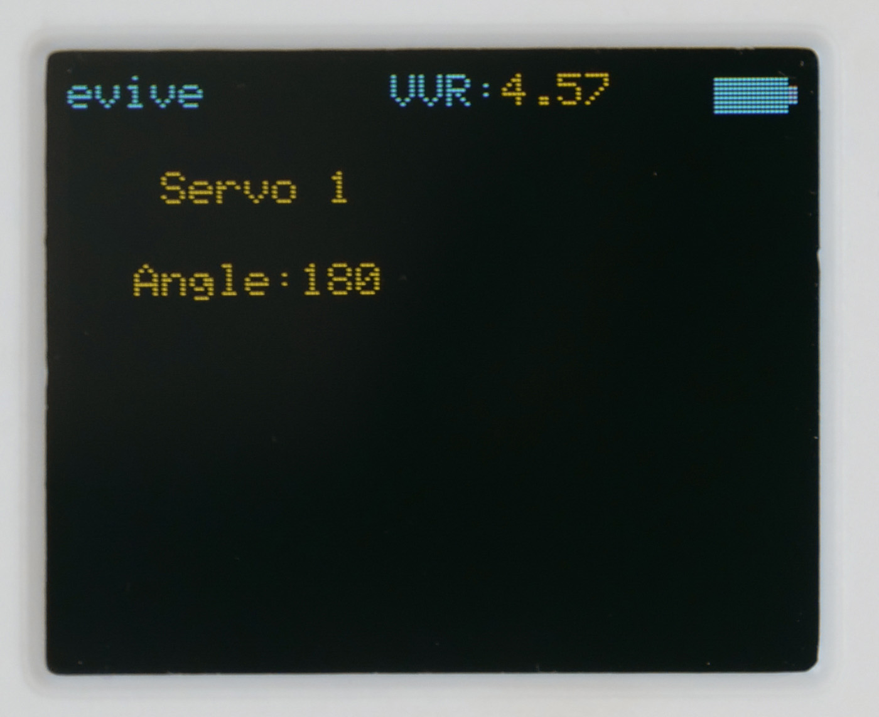
Controlling a Servo Motor using evive
From the three options that now appear on the screen, select Servo 1 & 2. The following screen will appear:

Slide 12
Controlling a Servo Motor using evive
The angle can be controlled/changed using the potentiometer knob. As you rotate the knob in a clockwise direction, the angle will increase, and the servo horn will rotate to its left; as you turn the knob anticlockwise, the angle will decrease, and the servo horn will rotate to its right.

Slide 13
Controlling a Servo Motor using evive
On rotating the knob, you’ll observe that the minimum the angle can go is 0° and the maximum is 180°.

Slide 14
Activity: Tobi’s Head Moves

Slide 15
Tobi’s Head Moves
In this activity, we’re going to move the head of a cutout of our learning buddy, Tobi with the help of a servo motor.
We will fit the servo motor in the cutout of Tobi’s head and control its movement using evive’s potentiometer.
Let's begin!

Slide 16
Tobi’s Head Moves
Cut out Tobi’s head and body using a pair of scissors.

Slide 17
Tobi’s Head Moves
On the cutout of Tobi’s body, there is a space marked for the servo motor. Cut and fold the flaps inwards to make support for the servo motor.

Slide 18
Tobi’s Head Moves
Insert the servo motor in the slot made on the cutout of Tobi’s body.

Slide 19
Tobi’s Head Moves
Attach the servo head that comes with the servo accessories to the servo motor.

Slide 20
Tobi’s Head Moves
Take the cutout of Tobi’s head and fix it onto the servo head using a tiny screw provided with the servo.
Connect the servo motor to evive.
Control Tobi’s head by rotating the knob of potentiometer 1.

