Slide 1
DIY Turntable

Slide 2
Recap
An actuator is the device that convert energy into movement.
Any motor, in general, takes in electricity from one end and uses it to rotate the rod at its other end. The rod can be connected to some other machine that works when it rotates.
You can control 2 DC motor with evive using Menu.

Slide 3
DIY Turntable

Slide 4
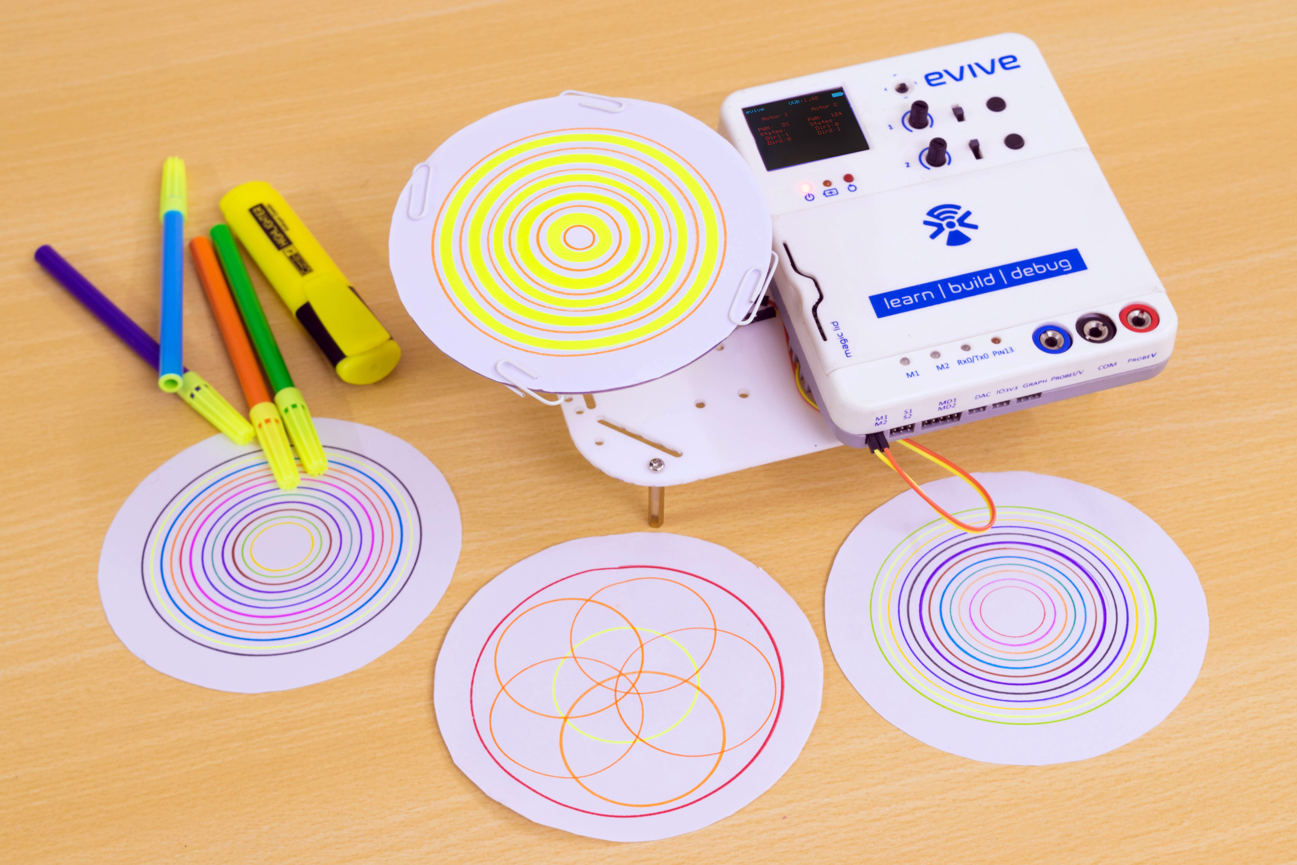
DIY Turntable

Slide 5
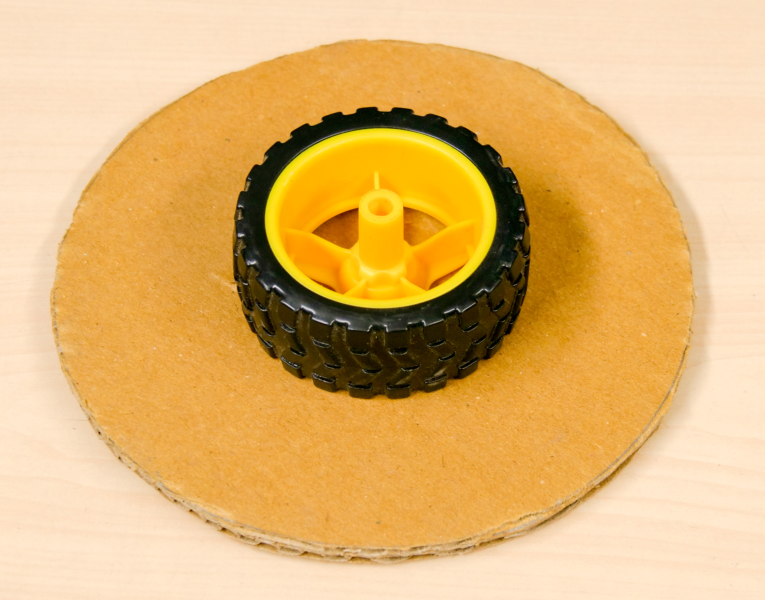
Steps
Take the wheel and stick it in the center of the circle cut from the cardboard using removable glue.

Slide 6
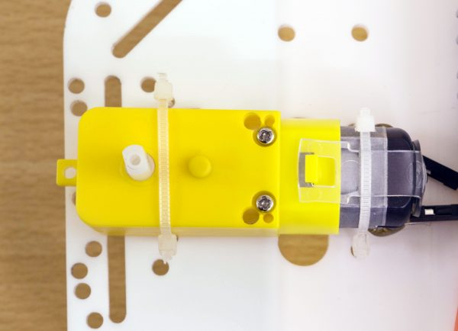
Steps
Then, take the chassis, the DC motor and the cable tie.
Place the DC motor on top of the chassis, near its end, and fasten it using the cable tie.
Make sure that the shaft one side goes through one of the holes on the chassis.

Slide 7
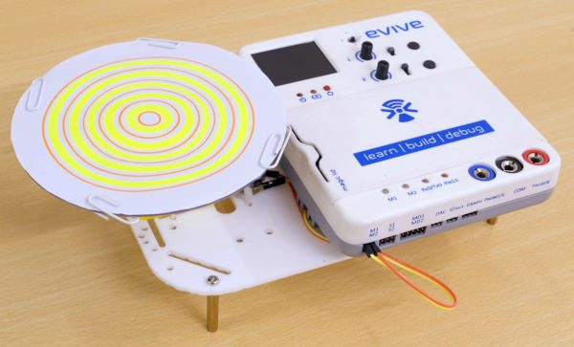
Steps
Take the wheel and cardboard assembly and fix it on top of the motor by inserting the shaft into the wheel.
Take a piece of paper and cut into circular shape. Fix it on the cardboard using binding clips.

Slide 8
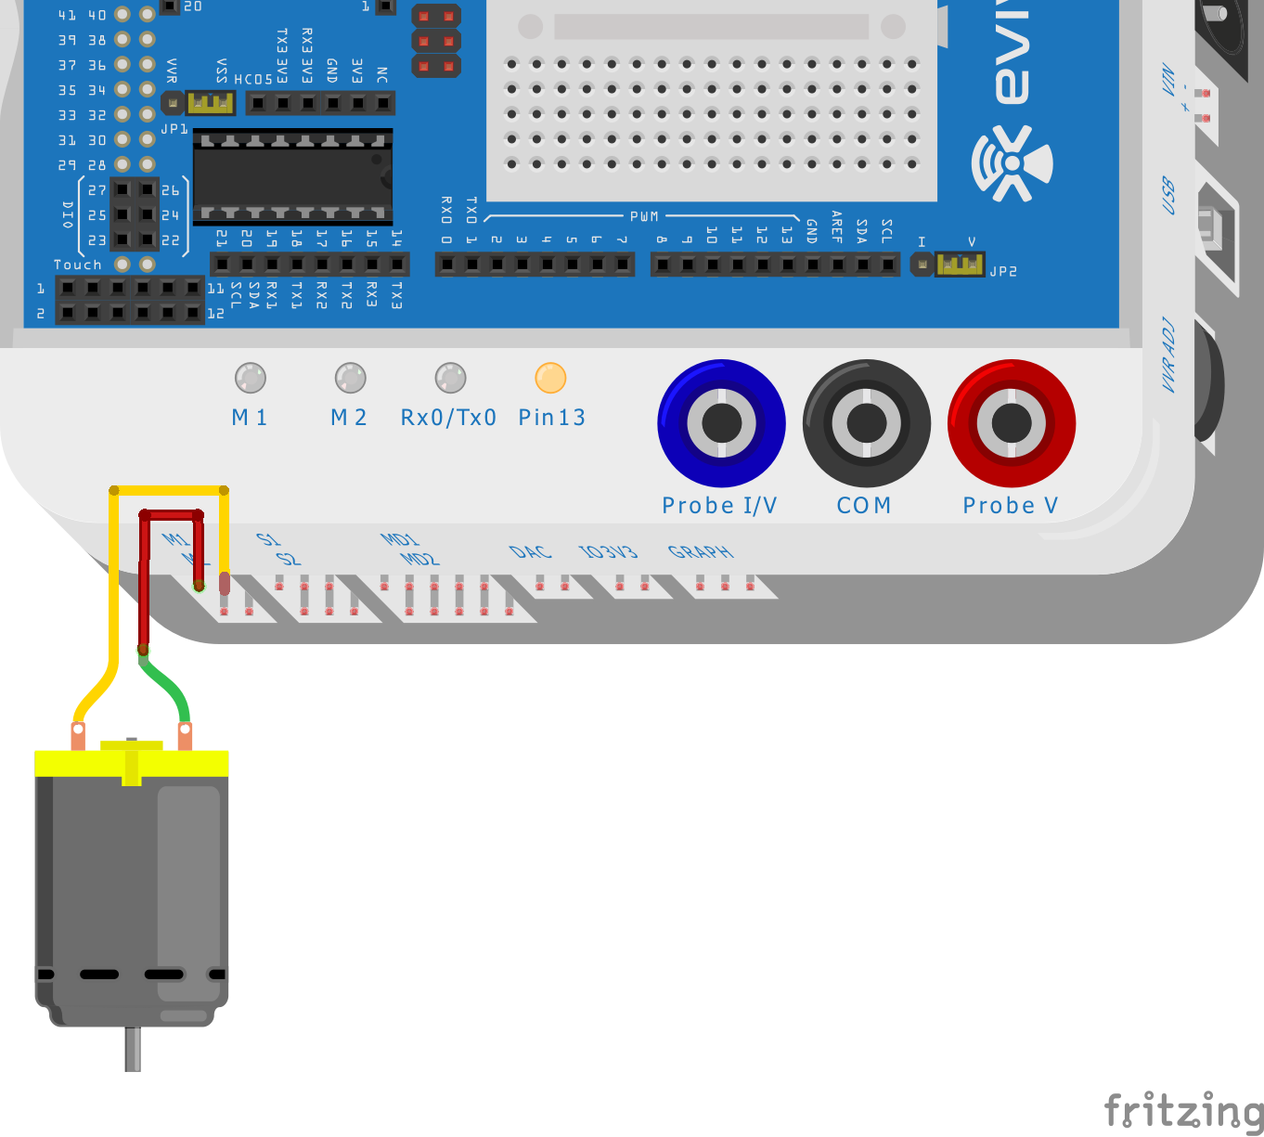
Controlling DC Motor with evive
Insert the motor wires in the first motor channel, i.e. M1.

Slide 9
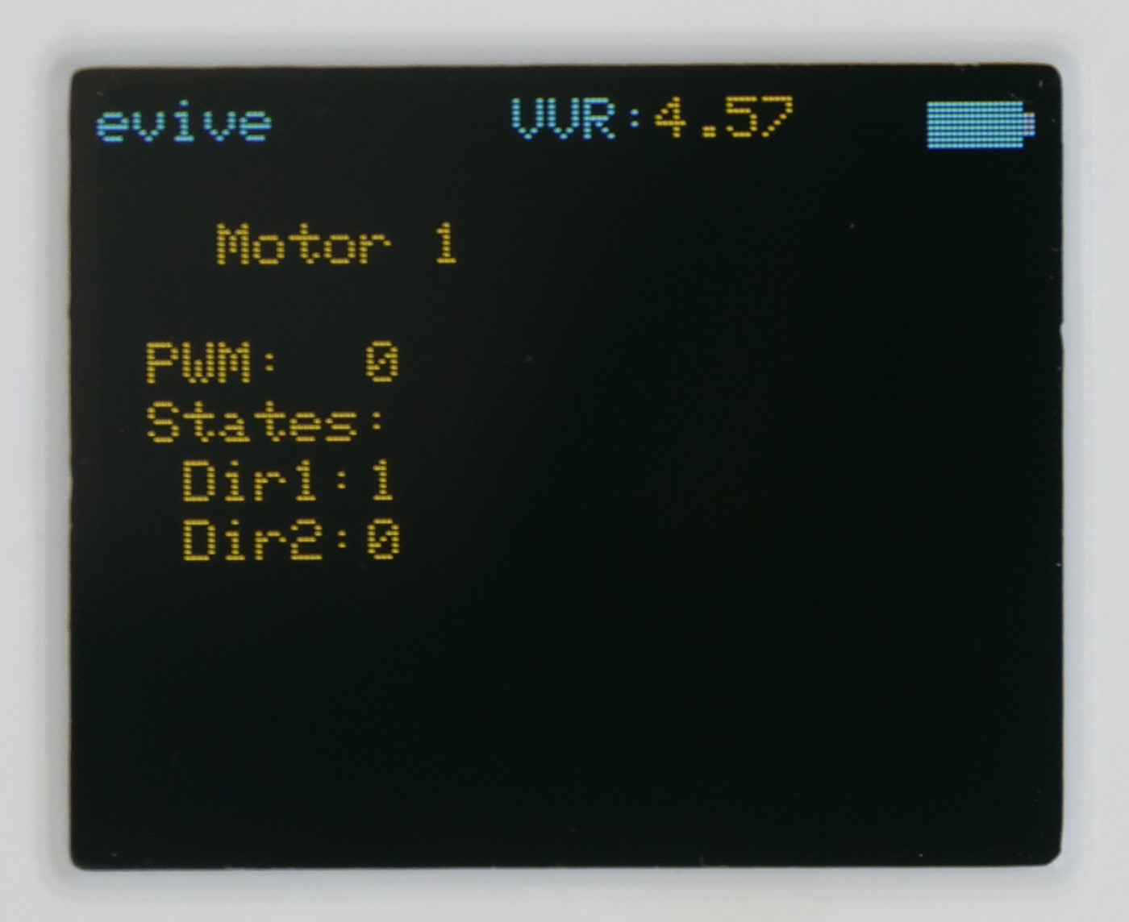
Controlling DC Motor with evive
Open the Menu and navigate to Controls > Motors > Motor 1.

Slide 10
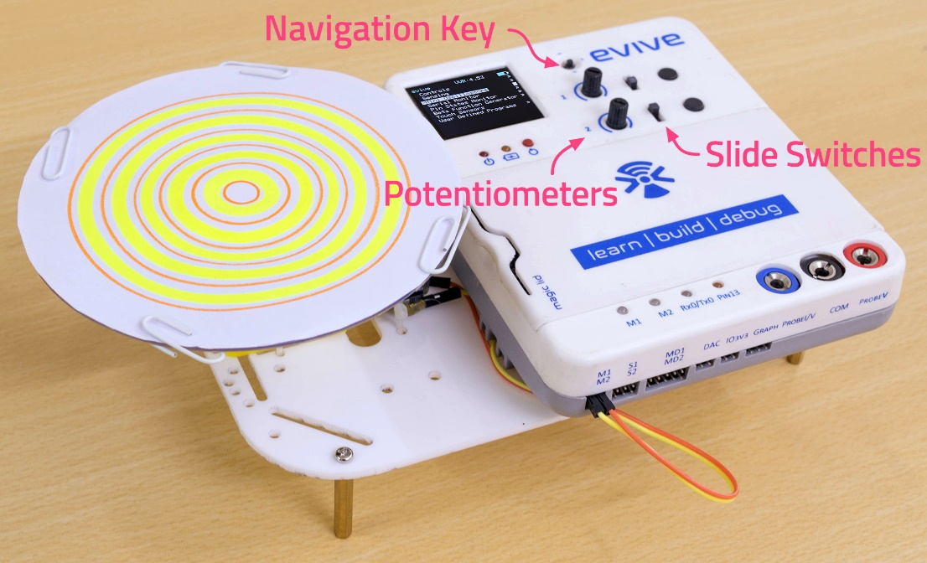
Controlling DC Motor with evive
Control the speed using potentiometer and direction using slide switch.

Slide 11
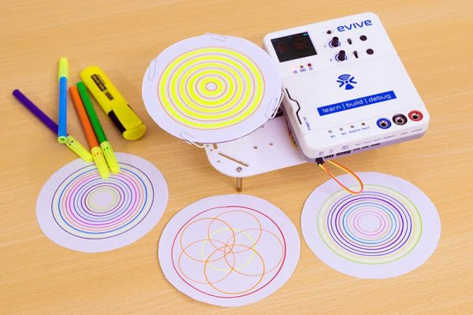
Steps
The project is complete. Let’s make cool drawings.
You just must put a marker on the rotating paper (very steadily), and the motor will do the rest of the work. Shift the center of the rotating paper or move marker to make creative drawing.

