Slide 1
Introduction to Motors

Slide 2
What is a Actuator?

Slide 3
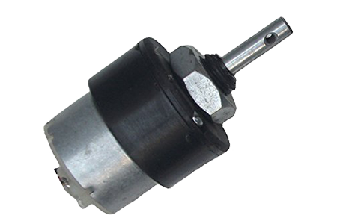
Actuators
An actuator is a mechanical device, typically a motor, that moves or controls a mechanism or another device.
In simple terms, an actuator is a mover. It helps the device move around and interact with its surrounding environment.

Slide 4
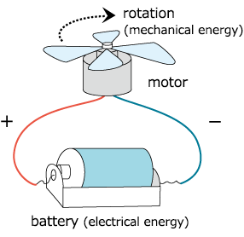
Actuators
The actuator takes in energy – which can be obtained from either air, electricity, or a liquid – and uses this energy to help something move.

Slide 5
Types of Actuators
There are four main types of actuators:
Electrical: Electrical actuators convert electricity into rotational motion.
Mechanical: Mechanical actuators convert circular motion into linear (straight-line) motion.
Hydraulic: Hydraulic actuators are motors that use liquids like water or oil to produce motion.
Pneumatic: Pneumatic actuators use the energy obtained from compressed air or high pressure and convert it into motion.

Slide 6
What is DC Motor?

Slide 7
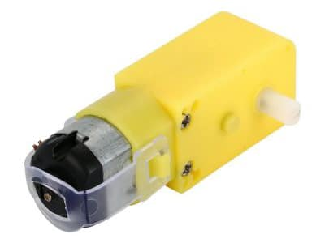
DC Motor
Any motor, in general, takes in electricity from one end and uses it to rotate the rod at its other end. The rod can be connected to some other machine that works when it rotates.

Slide 8
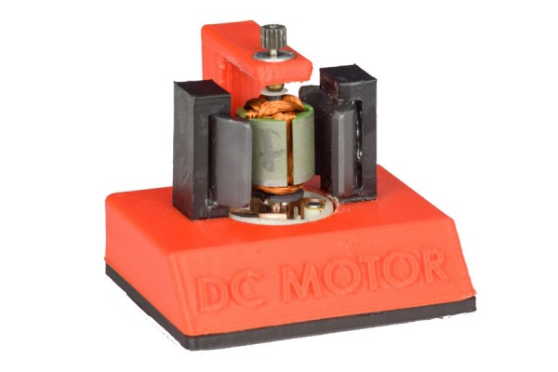
Components of a DC Motor

Slide 9
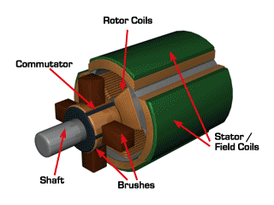
Components of a DC Motor
A DC motor has two essential components:
A magnet on the edge of the motor body that remains static and is hence called the stator.

Slide 10
Components of a DC Motor
A coil of thin wire placed in slots on a cylindrical object known as the armature. In a DC motor, the armature rotates when it receives electricity. Therefore, it is called the rotor. The rotor is placed between the north and south poles of the magnet. The two ends of the coil are connected to a component known as the commutator.

Slide 11
Components of a DC Motor
The current enters the motor through the coil placed on the rotor. The rotor due to the presence of the magnets starts rotating, thus converting electrical energy into rotational motion.

Slide 12
Controlling DC Motor?

Slide 13
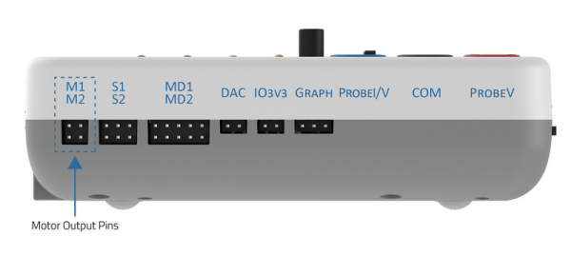
Controlling DC Motor with evive
You can control 2 DC motor with evive using Menu.
The upper pair of pins is motor channel 1 or M1, and the second pair is motor channel 2, or M2.

Slide 14
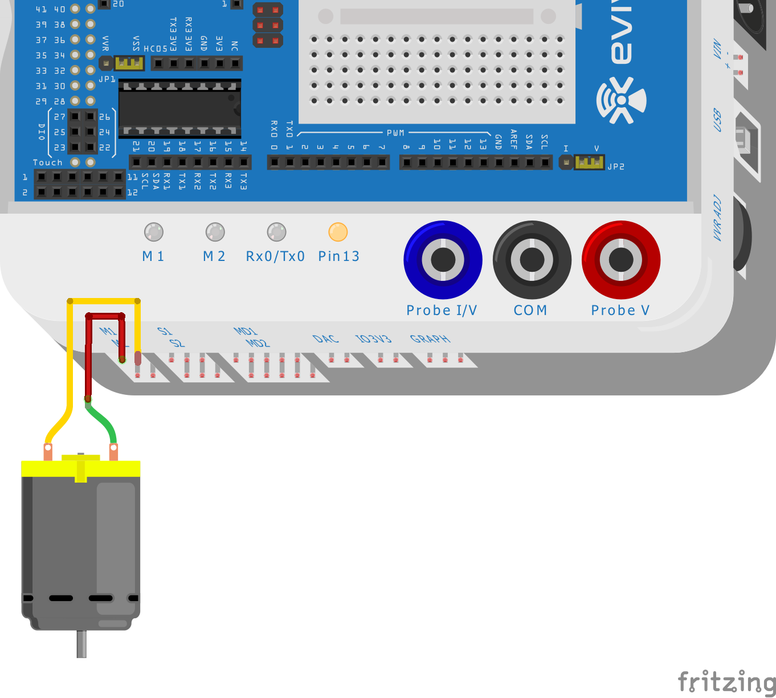
Controlling DC Motor with evive
Take the motor and insert the wires attached to it in the first motor channel, i.e. M1.

Slide 15
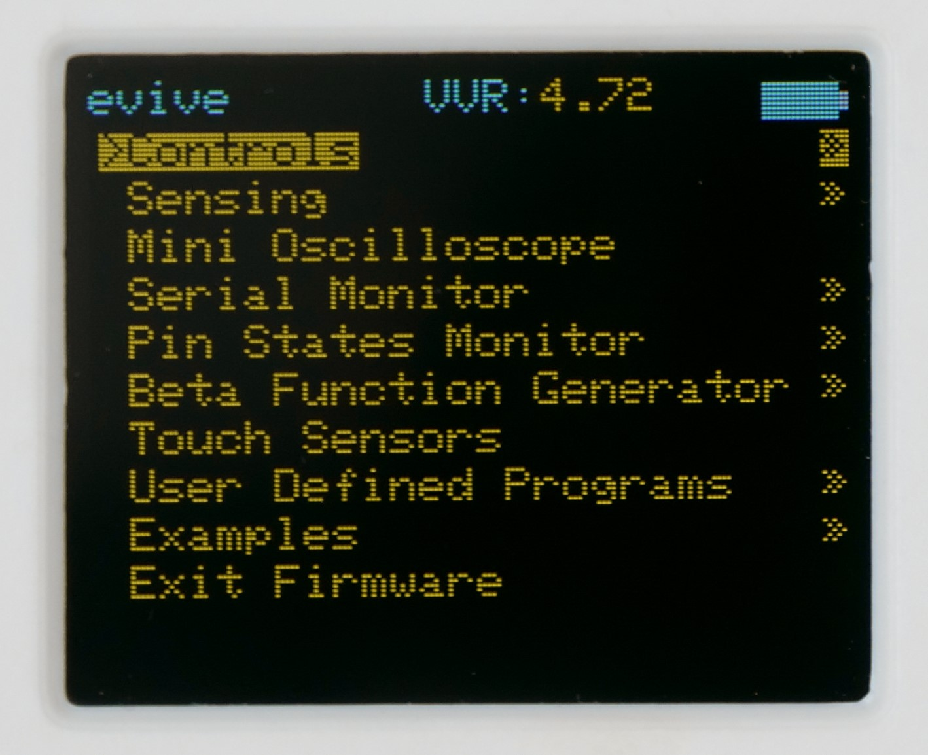
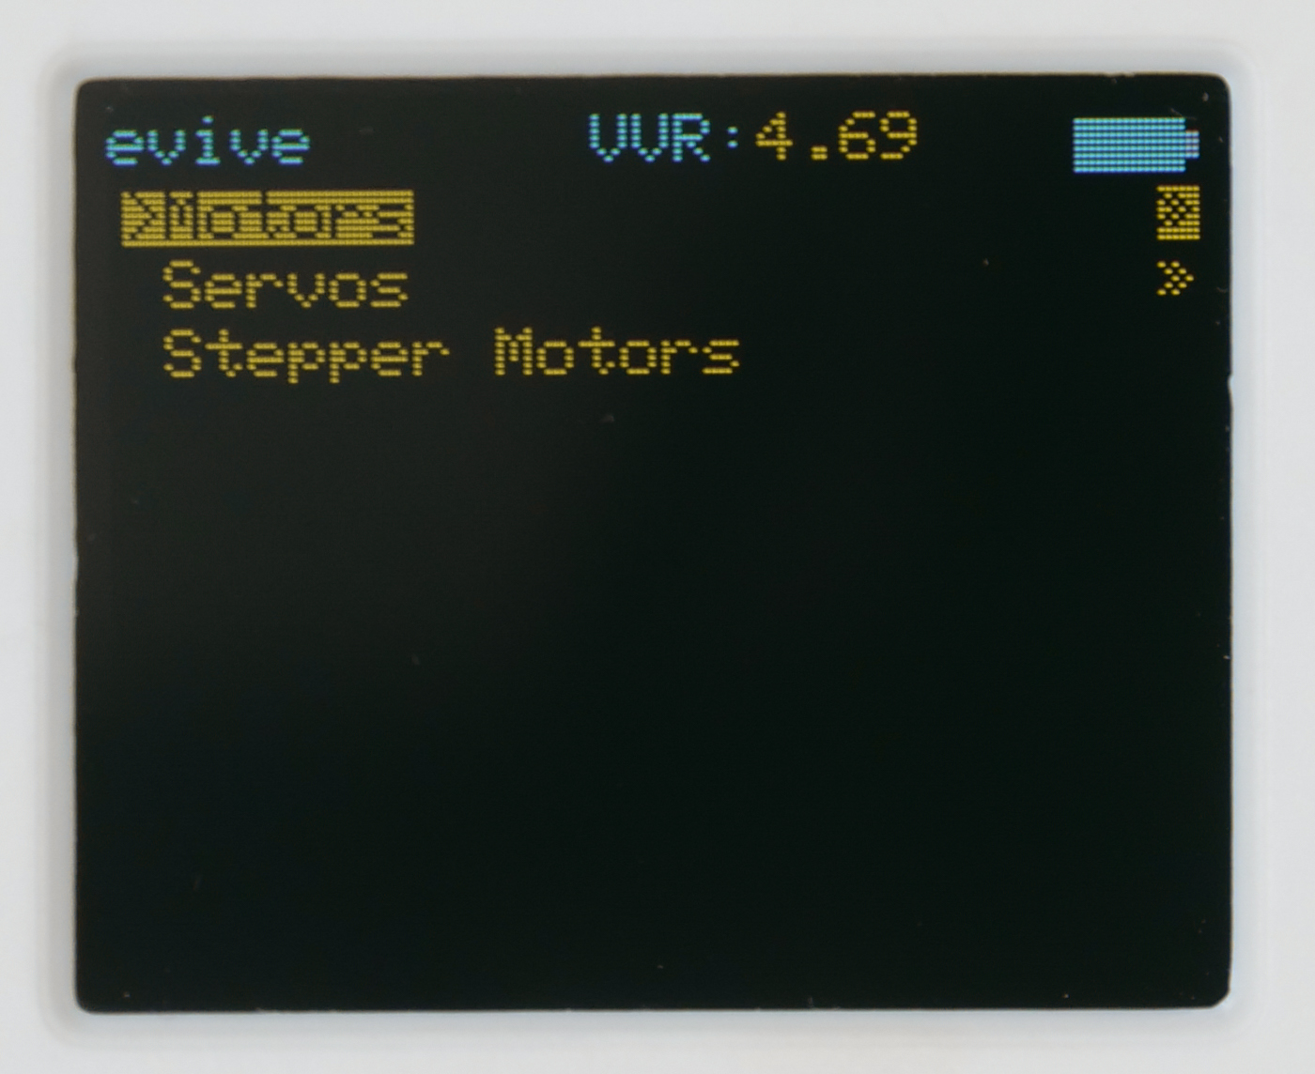
Controlling DC Motor with evive
Now, switch ON your evive. The first option in the menu that appears on the screen is Controls; select that option by pressing the control button to the right.
Next, you’ll see three more options, namely Motors, Servos, and Stepper Motors; select Motors.

Slide 16
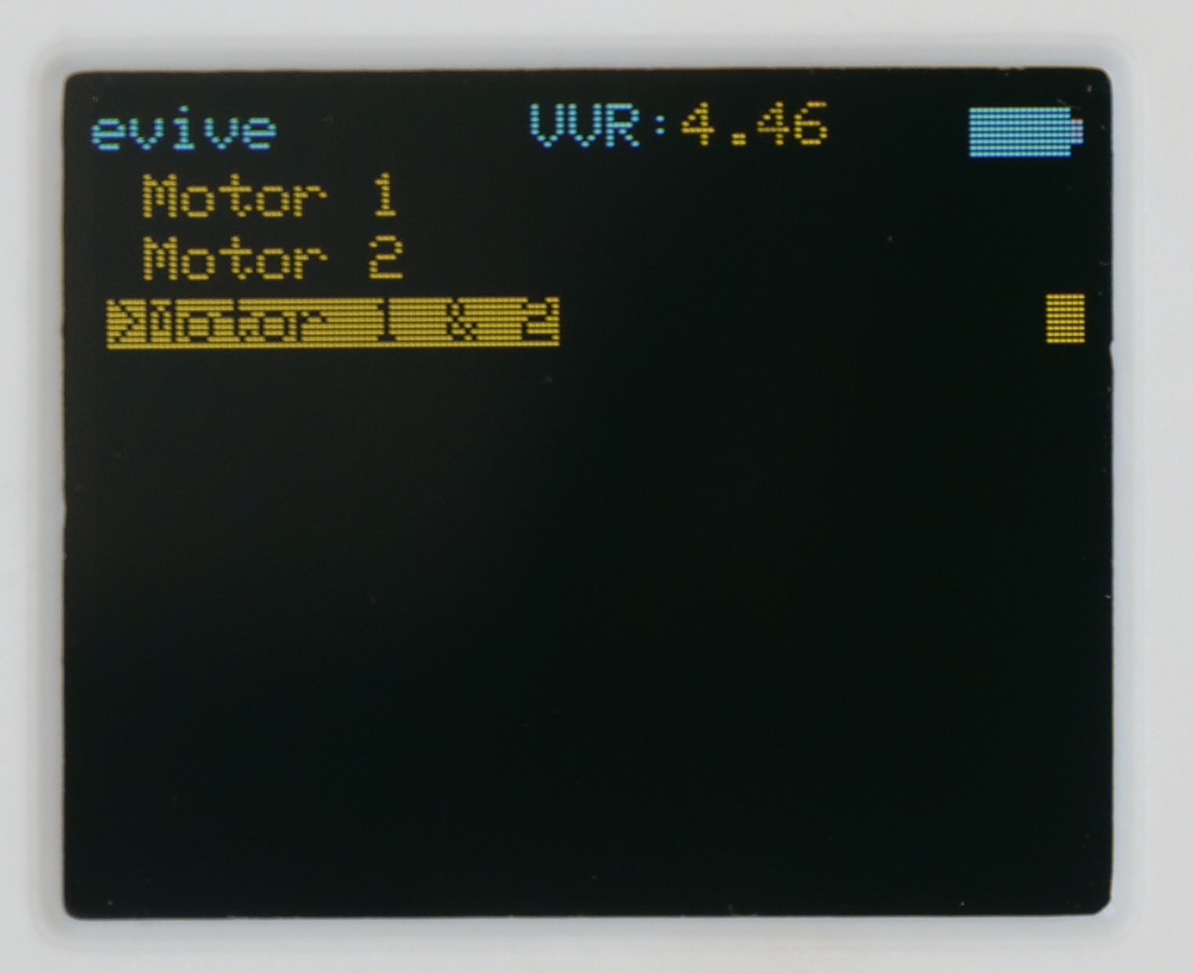
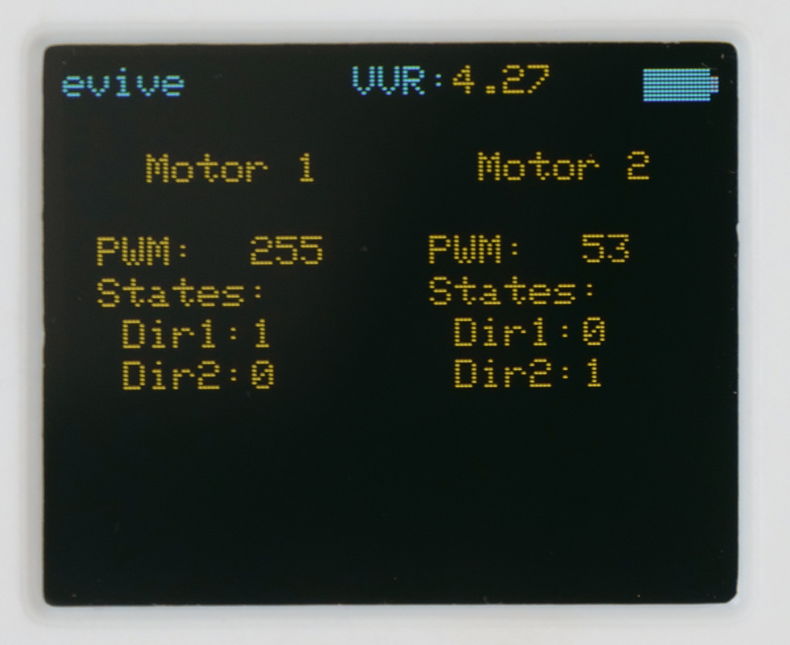
Controlling DC Motor with evive
From the three options that now appear on the screen, select Motor 1 & 2. The following screen will appear:

Slide 17
Controlling DC Motor with evive
PWM determines the speed of the motor.
It can be controlled using the two potentiometer knobs; knob 1 controls the PWM signal at channel M1 and knob 2 controls the PWM signal at channel M2.

Slide 18
Controlling DC Motor with evive
Dir1 and Dir2 are the two possible states or the two possible directions in which the motor can rotate.
Dir1 represents clockwise and Dir2 represents anticlockwise.
The two slide switches on evive controls the direction; when in center, no direction is selected.

Slide 19
Controlling DC Motor with evive
If the slide switch is up, then Dir1 is 1, i.e. the direction is clockwise, and Dir2 is 0. But, if the switch is down, then Dir2 is 1, i.e. the direction is anticlockwise and Dir1 is 0.
The 1st switch sets the directions for the motor connected to M1 and the 2nd switch sets the directions for the motor connected to M2.

