Slide 1
Ohm's Law and LED Basics

Slide 2
Revision
Voltage is nothing but a type of force that a power source creates at its two ends. This force makes the charge flow around the circuit.
The rate of flow of charge is defined as current.
The property of any material to resist the flow of charge is called resistance.
More the resistance, slower the flow i.e. lesser the current.

Slide 3
Ohm’s Law

Slide 4
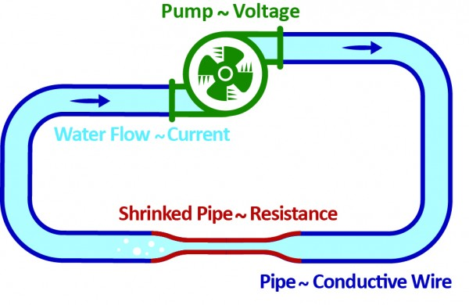
Relation between Voltage and Current
When pressure applied by the pump increases the rate of flow of water molecules also increases, when the length and thickness of the pipe is the same.
Similarly, in an electronic circuit, the current increases with an increase in voltage, and decreases as the voltage decreases.

Slide 5
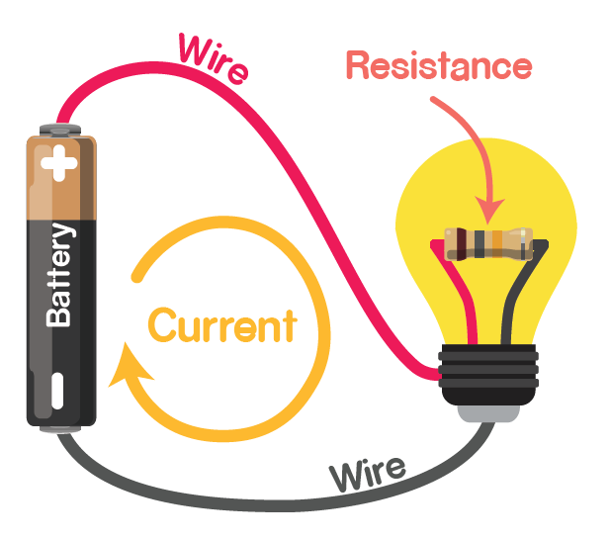
Ohm’s Law
Ohm’s law states that current increases when the voltage increases or when the resistance decreases, it is mathematically expressed as
V = I x R

Slide 6
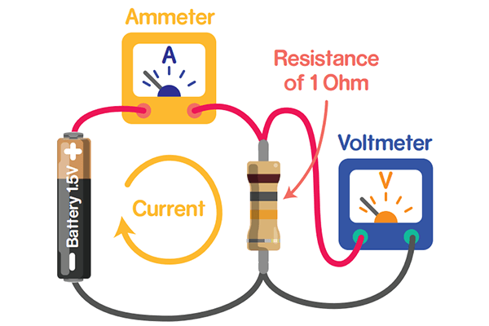
Ohm’s Law
If battery’s voltage is 1V and resistance of circuit is 1Ω, then the current flowing in the circuit will be 1A, and the relation between these units is expressed as
1V = 1A * 1Ω

Slide 7
Using Ohm’s Law
Suppose you have a simple circuit with a battery of 9V and a resistor. The current in the circuit is 3A.
What is the resistance?

Slide 8
Using Ohm’s Law

Slide 9
LED

Slide 10
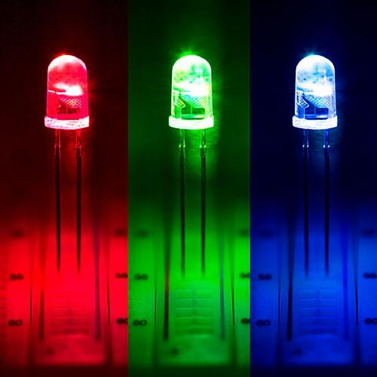
LED
LEDs are like tiny light-bulbs which glow when current passes through them.

Slide 11
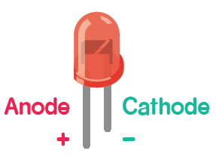
Properties of LED
Polarity: current flows only in one direction positive side (anode) to the negative side (cathode) and like many other electronic components, LEDs have them too. Connecting them in reverse may blow up the LED.
Intensity: more the current, brighter the LED.
Safety: If you pass too much current through the LED, it may blow up. For LEDs, this is usually around 20 mA (1A = 1000 mA or milliamperes).

Slide 12
LED Circuit

Slide 13
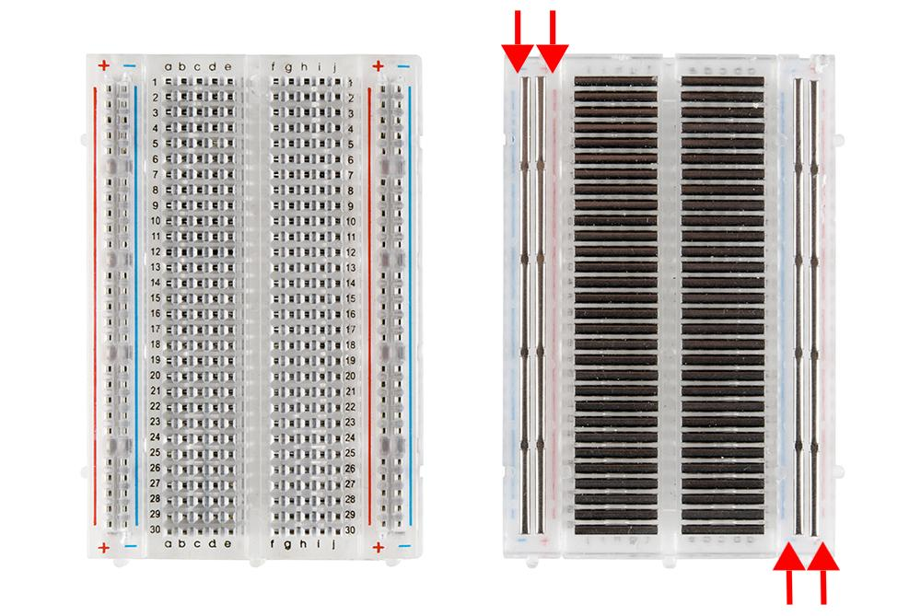
Breadboard
A breadboard is a solderless device for temporary prototype with electronics and test circuit designs.

Slide 14
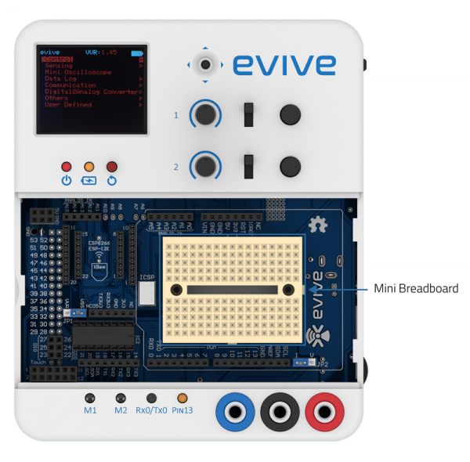
Breadboard
evive also has breadboard to make circuits.

Slide 15
Power Module of evive
You can take 5V voltage output from evive Power module.

Slide 16
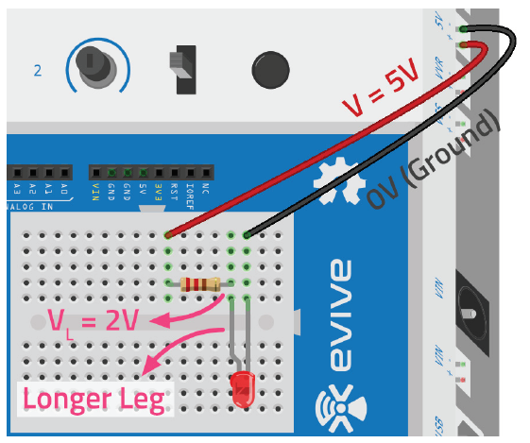
LED Circuit
Make the circuit. But what should be the resistor value?

Slide 17
Calculating the resistor value
LED works at 2V and evive is supplying 5V, if we include a resistor in the circuit, voltage across its terminals will be equal to 3V.
Since you don’t want the current to be more than 20mA, required resistance can be found using Ohm’s Law, which says V = I * R.
R = V/I = 3V/20mA = 3V / (20A/1000) = 3000V/20A = 150Ω
Anything greater than 150Ω will work and keep the current below 20 mA.

Slide 18
LED Circuit
Put the 220Ω resistor in the circuit to glow the LED.

Slide 19
LED Circuit
Change the resistor to see how the brightness of the LED changes.

