Slide 1
Basics of Electronics – Voltage

Slide 2
What is Electronics?

Slide 3
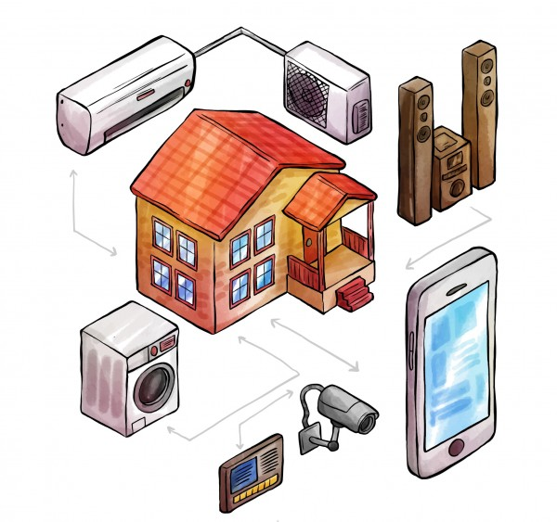
What is Electronics?
Electronics is a field of science in which we study about electric currents generated due to the movement of electric charges that flow in circuits that store and handle information, and how to control these currents.

Slide 4
Name 10 electronic device you know

Slide 5
Electronic Devices
Smartphone
Laptop
Microwave
Washing Machine
Camera
Water pump
Speaker
Projector
AC
Fridge, etc.

Slide 6
Basics of Electronics

Slide 7
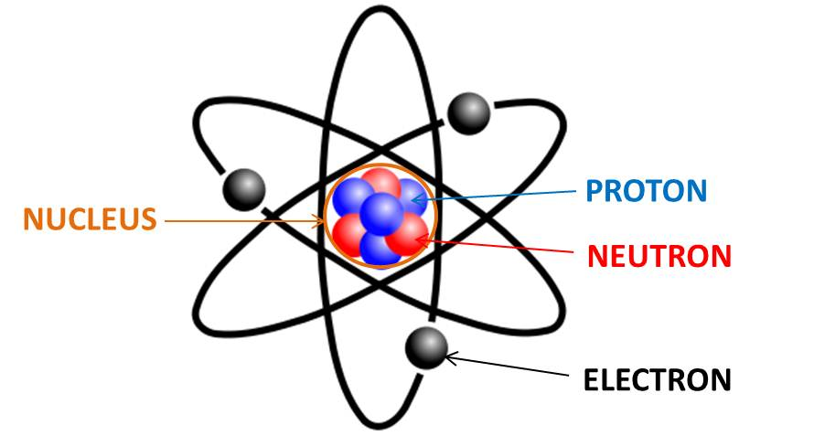
Atom
An atom is the smallest constituent unit of ordinary matter.
It has
    Protons – positively charged particle
    Electron – negatively charged particle which is free
    Neutrons – no charge
Movement of electrons, or the charge, create electricity.

Slide 8
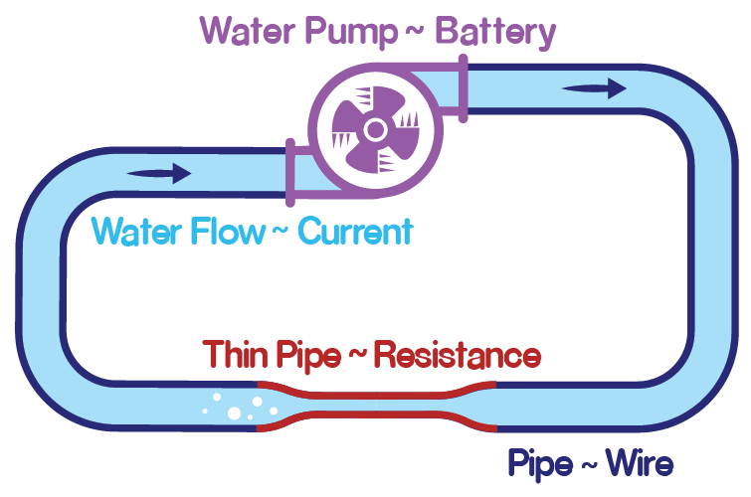
Pump Water System
Imagine a piece of rubber pipe full of water placed on a table with both of its ends glued together, forming a closed loop.

Slide 9
Pump Water System
When the pipe is lying on a flat surface, will the water inside it flow? It won’t.
To cause the water to flow, we will have to connect a pump.
This pump will pull water from one side and push it from the other, resulting in circulation or flow of water in the pipe.
It creates a pressure difference between two points in the pipe which causes the water to flow.

Slide 10
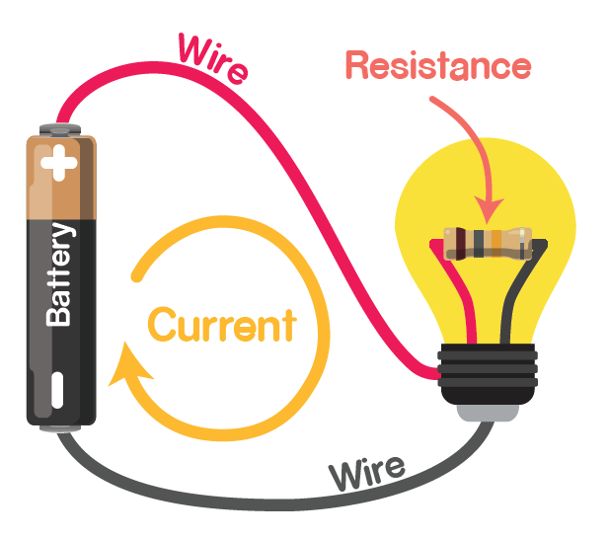
Electronic Circuit

Slide 11
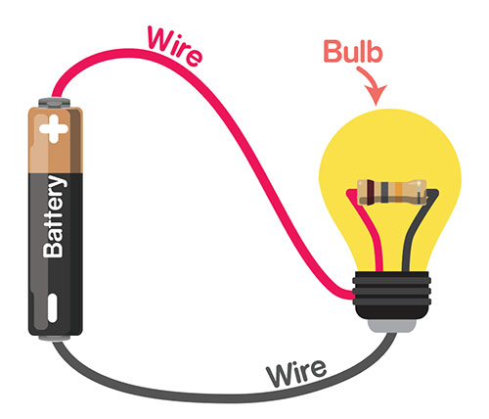
What is electronic circuit?
The arrangement of components in the form of a closed path for the charge to flow is known as a circuit.
A circuit made of electronic components and wires is known as an electronic circuit.
The simplest circuit can consist
of just a power source and one
component like battery and blub.

Slide 12
Voltage
Pump pulls water from one of its sides and pushes it from the other, resulting in circulation or flow of water in the pipe.
Voltage is nothing but a type of force that a power source creates at its two ends. This force makes the charge flow around the circuit.
In electronics,
  water would be analogous to charge,
  the pipe would be analogous to a wire,
  the pump to a battery,
  the pressure difference to voltage
  the complete pump-pipe system to an electronic circuit.

Slide 13
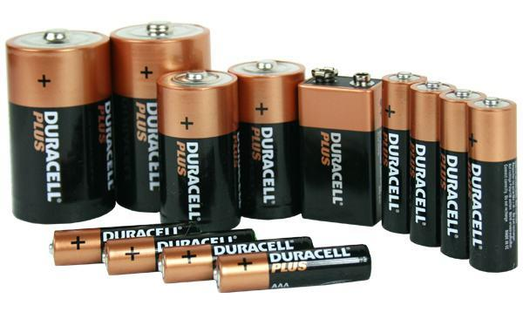
Battery – Power Source
Battery is the power source of the circuit which provide voltage.

Slide 14
Polarity
Polarity is the property of having two poles that have opposite physical properties:
  Positive
  Negative
Polarity is important because it decides the direction in which the charge in the circuit will flow.
If the polarity is reversed the direction of flow of charges is also reversed.
The positive pole or the positive terminal is said to have a higher voltage as compared to the negative terminal in a battery.

Slide 15
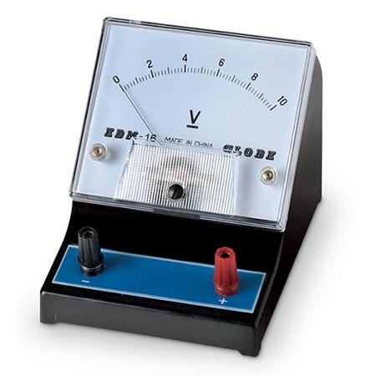
Measuring Voltage
In a circuit, we measure the voltage using a device known as a voltmeter.
A voltmeter is always connected across the component whose voltage we are measuring.

Slide 16
Activity :
Measuring Voltage

Slide 17
Activity – Measuring Voltage
We will use evive to measure the voltage.
evive can measure voltage from -30V to 30V range.

Slide 18
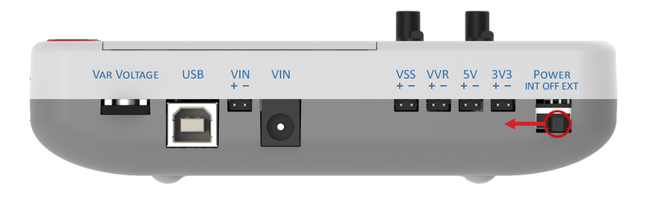
Powering up the evive
On the right side of evive, there is a switch labeled POWER.
It will be in the center, under OFF.
Flip it to its left, i.e. to INT; this will power up the evive with its internal battery.

Slide 19
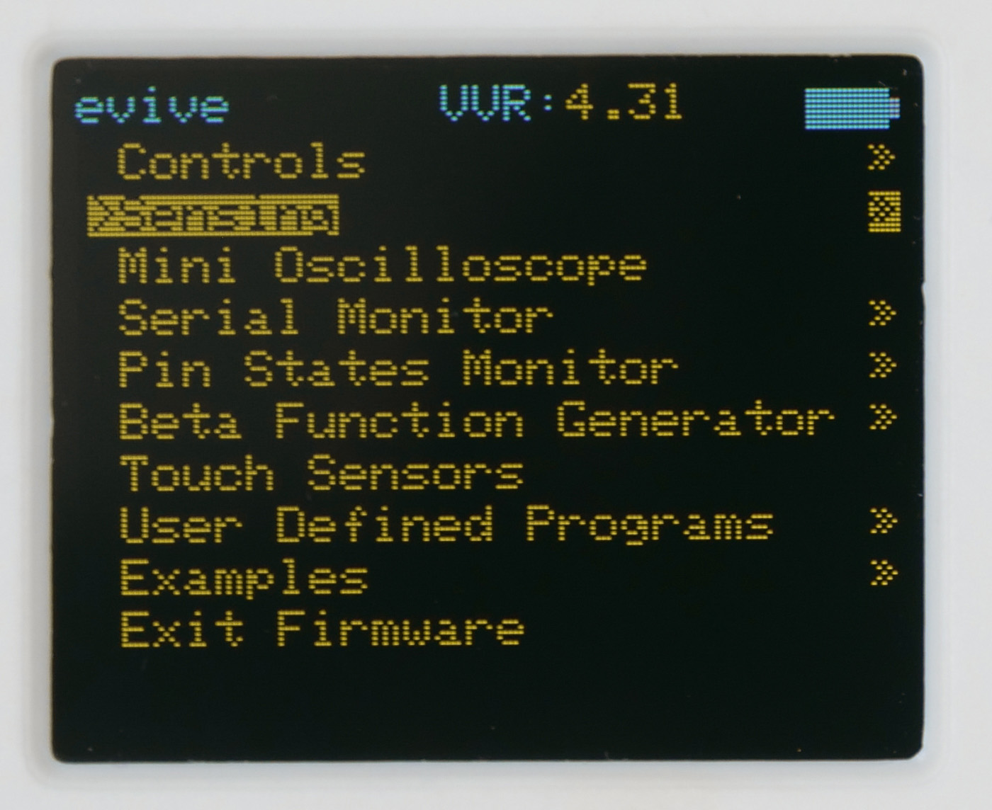
evive’s Menu
When evive starts up a menu will appear on the TFT screen.
If not, center press on navigation key.

Slide 20
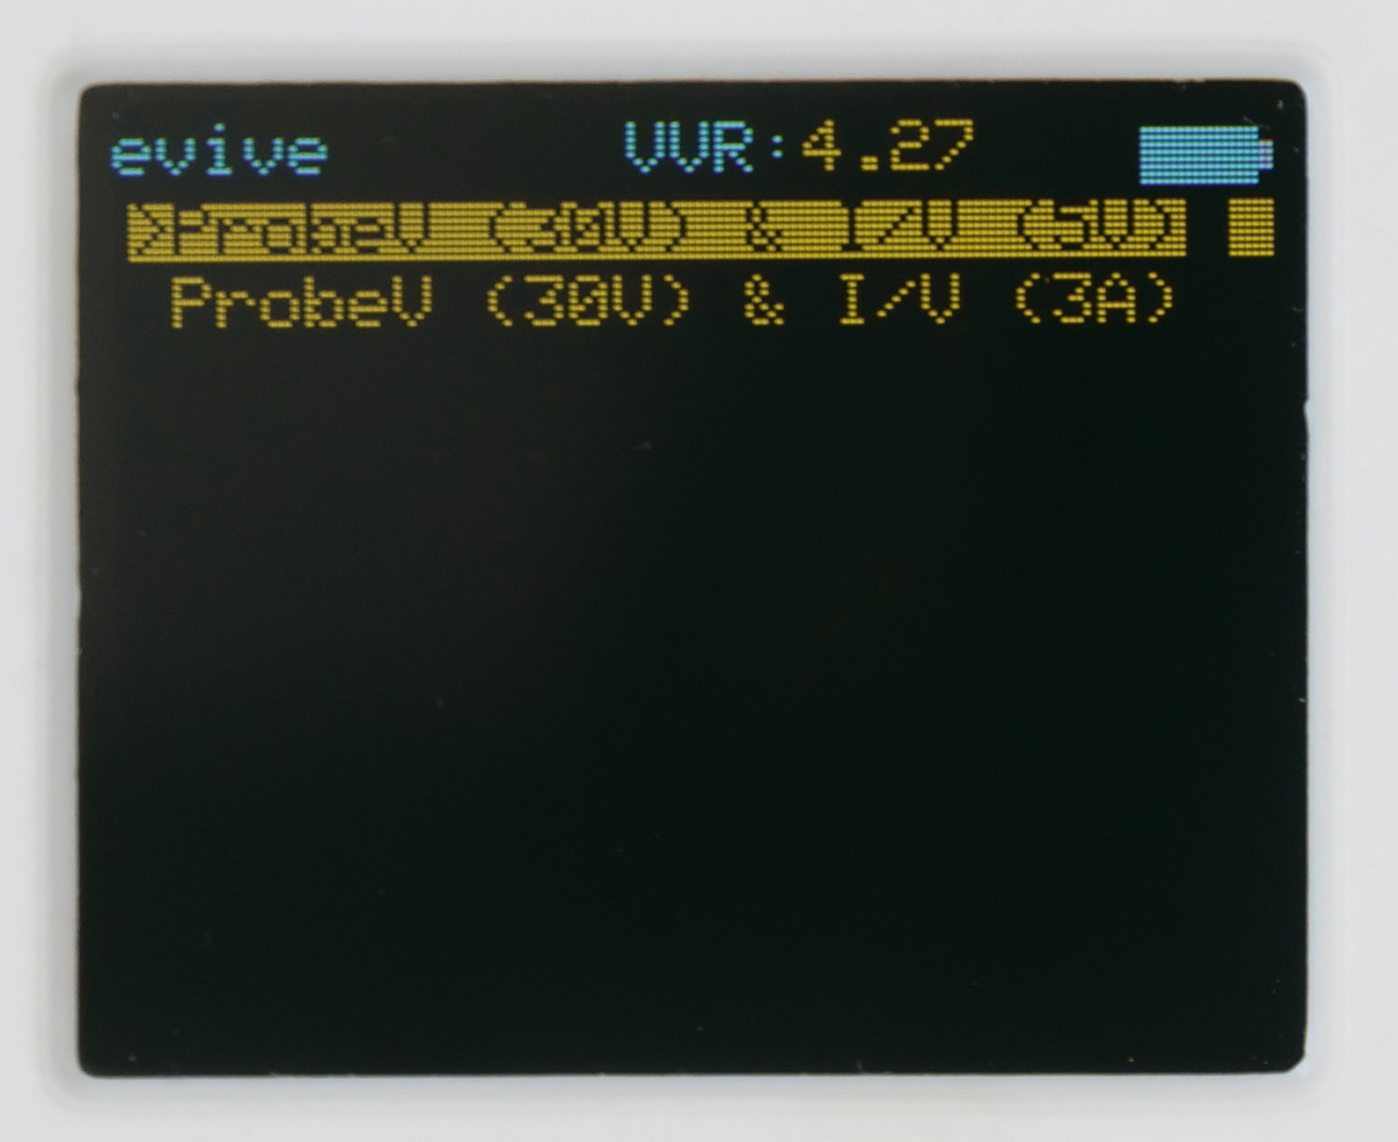
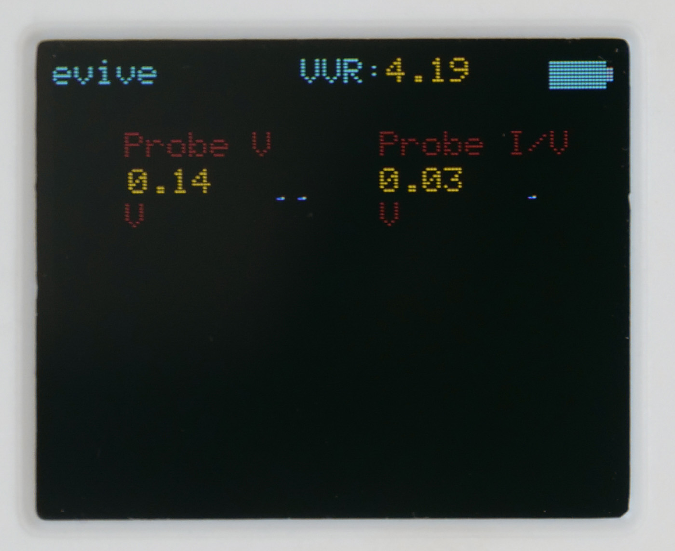
Navigating to Sensing
In the menu, the second option is Sensing
Select this option using the navigation key.
Then, navigate through the menu as follows: Sensing > ProbeV (30V) & I/V (5V).

Slide 21
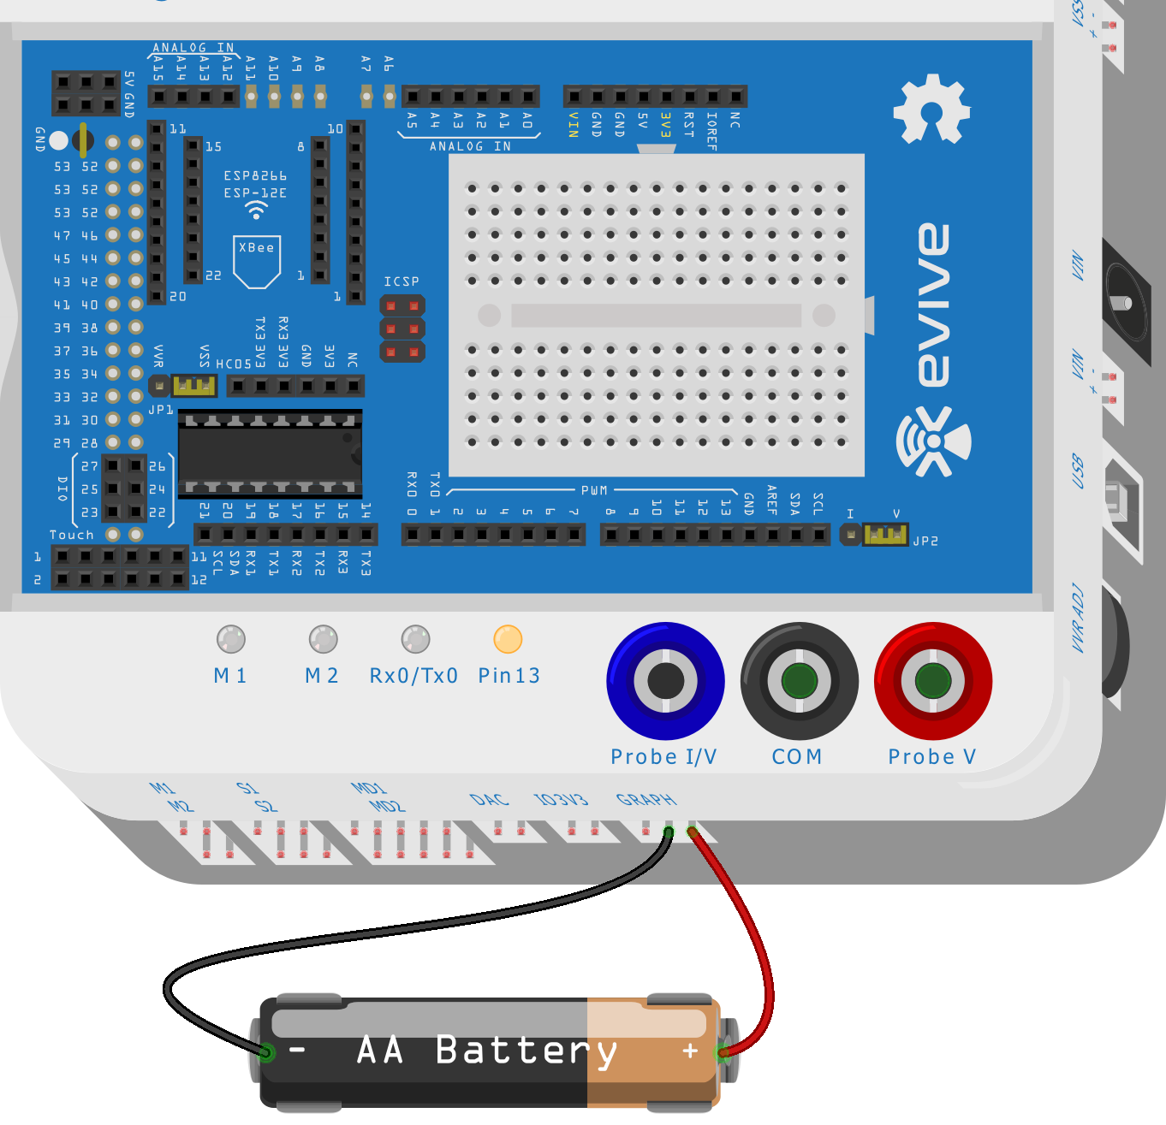
Measuring Voltage
Connect the rightmost pin of Graph to positive terminal of the battery using red wire.
Connect the center pin of Graph to the negative terminal of the battery using black wire.
The voltage will be shown on the evive display.

Slide 22


