Slide 1
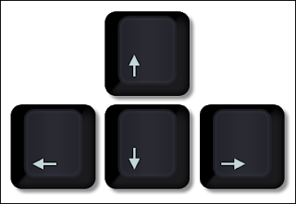
Programming a Robot

Slide 2
What is a Robot?

Slide 3
What is a Robot?
Robots are machines that can
Sense >> Plan >> Act (Just like you).
Parts of a Robot:
Sensors, Controller, Actuators, Structural Elements and Power Source

Slide 4
Your Robot is Ready !

Slide 5
Connecting Robot with PictoBlox

Slide 6
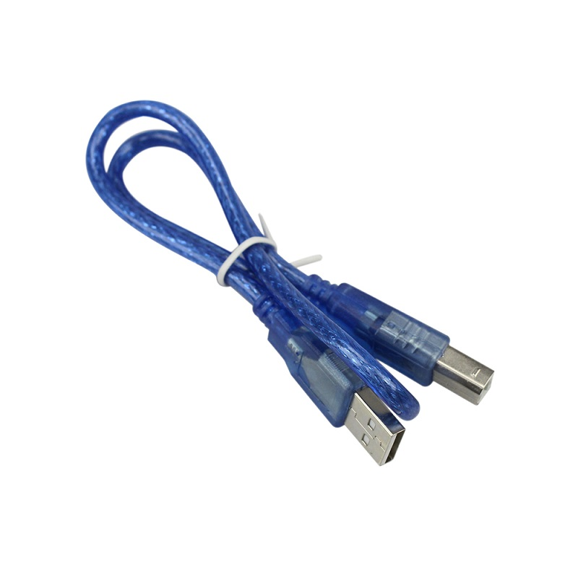
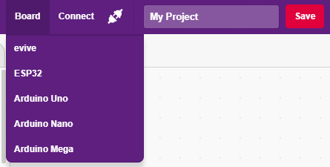
Interfacing evive with PictoBlox
Connect Robot to your laptop/PC via USB cable and open PictoBlox.
In PictoBlox, go to the menu and click on the Boards Select the evive.

Slide 7
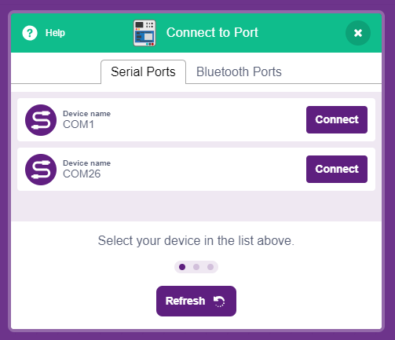
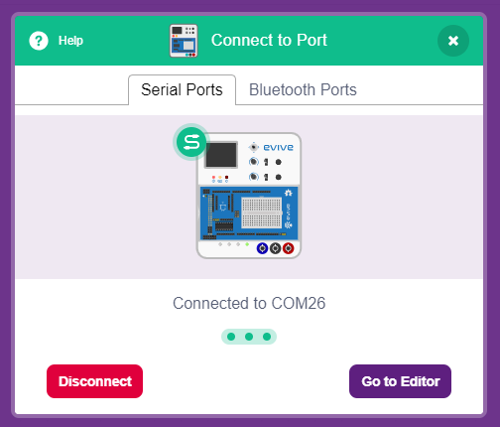
Interfacing evive with PictoBlox
Once you’ve selected the board, click on the Connect tab and connect the board.

Slide 8
Upload Firmware
You have to upload the firmware into the device before interacting with it.
Click on Upload Firmware button.
Once you successfully uploaded the firmware you will see evive logo on evive display.

Slide 9
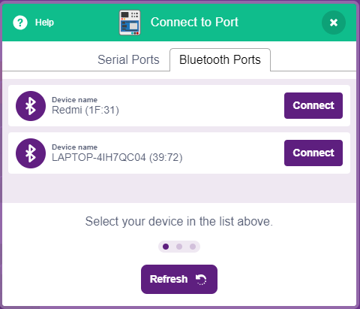
Connecting via Bluetooth
Remove USB cable.
Connect Robot with PictoBlox using Bluetooth.

Slide 10
Programming a Robot
In this Activity, We will learn how to move a robot forward, backward, left and right? And finally make scripts to run the robot forward, backward, left and right using keyboard keys.

Slide 11
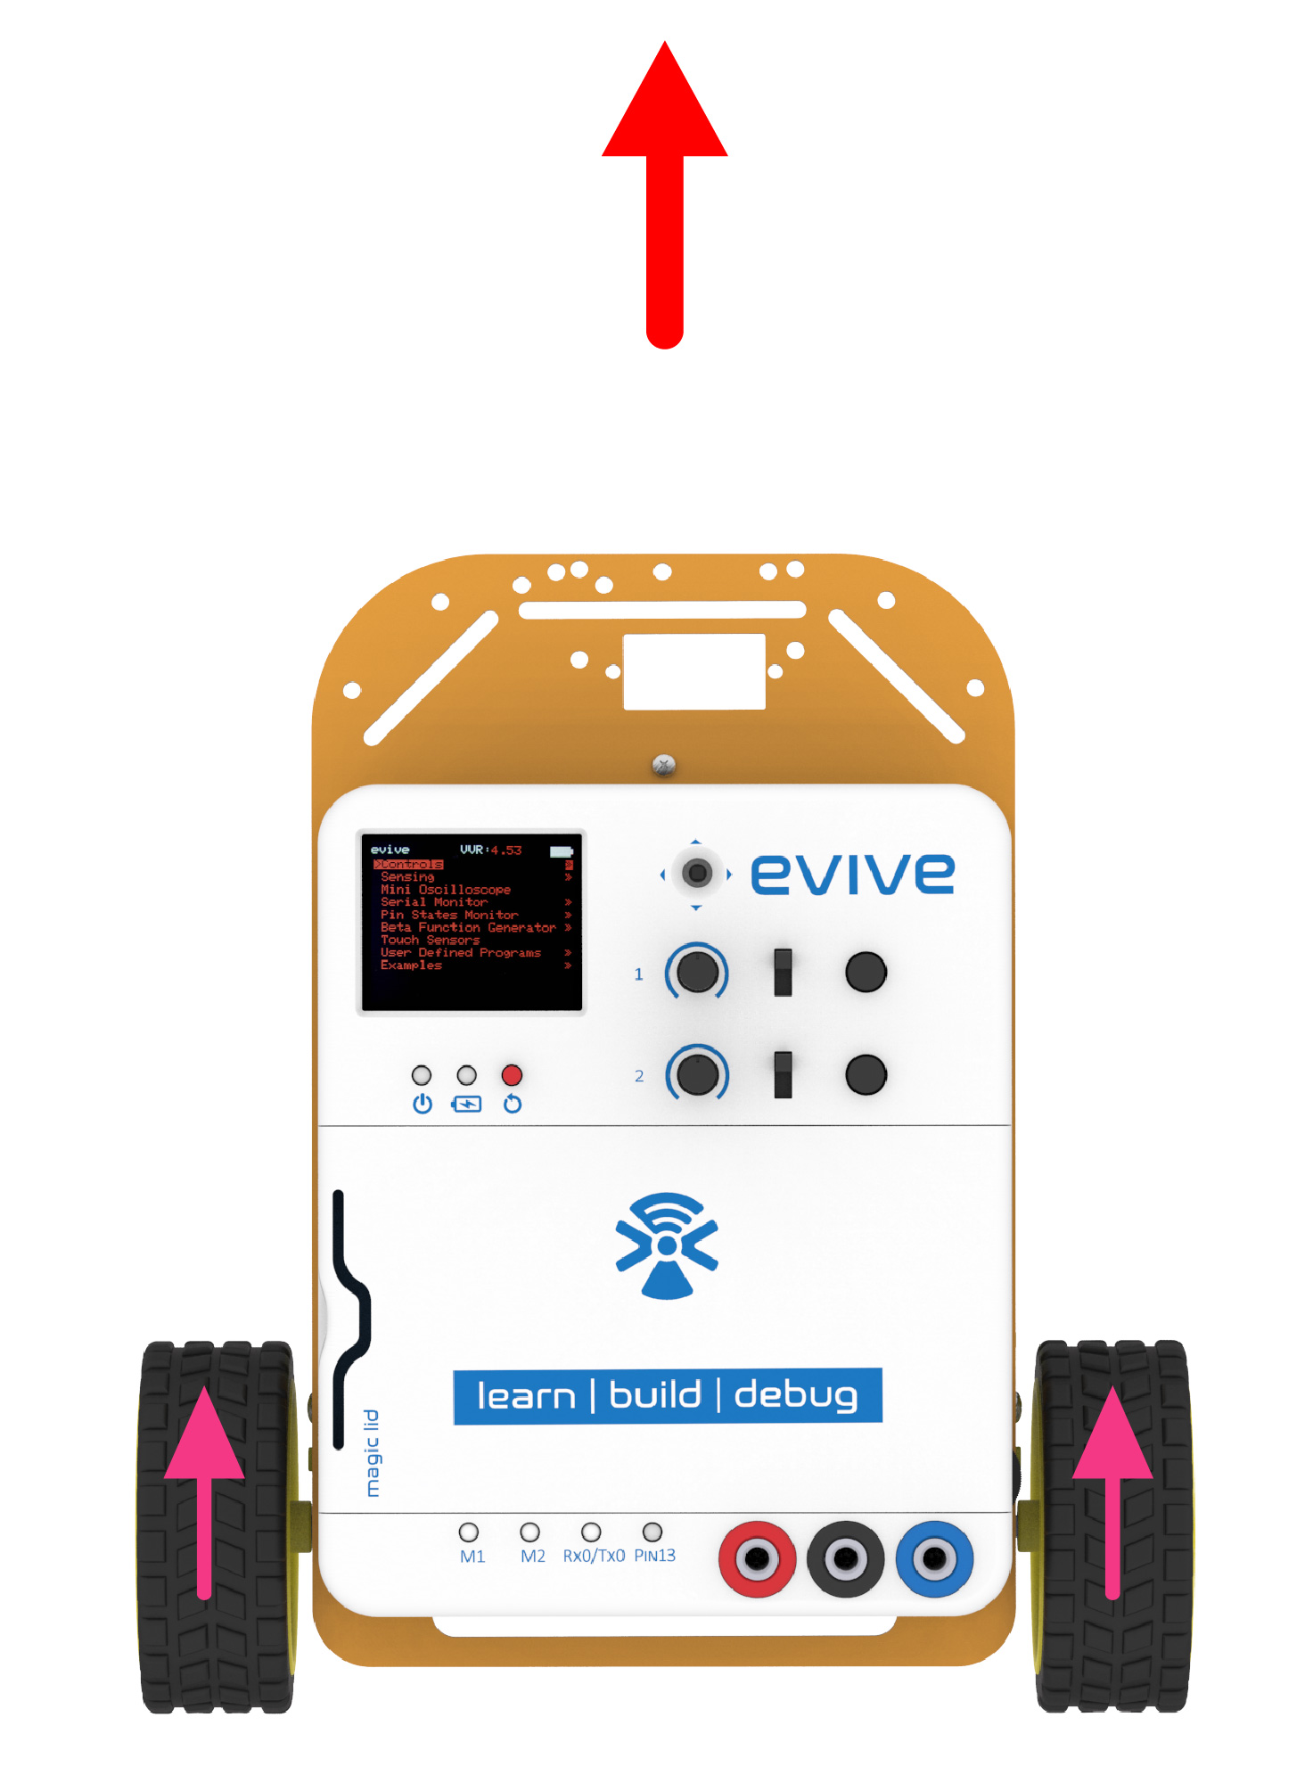
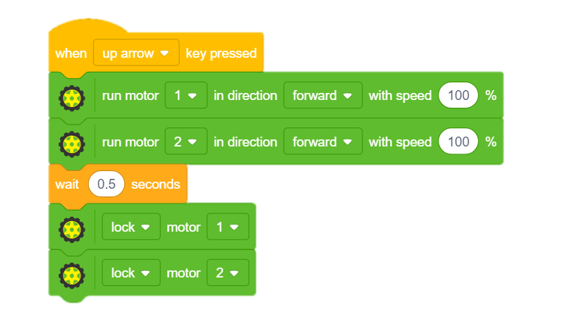
STEP 1: Move forward
To move robot forward, we will run both motors in the forward direction, then add some delay and finally lock motors to stop the robot.
Above thing will be executed whenever we press the up arrow key on the keyboard.

Slide 12
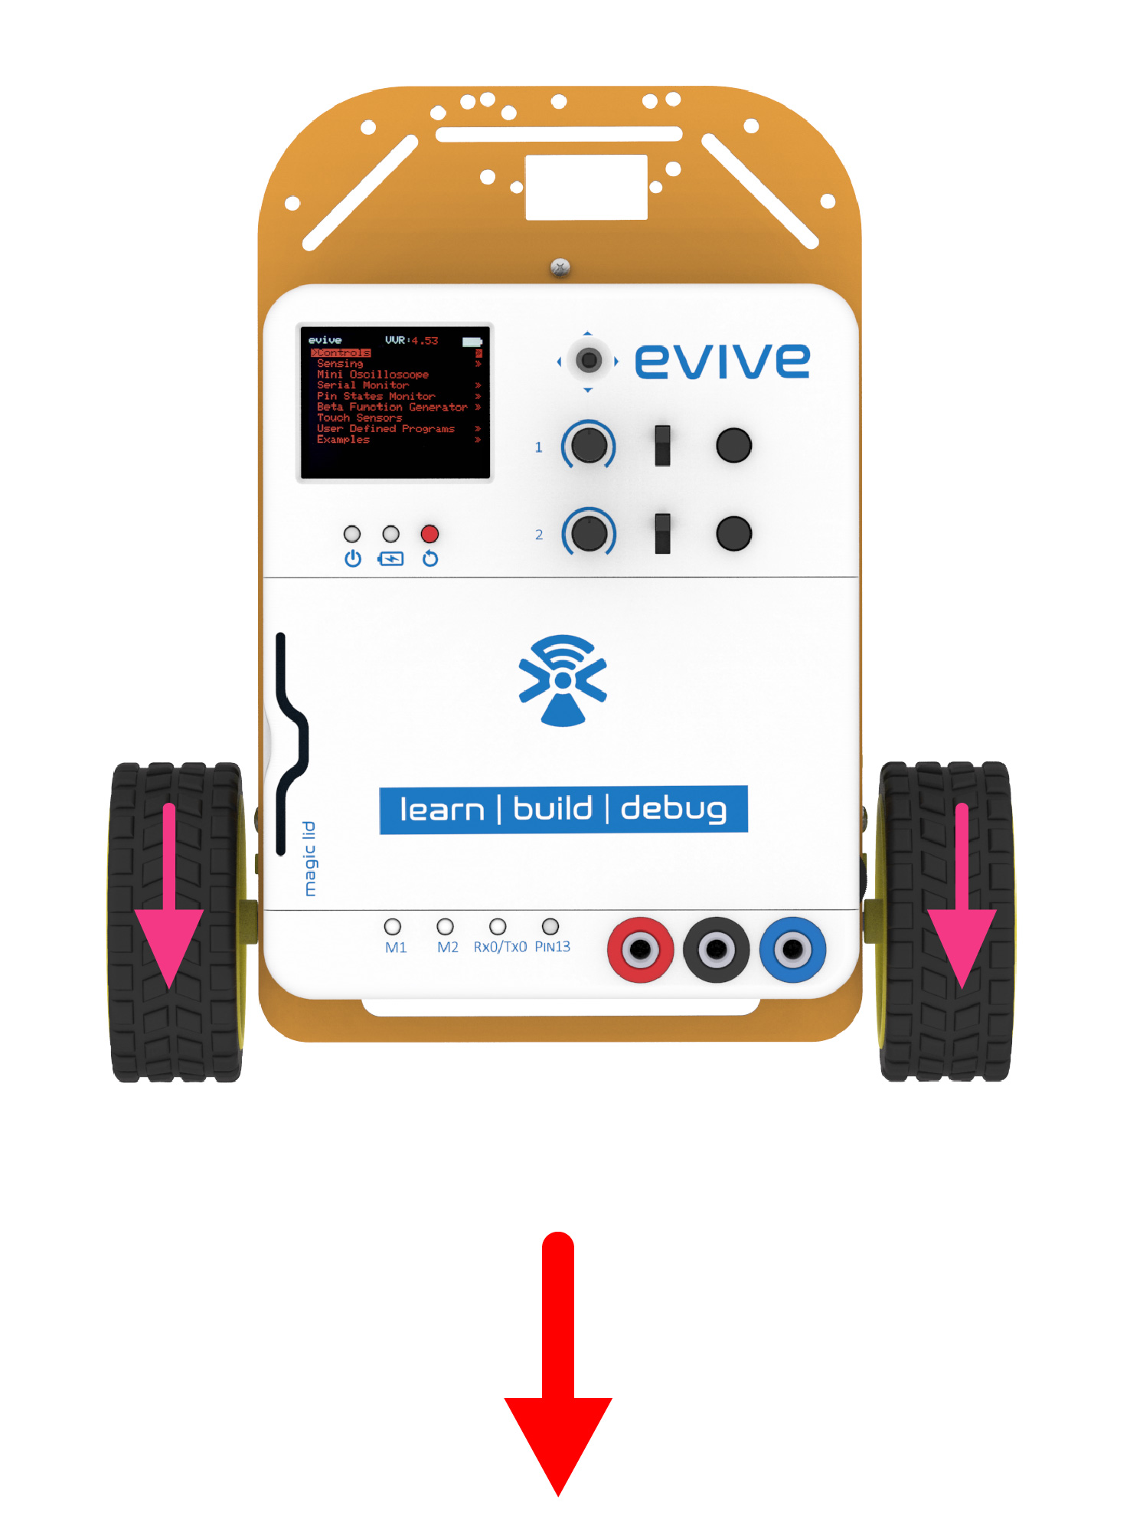
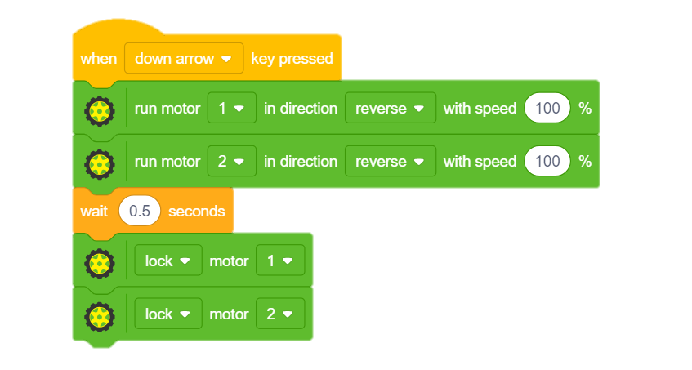
STEP 2: Move Backward
To move robot backward, we will run both motors in the reverse direction, then add some delay and finally lock motors to stop the robot.
Above thing will be executed whenever we press the down arrow key on the keyboard.

Slide 13
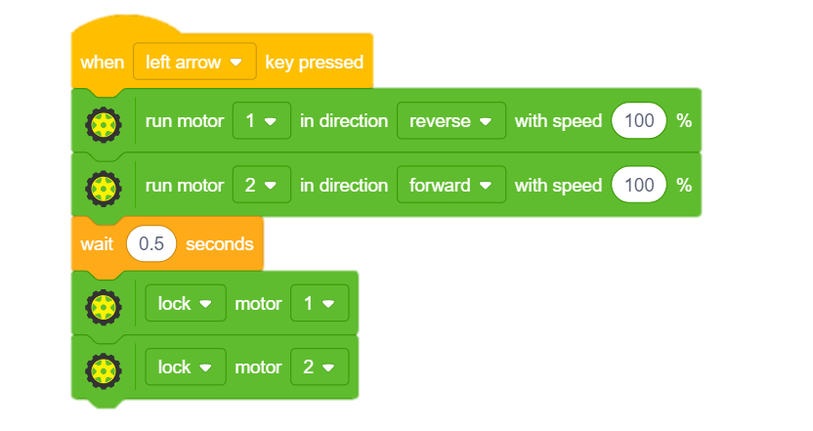
STEP 3: Turn Left
To turn the robot left, we will run left motor in reverse and right motor in forward direction, then add some delay and finally lock motors to stop the robot.
Above thing will be executed whenever we press the left arrow key on the keyboard.

Slide 14
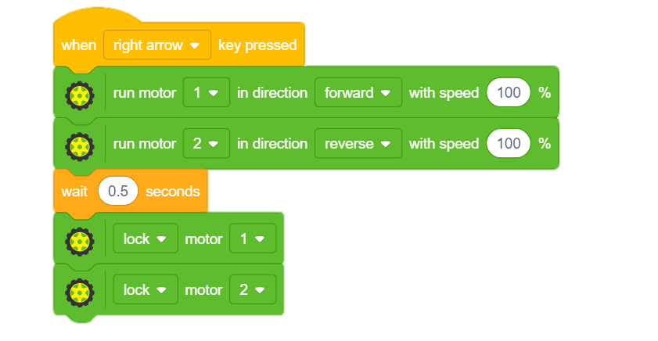
STEP 4: Turn Right
To turn the robot right, we will run left motor in forward and right motor in reverse direction, then add some delay and finally lock motors to stop the robot.
Above thing will be executed whenever we press the right arrow key on the keyboard.

Slide 15
STEP 5: Let’s Play
Choose an arena of your choice whether it’s a classroom or a playground and compete with your friends.

