Slide 1
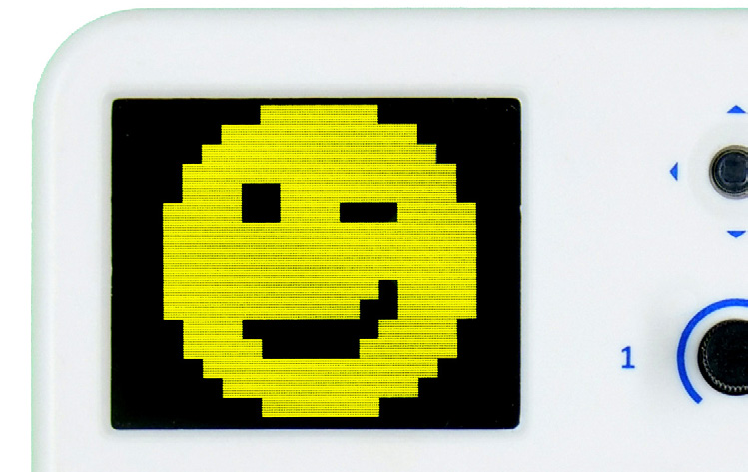
Animating emojis on evive Display

Slide 2
evive Display

Slide 3
evive Display
evive has a 1.8” TFT Display which is mainly used for visual feedback. The display has a 160 x 128 color pixels.

Slide 4
Interfacing evive with PictoBlox

Slide 5
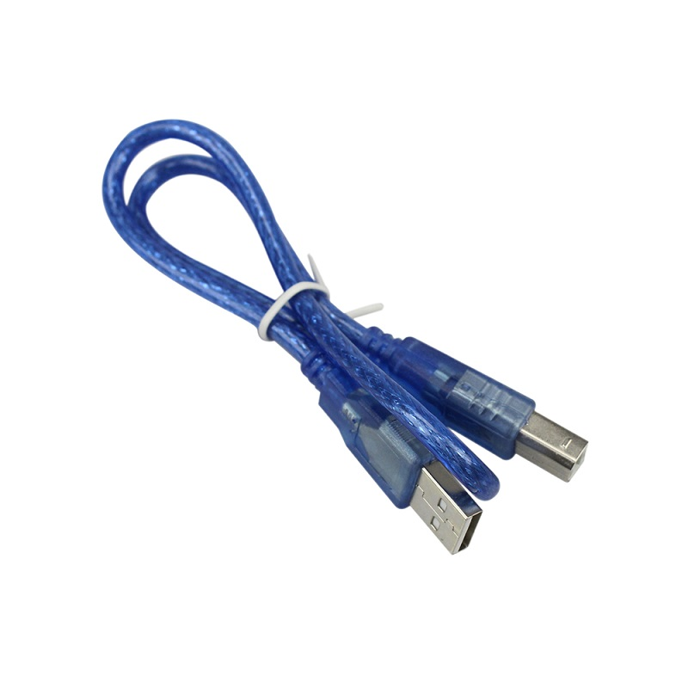
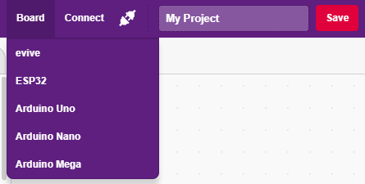
Interfacing evive with PictoBlox
Connect evive to your laptop/PC via USB cable and open PictoBlox.
In PictoBlox, go to the menu and click on the Boards Select the evive.

Slide 6
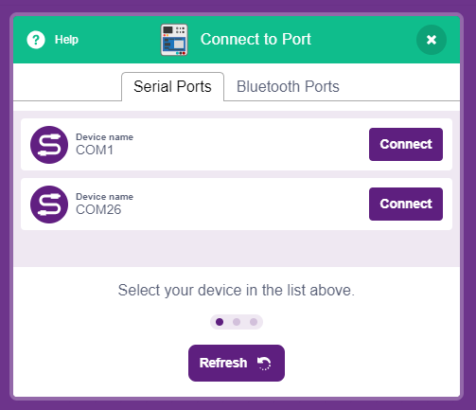
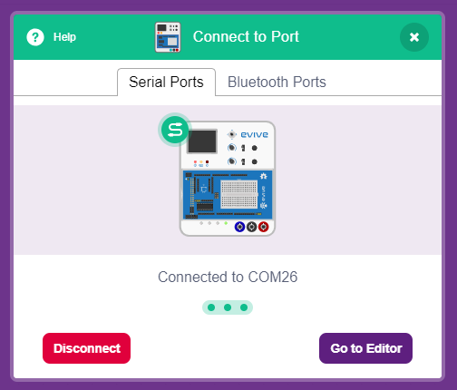
Interfacing evive with PictoBlox
Once you’ve selected the board, click on the Connect tab and connect the board.

Slide 7
Upload Firmware
You have to upload the firmware into the device before interacting with it.
Click on Upload Firmware button.
Once you successfully uploaded the firmware you will see evive logo on evive display.

Slide 8
Animating emojis on evive Display
In this Activity, First We will learn how to display custom emojis on evive's display using PictoBlox and then create a script to animate emojis.

Slide 9
evive Display Extension

Slide 10
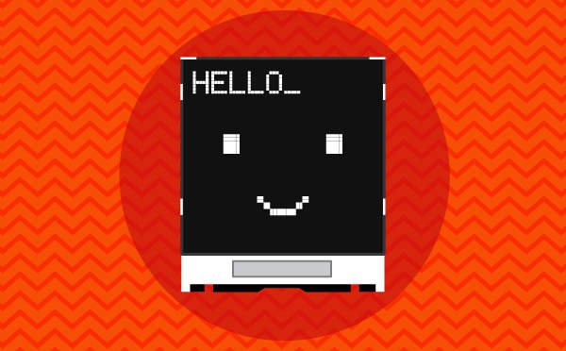
evive Display Extension
evive Display Extension allows you to control the display on evive screen (change colour, font size, and font colour), draw shapes, write text, and display values on the screen.

Slide 11
STEP 1: Drag emojis block
Go to the Display palette and drag and drop the following in the scripting area.
Select or create an expression in the drop-down.
Next, set the size as 8, the position as 10, 10, color as yellow, and background as black by moving the sliders in the drop-downs.

Slide 12
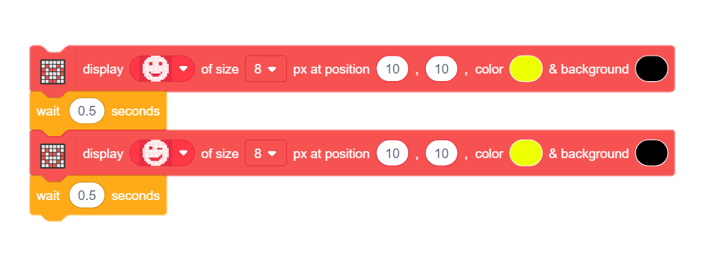
STEP 2: Make the pattern
Add another display block and stack below the first one.
Don’t forget to add wait blocks in between to observe the change.

Slide 13
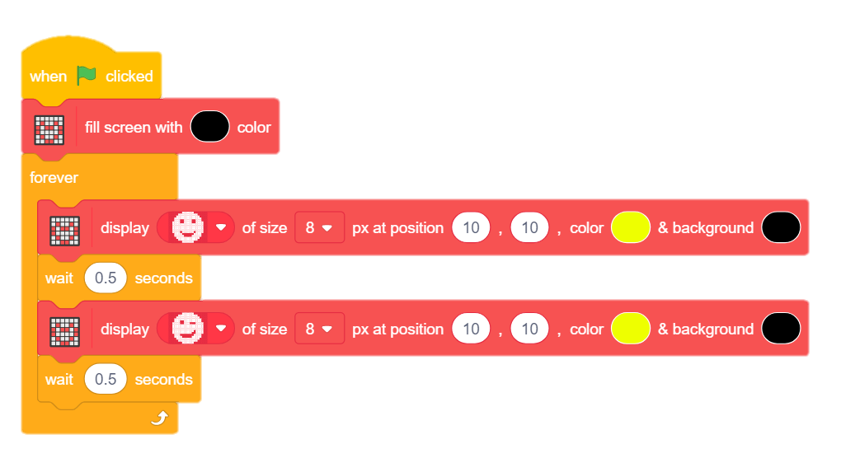
STEP 3: Finalise the Script
Add forever block from the control palette to make it run continuously.
Add fill screen block to make screen black at the beginning.
Finally add a hat block to trigger the script.

Slide 14
Let’s Play
Maximize the stage and click on flag to observe the animation on display.
Try to make more emojis.

