Slide 1
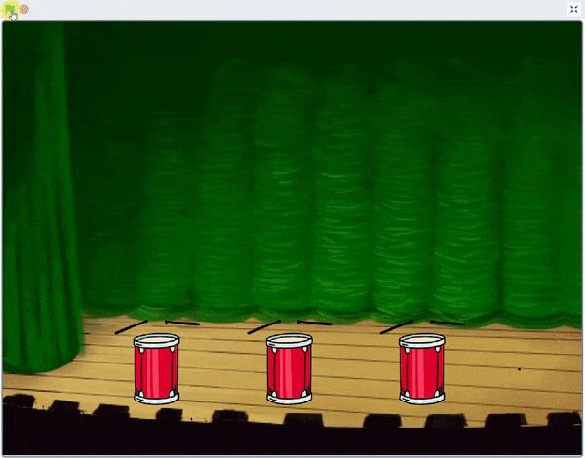
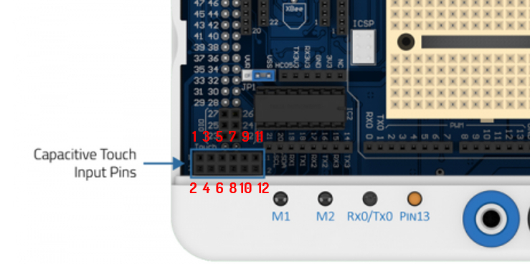
Musical Drums using Touch Sensors

Slide 2
Musical Drums using Touch Sensors
In this Activity, First We will construct a DIY drum and then make it musical by programming it inside the PictoBlox.

Slide 3
Construction of Drums

Slide 4
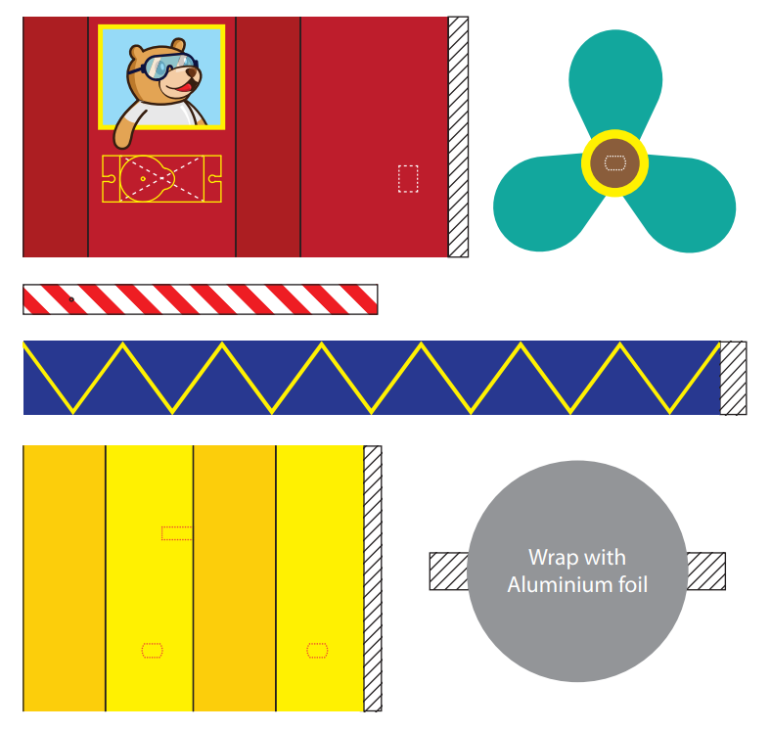
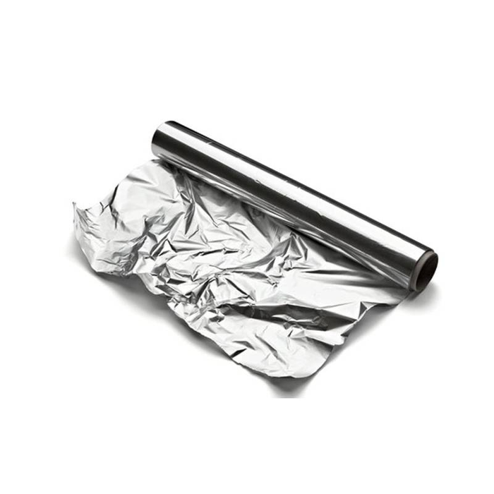
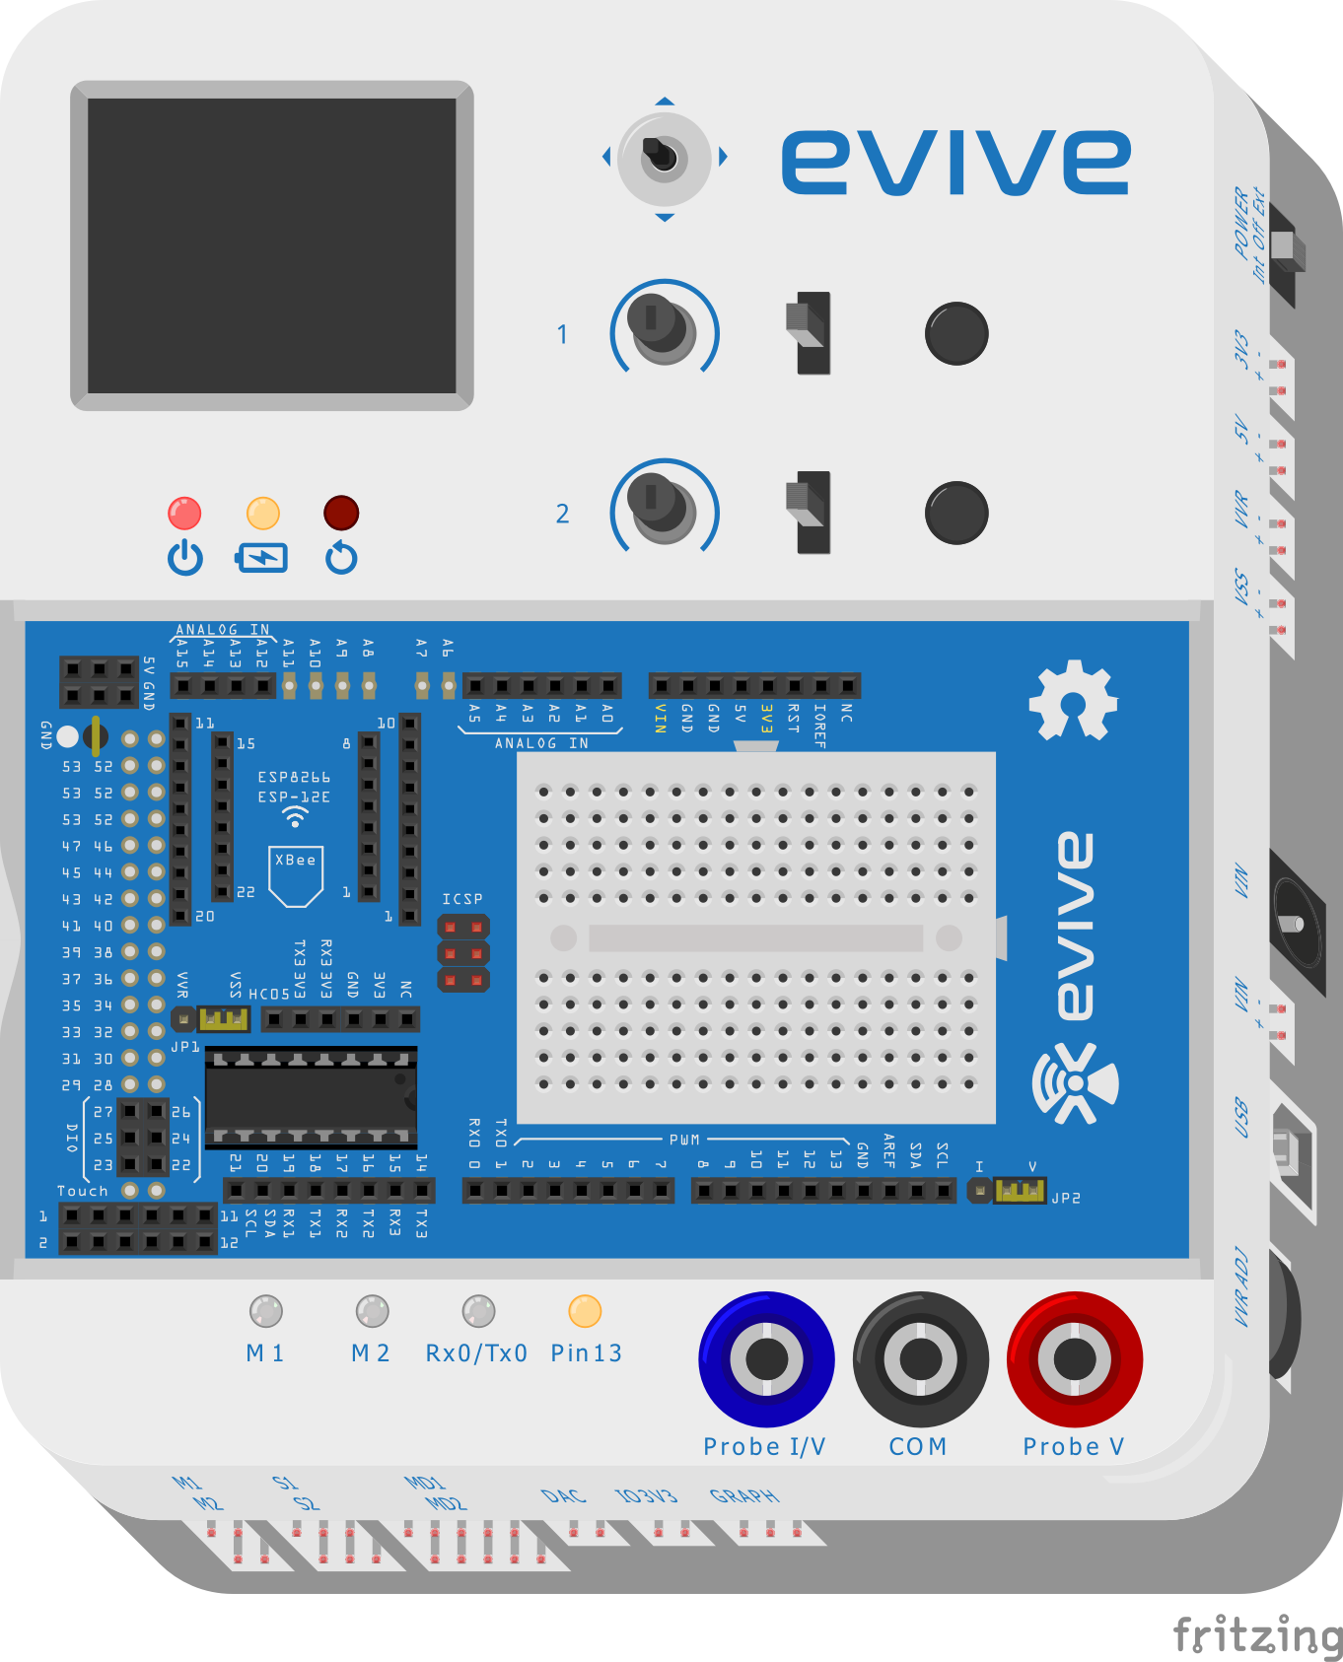
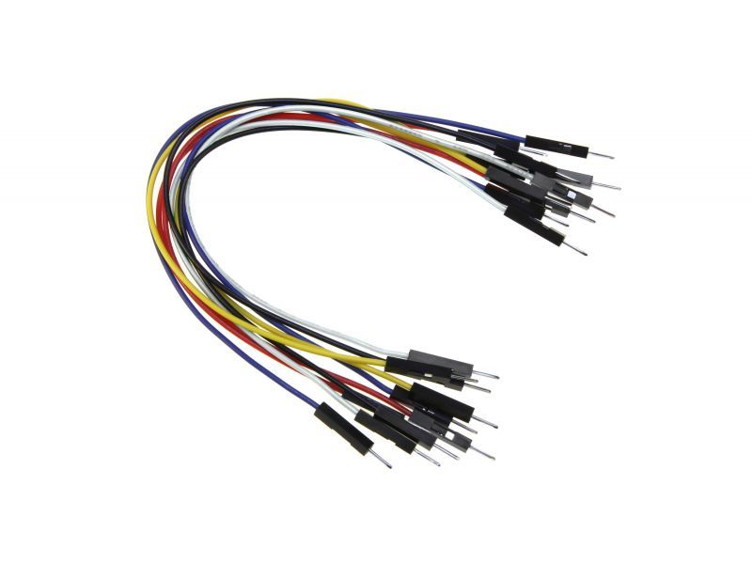
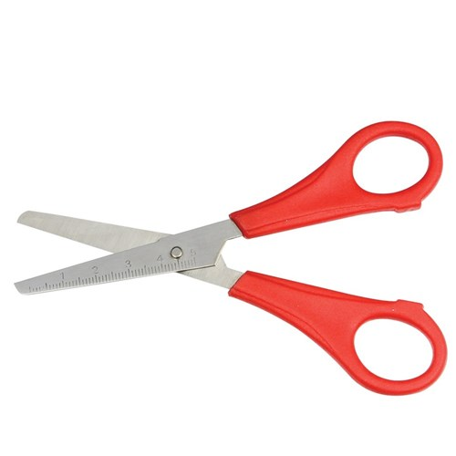
Components Required
evive
Male to Male Jumper wires
Drum Cut-outs
Aluminium Foil
Scissors

Slide 5
STEP 1: Take Cutouts
Cut out the drum parts using a pair of scissors.

Slide 6
STEP 2: Make it Conductive
To make drum surface conductive wrap it with the aluminum foil.
Bend the flaps in downward direction.

Slide 7
STEP 3: Attach the Periphery
Roll the periphery structure and glue the open end.
Fix the drum’s top on it.

Slide 8
STEP 4: Connect Jumper wire
Connect one end of the jumper wires to the drum and gentle press the aluminum foil so that it remains in contact with its end point.

Slide 9
STEP 5: Make the Circuit
Connect other end of the jumper to evive’s touch sensor 1.
Similarly make the 2 more drums and Connect their jumper wires to the 2nd & 3rd touch sensors of evive.

Slide 10
Interfacing evive with PictoBlox

Slide 11
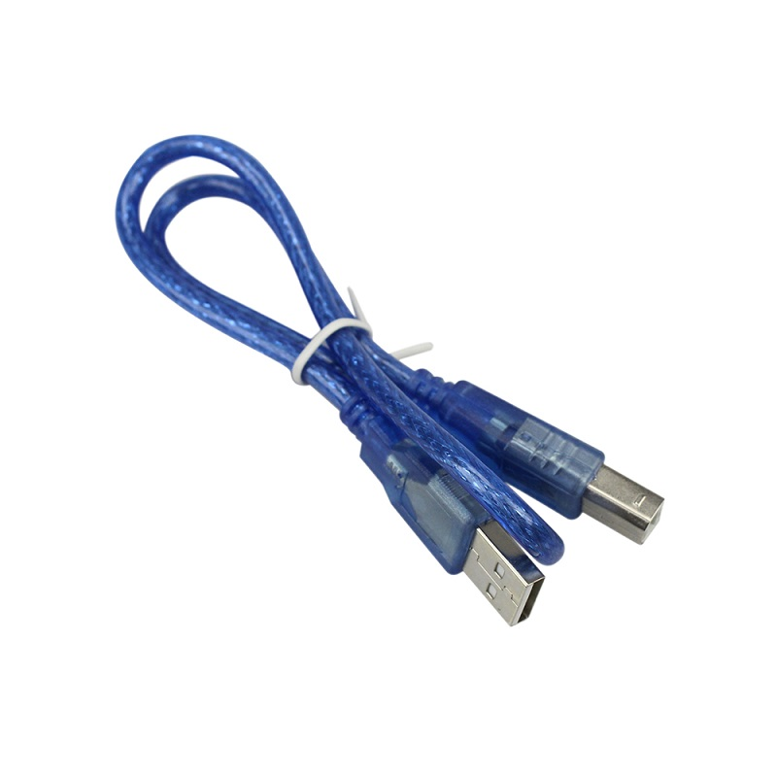
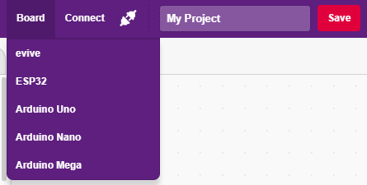
Interfacing evive with PictoBlox
Connect evive to your laptop/PC via USB cable and open PictoBlox.
In PictoBlox, go to the menu and click on the Boards Select the evive.

Slide 12
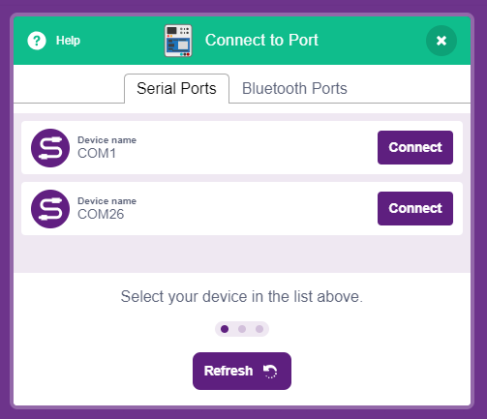
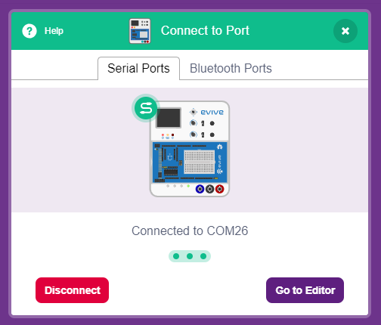
Interfacing evive with PictoBlox
Once you’ve selected the board, click on the Connect tab and connect the board.

Slide 13
Upload Firmware
You have to upload the firmware into the device before interacting with it.
Click on Upload Firmware button.
Once you successfully uploaded the firmware you will see evive logo on evive display.

Slide 14
Programming

Slide 15
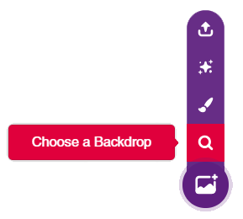
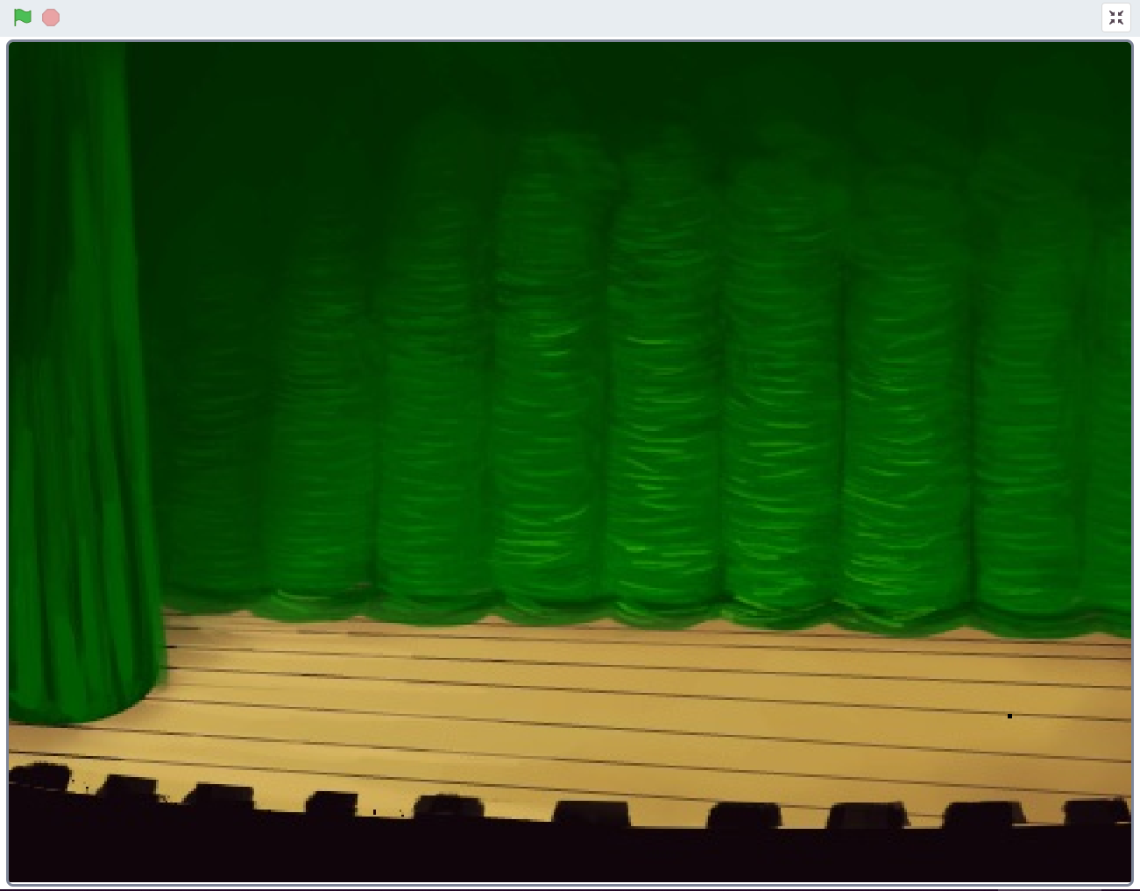
STEP 1: Choose a backdrop
Click on choose a backdrop button.
Choose “Theatre 2” as backdrop from library.

Slide 16
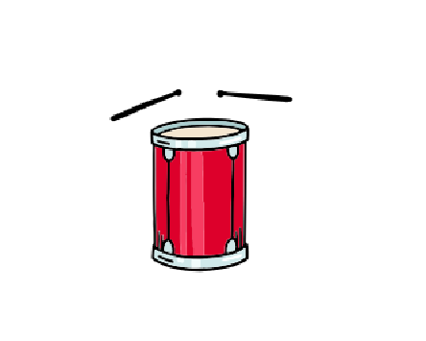
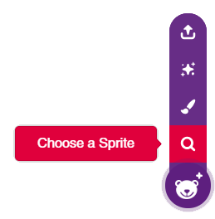
STEP 2: Choose a Sprite
Using choose a sprite button, choose the drum sprite and duplicate it 2 times to get 3 drum sprites in total.
Right click on Tobi icon in sprite palette and delete it.

Slide 17
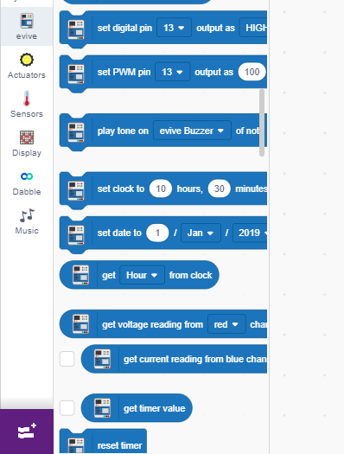
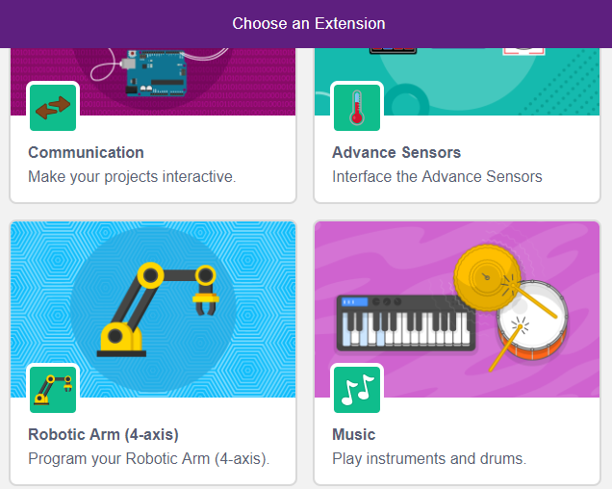
Adding Music Extension
Click on Add extension button in the bottom left corner and add the Music extension.
Add Extension

Slide 18
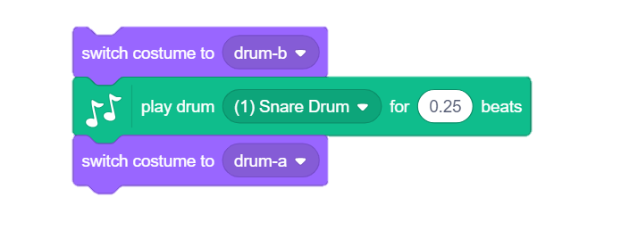
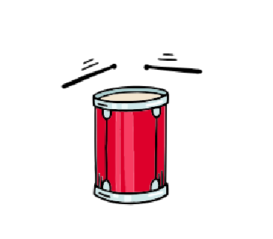
STEP 3: Script for Drum
Choose the Drum sprite by clicking on its icon.
To add music, we use play drum block from the Music palette.
To change costume of drum, Use costume blocks from the looks palette.

Slide 19
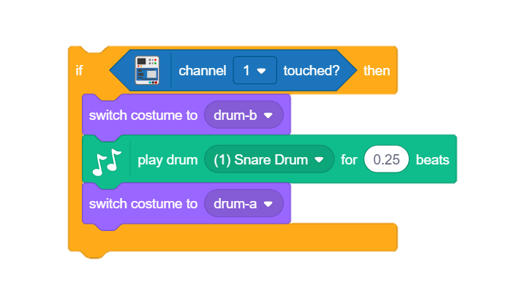
STEP 4: Sense the Touch
This music should play whenever touch the drum 1 our custom made drum set.
To sense this, we will use channel touched block from the evive palette and put it inside the if condition block.

Slide 20
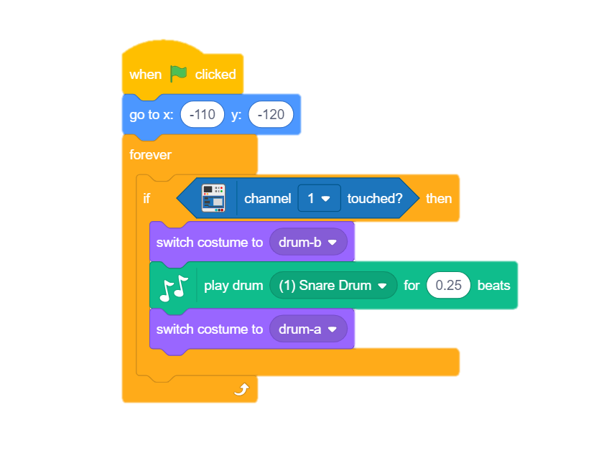
STEP 5: Compete the script.
Add forever block to sense continuously.
Use go to block to set the position of drum.
Finally add the hat block.
That’s it for drum 1, similarly make for drum 2 and drum 3.

Slide 21
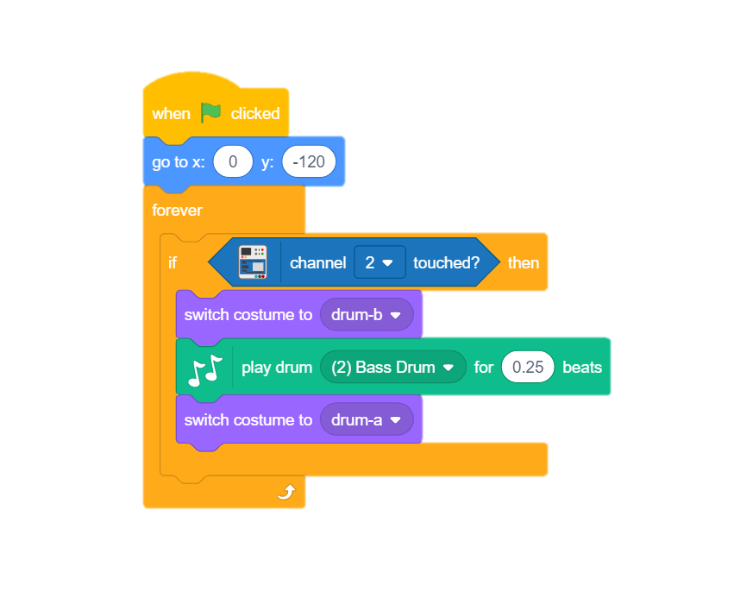
STEP 6: Script for Drum 2
Script is almost same except the following:
Position in go to block will be different.
Touch sensor 2 will be sensed.
Play drum block will have different music.

Slide 22
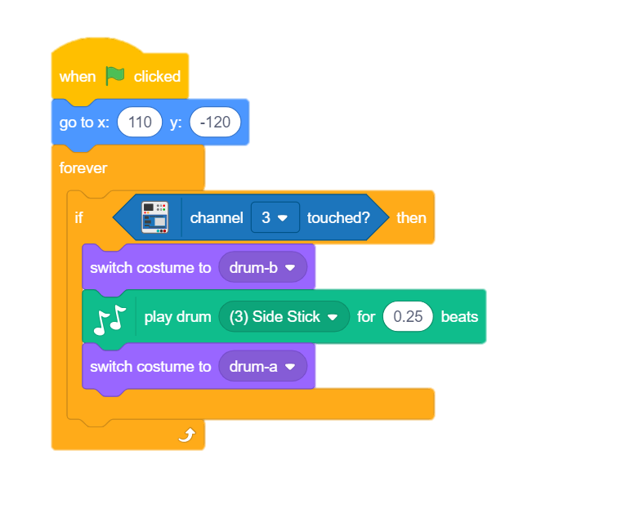
STEP 7: Script for Drum 3
Script is almost same except the following:
Position in go to block will be different.
Touch sensor 3 will be sensed.
Play drum block will have different music.

Slide 23
Let’s Play

