Slide 1
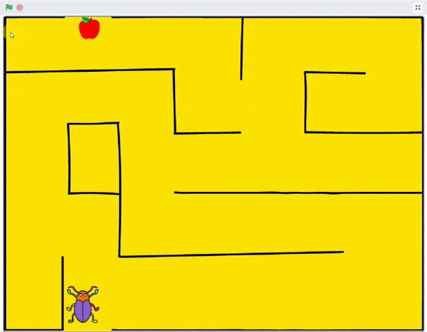
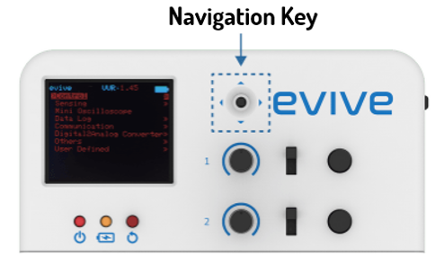
Beetle in the Maze

Slide 2
Interfacing evive with PictoBlox

Slide 3
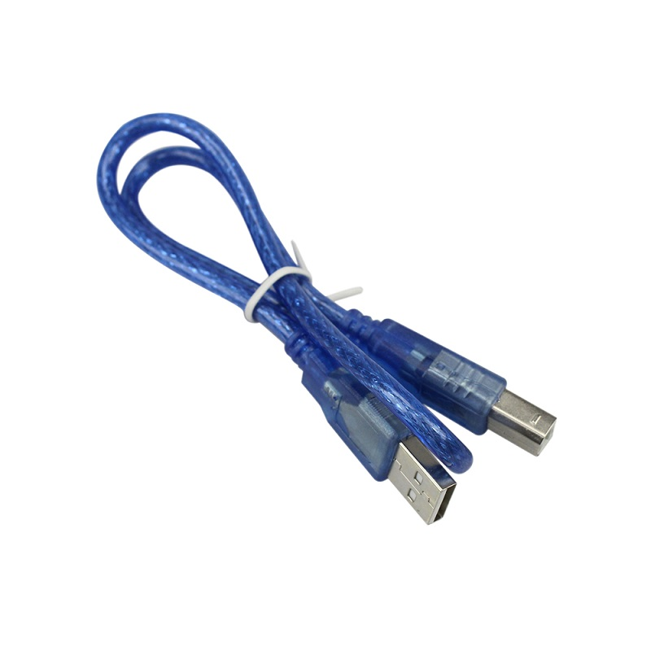
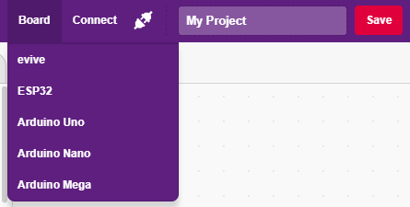
Interfacing evive with PictoBlox
Connect evive to your laptop/PC via USB cable and open PictoBlox.
In PictoBlox, go to the menu and click on the Boards Select the evive.

Slide 4
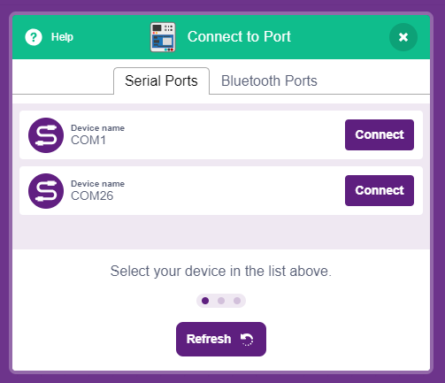
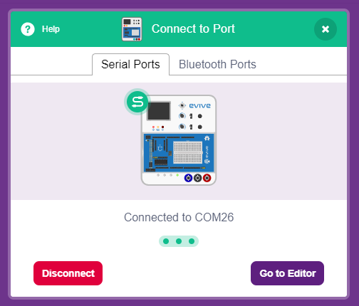
Interfacing evive with PictoBlox
Once you’ve selected the board, click on the Connect tab and connect the board.

Slide 5
Upload Firmware
You have to upload the firmware into the device before interacting with it.
Click on Upload Firmware button.
Once you successfully uploaded the firmware you will see evive logo on evive display.

Slide 6
Beetle in the Maze
In this activity, We will make an animated game in PictoBlox where beetle needs help to come out of the maze without touching the boundaries.

Slide 7
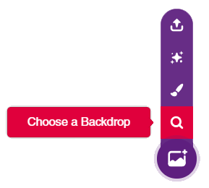
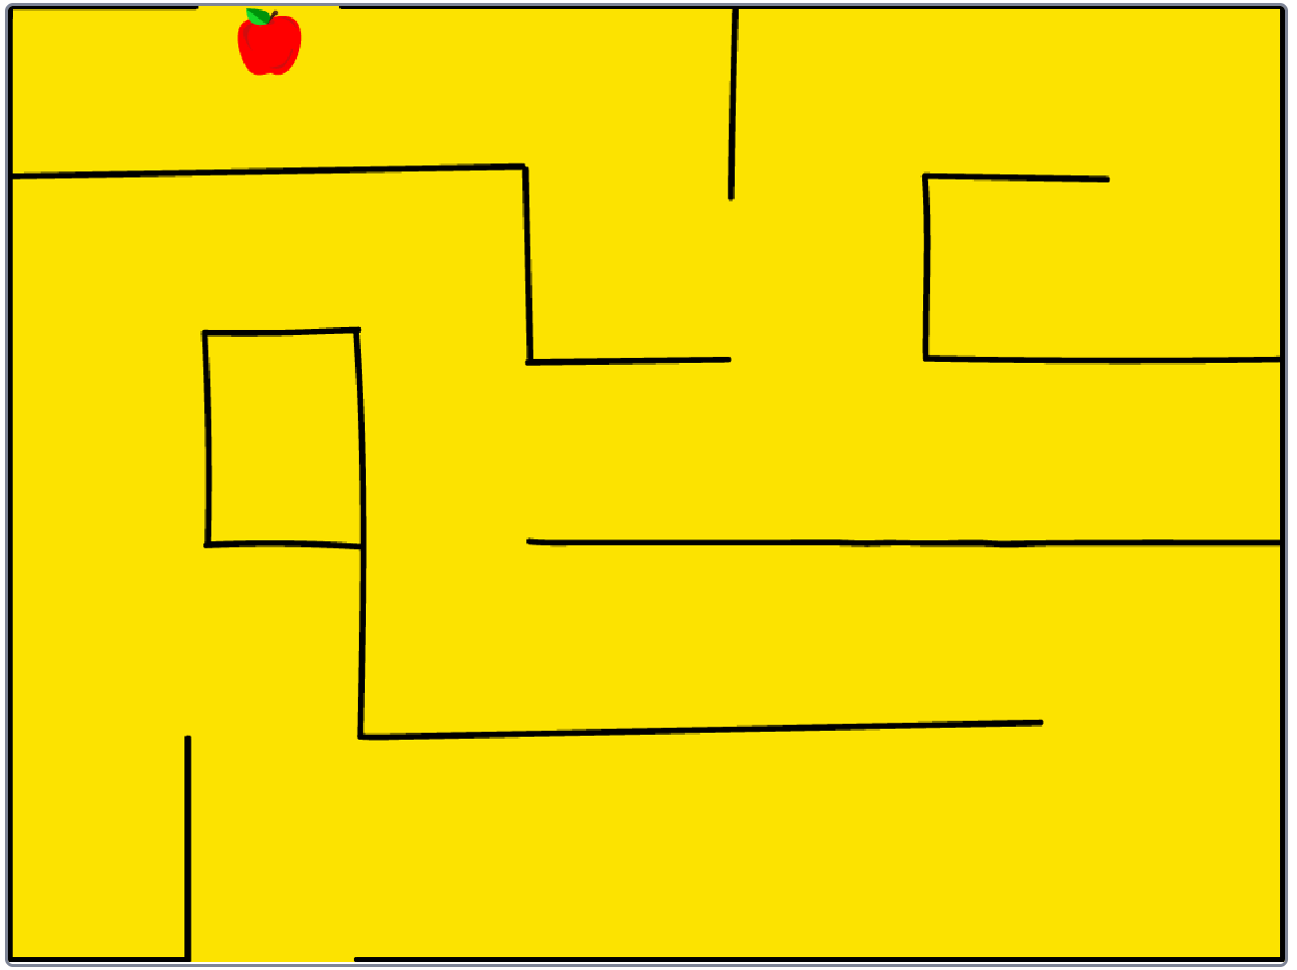
STEP 1: Choose a backdrop
Click on choose a backdrop button.
Choose “Maze” as backdrop from library.

Slide 8
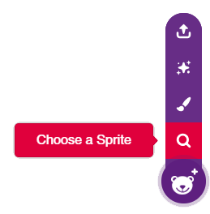
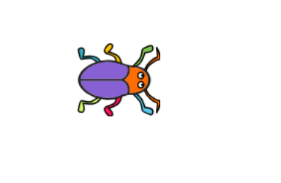
STEP 2: Choose a Sprite
Using choose a sprite button, Choose the Beetle sprite.
Right click on Tobi icon in sprite palette and delete it.

Slide 9
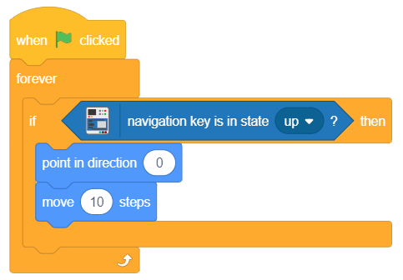
Step 3: Beetle & its Moves
To control the Beetle movement using Navigation Key of evive, we will use navigation key block from evive palette.
If block is used to set condition.
Point in direction will decide direction of beetle’s movement.
Move block will make it move.
forever block to sense continuously.
When flag clicked is used to trigger.

Slide 10
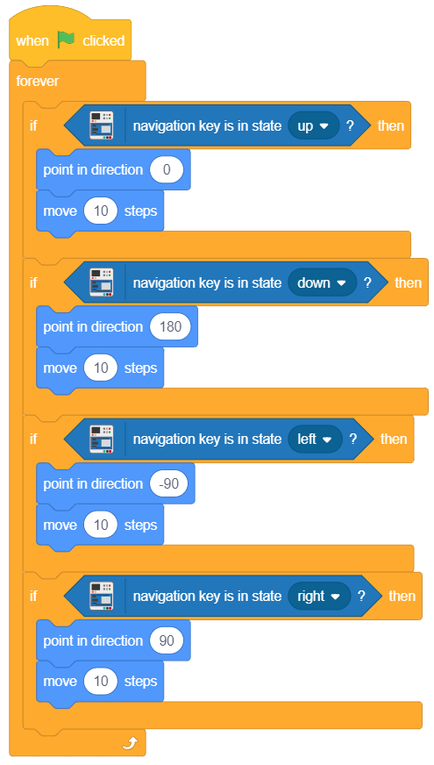
Step 4: Assign other directions
Similarly, set conditions for other directions and stack them together.
For ‘down’, set the direction as 180.
For ‘right’, set the direction as 90.
For ‘left’, set the direction as -90.

Slide 11
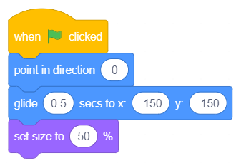
Step 5: Initialisation
Now, it’s time to write the script for safely taking the beetle to the end of the maze.
Stack the following blocks together to set the initial parameters of Beetle i.e. direction, position and size.

Slide 12
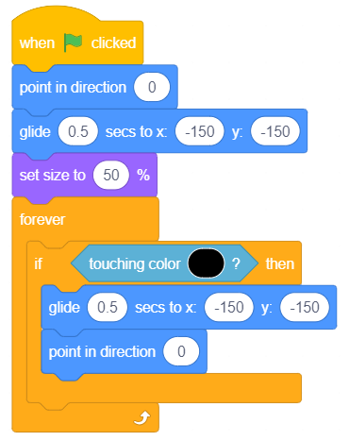
Step 6: Sensing the environment
Now we will add the condition i.e. whenever the Beetle touches the maze boundaries, it will go back to its original position.
Using the colour picker, pick the colour of Maze boundaries i.e. Black.

Slide 13
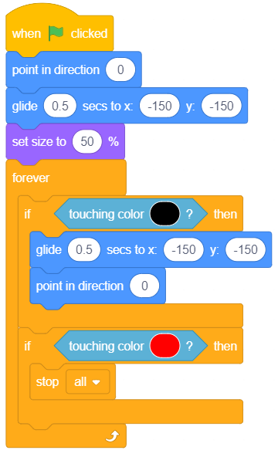
Step 6: Sense the environment
Now we will add the condition to end the game. Game ends whenever the beetle touches the apple.
Using the colour picker, pick the apple colour i.e. Red.
Stop all block is used to stop the all scripts i.e. GAMEOVER.

Slide 14
STEP 8: Let’s Play
Maximize the stage and enjoy the Game.

