Slide 1
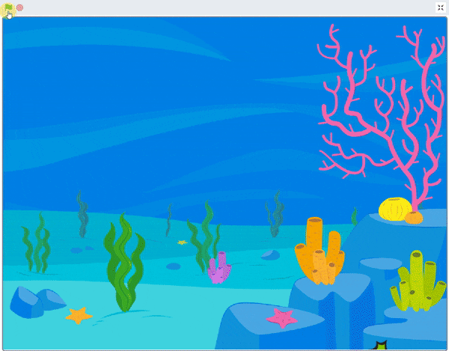
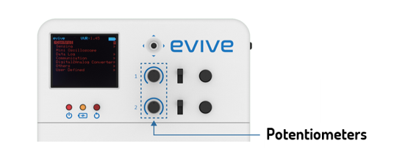
Scuba Diving

Slide 2
Interfacing evive with PictoBlox

Slide 3
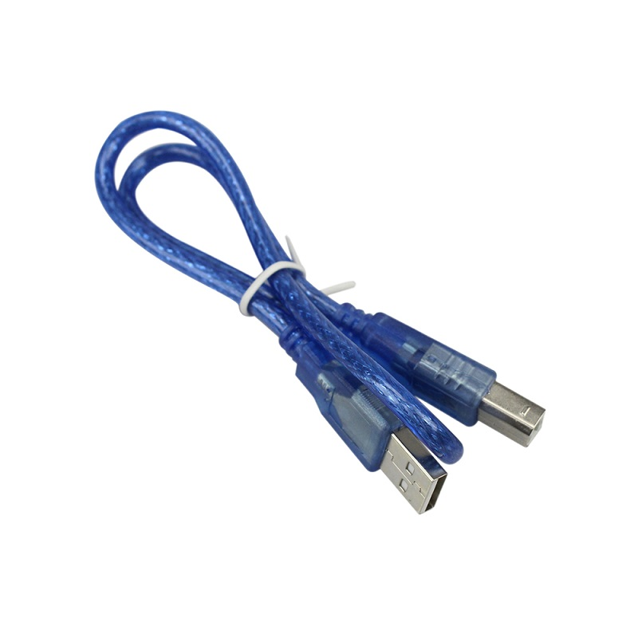
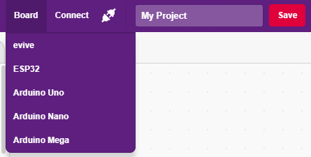
Interfacing evive with PictoBlox
Connect evive to your laptop/PC via USB cable and open PictoBlox.
In PictoBlox, go to the menu and click on the Boards Select the evive.

Slide 4
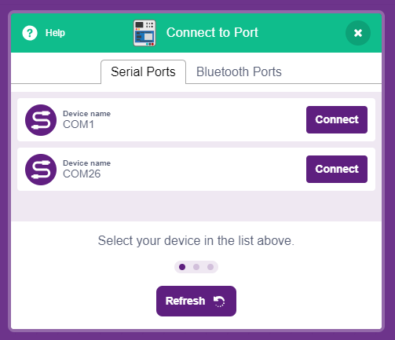
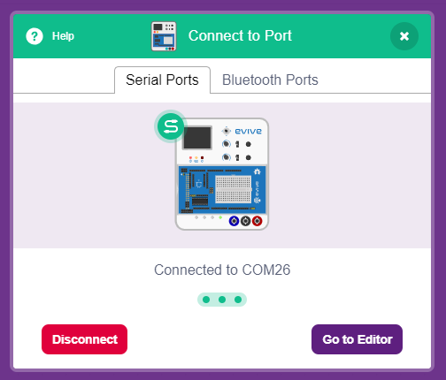
Interfacing evive with PictoBlox
Once you’ve selected the board, click on the Connect tab and connect the board.

Slide 5
Upload Firmware
You have to upload the firmware into the device before interacting with it.
Click on Upload Firmware button.
Once you successfully uploaded the firmware you will see evive logo on evive display.

Slide 6
What is a Potentiometer?

Slide 7
Potentiometer
A potentiometer is nothing but a variable resistor.
Since the movement of the slider or the knob is smooth and continuous, the change in the value of the resistance is smooth.
evive has 2 potentiometers.

Slide 8
Scuba Diving
In this Activity, First We will learn about potentiometer and then create an animation of scuba diving using potentiometer of evive.

Slide 9
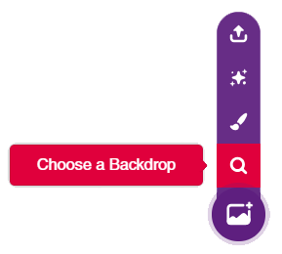
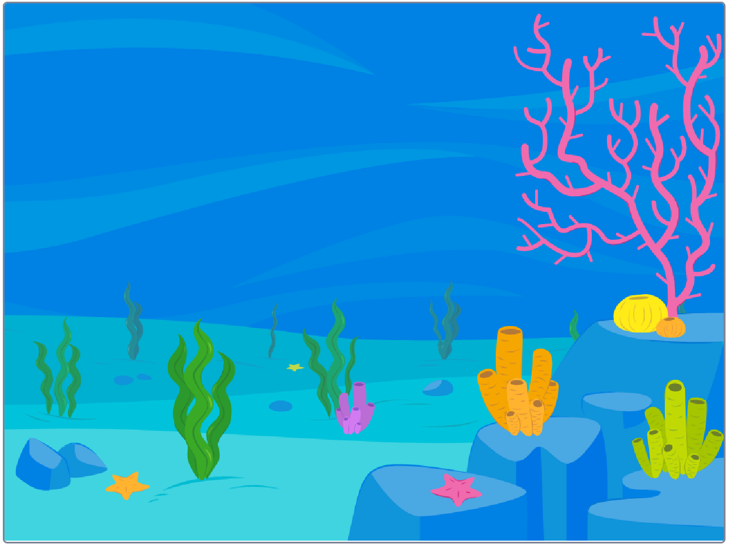
STEP 1: Choose a backdrop
Click on choose a backdrop button.
Choose “Underwater 1” as backdrop from library.

Slide 10
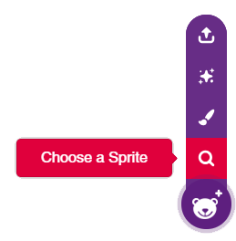
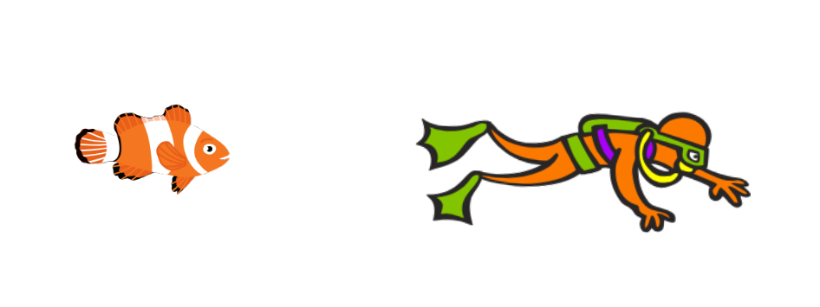
STEP 2: Choose a Sprite
Using choose a sprite button, One by one choose the Fish and Diver2.
Right click on Tobi icon in sprite palette and delete it.

Slide 11
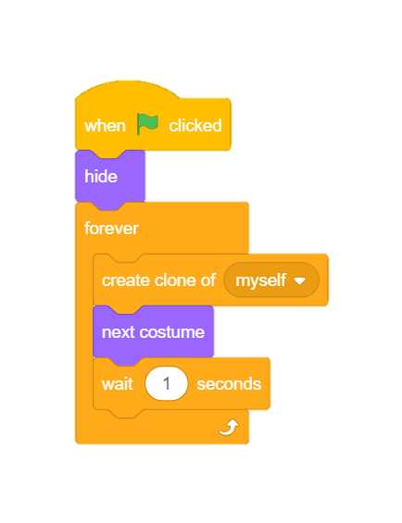
STEP 3: Create multiple Fishes
Choose the Fish sprite.
To make our sea full of fishes, we will use create clone block from control palette.
To make every fish look different, Let’s change costume using next costume block.
Add some delay using wait block.
Make it continuous using forever block.
Hide it initially using hide block.
To trigger let’s use when flag clicked hat block.

Slide 12
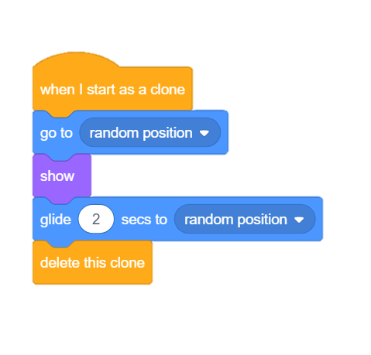
STEP 4: Assign Actions
We will use a hat block to sense the creation of a clone.
It should appear from random positions, hence we use go to random position block.
To show we will use show block from looks palette.
To make it move, use glide block.
Finally to make it disappear, add delete this clone block.

Slide 13
STEP 5: Point & Move
Choose the Diver2 sprite.
To sense the potentiometer, we will use potentiometer block from evive palette.
Potentiometer will give value between 0-1023 but Diver can point in any direction between 0-360 degree, hence to map we multiply its value with 360 and finally divide with 1023 using blocks from operator palette.
To move, use move block.

Slide 14
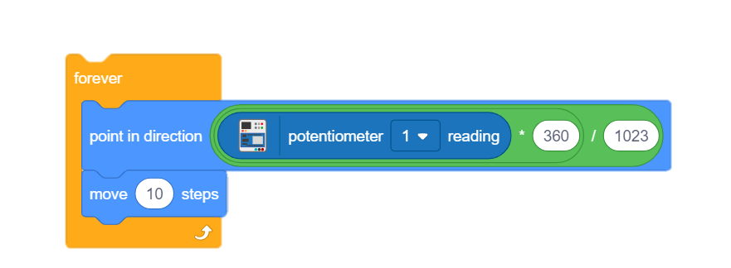
STEP 6: Sense Continuously
Add forever block to sense continuously.

Slide 15
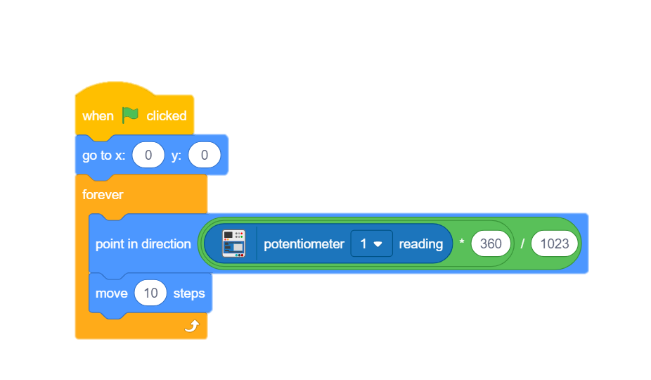
STEP 7: Finalize the script
To set initial position of diver use go to block.
Add when flag clicked block to trigger.

Slide 16
Let’s Play
Maximize the stage and enjoy the animation.

