Slide 1
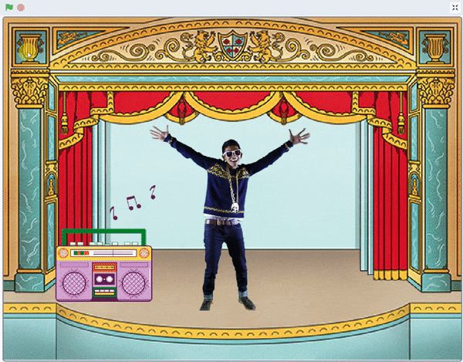
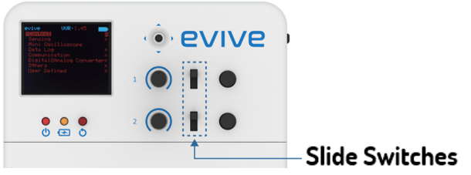
Musical Party

Slide 2
Interfacing evive with PictoBlox

Slide 3
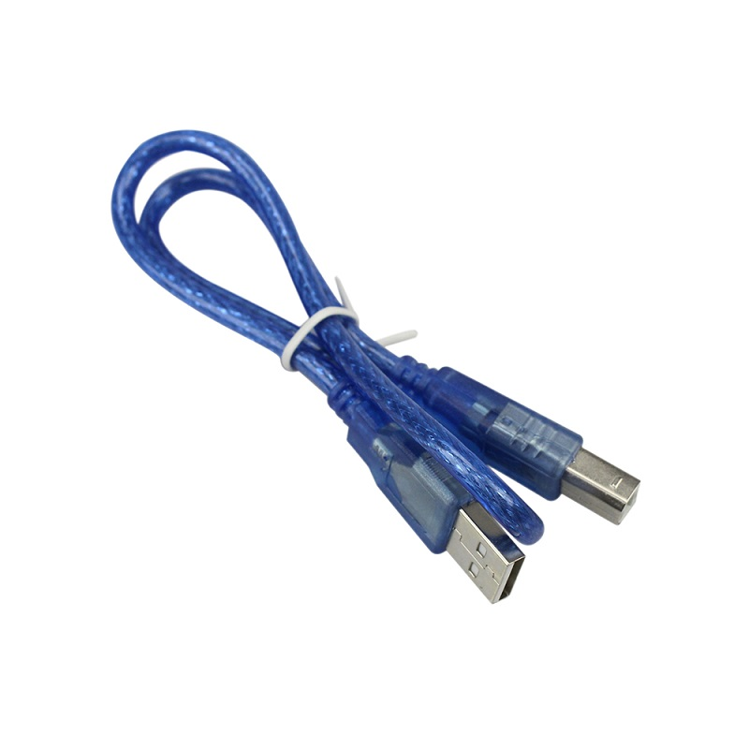
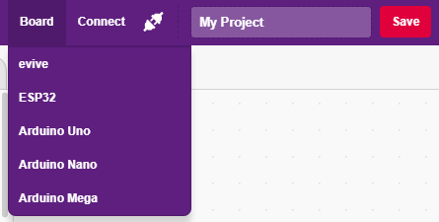
Interfacing evive with PictoBlox
Connect evive to your laptop/PC via USB cable and open PictoBlox.
In PictoBlox, go to the menu and click on the Boards Select the evive.

Slide 4
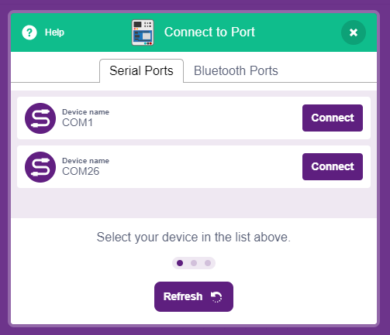
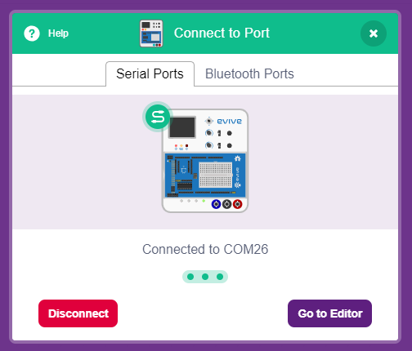
Interfacing evive with PictoBlox
Once you’ve selected the board, click on the Connect tab and connect the board.

Slide 5
Upload Firmware
You have to upload the firmware into the device before interacting with it.
Click on Upload Firmware button.
Once you successfully uploaded the firmware you will see evive logo on evive display.

Slide 6
What is a Switch?

Slide 7
Switch
A switch is one of the most basic, but VERY important components in a circuit.
When the switch is open, the circuit is broken, and no current will flow through it. When the switch is closed, the circuit is closed or made, and therefore, current will flow through it.

Slide 8
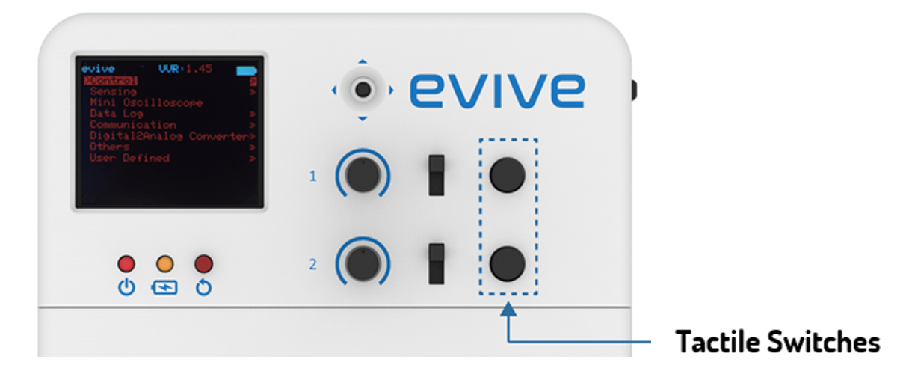
Types of Switches
Momentary switches: These switches stay in a state i.e. either ON or OFF, if they are activated. They come back to their original state once they are released.
Maintained Switches: These switches stay in one state i.e. either ON or OFF, unless the state is changed by someone.

Slide 9
Musical Party
In this Activity, First We will learn about switches and then create an animation of Musical Party using slide switch of evive.

Slide 10
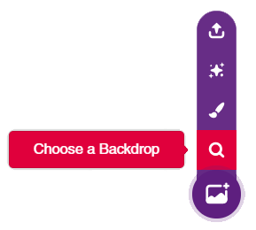
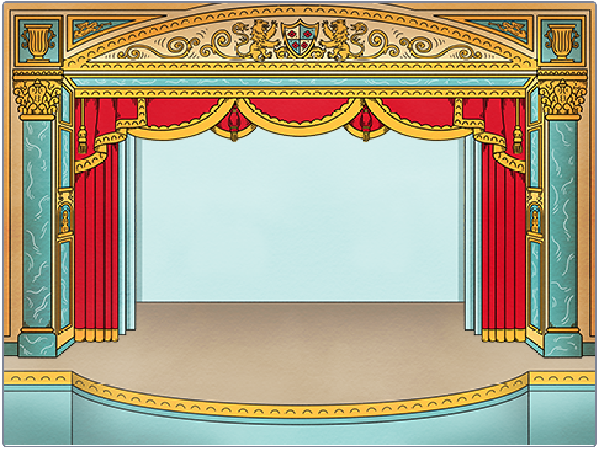
STEP 1: Choose a backdrop
Click on choose a backdrop button.
Choose “Theatre” as backdrop from library.

Slide 11
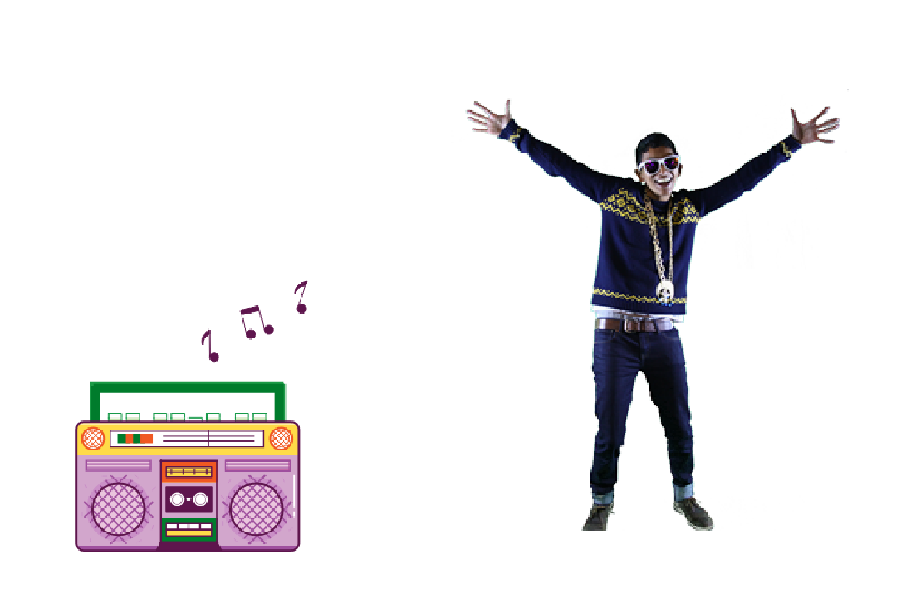
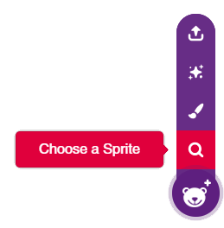
STEP 2: Choose a Sprite
Using choose a sprite button, One by one choose the Radio and Champ99.
Right click on Tobi icon in sprite palette and delete it.

Slide 12
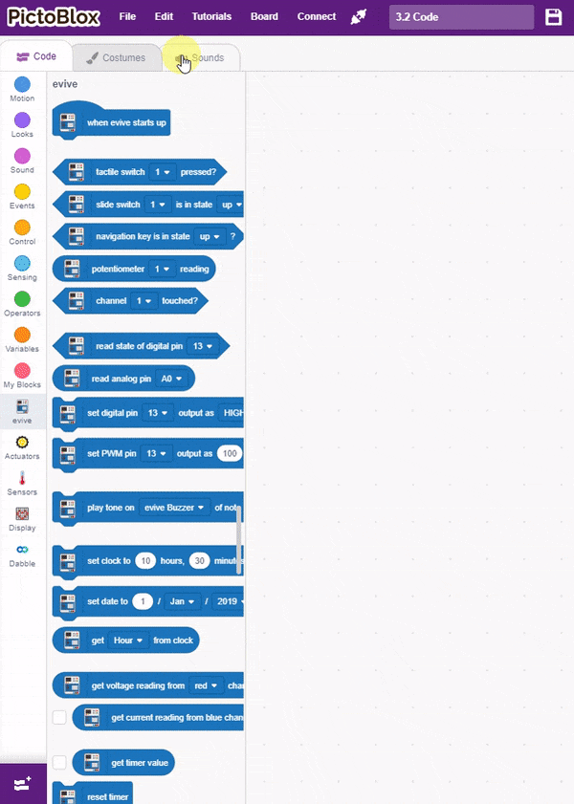
STEP 3: Script for Radio
Choose the Radio sprite by clicking on its icon.
First let’s add Drum Machine sound from sound library.

Slide 13
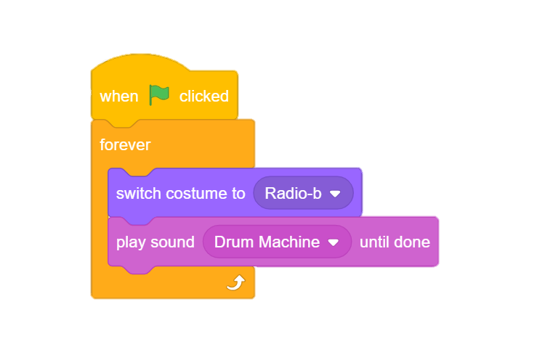
STEP 3: Script for Radio
Now to make party musical, we will use play sound block from sound palette and choose the music from its dropdown.
To change radio costume, we use switch costume block.
Add forever block for non-stop party and a hat block to trigger it.

Slide 14
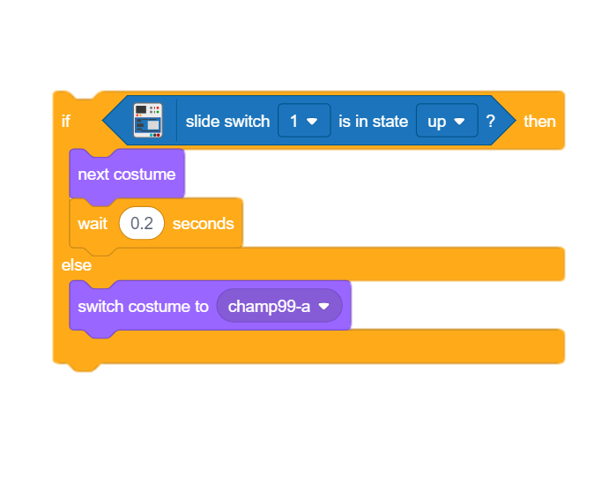
STEP 4: Script for Champ99
Choose the Champ99 sprite by clicking on its icon.
To sense the slide switch, we will use tactile switch block from evive palette.
If we move the slide switch upward the Champ99 should start dancing else it should stand still, hence we use if-else block to implement this.

Slide 15
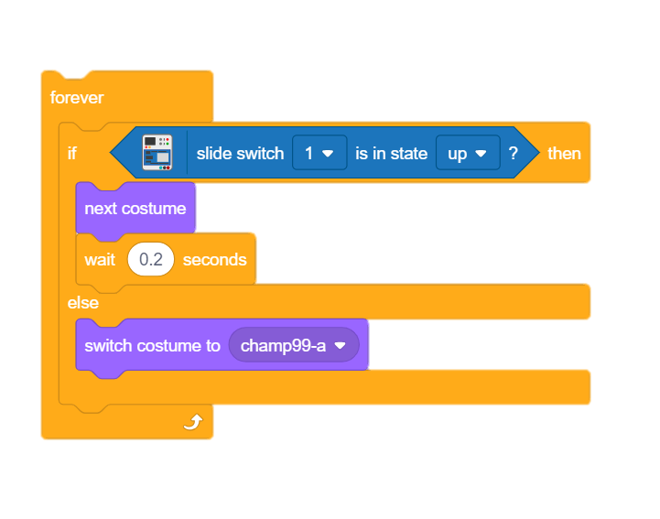
STEP 5: Sense Continuously
Add forever block to sense continuously.

Slide 16
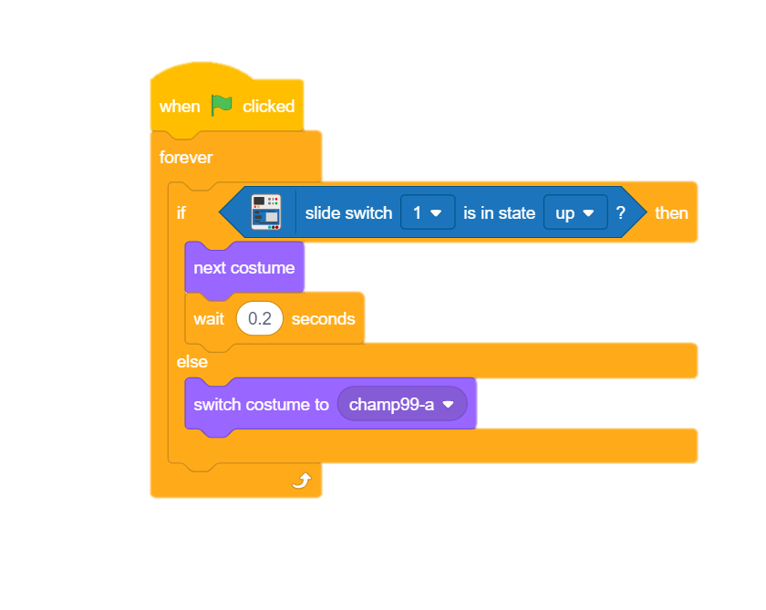
STEP 6: Add a Hat Block
Lets add when flag clicked block. Now flag button will act as trigger.

Slide 17
STEP 7: Let’s Play
Maximize the stage and make it move.

