Slide 1
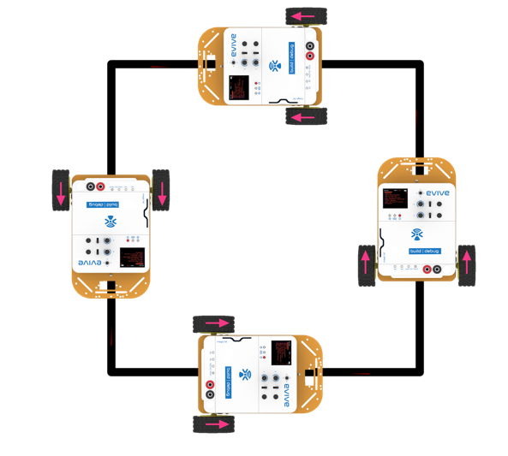
Running a Robot Along a Square

Slide 2
Connecting Robot with PictoBlox

Slide 3
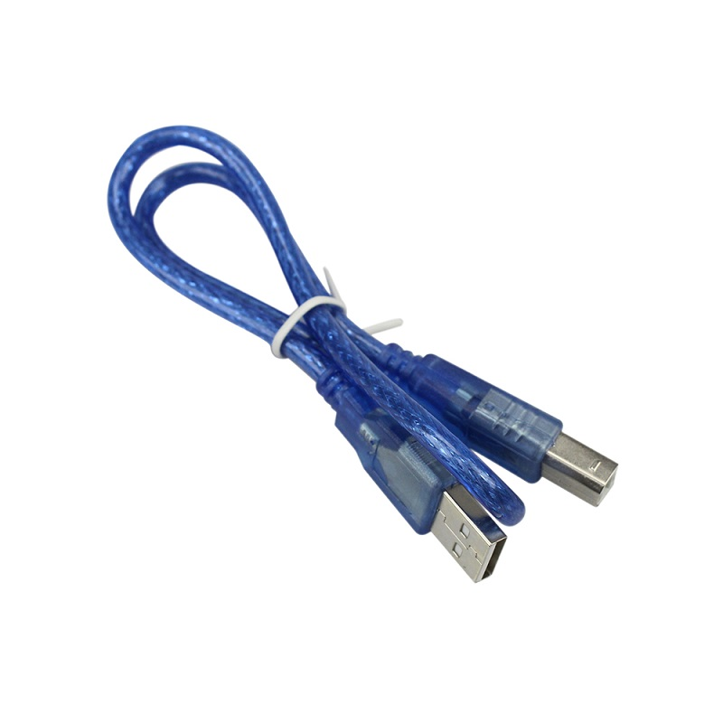
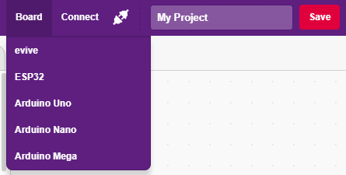
Interfacing evive with PictoBlox
Connect Robot to your laptop/PC via USB cable and open PictoBlox.
In PictoBlox, go to the menu and click on the Boards Select the evive.

Slide 4
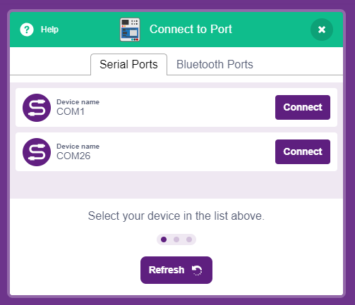
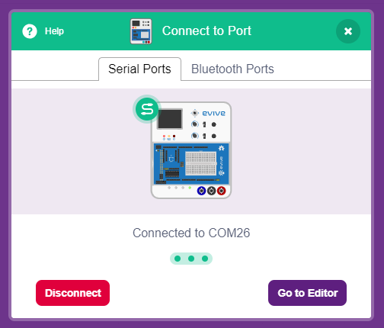
Interfacing evive with PictoBlox
Once you’ve selected the board, click on the Connect tab and connect the board.

Slide 5
Upload Firmware
You have to upload the firmware into the device before interacting with it.
Click on Upload Firmware button.
Once you successfully uploaded the firmware you will see evive logo on evive display.

Slide 6
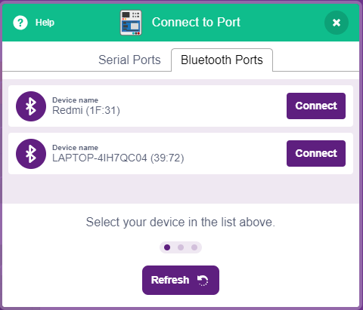
Connecting via Bluetooth
Remove USB cable.
Connect Robot with PictoBlox using Bluetooth.

Slide 7
Running a Robot
Along a Square
In this Activity, We will ideate an algorithm to make a robot run along a square and then create to execute this.

Slide 8
Ideation
To move along a square, our robot should move straight when it is moving on th sides of the square.
It should take a 90 degree turn at corners.
We have to control delay/wait time to make required movements.
Let’s begin

Slide 9
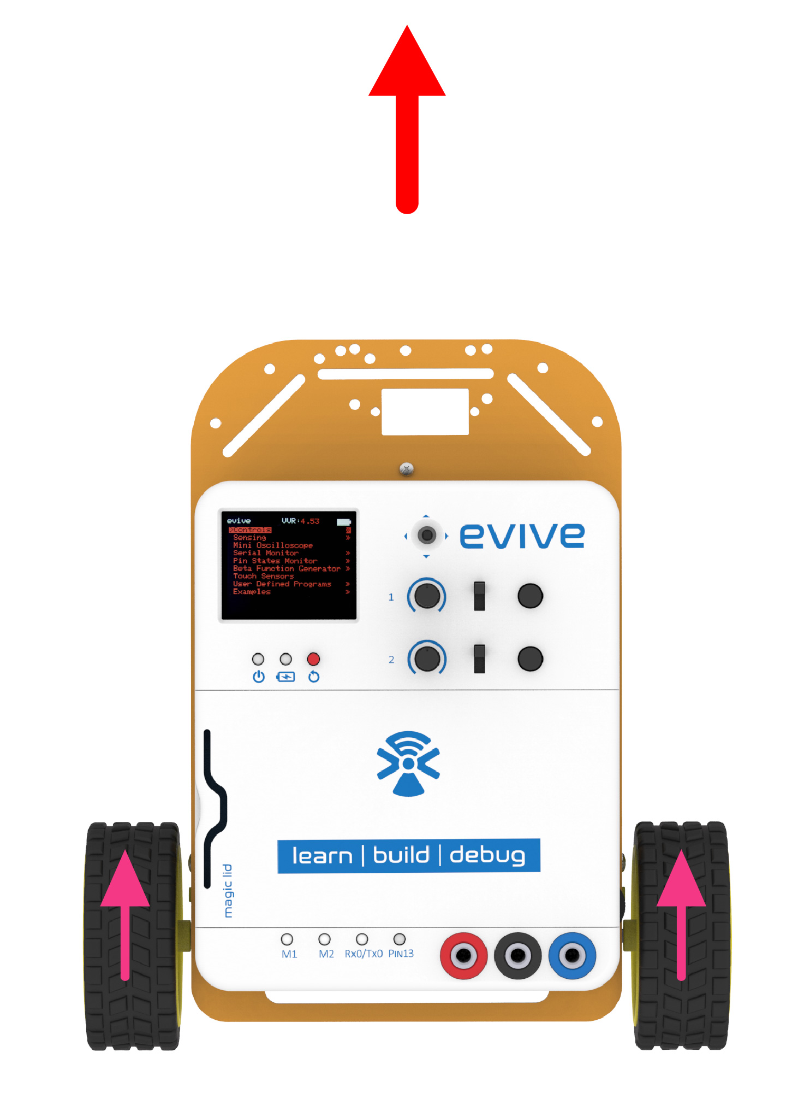
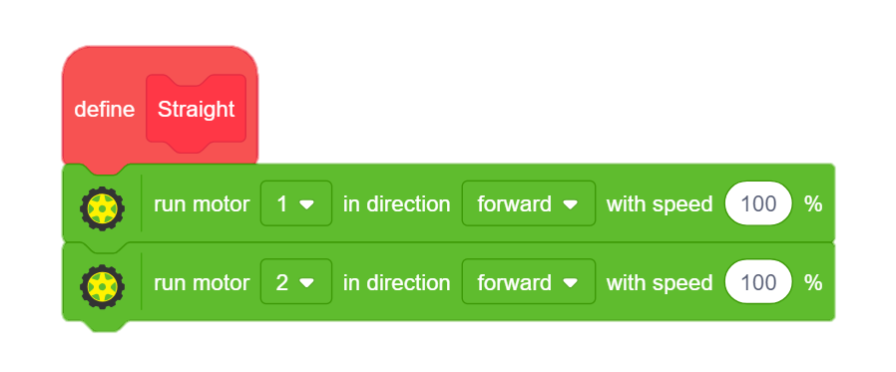
STEP 1: Go Straight
First, let’s create a block for the straight movement.
Go to the Data & Blocks palette and create a block named Straight.
To move robot forward, we will run both motors in the forward direction.

Slide 10
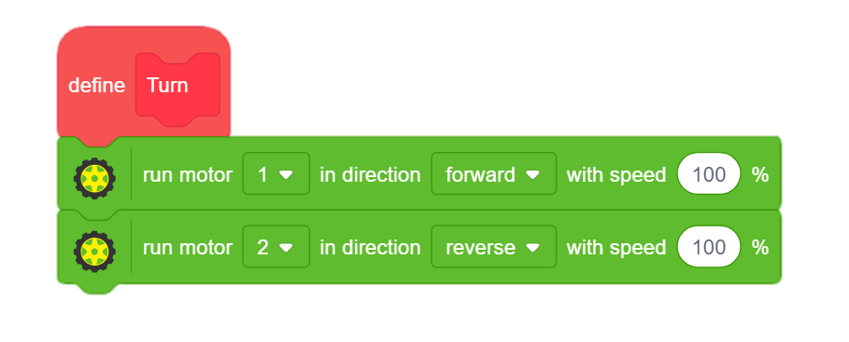
STEP 2: Take Turn
Now, let’s create a block for the taking turn.
Go to the Data & Blocks palette and create a block named Turn.
To turn the robot , we will run left motor in reverse and right motor in forward direction.

Slide 11
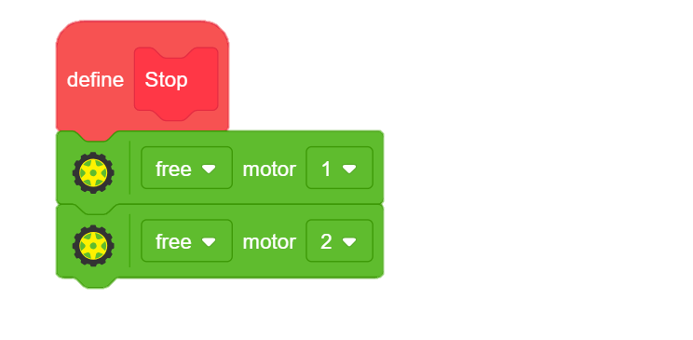
STEP 3: Get Stopped
Now, let’s create a block to get stopped.
Go to the Data & Blocks palette and create a block named Stop.
We will lock both the motors to stop the robot

Slide 12
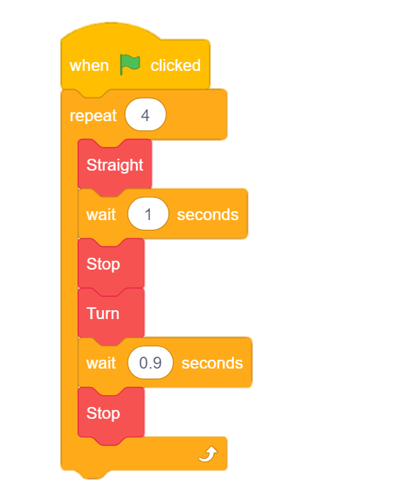
STEP 4: Combine the logic
First we will use the straight block and then add wait block. Timing of this wait block will depend upon length of the side of square path.
Use stop block to stop at the corner then use turn block to take turn and add another wait block, timing of this will decide degrees of turn.
Then add stop to finish turn.
As square has 4 sides, use repeat block to repeat it four times and add hat block to trigger.

Slide 13
STEP 5: Let’s Play
Choose an arena of your choice whether it’s a classroom or a playground and compete with your friends.

