Slide 1
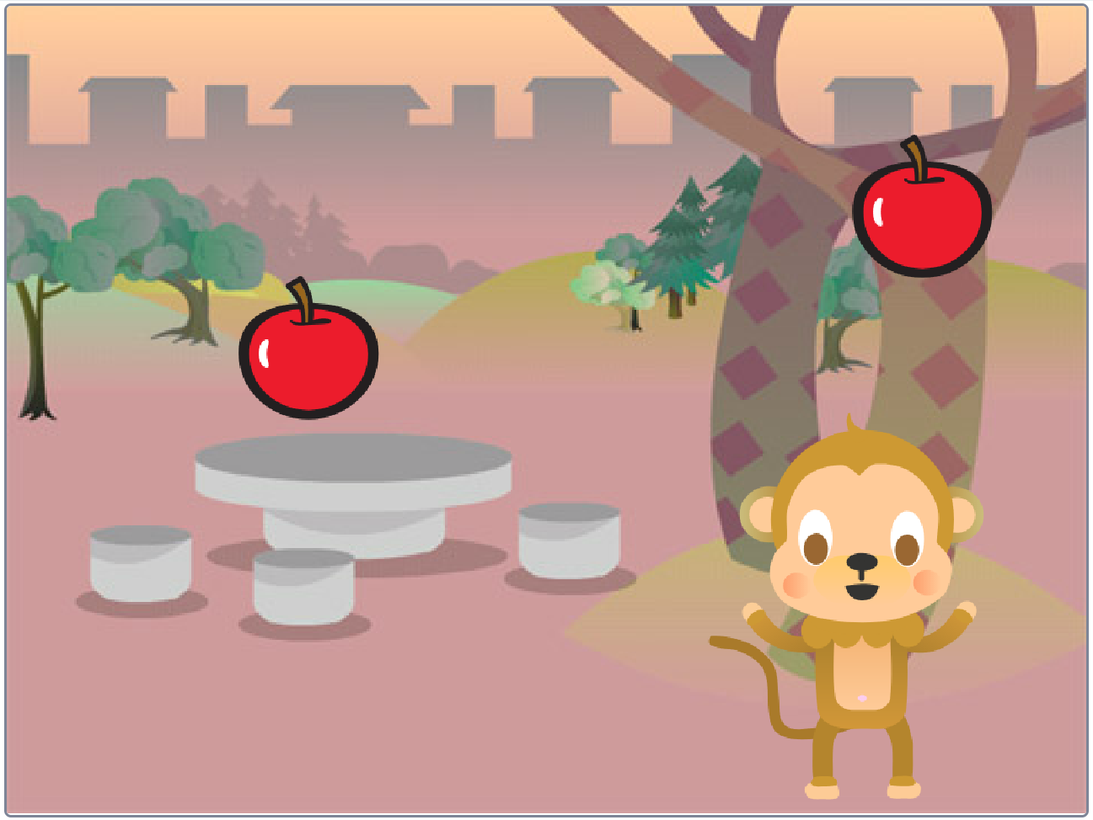
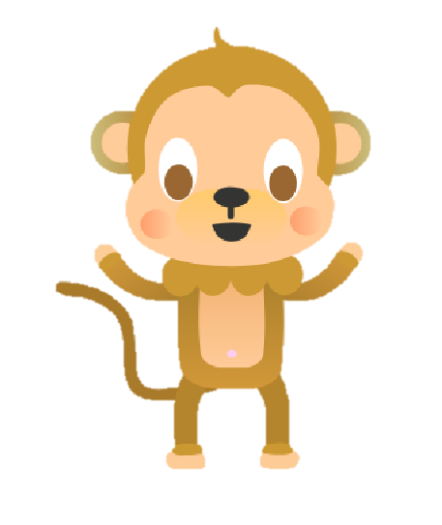
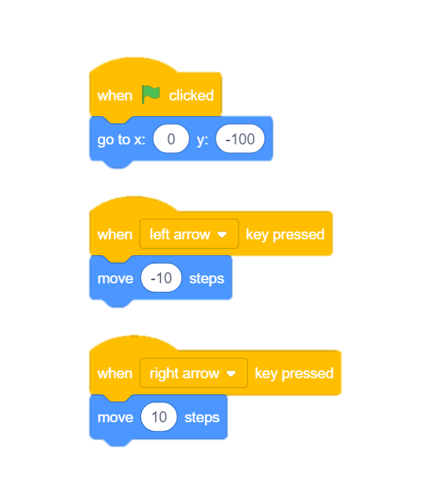
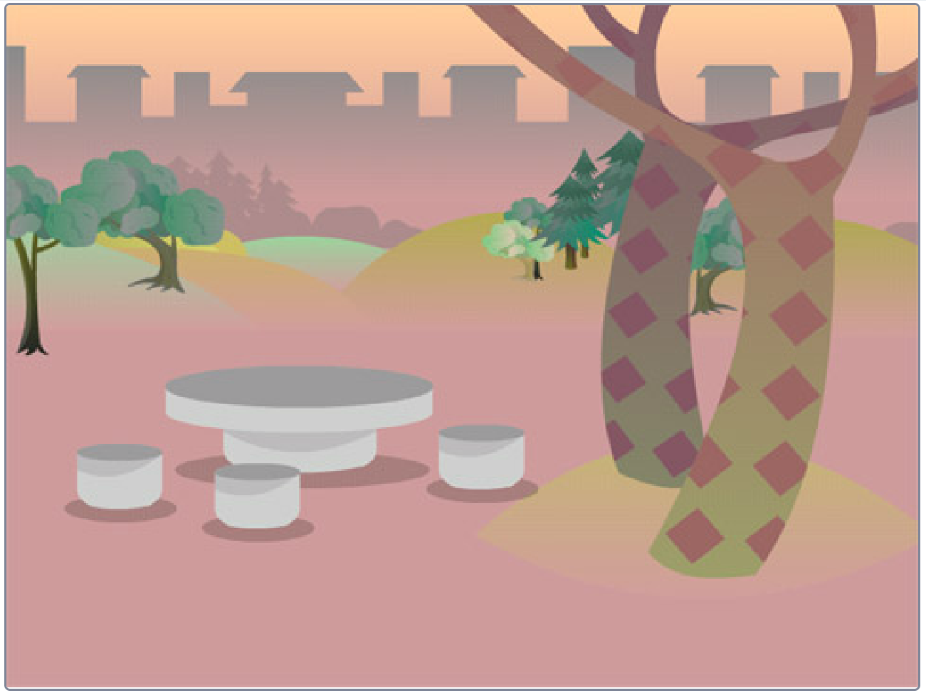
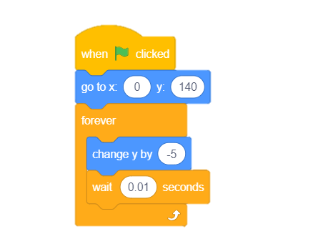
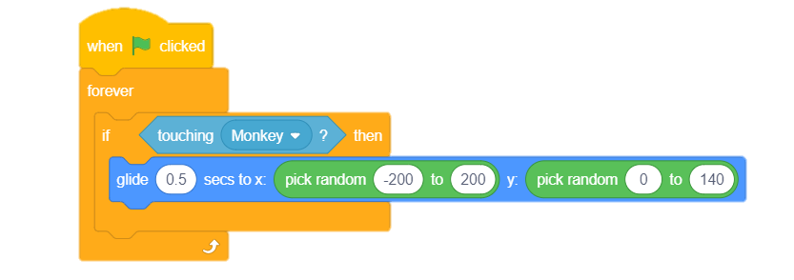
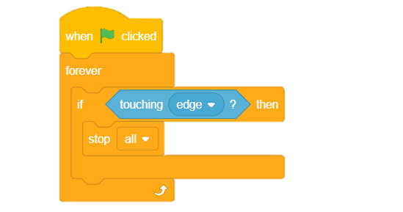
2.6 Let’s Play
In this Activity, We learn how to make a sprite move with the keys of a keyboard? And create a game to catch the falling apple.
evive, USB cable, Laptop/PC
2. Choose a Sprite
1. Choose a backdrop
3. Script for Monkey
4. Script for Apple
5. Sense the Monkey
6. Sense the edge
In which palette, you will find the “touching block”?
. . . . . . . . . . . . . . . . . . . . . . . . . . . . . . . . . . . . . . . . . . . . . . . . . . . . . . . . . . . . . . . . . . . . . . . . . . . . . . . . . . . . . . . . . . . . . . . . . . . . . . . . . . . . . . . . . . . . . . . . . . . . . . . . . . . . . . . . . . . . . . . . . . . . . . . . . . . . . .

