Slide 1
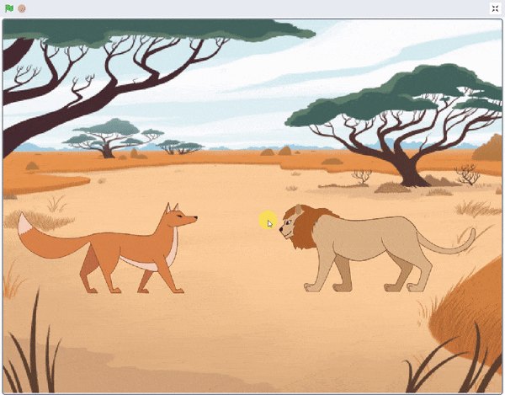
Once Upon a Time

Slide 2
Once Upon a Time
In this Activity, We learn how to make two sprites communicate and turn it into a story in which a fox and lion talk about the problem they are facing in the forest.

Slide 3
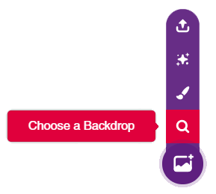
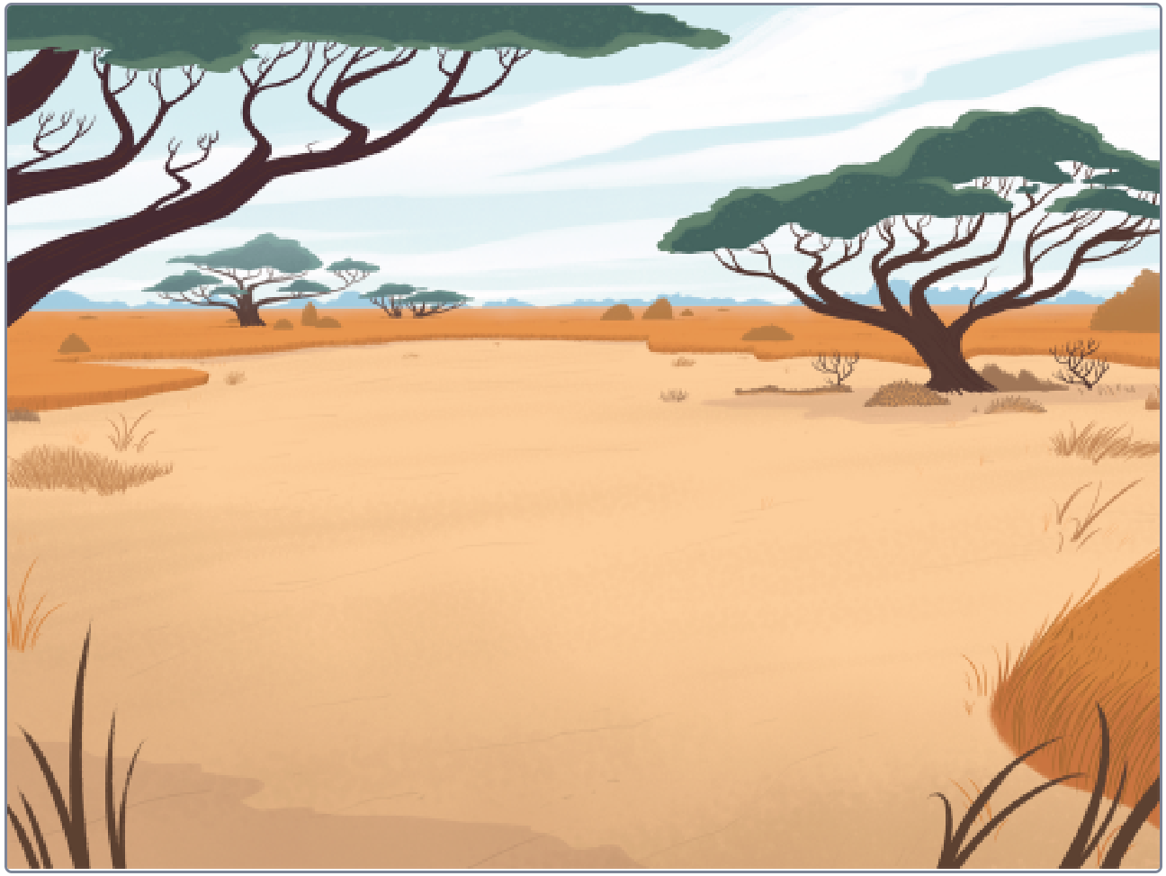
STEP 1: Choose a backdrop
Click on choose a backdrop button.
Choose “Savanna” as backdrop from library.

Slide 4
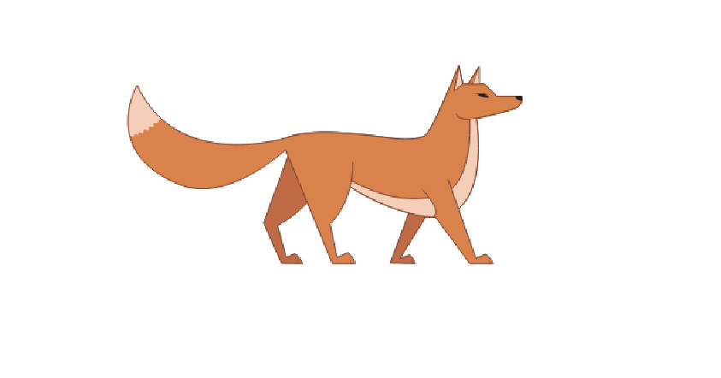
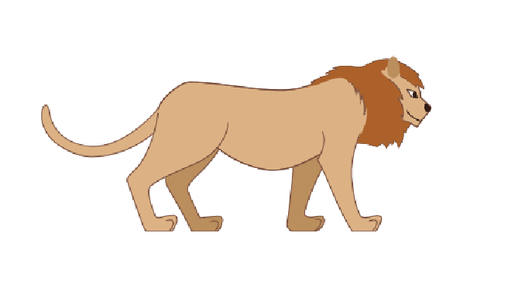
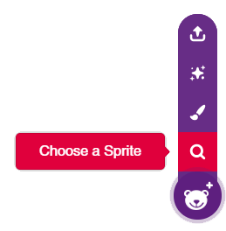
STEP 2: Choose a Sprite
Using choose a sprite button, One by one choose the Fox and Lion.
Right click on Tobi icon in sprite palette and delete it.

Slide 5
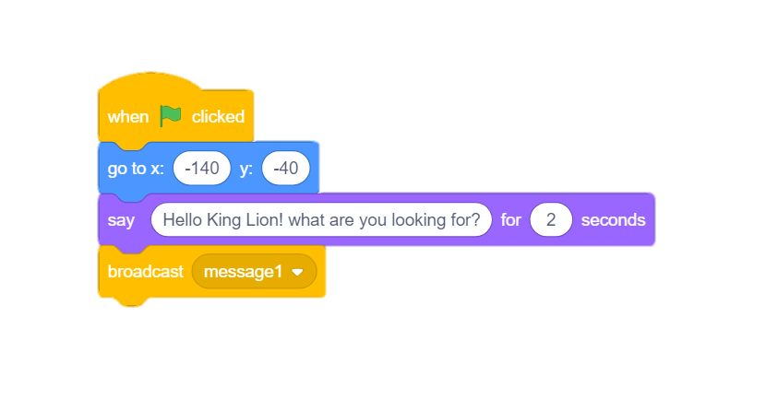
STEP 3: Script for Fox
Choose the Fox sprite by clicking on its icon.
Using go to block, First we will set the initial position of fox.
Then using say block, Fox initiates conversation with Lion.
Then we use broadcast block from event palette, it will broadcast a message so that Lion sprite can sense and answer it.

Slide 6
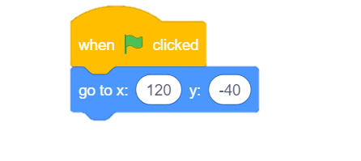
STEP 4: Script for Lion
Choose the Lion sprite by clicking on its icon and Set the initial position of Lion.
Flip it horizontally from the edit costume section.

Slide 7
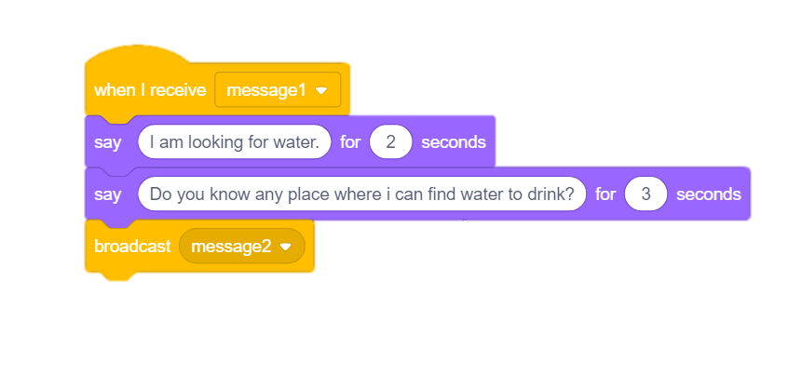
STEP 5: Receive message & Reply
Sense the message 1, using when I receive hat block from events palette.
Make a reply using say blocks, and use broadcast block to broadcast message2 for fox.

Slide 8
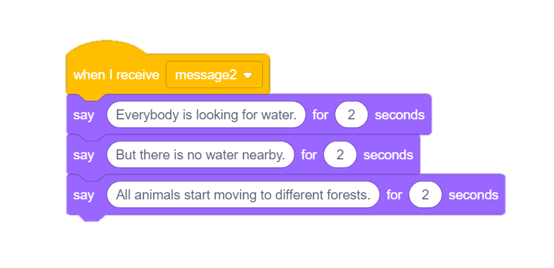
STEP 6: Script for Fox
Choose the Fox sprite by clicking on its icon.
Sense the message2 and using say block make a reply to Lion.

Slide 9
STEP 7: Let’s Play
Maximize the stage and enjoy the animation.

