Slide 1
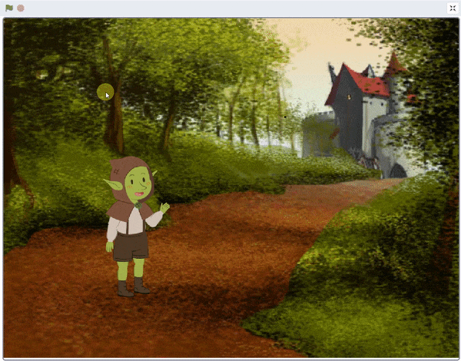
Let’s Chat!

Slide 2
Let’s Chat
In this Activity, We learn how to take user input by asking a question and create a script where a friendly goblin chats.

Slide 3
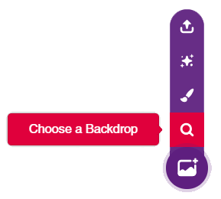
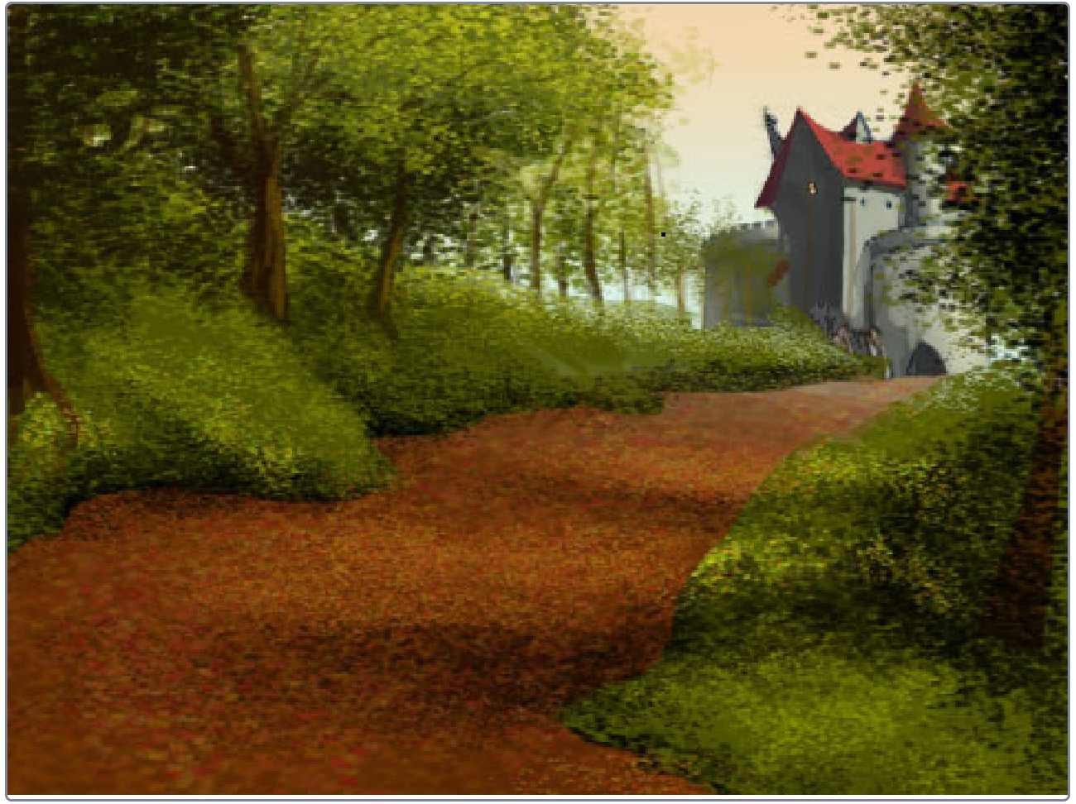
STEP 1: Choose a backdrop
Click on choose a backdrop button.
Choose “Castle 2” as backdrop from library.

Slide 4
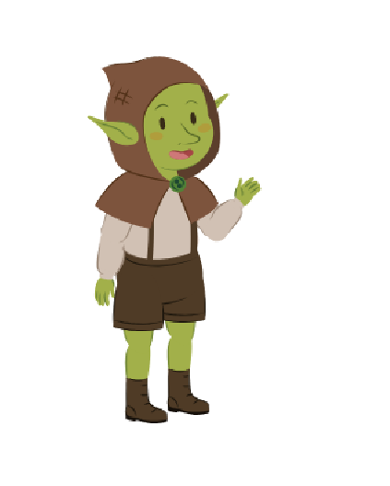
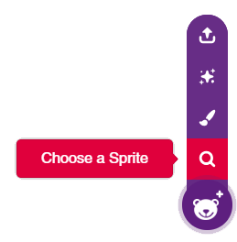
STEP 2: Choose a Sprite
Using choose a sprite button, Choose the Goblin.
Right click on Tobi icon in sprite palette and delete it.

Slide 5
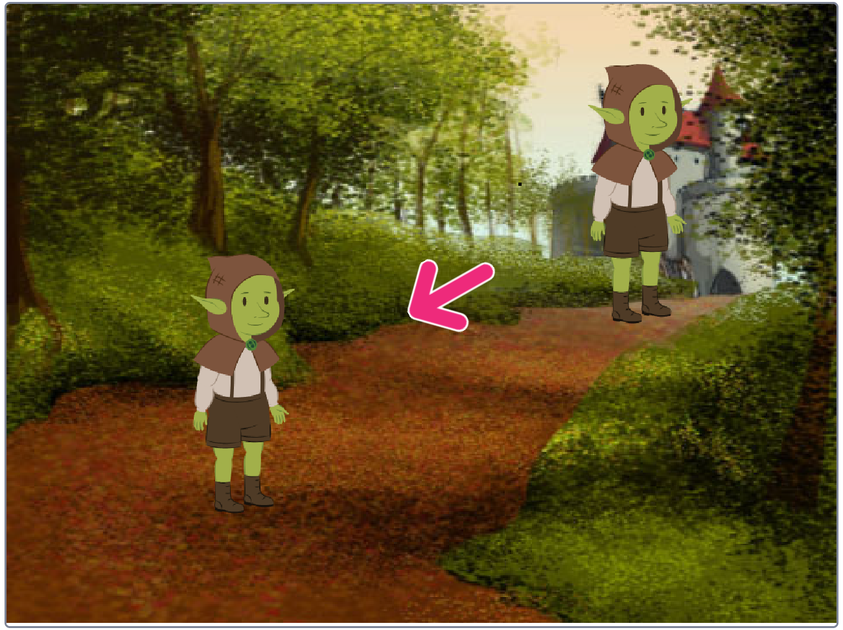
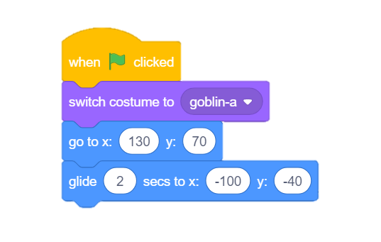
STEP 3: Make Goblin Glide
Using following blocks, we will make Goblin Glide.

Slide 6
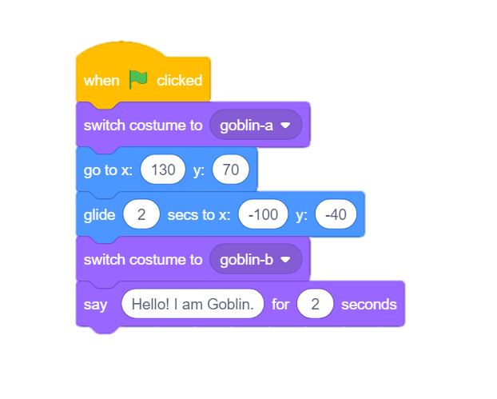
STEP 4: Switch Costume & Say
Next, We will use switch costume and say block from looks palette.

Slide 7
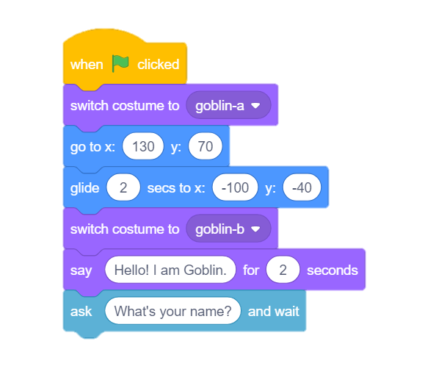
STEP 5: Ask Question
To ask question, We will use ask block from sensing palette.
It will ask from user whatever you write inside it, wait for user input and store that input inside answer block.

Slide 8
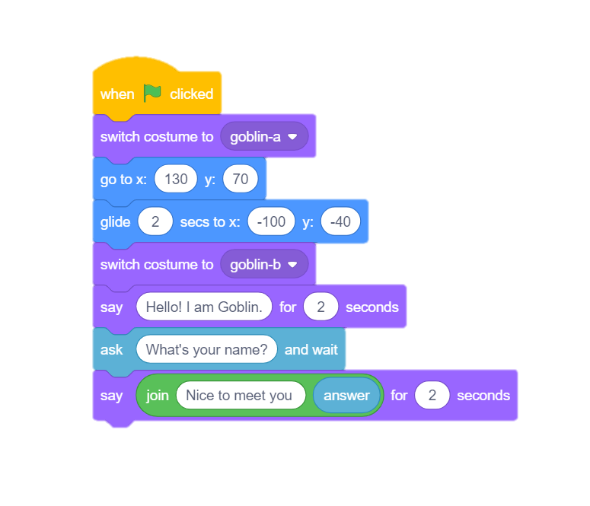
STEP 6: Reply
To read user input, we will use answer block from sensing palette.
To combine our message with user’s answer, we will use join block from operator palette.
Finally, to reply , we will use say block from looks palette.

Slide 9
STEP 7: Let’s Play
Maximize the stage and enjoy the animation.

