Slide 1
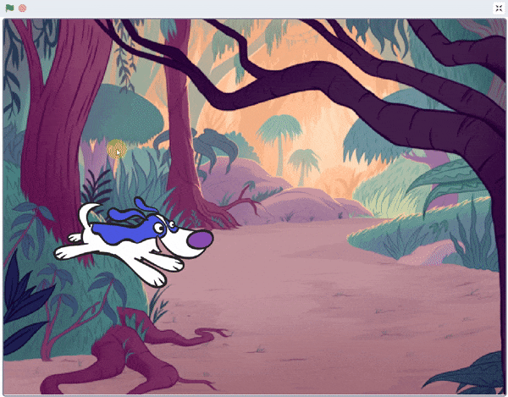
Playing Sounds

Slide 2
What is sound?

Slide 3
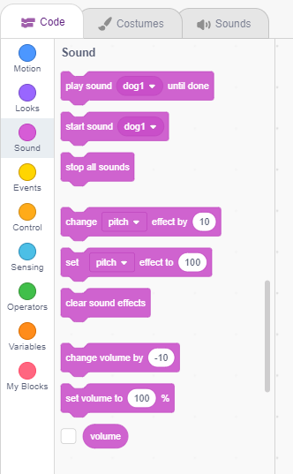
What is sound?
A sound is an item which one hears that can be played, available by importing, built-in sound library, or recording.
Sounds are played by using the sound blocks, which control a sound's volume, tempo, and more.

Slide 4
Playing Sounds
In this Activity, We make a barking dog animation where when the spacebar is pressed, dog barks and go to a random location on the stage.

Slide 5
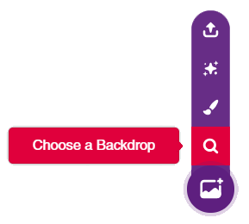
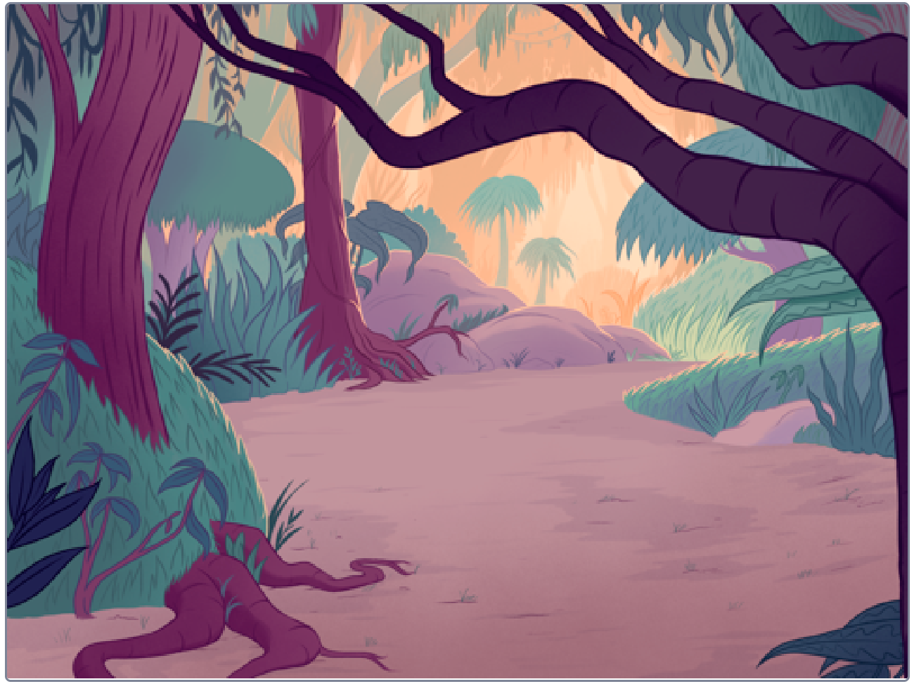
STEP 1: Choose a backdrop
Click on choose a backdrop button.
Choose “Jungle” as backdrop from library.

Slide 6
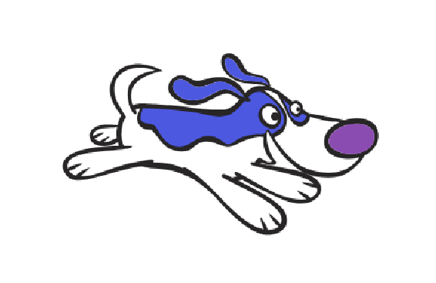
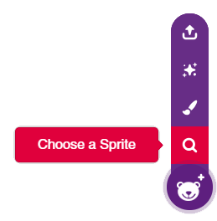
STEP 2: Choose a Sprite
Using choose a sprite button, Choose the Dog1
Right click on Tobi icon in sprite palette and delete it.

Slide 7
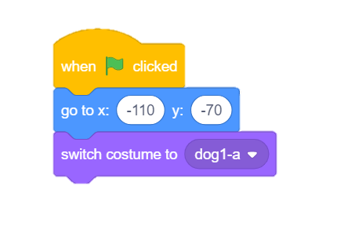
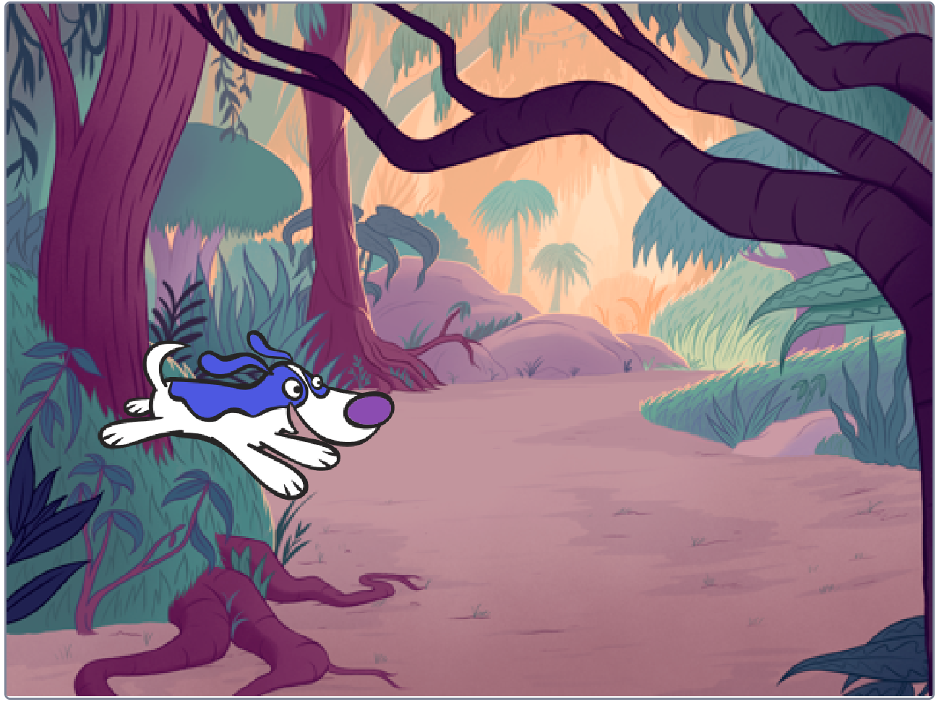
STEP 3: Set the Starting Position
Using following blocks, we will set the starting position of Dog.

Slide 8
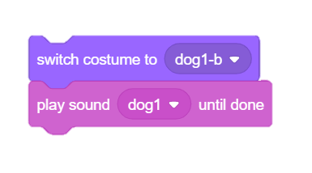
STEP 4: Switch Costume & Play sound
Next, we create an another script, We will use switch costume block from looks palette and play sound block from sound palette.

Slide 9
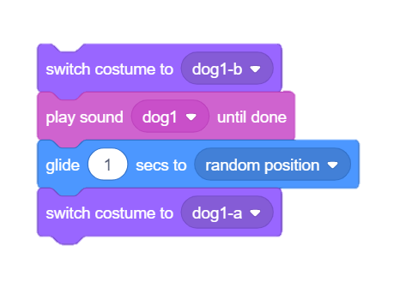
STEP 5: Glide Randomly
To make our Dog sprite glide randomly, We will use glide block from motion palette.
To switch back to initial costume, use switch costume block from looks palette.

Slide 10
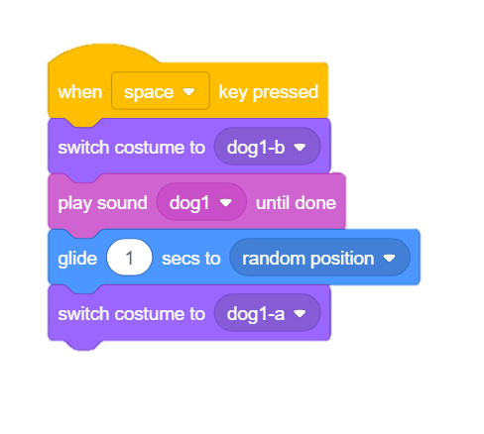
STEP 6: Sense the Spacebar
From the control palette, Let’s add a hat on this script.
This hat will sense whenever we press the Spacebar on Keyboard and make the script run.

Slide 11
STEP 7: Let’s Play
Maximize the stage and enjoy the animation.

