Slide 1
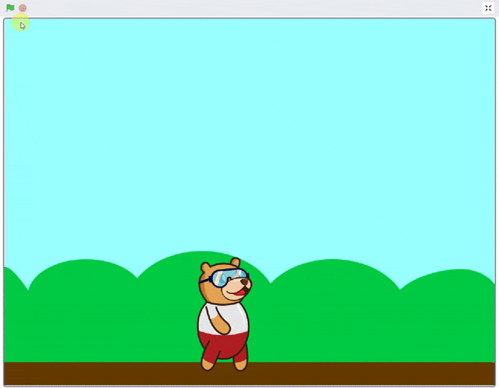
Walking Animation

Slide 2
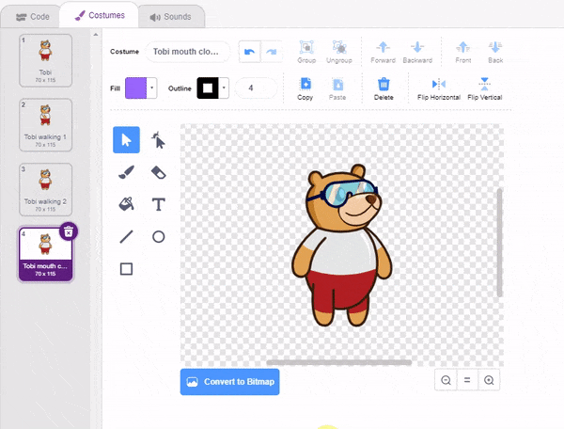
What is Costume?

Slide 3
What is Costume?
A costume is one out of many alternate appearances of a sprite.
Sprites can change their look to any of its costumes. They can be named, edited, created, and deleted, but every sprite must have at least one costume.
One of the most common uses of costumes is to make an animation for a game or other project.

Slide 4
Walking Animation
In this Activity, We create a small animation of “Tobi’s walk” by switching between his costumes.

Slide 5
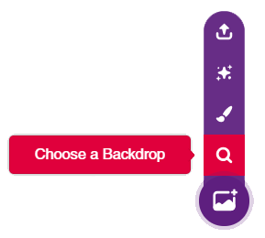
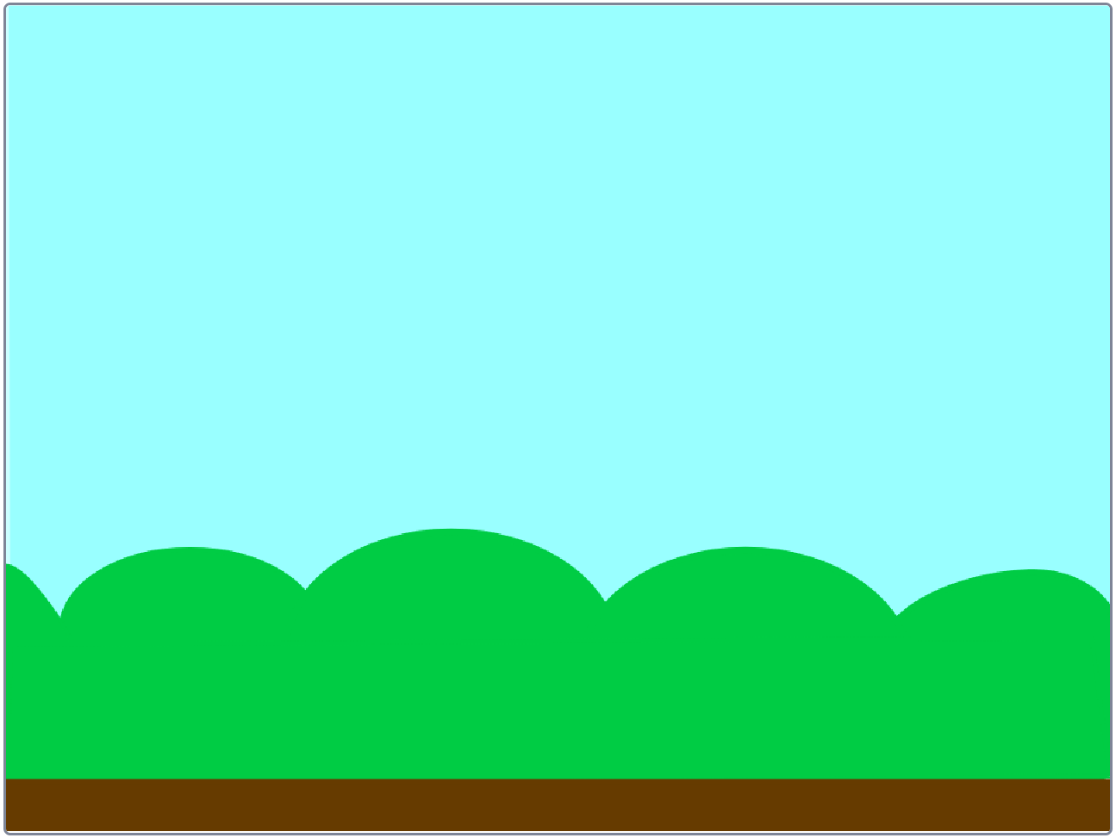
STEP 1: Choose a backdrop
Click on choose a backdrop button.
Choose “Blue Sky” as backdrop from library.

Slide 6
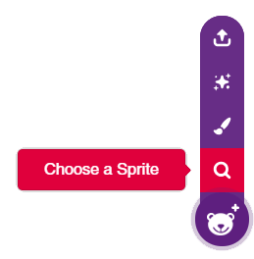
STEP 2: Choose a Sprite
We can choose sprite from choose a sprite button.
“Tobi” sprite is already selected. Let’s animate it

Slide 7
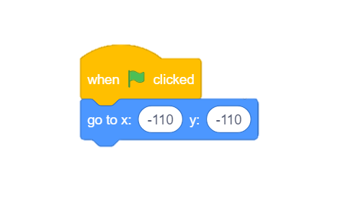
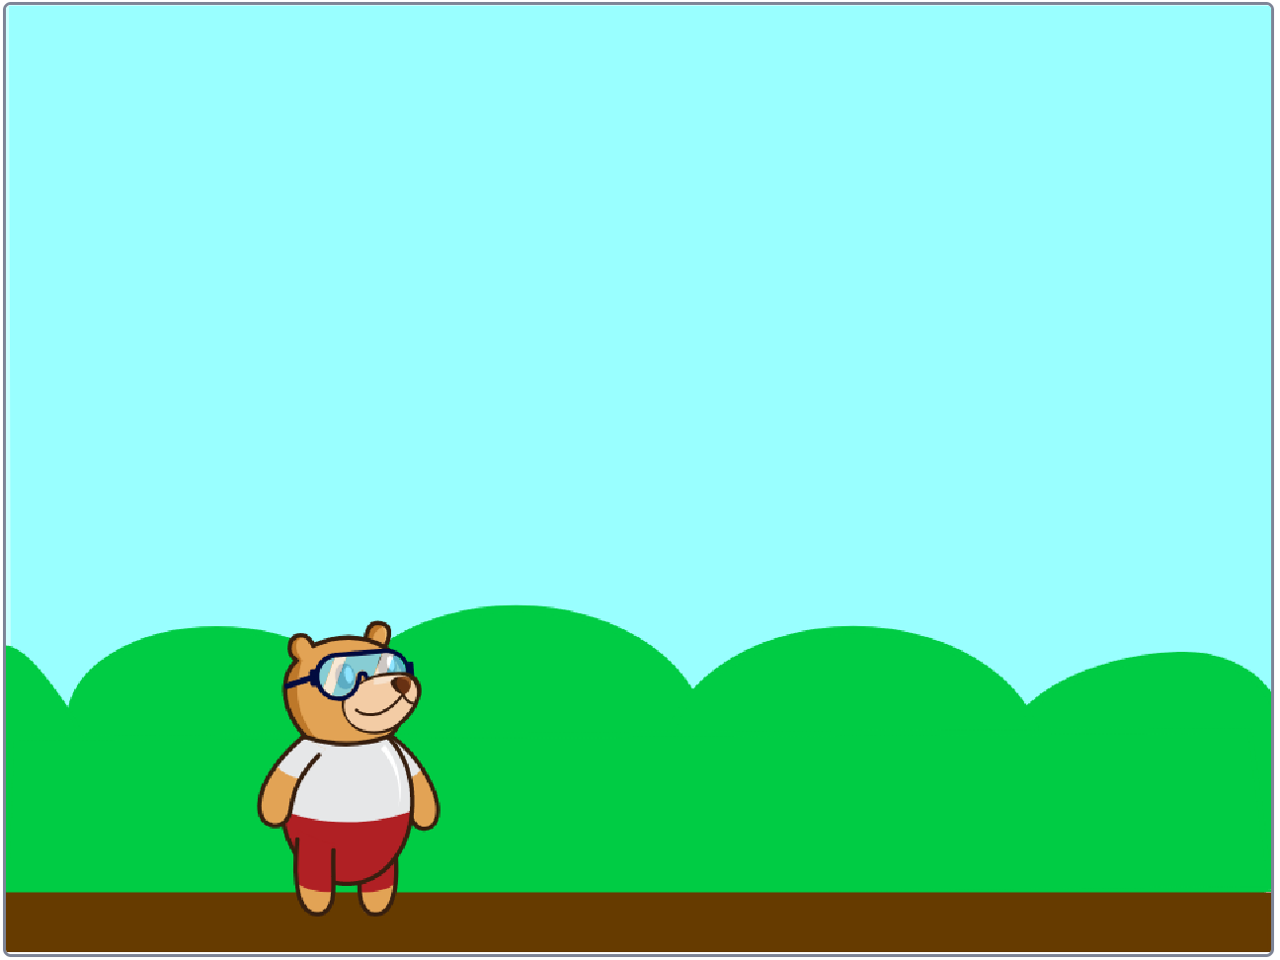
STEP 3: Set the Starting Point
Using following blocks from motion palette, we will set the starting position of Tobi.

Slide 8
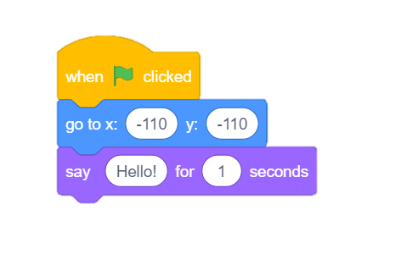
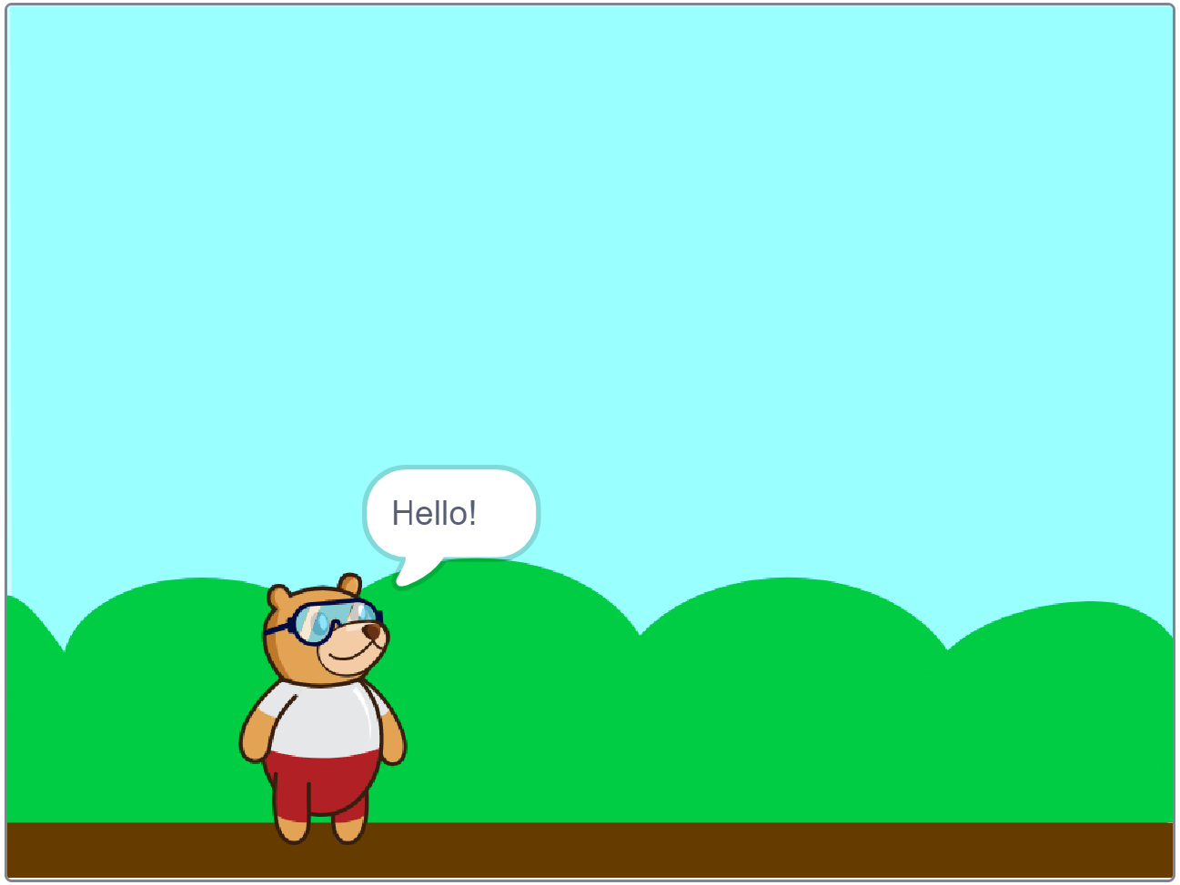
STEP 4: Say “Hello”
Use the say block from looks palette.

Slide 9
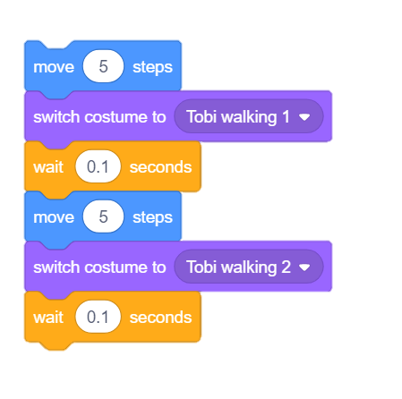
STEP 5: Move and Switch Costume
We will use following blocks:
move block from motion palette
switch costume from looks palette
wait block from control palette.
From the dropdown of switch costume block, choose the Tobi walking 1/ Tobi walking 2 costumes.

Slide 10
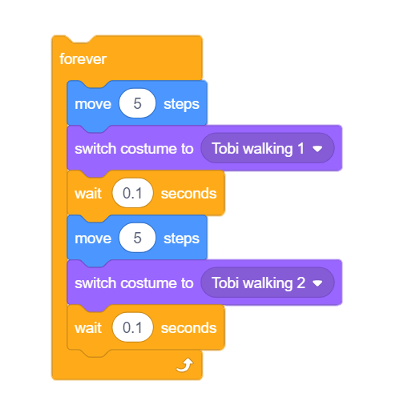
STEP 6: Repeat Forever
To make Tobi walk continuously, we will use forever block from control palette.

Slide 11
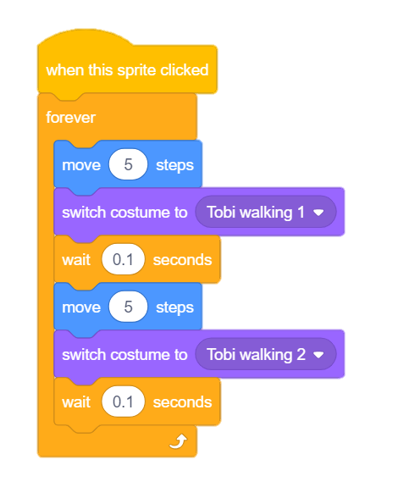
STEP 7: Add a Hat Block
Let’s add a hat on this script.
This hat will sense whenever we click on Tobi and make it walk.

Slide 12
STEP 8: Let’s Play
Maximize the stage and make it walk.

