Slide 1
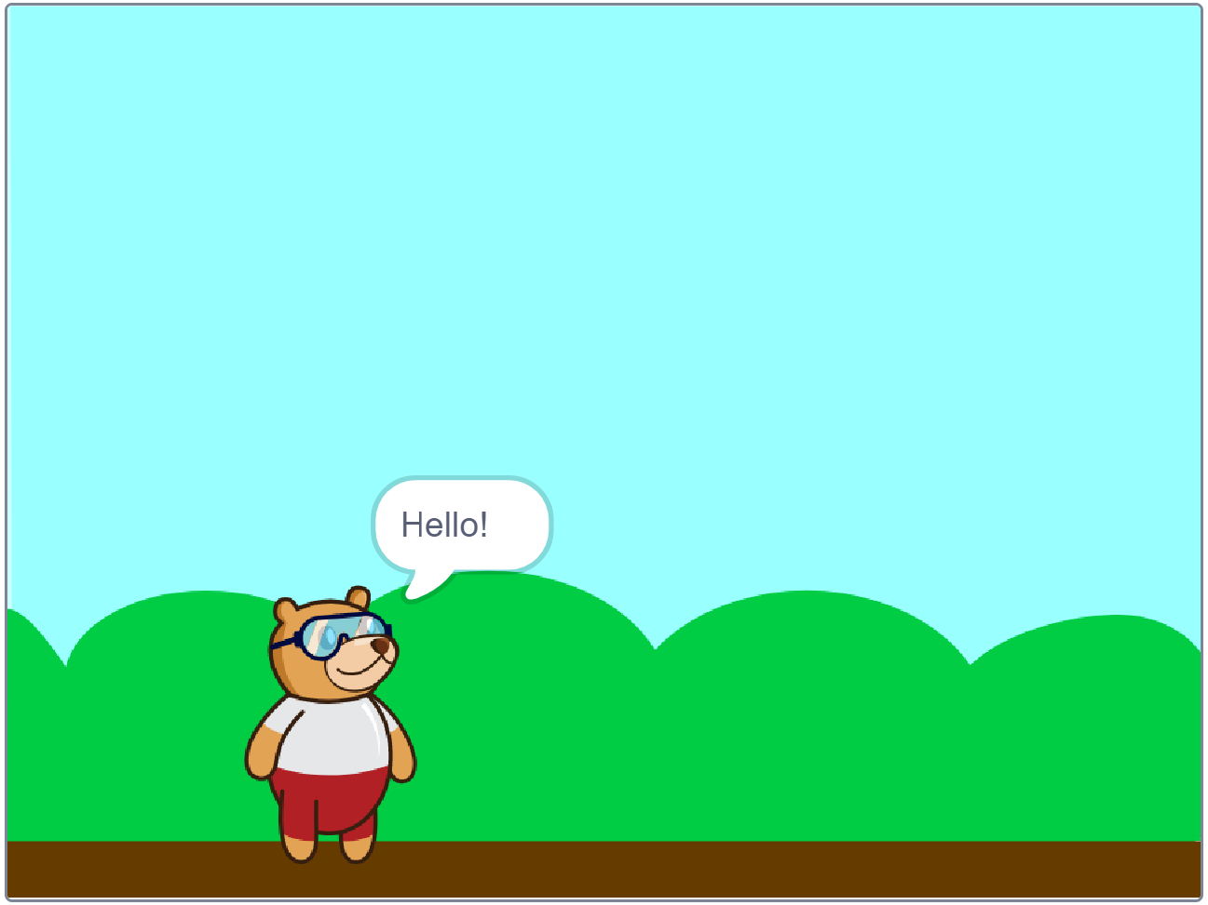
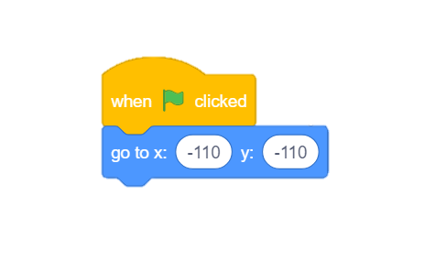
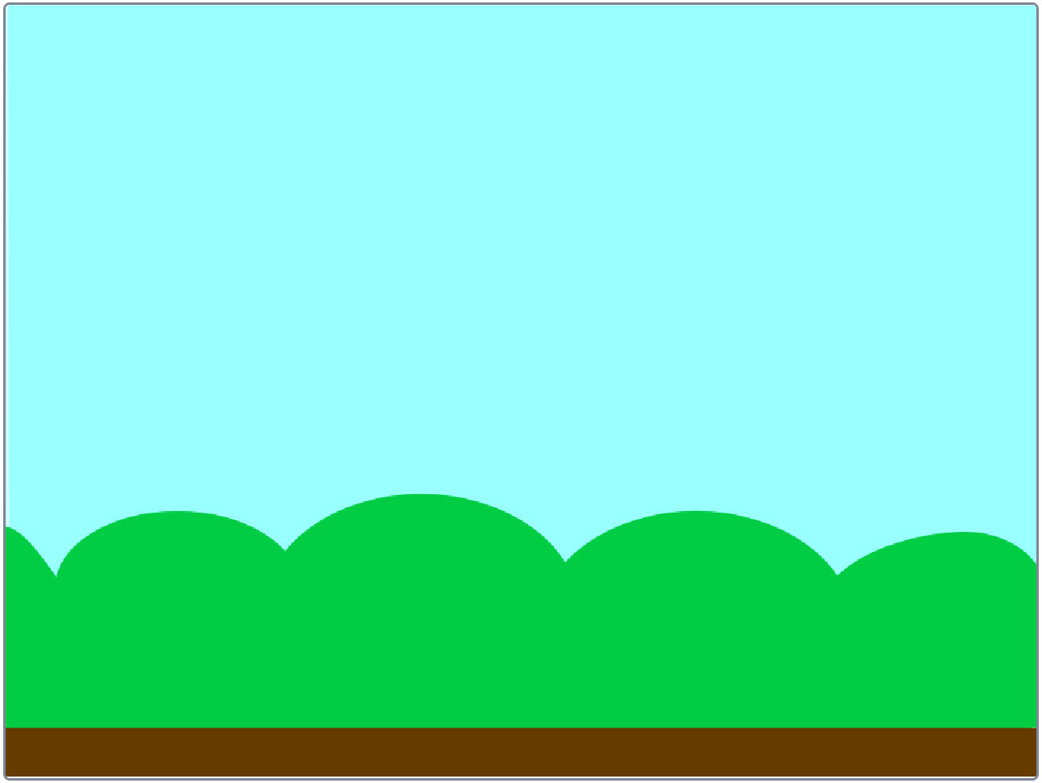
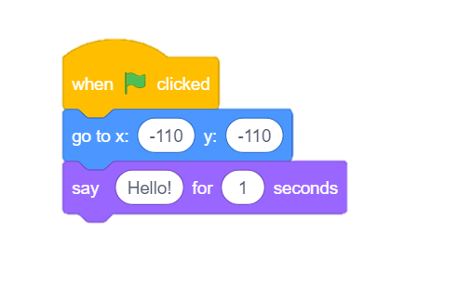
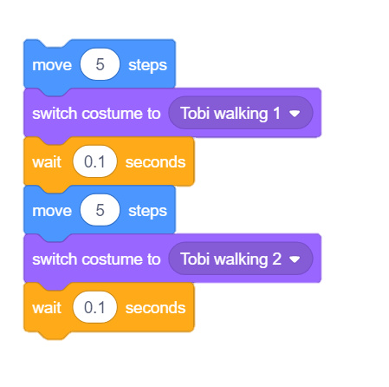
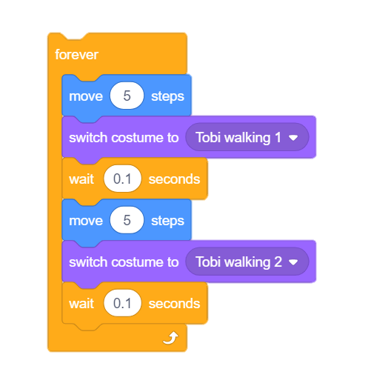
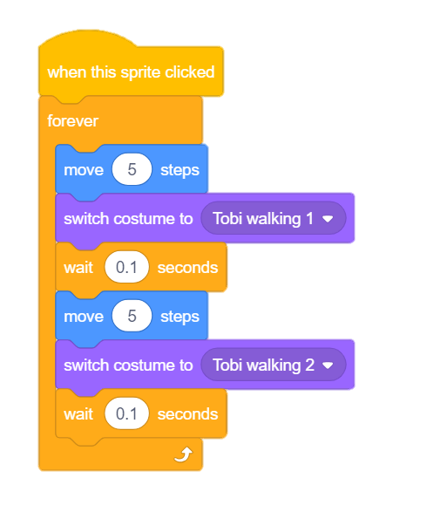
2.2 Walking Animation
In this Activity, We create a small animation of “Tobi’s walk” by switching between his costumes.
evive, USB cable, Laptop/PC
2. Choose a Sprite
3. Set the Starting Point
1. Choose a backdrop
4. Say “Hello”
5. Move and Switch
6. Repeat Forever
7. Add a Hat Block
What is the use of “forever block”?
. . . . . . . . . . . . . . . . . . . . . . . . . . . . . . . . . . . . . . . . . . . . . . . . . . . . . . . . . . . . . . . . . . . . . . . . . . . . . . . . . . . . . . . . . . . . . . . . . . . . . . . . . . . . . . . . . . . . . . . . . . . . . . . . . . . . . . . . . . . . . . . . . . . . . . . . . . . . . .

